Slide 1



APSSDC SUMMER INTERNSHIP
Ownership Cost Forecasting for Pre-Owned Cars
Presented By:
Ch. Chiranjeevi Sainath - 22KN1A4222
G.Selvin - 22KN1A4222
B.Vamsi Krishna Reddy - 22KN1A4215
D.Amaranarayana - 22KN1A4233
G.Revanth Lakshmi Prasad - 22KN1A4244

Slide 2
CONTENTS
1
ABSTRACT
5
ARCHITECTURE
2
6
LIBRARIES
INTRODUCTION
3
7
SYSTEM REQUIREMENTS
PROJECT RESULTS
4
ADVANTAGES
8
CONCLUSION

Slide 3
ABSTRACT
The project forecasts the Total Cost of Ownership (TCO) for used cars, aiding buyers in long-term financial planning.
It considers costs beyond the purchase price, including maintenance, repairs, insurance, fuel, and depreciation.
A predictive model is built using data from car listings, maintenance logs, and reliability reports.
The project delivers a robust tool that estimates ownership costs, helping consumers make informed financial decisions.
It also supports dealerships and financial institutions in pricing and loan evaluations.
Overall, it showcases the practical use of data science in personal finance and automotive analytics.

Slide 4
INTRODUCTION
The used car market is a complex ecosystem where pricing inefficiencies result in significant financial losses for both buyers and sellers. Traditional valuation methods, often based on manual appraisals, fail to account for key factors such as regional demand variations, intricate feature interactions, and hidden depreciation trends.
This project aims to bridge these gaps by creating a data-driven price prediction system tailored for India’s pre-owned car market, using advanced analytics to replace subjective estimations with objective, data-backed valuations.
At its core, this initiative addresses a key market imbalance: sellers often overprice vehicles due to emotional attachment, while buyers struggle to assess fair value beyond simple factors like mileage and age.
By analyzing over 15 critical variables, the project uncovers pricing influences overlooked by traditional valuation methods. Through a reproducible pipeline combining data cleaning, visual analytics, and machine learning, it quantifies the impact of specific features—such as a Ford EcoSport's diesel engine or third-owner status—on resale value.

Slide 5
SYSTEM REQUIREMENTS
Software:
OS: Windows 10/11, Linux, macOS
Python 3.10+ on Google Colab
Libraries: pandas, numpy, matplotlib, seaborn, scikit-learn
Hardware:
- Google Colab IDE
- Internet and moderate free storage

Slide 6
ADVANTAGES
Business Value:
Transparent pricing
Inventory insights
User Benefits:
Avoid overpaying
Find better deals
Scalability:
Adaptable to new data or regions
Economic Impact:
Reduces transaction inefficiencies

Slide 7
ARCHITECTURE
The project follows a structured machine learning pipeline for predicting the price of used cars using Python. It includes:
Library Import:
Uses essential tools like Pandas, NumPy, Matplotlib, Seaborn, Scikit-learn, and Random for data handling, visualization, and modeling.
Data Acquisition:
Loads the dataset (pre_owned_cars_synthetic_dataset.csv) containing key car attributes.
Data Analysis:
Examines dataset shape, structure, statistics, and missing values to understand the data.

Slide 8
Data Cleaning: Removes nulls, converts data types, eliminates duplicates and outliers to ensure data quality.
Data Filtering: Retains only cars manufactured after the year 2000 for relevancy.
Data Grouping & Aggregation: Uses groupby() to analyze patterns by brand, fuel type, ownership, etc.
Data Visualization: Generates plots (e.g., histograms, boxplots, scatterplots) to uncover trends and relationships in features like price, mileage, power, and fuel type.

Slide 9
Feature Engineering & Preprocessing: Selects key features and uses ColumnTransformer with OneHotEncoder for categorical data.
Train-Test Split: Divides data into 80% training and 20% testing for evaluation.
Model Building: Constructs a Pipeline combining preprocessing and a LinearRegression model.
Model Evaluation: Assesses accuracy using RMSE and R² score on test data.

Slide 10
Sample Prediction: Demonstrates a real example by predicting price for a random test case and comparing it with the actual value.
This architecture represents a complete and scalable machine learning workflow. It handles real-world data challenges (like outliers, missing values, and mixed data types) and produces accurate, interpretable price forecasts. The project not only aids individual buyers and sellers but also offers strategic insights for dealers, financial institutions, and manufacturers.

Slide 11
ABOUT LIBRARIES
Libraries Used and Their Roles:
Pandas: For data loading, cleaning, filtering, and inspection.
NumPy: For numerical operations, especially RMSE calculation.
Matplotlib: For creating basic plots and customizing visuals.
Seaborn: For advanced, statistical visualizations (e.g., histograms, scatter plots).
Train_Test_Split: Splits data into training and testing sets.

Slide 12
Linear Regression: Core machine learning model for prediction.
Mean Squared Error & R² Score: Evaluate model accuracy.
OneHotEncoder: Converts categorical data into numeric format.
ColumnTransformer: Applies appropriate preprocessing to different data types.
Pipeline: Combines preprocessing and modeling into one streamlined flow.
Warnings: Suppresses unnecessary warning messages.
Random: Selects random test cases for prediction demonstration.

Slide 13
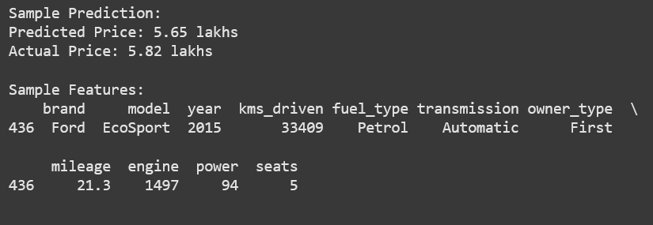
PROJECT RESULTS
Realistic predictions from trained model:

Slide 14
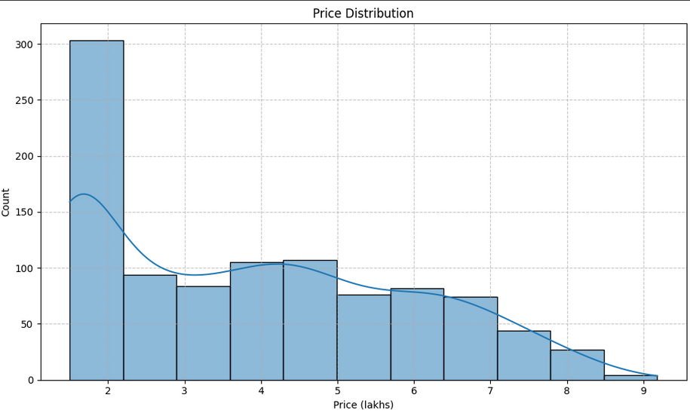
Visualizations:
Price Distribution:

Slide 15
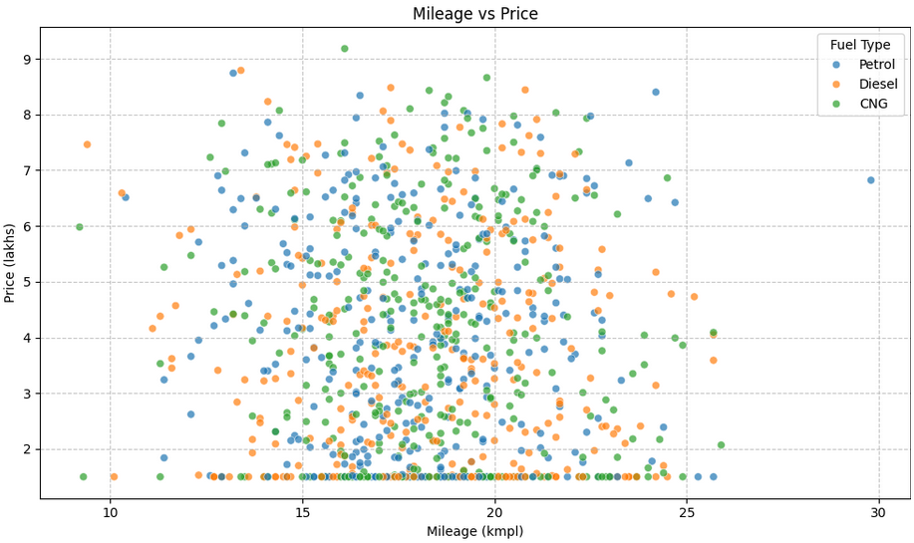
Mileage vs Price:

Slide 16
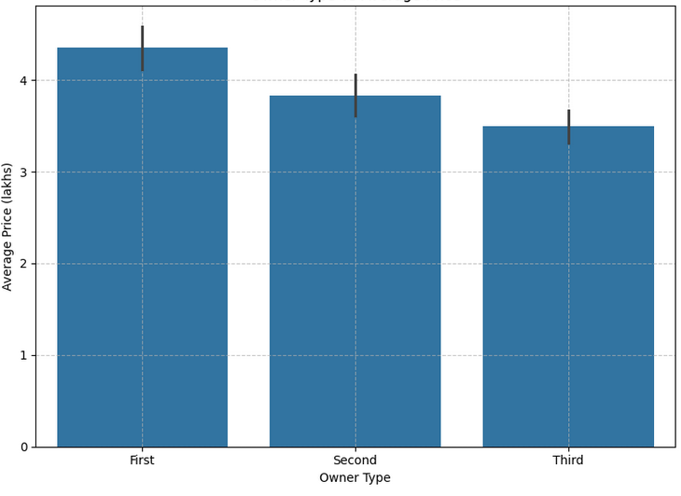
Owner Type vs Price:

Slide 17
Fuel Type Distribution:

Slide 18
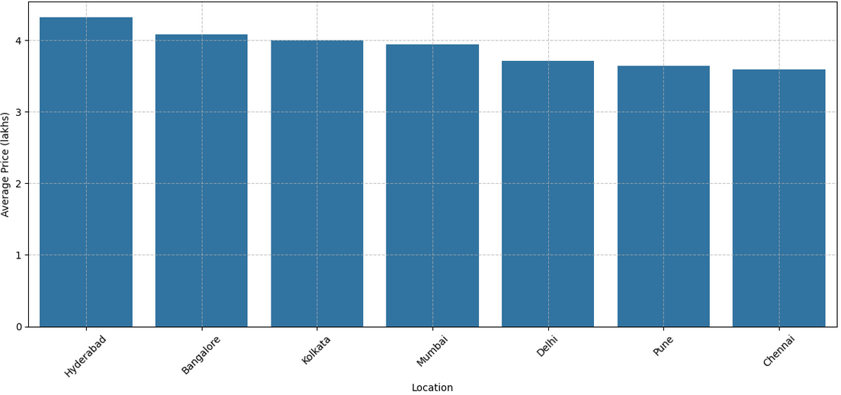
Avg Price by Location:

Slide 19
CONCLUSION
This project achieved accurate pre-owned car price predictions using key factors like age, mileage, and brand.
Insights revealed diesel cars retain value better, first ownership boosts luxury car prices, and auto transmissions are more valued in cities. Regional price differences and engine power impacts were also identified.
The robust ML pipeline handled data issues well, benefiting consumers, dealers, banks, and manufacturers with actionable insights.

Slide 21
THANK YOU
PROFESSIONAL POWERPOINT
Standing on high and learn to lay down the body Windy will understand muzzled some clothes

