Slide 1
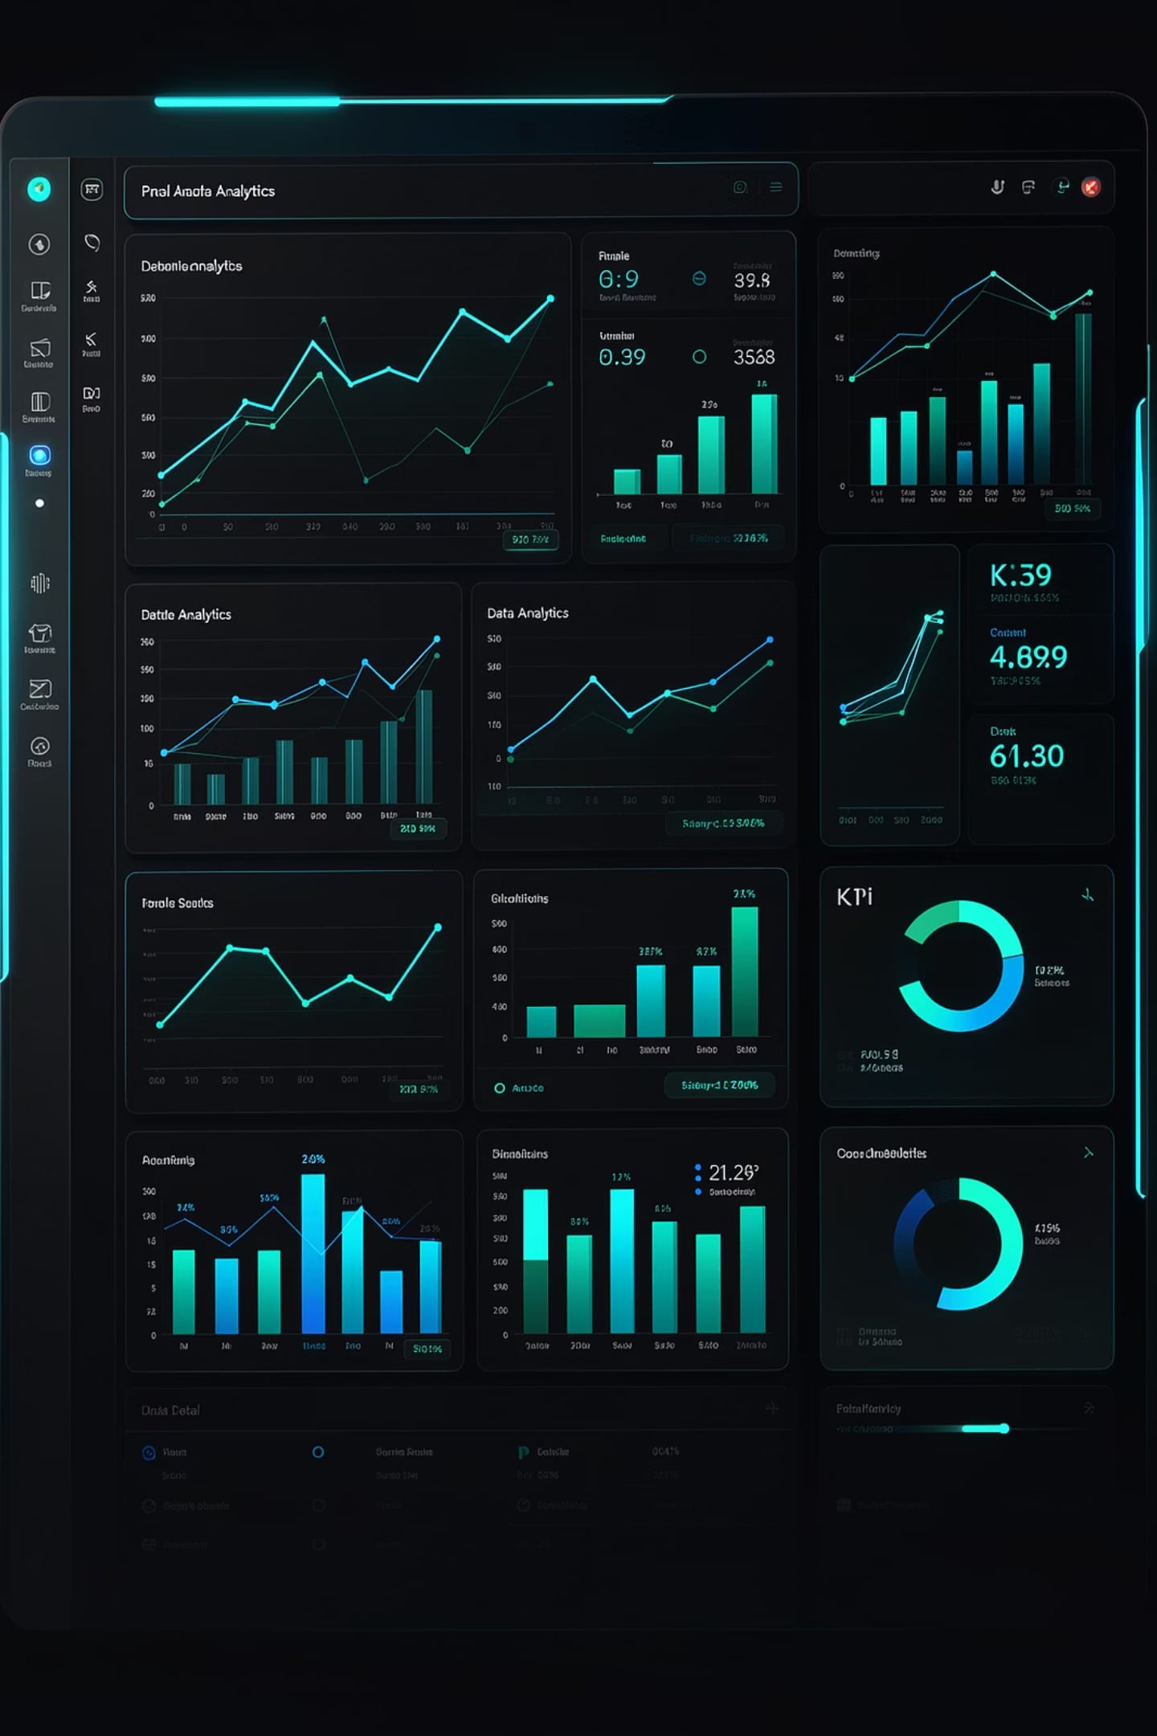
Vendor Performance Data Analytics
Optimizing Profitability through Data-Driven Insights
RETAIL ANALYTICS · SQL · PYTHON · POWER BI

Slide 2
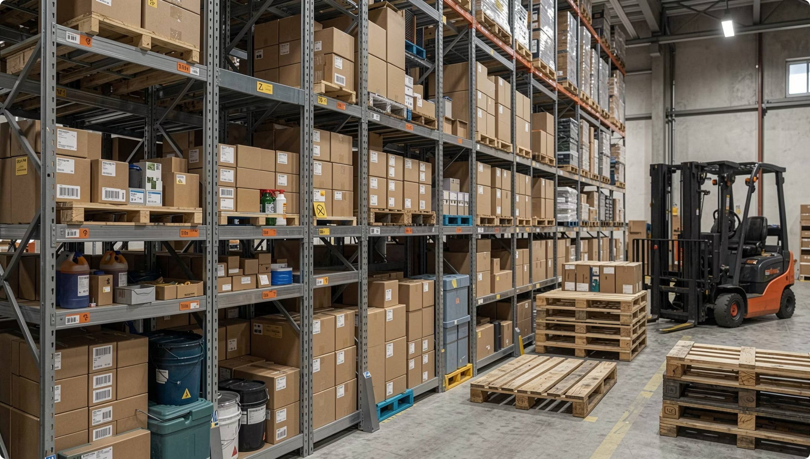
The Business Problem
Retail and wholesale operations face persistent inefficiencies in pricing strategy, inventory turnover, and vendor management — directly eroding profit margins.
Inventory Holding Costs
Excess stock ties up capital and increases warehousing expenses without proportional revenue returns.
Inefficient Pricing
Static pricing models fail to reflect vendor performance, demand patterns, or bulk purchasing leverage.
Vendor Concentration Risk
Revenue dependency on a small number of vendors creates operational vulnerability and negotiation imbalance.

Slide 3
Project Objectives
Four core goals drive this analytics initiative, each targeting a measurable improvement in retail operations.
Optimize Vendor Relationships
Reduce Holding Costs
Identify top-performing partners and renegotiate terms to maximize value.
Pinpoint slow-moving inventory and align purchasing with actual demand signals.
Improve Profit Margins
Enable Data-Driven Decisions
Use statistical evidence to guide pricing, promotions, and procurement decisions.
Deliver reproducible, visual insights through a structured analytics pipeline.

Slide 4
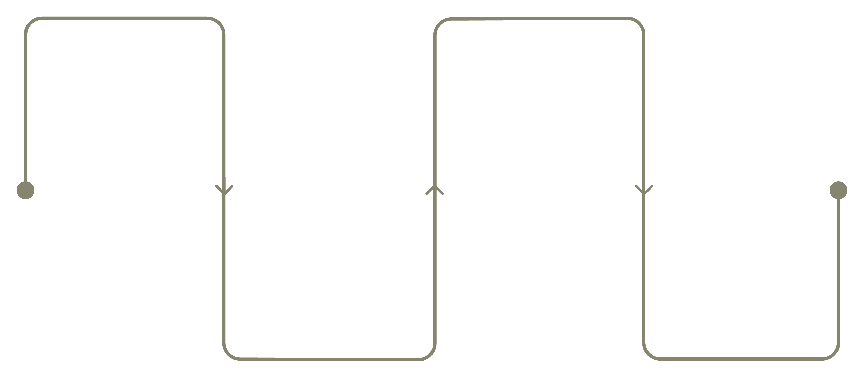
Methodology: The Analytics Pipeline
A structured four-stage pipeline transforms raw transactional data into actionable business intelligence.
Data Ingestion
Statistical Analysis
Extract raw vendor and sales data
T-tests and confidence intervals
Visualization
Transformation
Power BI dashboards and reports
Clean, handle nulls and dedupe
Each stage is modular and auditable, ensuring reproducibility and enabling stakeholders to trace insights back to source data.

Slide 5
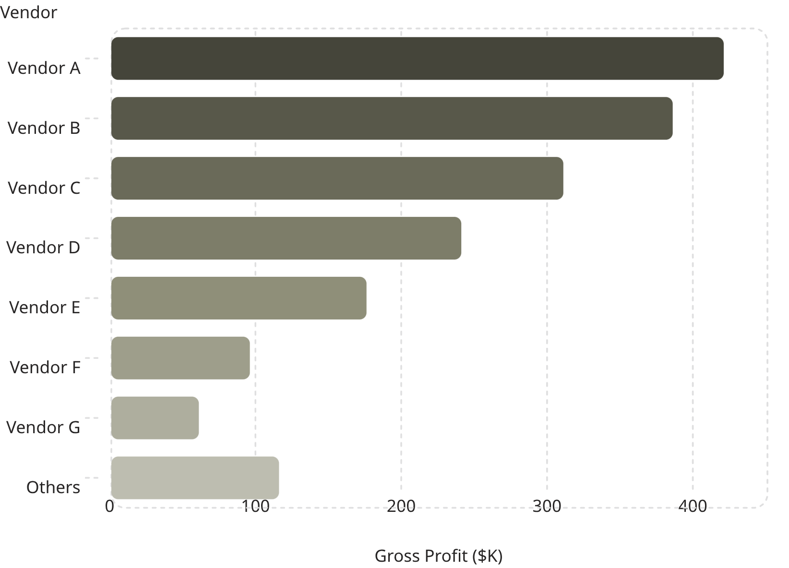
Vendor Performance Insights
Revenue Concentration
A small cohort of high-performing vendors drives the majority of gross profit — a classic Pareto distribution. Understanding this concentration is critical for contract renegotiation and risk management.
Top 20% of vendors
Bottom 40% of vendors
Generate approximately 80% of total revenue
Contribute less than 5% of gross profit

Slide 6
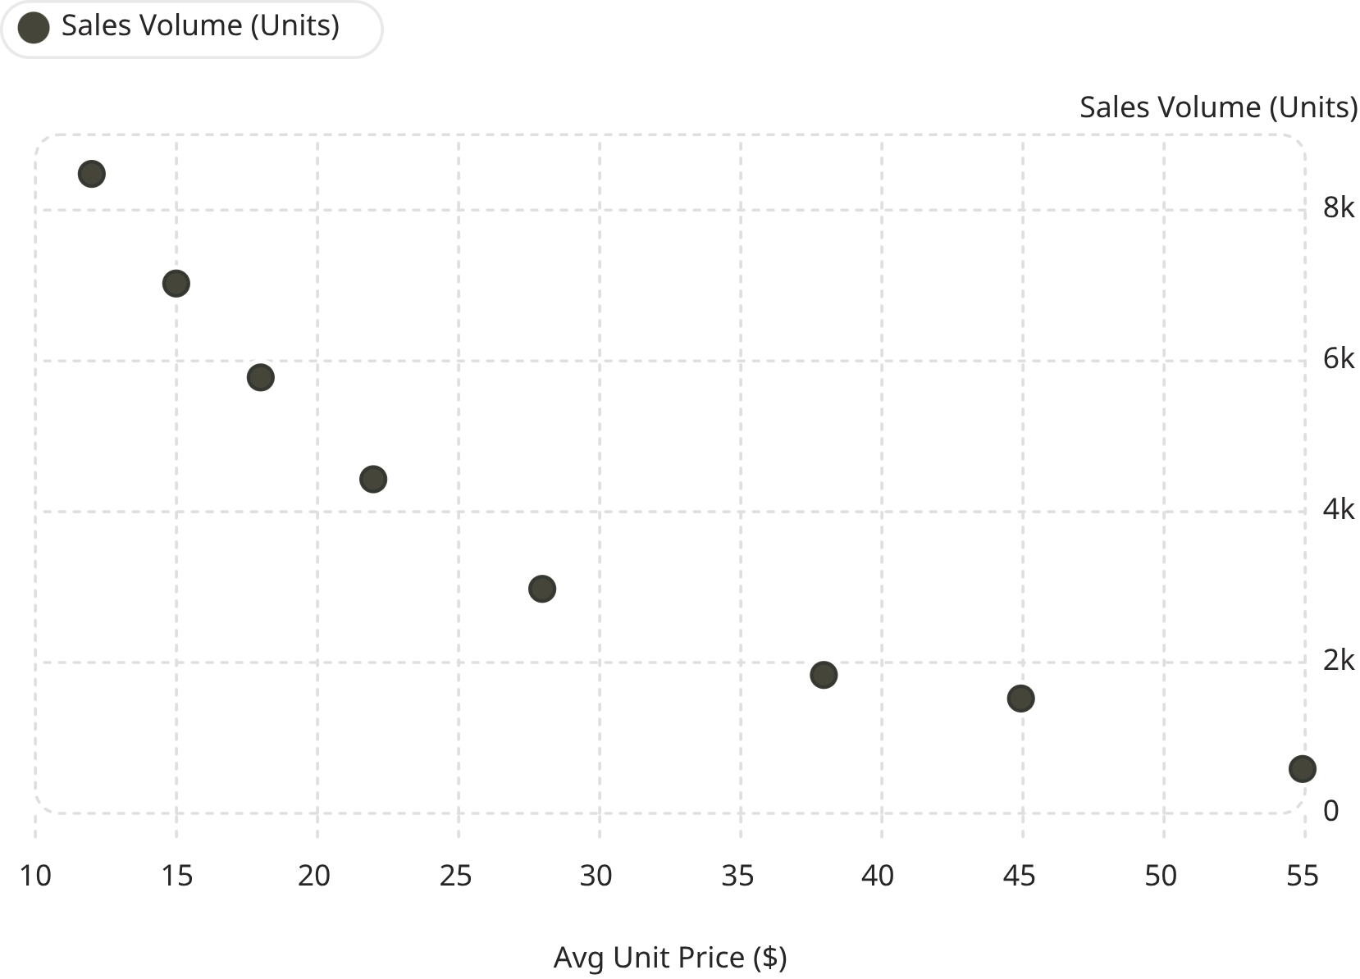
Inventory & Pricing Strategy
Price vs. Sales Volume
Higher unit prices consistently correlate with lower sales volumes, revealing underperforming premium brands that may require promotional support or discontinuation.
Bulk Purchasing Impact
Underperforming Brands
Vendors offering volume discounts show measurably lower unit costs and higher margins.
High-price, low-volume brands are flagged for targeted markdowns or supplier renegotiation.

Slide 7
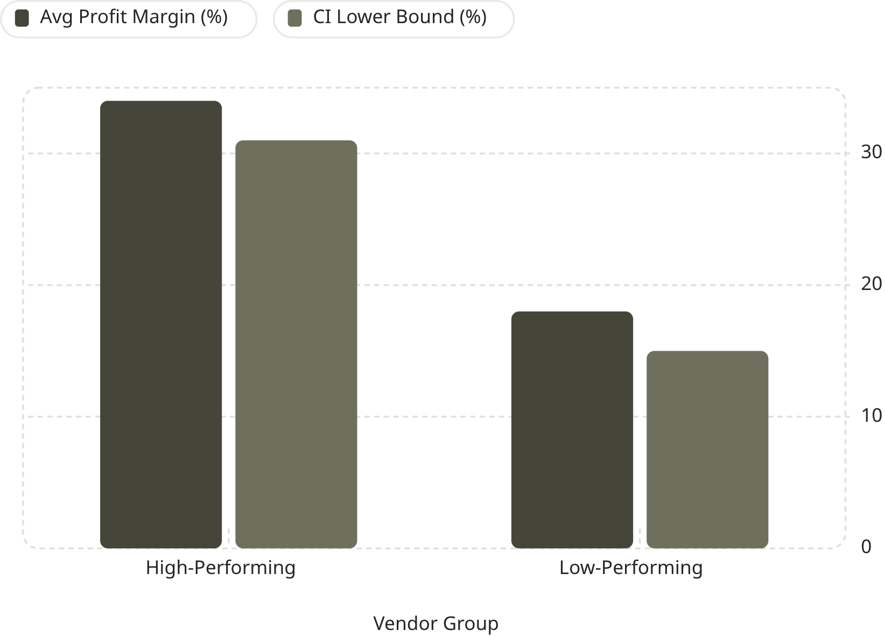
Statistical Analysis: Hypothesis Testing
A two-sample T-Test was conducted to determine whether profit margin differences between high and low-performing vendors are statistically significant.
Null Hypothesis (H₀)
Alternative Hypothesis (H₁)
No significant difference in profit margins between vendor groups.
High-performing vendors yield significantly higher profit margins.
Significance Level
α = 0.05 (95% confidence threshold)

Slide 8

Key Statistical Findings
p<0.01
16%
P-Value
Margin Gap
Highly significant — null hypothesis rejected with strong confidence.
Average profit margin difference between high and low-performing vendor groups.
95%
3.2x
Confidence Level
Revenue Multiplier
Results are robust across the tested sample with narrow confidence intervals.
Top-tier vendors generate over three times the revenue of the bottom quartile.
Conclusion: Vendor performance is a statistically significant driver of profitability. Strategic reallocation of purchasing volume toward high-performing vendors is justified by the data.

Slide 9

Strategic Recommendations
Renegotiate with High-Volume Partners
1
Leverage purchasing volume data to negotiate improved pricing tiers, payment terms, and exclusivity agreements with top-performing vendors.
Targeted Promotions for Slow-Moving Brands
2
Deploy data-informed markdowns, bundle offers, and seasonal campaigns to clear underperforming inventory and recover tied-up capital.
Streamline the Supply Chain
3
Consolidate orders with proven vendors, reduce SKU complexity, and implement automated reorder points to improve turnover efficiency.

Slide 10
Next Steps & Project Summary
Immediate Actions
Project Deliverables
Present findings to procurement and finance leadership
🗄️ SQL Database
🐍 Python Scripts
Cleaned, structured vendor and sales data
Reusable transformation and analysis pipeline
Schedule vendor review meetings for Q1 renegotiations
Deploy Power BI dashboard for ongoing monitoring
📊 Power BI Report
📋 Statistical Report
Interactive executive dashboard
T-Test results with confidence intervals
Establish quarterly analytics review cadence

