Slide 1
Selenium Webdriver with PYTHON from Scratch + Frameworks

Slide 2
Selenium Features
Selenium is open-Source Automation Testing tool
It is exclusively for Web Based applications.
Selenium supports multiple browsers - Chrome, Firefox, Internet Explorer, Safari
Selenium works with Multiple Platforms Windows, Apple OS X, Linux
Selenium can be coded in multiple languages - Java, C#, Python, Javascript, Python, php,Ruby

Slide 3
How to install Python
Download Python | Python.org from the website
If the python is already installed and need to check the path –- “where python” in cmd
Alternate way-open python idle-”import sys” then “sys.executable” will give you the path of the python.
"C:\Python312\python.exe“ –location
Need to set python home is system variables-go to edit environmental variables and add the path of python.exe and the scripts path as below
C:\Python312\Scripts
C:\Python312\python.exe
Then once you installed successfully make sure you see the version is listed in the cmd prompt by giving – ”python --version”
PIP?- It is a standard package manager for Python. It allows you to install and manage additional packages that are not part of the python standard library.
We can get the selenium package into python in cmd prompt through –”pip install selenium” –it will download all the selenium related packages

Slide 4
Cont..
After install you can verify in cmd –”pip show selenium” -it should show the version details of selenium.
Best editor to code python is pycharm-we can get the community edition for sometime which is free.
After install we need to verify the path it should automatically detect form the system for example:
“C:\Users\617633301\PycharmProjects\PythonProject\.venv”-location
“C:\Python312\python.exe”- base python
Later after that we need to see the workspace from there go to file->settings->search for interpreter->then you should see the default path specified in the interpreter.

Slide 5
Python, Selenium Installation Guide Download
Installing Python and Selenium
Installing Python:
Windows : http://python.org/download/.
Note : IF you are using Linux, MacOS X, Unix operating Systems then python will be installed by default with OS
1.What is PIP installer Tool? pip is a package management system used to install and manage software packages written in Python pip is a recursive acronym that can stand for either "Pip Installs Packages" or "Pip Installs Python
2.Where do we get this PIP Tool? And how to configure it in our Local Machines
3.Installing Selenium Use Below command on PIP to install Selenium Package pip install selenium
This command will set up the Selenium WebDriver client library on your machine with all modules and classes that we will need to create automated scripts using Python
4.pip install -U selenium The optional –U flag will upgrade the existing version of the installed package

Slide 6
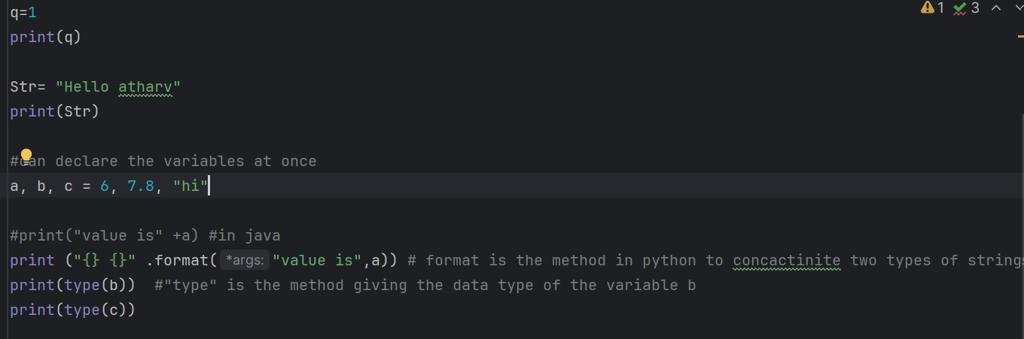
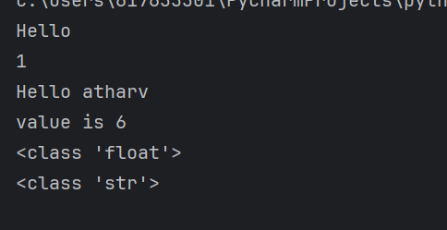
Python coding
Create new file with in the ide with .py extension and run that by right click and run
Ex: print(“Hello world”)
Refer journaldev.com/14036/python-data-types for datatypes in python.
In python we can concatenate same data type values but not different.

Slide 7
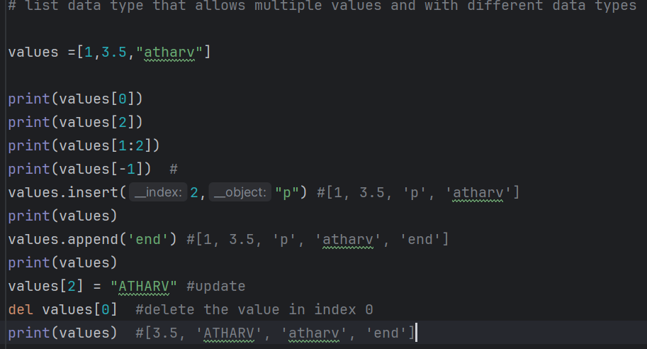
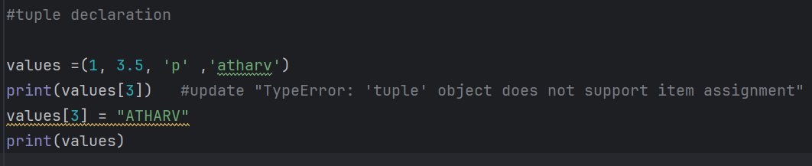
Cont..
Data type :”List” –it is mutable which means you can update and do modifications on data.it is defined in [] brackets
“Tuple” –immutable and it is protected we cannot do modifications like update.it is defined in () bracket.

Slide 8
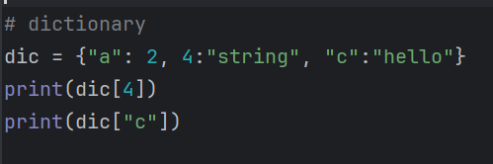

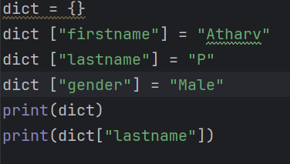
Cont..
Data type :”Dictionary” –it is an unordered sequence of data in the form of key –value pair.{key:value} .It is useful to retrieve the data when you have large amount of data.
Just note if are giving string in key or value then give it in “”
Below is the example of dictionary data type
How to build a empty dictionary by adding key value pairs.

Slide 9
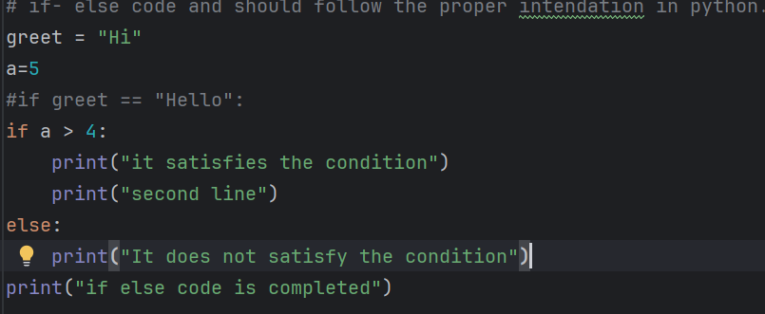
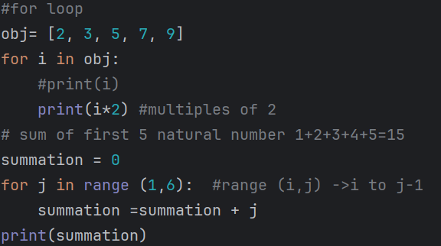


Cont..
Loops concepts
if-else –here we need to remember to follow correct intendation.There won’t be any open close braces only “:” will differentiate the syntax.
For loop: For I in obj: fixed iteration number

Slide 10
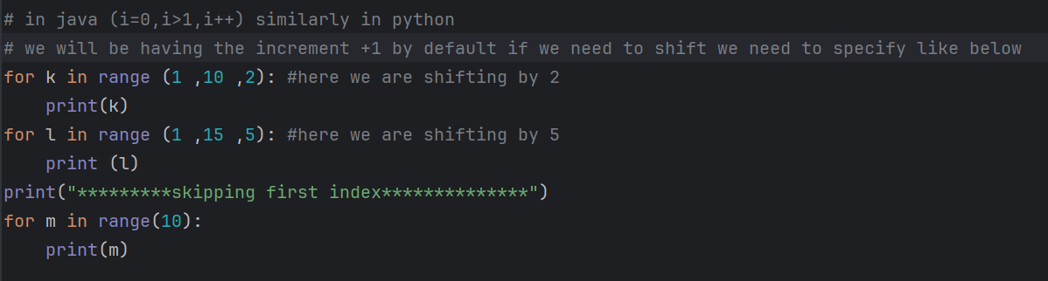
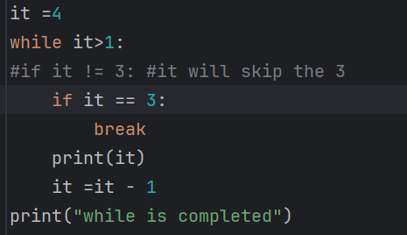

Cont..
Loops concepts:
For loop: For I in obj:
While loop:
Break and continue are the keywords we can use in while loop

Slide 11
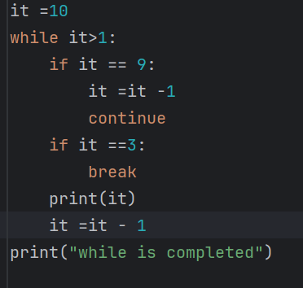
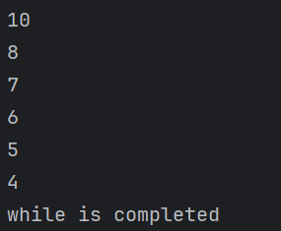
Cont..
Loops concepts:
While loop:
Break and continue are the keywords we can use in while loop
Break: It stops the execution abruptly
Continue: skips all the current iteration steps and will continue the next iteration

Slide 12
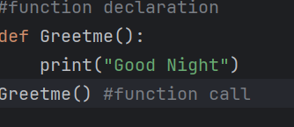

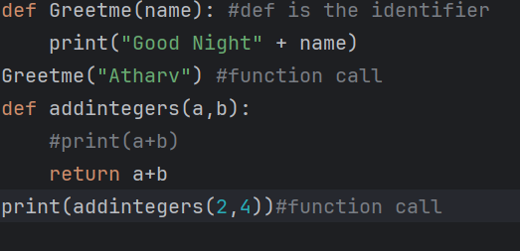

Cont..
Functions: It is a group of related statements that perform a specific task.

Slide 13
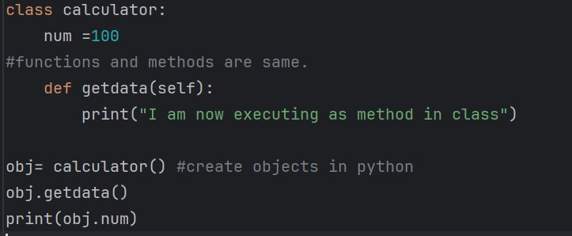

Oops
Classes:These are user defined blueprint or prototype
For example If we consider calculator it should perform all operations like sum,mul,div,substaction.
Classes consists of methods,class variables,instance variables and constructors etc..

Slide 14
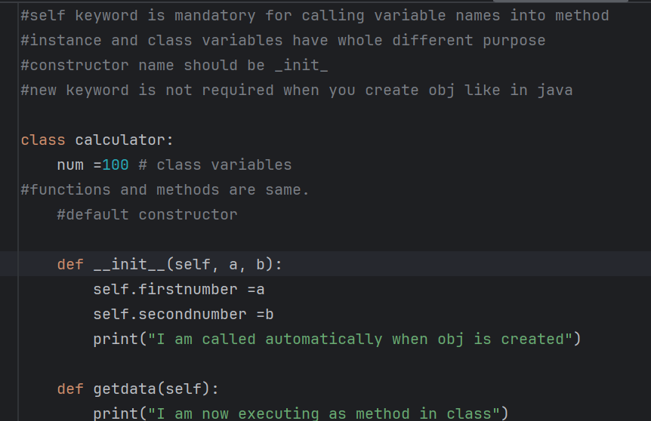
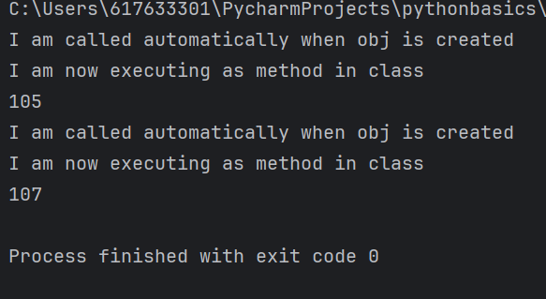
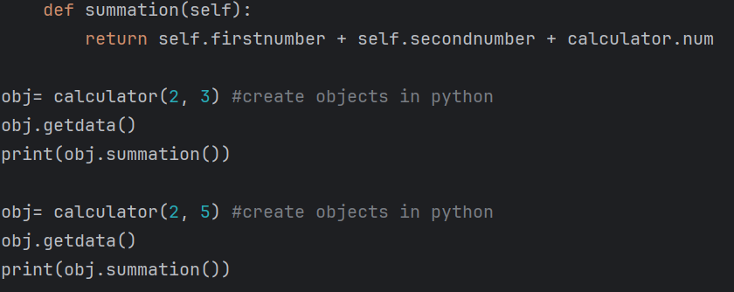
Oops

Slide 15
Inheritance
Acquiring the properties from parent to child.

