Slide 1

AMAZON FRESH ANALYTICS USING SQL

Slide 2
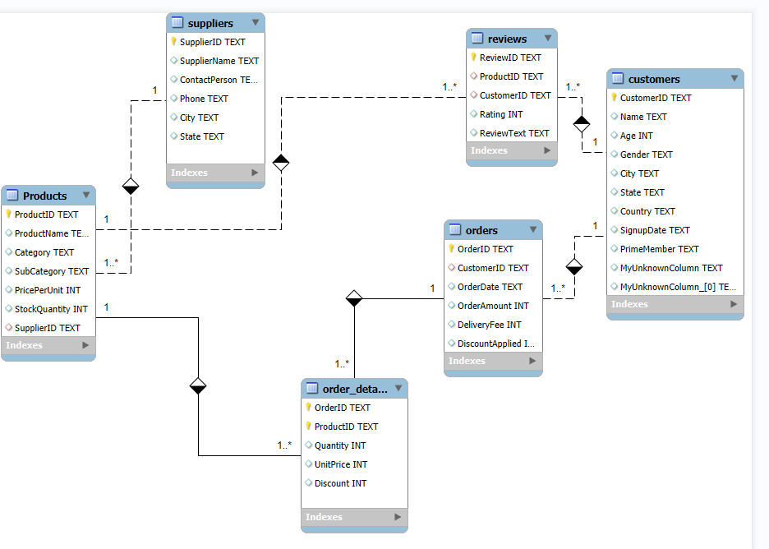
ER DIAGRAM

Slide 3
IDENTIFYING PRIMARY KEYS AND FOREIGN KEYS:
TABLES | PRIMARY KEY | FOREIGN KEY
Customers | customer_id | None
Orders | order_id | customer_id
Order Details | order_id, product_id | order_id, product_id
Products | product_id | supplier_id
Reviews | review_id | customer_id, product_id
Suppliers | supplier_id | None

Slide 4
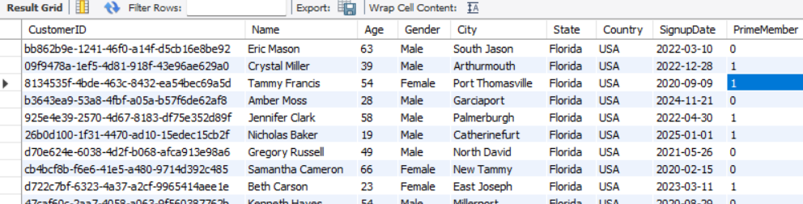
TASK 3.1 Retrieve all customers from a specific city select * from customers where state = "Florida";
Purpose:
Identify customer distribution by region.
Helps in location-based marketing strategies.
Provides insight into customer demographics for better business decisions

Slide 5
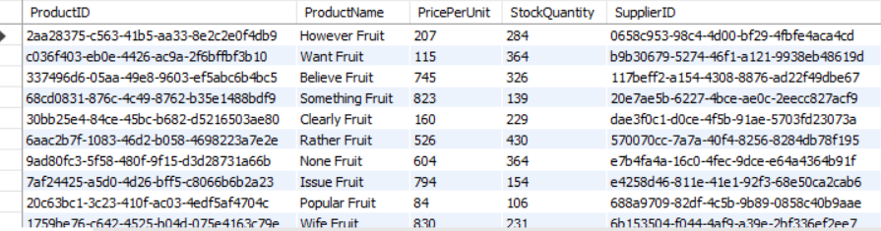
TASK 3.2 Fetch all products under the "Fruits" category.
select * from products
where category = "Fruits";
Purpose:
Extracts all products belonging to the 'Fruits' category.
Helps in inventory management and stock replenishment.
Useful for seasonal promotions and demand forecasting.

Slide 6
TASK 4:Data Definition Language (DDL) and Constraints (Recreate the customer Table)
Query:
create table new_customers (
customerid int primary key, #primary key constraint
name varchar(255) unique not null, #unique constraint for name
age int not null check (age > 18), #age must be greater than 18 and cannot be null
gender varchar(10),
city varchar(100),
state varchar(100),
country varchar(100),
signupdate date,
primemember boolean
);

Slide 7
Purpose:
The new_customers table is created to store customer-related data
Primary Key (customerid) - Ensures each customer has a unique identifier, preventing duplicate records.
Constraints for Data Integrity:
UNIQUE (name): Prevents duplicate names.
NOT NULL: Ensures critical fields (like name and age) are always filled.
CHECK (age > 18): Restricts entries to adult customers.

Slide 8
Data Manipulation Language (DML)
Task 5: Insert 3 new rows into the Products table
Query:
insert into products(ProductID,Productname,Category,SubCategory,priceperunit,StockQuantity,SupplierID)
values (12001, "Farm Apple", "Fruits", "Sub-fruits-4", 308, 150, 1000051),
(12051, "Meat Mash", "Meat", "Sub-Meat-1", 765, 100, 1234512),
(15501, "Snackzo", "Snacks", "Sub-Snacks-1", 251, 547, 1887641);
Purpose:
This involves adding new products to the inventory
Ensure continuous supply of stock
Helps in tracking new product launches

Slide 9
Task 6: Update the stock quantity of a product where ProductID matches a specific ID.
Query: update Products
set stockquantity = 120 where productId = 12001;
Purpose:
Updates stock levels to reflect recent inventory changes.
Prevents overselling of out-of-stock items.
Ensures accurate stock tracking for supply chain efficiency.
Task 7: Delete a supplier from the Suppliers table where their city matches a specific value.
Query: delete from suppliers
where city="New James";
Purpose:
It helps in removing outdated, inactive, or unwanted suppliers from that location.
Ensures that reports and queries only focus on active suppliers.

Slide 10
SQL Constraints and Operators
Task 8: Use SQL constraints
8.1 Constraint to ensure the ratings are between 1 and 5 and prime membership is set to default “No”
Query:
alter table customers
alter column primemember
set default 0;
Query:
alter table Reviews
add constraint check_rating check (rating BETWEEN 1 AND 5);
Comprehension: Sets the default value of the PrimeMember column to 0 to prevent null values, to ensure data consistency
Improves data reliability for customer feedback analysis.

Slide 11
Clauses and Aggregations (Task 9): To find orders placed after 2024-01-01.
select * from orders
where orderdate > '2024-01-01’;
Purpose:
Removes outdated orders to maintain a clean and optimized database.
Ensures reports focus on recent, relevant transactions.
Useful for sales forecasting, identifying demand patterns, and tracking customer activity.
TASK:HAVING clause to list products with average ratings greater than 4.
select productID, avg(rating) as Average_Rating
from reviews
group by productID
having avg(rating) > 4;
Purpose:
Identifies highly-rated products with an average rating above 4 stars.
Helps highlight best-selling or popular products for promotions.
Assists in customer satisfaction analysis by finding products with consistently high ratings.

Slide 12
TASK: Rank products by total sales
select
p.ProductID,
p.ProductName,
sum(od.Quantity*(od.Unitprice-od.discount)) as Total_sales
from order_details od
join products p on od.ProductID = p.ProductID
group by p.ProductID,p.ProductName
Order by Total_sales desc;
Purpose:
Helps identify best-selling products based on total sales.
Supports inventory planning and pricing strategy decisions.

Slide 13
Task 10: Identifying High-Value Customers
Query:
select
o.customerID,c.name,
sum(o.orderamount) as Total_Spending
from orders o
join customers c on o.CustomerID = c.CustomerID
group by c.name,o.CustomerID
having total_Spending > 5000
order by total_spending desc;
Purpose:
Customer Segmentation – Helps businesses identify VIP customers for loyalty programs or exclusive offers.
Can be used to personalize discounts, offers, and engagement strategies for top customers.

Slide 14
Task : Identifying the top 3 products based on sales revenue.
select ProductID,ProductName,Total_revenue
from(
select od.ProductID as productID,
p.ProductName as ProductName,
sum(od.quantity * (od.unitprice - od.discount)) as Total_revenue
from order_details od
join products p on od.productID = p.ProductID
group by p.ProductName,od.ProductID
order by Total_revenue desc
limit 3
)
As Top_Product;
Purpose:
Helps businesses understand which products generate the most revenue.
Popular products can be strategically promoted to drive more sales.
Ensures high-demand products are always in stock.
Businesses can focus on expanding profitable product lines.

Slide 15
Task: Find customers who haven’t placed any orders yet.
select CustomerID,Name
from customers
where CustomerID not in (select distinct CustomerID from orders);
Purpose:
Helps identify inactive customers for targeted marketing.
Useful for tracking customer conversion rates.
Helps businesses convert potential leads into buyers.
Encourages businesses to offer discounts, promotions, or reminders to these customers.

Slide 16
BUSINESS USE CASES: Top customers contributing to revenue for targeted marketing:
Based on Age Group
Age Group | Customer count | Total Spent
50+ | 362 | 8838283
36-50 | 289 | 7214085
26-35 | 184 | 4823334
18-25 | 154 | 3936233

Slide 17
BUSINESS USE CASES: Top customers contributing to revenue for targeted marketing:
Name | City | Customer ID | Total spent
Hannah Day | New Patricia | 82ea7efb-dd18-42cd-a4e3-9e2f4519beb5 | 69698
Ralph Evans | Mooreborough | a3eb895d-40f9-423c-aabe-9b3826bdff3c | 69469
Yvette Murray | Robertsborough | d736cf4e-bf76-4cc3-996c-8db1de150ed5 | 69398
Anthony Martinez | South Michael | 9a863734-e786-47b1-82c2-f976cbc54db3 | 67027
Joseph Thomas | East Loretta | 9dbf19e4-2148-4898-bef4-f59f65589a60 | 66310
Lawrence Walsh | Mariahside | 959d815d-bfbc-4f68-9405-f8d8eea87095 | 64141
Daniel Clark | Reevesbury | f7d12d27-d34d-4871-9ebd-5d25aa83a81f | 62881
Heather Bennett | West Emily | f4269db2-909a-444e-9d2e-7fd7463b3f0d | 61343
Amanda Stevenson | Sampsonbury | 656ac2d5-21c9-42a1-8236-f2df7cb8b92e | 60289
Stacey Webb | Scottfurt | c20121ee-13c1-4273-92c4-1191f0fd29f8 | 59329

Slide 18
TOP SELLING PRODUCT CATEGORY:
Product Name | Category | Total Quantity sold
Fall Snack | Snacks | 321
Do Dair | Dairy | 255
Better Fruit | Fruits | 248
Close Vegetable | Vegetables | 244
Individual Snack | Snacks | 238
Study Snack | Snacks | 234
Control Snack | Snacks | 231
Lose Vegetable | Vegetables | 225
Body Vegetable | Vegetables | 217
Blue Mea | Meat | 210

Slide 19
KEY SUPPLIERS
Supplier ID | Products supplied | Total stock
1887641 | 2 | 1094
5f23af2b-90e2-45a7-b4d6-f02d3fbf2ab0 | 1 | 498
edad5554-ff41-4e8e-82b6-109c0786cef3 | 1 | 495
7404e664-c243-40da-b135-042051d91961 | 1 | 490
5d905a13-6e95-4142-8b11-a2c3dc1e5ce6 | 1 | 489
8e28284d-6a55-421c-8161-974479e7c78b | 1 | 487
8a481aa4-7f6a-42f1-99b2-5d05b4e9f096 | 1 | 487
3b664587-1c3b-4b2f-8af8-71943b930b01 | 1 | 485
a1c8ea5f-a8d6-4f99-be4c-478ffd0146e4 | 1 | 484
89583c7f-4a5a-4eb6-970c-8c2eb5243497 | 1 | 484

Slide 20
KEY REVENUE CONTRIBUTORS BY CATEGORY:
Category | Revenue
Meat | 9978717
Fruits | 9062514
Snacks | 8517333
Vegetables | 8069444
Dairy | 7703526
Bakery | 6067665
CUSTOMER SATISFACTION USING AVERAGE RATING:
Category | Avg Rating
Fruits | 3.0696
Vegetables | 3.0677
Dairy | 2.9938
Meat | 2.9031
Bakery | 2.8969
Snacks | 2.8922

Slide 21


