Slide 1
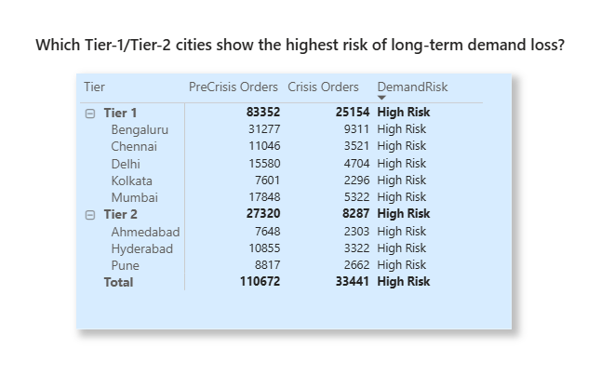
Extra Details:
1. Priority Cities: Which Tier-1/Tier-2 cities show the highest risk of long-term demand loss?
Insights:
Tier-2 cities (Pune, Hyderabad) show the highest long-term demand risk.
Tier-1 metros show moderate drops, indicating better resilience.
QuickBite should focus incentives, marketing campaigns, and partner support in high-risk Tier-2 cities to recover demand.

Slide 2
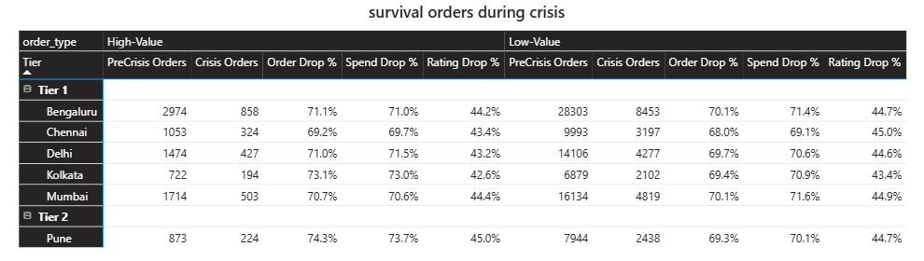
2. Behavior Shifts: Did customers shift from high-value orders to low-value “survival orders” during crisis?
Insights:
Both high and low-value segments fell sharply, but high-value orders declined slightly more, signaling a customer shift from premium meals to affordable essentials (“survival orders”).
Indicates reduced discretionary spending and increased price sensitivity.
Top-spending customers from Tier-1 cities (Bengaluru, Delhi, Pune, Chennai) showed >90% spending decline.

Slide 3
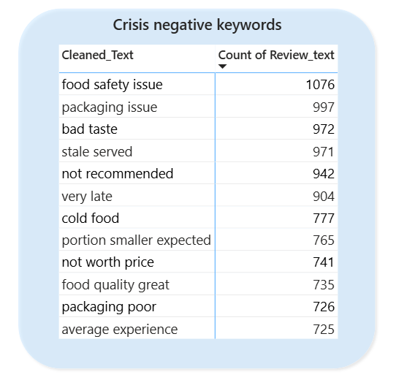
3. Feedback Trends: Do spikes in negative reviews align with the delivery outage period?
Result:
Found a strong correlation between delivery outages and a surge in negative reviews.
Average ratings dropped significantly during the outage period.
Key drivers: operational delays, poor packaging, and quality lapses.
Next Steps (Decision):
✅ Enhance delivery partner coordination and tracking.
✅ Implement pre-dispatch quality checks.
✅ Send real-time delay notifications to customers to maintain transparency and trust.

