Slide 1
PROJECT TITLE: SMART PARKING PHASE 4: DEVELOPMENT PART 2
TEAM MEMBERS:
A.WAZIL 913021104042
A.REVATHI 913021104025
R.THIRUMAGAL 913021104036
R.NIVETHITHA 913021104018

Slide 2
INTRODUCTION
The introduction of automated, digitized, and smart factors into parking systems can improve labor costs, user efficiency, and management. Among these improvements, smart factors are the most anticipated innovation.
Equipped with network sensing and camera monitoring in the parking space, a smart parking management system (or so-called smart parking system) can transmit the on-site conditions instantly to the central control in order to sense various abnormalities, alleviate real-time problems, and guide vehicles, based on management viewpoints, to assist in the control of parking access.

Slide 3
TINKERCAD
Tinkercad Circuits is a free online service for creating basic 3D shapes and developing digital prototypes of electronic components.These prototypes can include basic circuits with LED lights, buzzers, switches, and even light sensors.
COMPONENTS REQUIRED
Arduino UNO(microcontroller)
Ultrasonic Wave Sensor
Bread Board

Slide 4
OBJECTIVE
smart parking system using an Arduino circuit board, you will need to use sensors to detect the presence of vehicles in each parking space. You can use infrared (IR) sensors to detect the presence of a vehicle in a parking space. When a vehicle enters or leaves a parking space, the sensor will send a signal to the Arduino board, which will then update the status of that parking space in real-time.
To make the system more user-friendly, you can use an LCD display to show drivers which parking spaces are available. You can also use a servo motor to control the opening and closing of the entry and exit gates.

Slide 5
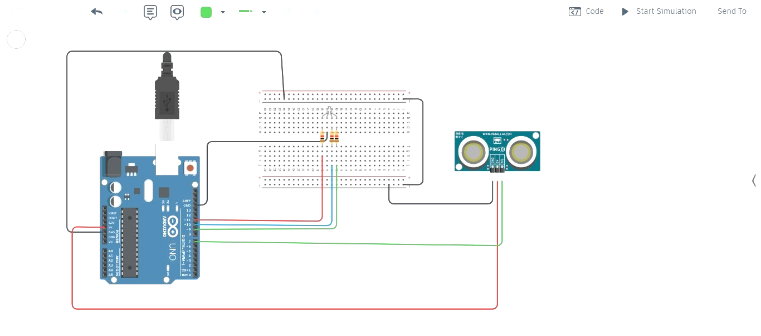
CIRCUIT DIAGRAM

Slide 6
const int pingPin = 7;
int redled = 11;
int blueled = 10;
int greenled = 9;
void setup() {
pinMode(redled,OUTPUT);
pinMode(blueled,OUTPUT);
pinMode(greenled,OUTPUT);
// initialize serial communication:
Serial.begin(9600);
}
void loop() {
// establish variables for duration of the ping, and the distance result
// in inches and centimeters:
long duration, inches, cm;
// The PING))) is triggered by a HIGH pulse of 2 or more microseconds.
// Give a short LOW pulse beforehand to ensure a clean HIGH pulse:
pinMode(pingPin, OUTPUT);
digitalWrite(pingPin, LOW);
delayMicroseconds(2);
digitalWrite(pingPin, HIGH);
delayMicroseconds(5);
PYTHON SCRIPT

Slide 7
digitalWrite(pingPin, LOW);
// The same pin is used to read the signal from the PING))): a HIGH pulse
// whose duration is the time (in microseconds) from the sending of the ping
// to the reception of its echo off of an object.
pinMode(pingPin, INPUT);
duration = pulseIn(pingPin, HIGH);
// convert the time into a distance
inches = microsecondsToInches(duration);
cm = microsecondsToCentimeters(duration);
if (inches<10)
{
digitalWrite(redled,HIGH);
digitalWrite(blueled,LOW);
digitalWrite(greenled,LOW);
}
else if (inches>10 && inches<50)
{
digitalWrite(redled,LOW);
digitalWrite(blueled,HIGH);
digitalWrite(greenled,LOW);
}
else
{

Slide 8
digitalWrite(redled,LOW);
digitalWrite(blueled,LOW);
digitalWrite(greenled,HIGH);
}
Serial.print(inches);
Serial.print("in, ");
Serial.print(cm);
Serial.print("cm");
Serial.println();
delay(100);
}
long microsecondsToInches(long microseconds) {
// 74 microseconds per inch(sound travels at 1130 feet per second)
return microseconds / 74 / 2;
}
long microsecondsToCentimeters(long microseconds) {
// 29 microseconds per cm travels at 340 m per second)
return microseconds / 29 / 2;
}

Slide 9
RESULT ANALYSIS
The aim of the project is to create smart parking using Tinkercad circuits to detect available parking spaces for this we build this simulation using components such as Arduino UNO, Bread Board and Ultrasonic Wave Sensor. This simulation exactly shows virtual components to emulate the functionality of the above mentioned components by using IOT devices.
CONCLUSION
By using the above simulation of circuit and code we can build the smart parking system using IR sensor in real world events.

Slide 10
Thank You

