Slide 1
PROJECT TITLE: SMARTPARKING PHASE 3: DEVELOPMENT PART 1
TEAM MEMBERS:
A.WAZIL 913021104042
A.REVATHI 913021104025
R.THIRUMAGAL 913021104036
R.NIVETHITHA 913021104018

Slide 2
INTRODUCTION
The introduction of automated, digitized, and smart factors into parking systems can improve labor costs, user efficiency, and management. Among these improvements, smart factors are the most anticipated innovation.
Equipped with network sensing and camera monitoring in the parking space, a smart parking management system (or so-called smart parking system) can transmit the on-site conditions instantly to the central control in order to sense various abnormalities, alleviate real-time problems, and guide vehicles, based on management viewpoints, to assist in the control of parking access.

Slide 3
TINKERCAD
Tinkercad Circuits is a free online service for creating basic 3D shapes and developing digital prototypes of electronic components.These prototypes can include basic circuits with LED lights, buzzers, switches, and even light sensors.
COMPONENTS REQUIRED
Arduino UNO(microcontroller)
Ultrasonic Wave Sensor
Bread Board

Slide 4
OBJECTIVE
smart parking system using an Arduino circuit board, you will need to use sensors to detect the presence of vehicles in each parking space. You can use infrared (IR) sensors to detect the presence of a vehicle in a parking space. When a vehicle enters or leaves a parking space, the sensor will send a signal to the Arduino board, which will then update the status of that parking space in real-time.
To make the system more user-friendly, you can use an LCD display to show drivers which parking spaces are available. You can also use a servo motor to control the opening and closing of the entry and exit gates.

Slide 5
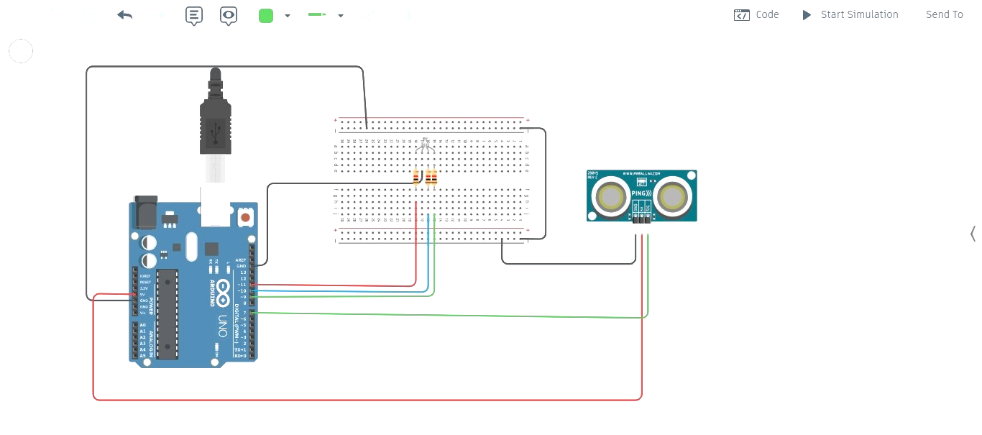
CIRCUIT DIAGRAM

Slide 6
WORKING
Sensor Integration:
Install parking sensors in each parking spot that can detect whether a spot is occupied or vacant. These sensors will send data to a central system.
Database:
Set up a database to store information about parking spots. Each entry should include a spot ID and its current status .
Mobile App Development:
Create a mobile app using Python, where users can see a map of the parking area and available spots. You'll need a Python framework like Flask or Django to build the backend.

