Slide 1
PROJECT TITLE: SMART PARKING PHASE 5: PROJECT DOCUMENTATION & SUBMISSION
TEAM MEMBERS:
A.WAZIL 913021104042
A.REVATHI 913021104025
R.THIRUMAGAL 913021104036
R.NIVETHITHA 913021104018

Slide 2
INTRODUCTION
The introduction of automated, digitized, and smart factors into parking systems can improve labor costs, user efficiency, and management. Among these improvements, smart factors are the most anticipated innovation.
Equipped with network sensing and camera monitoring in the parking space, a smart parking management system (or so-called smart parking system) can transmit the on-site conditions instantly to the central control in order to sense various abnormalities, alleviate real-time problems, and guide vehicles, based on management viewpoints, to assist in the control of parking access.

Slide 3
Project Objectives
Optimize Parking Space Utilization: The primary goal of smart parking is to maximize the use of available parking spaces. This involves reducing congestion and minimizing the time and fuel wasted by drivers searching for parking spots.
Reduce Traffic Congestion: By guiding drivers to available parking spaces and reducing the time spent circling for a spot, smart parking systems aim to alleviate traffic congestion in urban areas. This can lead to reduced emissions and improved air quality.
Enhance User Convenience: Smart parking systems should make it easier for drivers to find, reserve, and pay for parking. Mobile apps, online booking, and real-time availability updates contribute to a more convenient and user-friendly experience.
Improve Revenue Generation: Many smart parking initiatives are designed to increase revenue for municipalities or private operators. This can be achieved through dynamic pricing, efficient enforcement, and improved space turnover.
Enhance Safety and Security: Smart parking solutions can incorporate security features like surveillance cameras and emergency call buttons to enhance the safety of parking facilities.
Reduce Environmental Impact: Reducing the time vehicles spend idling and circling for parking spots can contribute to lower fuel consumption and emissions, thus helping to combat air pollution and climate change.

Slide 4
PLATFORM
TINKERCAD
Tinkercad Circuits is a free online service for creating basic 3D shapes and developing digital prototypes of electronic components.These prototypes can include basic circuits with LED lights, buzzers, switches, and even light sensors.
COMPONENTS REQUIRED
Arduino UNO(microcontroller)
Ultrasonic Wave Sensor
Bread Board

Slide 5
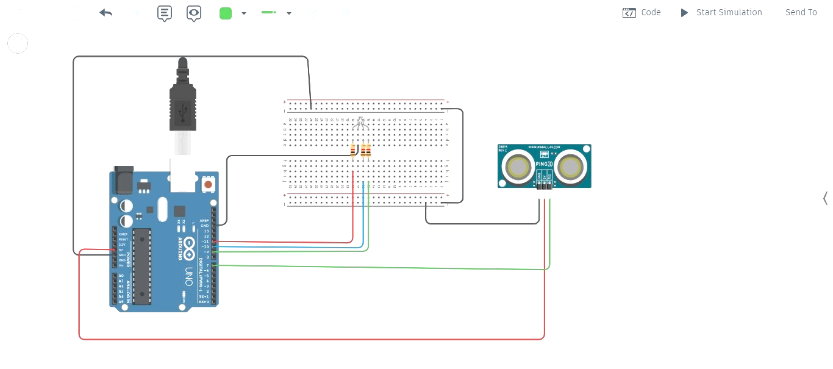
CIRCUIT DIAGRAM

Slide 6
const int pingPin = 7;
int redled = 11;
int blueled = 10;
int greenled = 9;
void setup() {
pinMode(redled,OUTPUT);
pinMode(blueled,OUTPUT);
pinMode(greenled,OUTPUT);
// initialize serial communication:
Serial.begin(9600);
}
void loop() {
// establish variables for duration of the ping, and the distance result
// in inches and centimeters:
long duration, inches, cm;
// The PING))) is triggered by a HIGH pulse of 2 or more microseconds.
// Give a short LOW pulse beforehand to ensure a clean HIGH pulse:
pinMode(pingPin, OUTPUT);
digitalWrite(pingPin, LOW);
delayMicroseconds(2);
digitalWrite(pingPin, HIGH);
delayMicroseconds(5);
PYTHON SCRIPT

Slide 7
digitalWrite(pingPin, LOW);
// The same pin is used to read the signal from the PING))): a HIGH pulse
// whose duration is the time (in microseconds) from the sending of the ping
// to the reception of its echo off of an object.
pinMode(pingPin, INPUT);
duration = pulseIn(pingPin, HIGH);
// convert the time into a distance
inches = microsecondsToInches(duration);
cm = microsecondsToCentimeters(duration);
if (inches<10)
{
digitalWrite(redled,HIGH);
digitalWrite(blueled,LOW);
digitalWrite(greenled,LOW);
}
else if (inches>10 && inches<50)
{
digitalWrite(redled,LOW);
digitalWrite(blueled,HIGH);
digitalWrite(greenled,LOW);
}
else
{

Slide 8
digitalWrite(redled,LOW);
digitalWrite(blueled,LOW);
digitalWrite(greenled,HIGH);
}
Serial.print(inches);
Serial.print("in, ");
Serial.print(cm);
Serial.print("cm");
Serial.println();
delay(100);
}
long microsecondsToInches(long microseconds) {
// 74 microseconds per inch(sound travels at 1130 feet per second)
return microseconds / 74 / 2;
}
long microsecondsToCentimeters(long microseconds) {
// 29 microseconds per cm travels at 340 m per second)
return microseconds / 29 / 2;
}

Slide 9
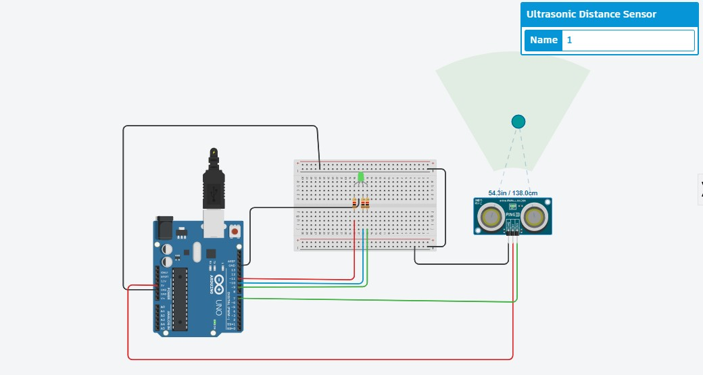
OUTPUT:
Case1:(green light)
Object was not parked correctly in the parking slot

Slide 10
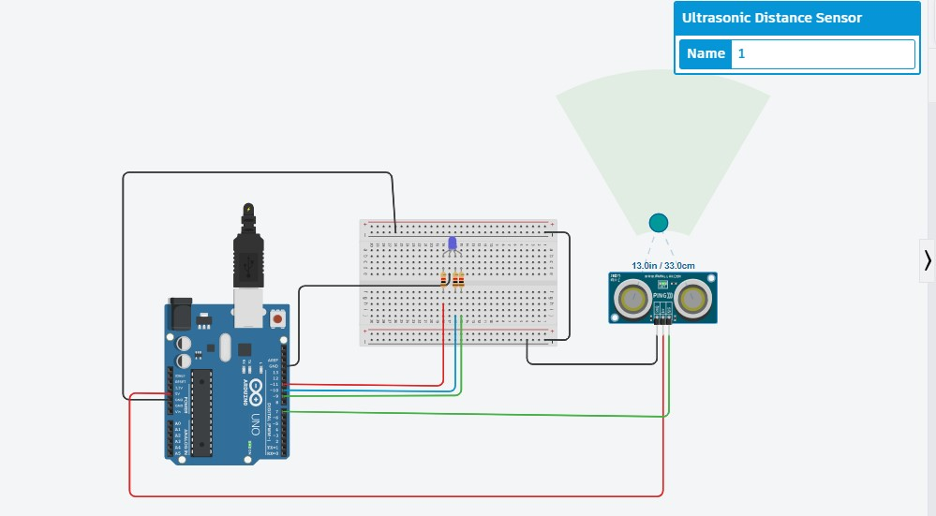
Case2:(blue light)
Object was approximatly parked in the parking slot

Slide 11
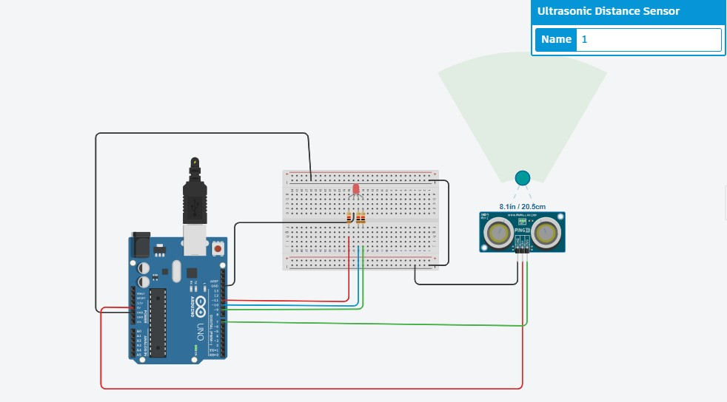
Case3:(Red light)
Object was parked in the parking slot

Slide 12
RESULT ANALYSIS
The aim of the project is to create smart parking using Tinkercad circuits to detect available parking spaces for this we build this simulation using components such as Arduino UNO, Bread Board and Ultrasonic Wave Sensor. This simulation exactly shows virtual components to emulate the functionality of the above mentioned components by using IOT devices.
CONCLUSION
By using the above simulation of circuit and code we can build the smart parking system using IR sensor in real world events.

Slide 13
Thank You

