Slide 1

Nmaj
MAHATMA GANDHI INSTITUTE OF TECHNOLOGY(A) DEPARTMENT OF INFORMATION TECHNOLOGY
An Industry Oriented Mini Project (IT653PC) On
HYBRID APPROACH FOR NETWORK INTRUSION DETECTION SYSTEM USING MACHINE LEARNING
BY
Patloori Durga-22261A1246 Suragani Revathi-22261A1253
Batch ID-IT-25-12
Internal Supervisor
Mrs.U.Chaitanya
IOMP Supervisor
Mrs.Ch.Sudha

Slide 2
OUTLINE
ABSTRACT
INTRODUCTION
EXISTING SYSTEM
PROPOSED SYSTEM
APPLICATIONS
REQUIREMENTS
LITERATURE SURVEY
PROBLEM STATEMENT
OBJECTIVES
MODULES DESCRIPTION
ALGORITHM
DESIGN ARCHITECTURE
UML DIAGRAMS
TEST CASES
RESULTS
CONCLUSION
FUTURE SCOPE
REFERENCES

Slide 3
ABSTRACT
IDS is
Signature-based
essential for detecting malicious activities and securing networks.
IDS effectively detects known threats but struggles with anomalies and novel attacks.
Machine learning classifiers improve detection but have difficulty identifying rare attacks like R2L and U2R due to their similarity to normal behavior.
The Double Layered Hybrid Approach (DLHA) integrates enhanced BLSTM to improve attack detection.
PCA extracts key features, while BLSTM enhances temporal and sequential pattern recognition for rare attack detection.
Layer 1 uses Naive Bayes for detecting DoS and Probe attacks; Layer 2 combines SVM and BLSTM to differentiate R2L and U2R from normal instances.

Slide 4
INTRODUCTION
Intrusion Detection
Signature-based
Systems (IDS) help secure networks by detecting and mitigating cyber threats.
IDS fails to detect new and
anomalous threats.
U2R due to imbalanced data.
Machine learning improves detection but struggles with rare attacks like R2L and
The Double Layered Hybrid Approach (DLHA) integrates BLSTM for better anomaly detection.
Naïve Bayes classifies DoS and Probe attacks, while SVM and BLSTM differentiate R2L and U2R attacks from normal traffic.
BLSTM enhances the learning of attack patterns, making IDS more effective against evolving cyber threats.

Slide 5
IDENTIFYING ATTACKS
DoS Attacks (Denial of Service)-
Back,land,neptune,pod,smurf,teardrop,apache2,udp storm,processtable,worm. Probe Attacks (Probing and Scanning)- Satan,ipsweep,nmap,portsweep,mscan,saint.
R2L (Remote-to-Local)-
ftp_write, guess_passwd, imap, multihop, etc.
U2R (User-to-Root)-
buffer_overflow, rootkit, loadmodule, perl, etc.

Slide 6
EXISTING SYSTEM:
Limited Detection of Evolving Threats
Signature-based IDS fails to detect new and evolving attacks, while anomaly-based IDS has high false positives.
ML models struggle with imbalanced datasets, leading to poor detection of rare attacks like R2L and U2R. Limitation: Ineffective against zero-day attacks and misclassifies rare threats.
High Computational Cost & Real-Time Inefficiency
Deep learning models (CNN, LSTM, Hybrid Approaches)
improve accuracy but require high processing power.
Manual feature Limitation:
selection Slow
reduces processing,
adaptability, scalability
making challenges,
real-time
and
intrusion high
detection resource
difficult. consumption.

Slide 7
PROPOSED SYSTEM
Optimized Feature Selection & Real-Time Efficiency
Principal Component Analysis (PCA) extracts key features, improving detection
speed and reducing noise.
The system balances accuracy and computational efficiency, making it scalable for real-time intrusion detection. Benefit: Faster processing, adaptability to new threats, and efficient real-time performance.
Improved Rare Attack Detection with Hybrid Approach
A two-layer
Layer 1: Naive Bayes efficiently
Layer 2: SVM + BLSTM accurately identifies rare R2L
classification
model:
and Probe attacks. learning sequential attack patterns.
detects DoS
and U2R attacks by
Benefit: Higher accuracy in detecting both common and rare attacks with reduced false positives.

Slide 8
APPLICATIONS
Enterprise Network Security
Cloud Security & Data Centers
Government & Defense Networks
Banking & Financial Institutions
Healthcare Systems & IoT Security
Smart Cities & Critical Infrastructure
Educational Institutions & Research Labs

Slide 9
REQUIREMENTS
SOFTWARE:
Operating System:Windows 10/11
Programming Language:Python 3.x
Libraries and Frameworks:TensorFlow / PyTorch (for BLSTM),Scikit-learn (for PCA, SVM, and Naïve Bayes),NumPy & Pandas (for data handling),Matplotlib & Seaborn (for visualization)
Development Environment:VsCode Additional Tools:NSL-KDD (data set) HARDWARE:
Processor - Intel Core i5/i7/i9
RAM - Minimum: 8GB
Storage - Minimum: 256GB SSD

Slide 10
LITERATURE SURVEY
S.NO | AUTHOR NAMES,YEAR OF PUBLICATION | JOURNAL OR CONFERENCE NAME AND PUBLISHER NAME | METHODOLOGY/ ALGORITHM / TECHNIQUES USED | MERITS | DEMERITS | RESEARCH GAPS
1. | Muhammad Sajid et al. (2024) | Journal of Cloud Computing, | Developed a Hybrid Machine and Deep | Enhanced anomaly | CNN struggles with sequential | Requires improvement in
 |  | Springer | Learning Approach | detection with | dependencies | feature selection
 |  |  | integrating CNN, | a focus on | in network | techniques for
 |  |  | LSTM, and ensemble | cloud based | traffic | better
 |  |  | learning | environments |  | performance
2. | Security and Communication Networks | Security and Communication | Designed a Supervised Ensemble | High detection | Overfitting issue due to | Needs validation on real - world
 | (2024) | Networks, | Stacking Model | accuracy | ensemble | datasets for
 |  | Hindawi | combining multiple | across | complexity | better
 |  |  | ML algorithms for | multiple |  | generalization
 |  |  | IDS | attack type

Slide 11
3. | S. Shi, D. Han, & M. Cui (2023) | Connection Science, Taylor & Francis | Introduced a Multimodal Hybrid Parallel IDS using ML and DL models for feature extraction and classification | improved performance in handling high dimensional network traffic data | High computational cost | Needs lightweight IDS solutions for real time deployment
4. | R. Jalili, S. Imani, & | Proceedings of ACM | Proposed a CNN | Effective in | High training | Needs
 | M. R. Aminzadeh | SIN Conference, | LSTM-based | detecting | time and | optimization
 | (2021) | ACM Digital Library | approach for | unknown attacks | resource | techniques to
 |  |  | anomaly detection | and reducing | consumption | improve
 |  |  | in Software Defined | false positives |  | efficiency
 |  |  | Networks (SDNs)
5. | M. Mohammadi, A. | IEEE Xplore, IEEE | Proposed a Double | Effective in | Struggles with | Requires further
 | Navaras, & M. H. |  | Layered Hybrid | detecting DoS | class imbalance | optimization for
 | Amini (2021) |  | Approach (DLHA) | and Probe | in R2L and U2R | real time attack
 |  |  | using Naïve Bayes, | attacks with high | attacks | detection
 |  |  | SVM for network | accuracy
 |  |  | intrusion detection

Slide 12
PROBLEM STATEMENT
Traditional IDS fail to detect rare and evolving attacks like R2L and U2R, resulting in high false negatives due to limited adaptability and reliance on signature-based methods.
Existing machine learning approaches face challenges with data imbalance, while deep learning models are resource-intensive—highlighting the need for a hybrid, efficient, and accurate IDS for real-time cybersecurity.

Slide 13
OBJECTIVES
Enhance Intrusion Detection Accuracy
Optimize Feature Selection
Reduce False Positives & Improve Adaptability

Slide 14
MODULES DESCRIPTION
Data Preprocessing & Feature Selection
Uses PCA to extract relevant features and reduce noise.
Layer 1: Naive Bayes Classification
Detects DoS and Probe attacks as an initial filtering step.
Layer 2: SVM + BLSTM for Rare Attack Detection
SVM separates normal traffic from anomalies.
BLSTM captures sequential attack patterns, improving R2L and U2R detection.
Intrusion Detection & Classification
Labels traffic as normal or attack, minimizing false positives.
Performance Evaluation & Real-Time Implementation
Measures accuracy, precision, recall, and F1-score for real-time security.

Slide 15
ALGORITHM
Data Preprocessing & Feature Selection
Layer 1 - Initial Classification (Naïve Bayes)
Layer 2 - Rare Attack Detection (SVM + BLSTM)
Intrusion Detection & Classification
Performance Evaluation & Real-Time Implementation

Slide 16
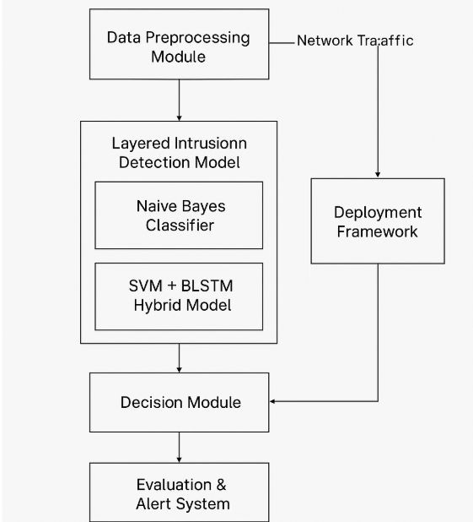
DESIGN ARCHITECTURE

Slide 17
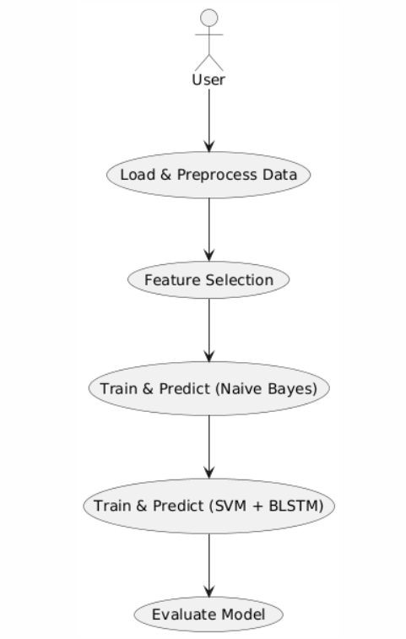
UML DIAGRAMS
USE CASE DIAGRAM:

Slide 18
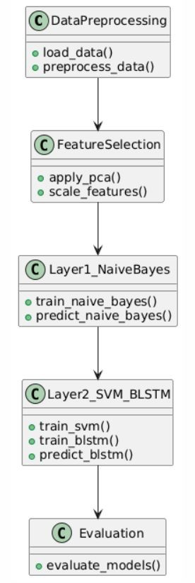
CLASS DIAGRAM:

Slide 19
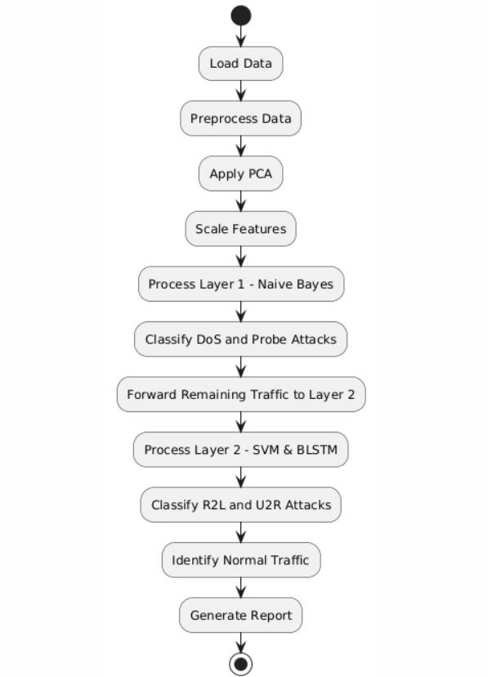
ACTIVITY DIAGRAM:

Slide 20
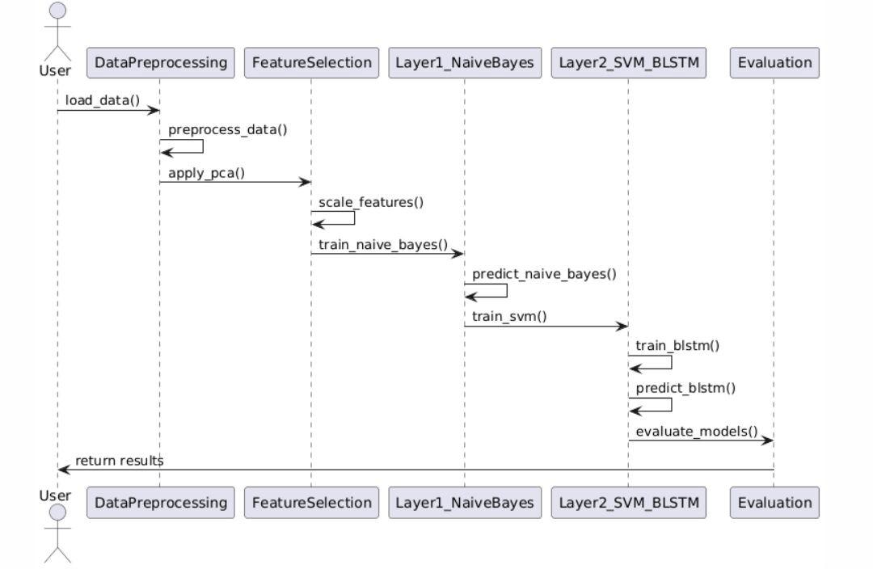
SEQUENCE DIAGRAM:

Slide 21
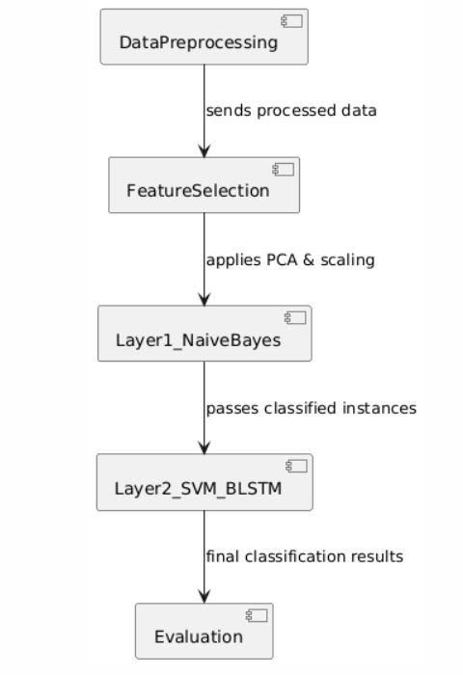
COMPONENT DIAGRAM:

Slide 22
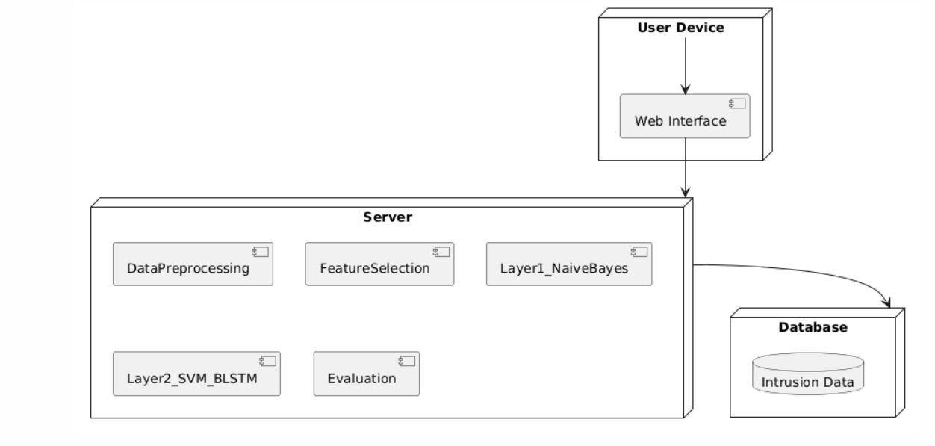
DEPLOYMENT DIAGRAM:

Slide 23
TEST CASES:
Test Case ID | Model | Data Source | What’s Tested | Pass Criteria
TC1 | Naive Bayes (Layer 1) | 30% hold-out split of X_pca/y from training set (X_test1, y_test1) | Layer 1 classification performance | Model returns predictions
TC2 | SVM (Layer 2) | 30% hold-out split of the correctly classified subset (X_test2, y_test2) | Layer 2 (SVM) classification on “easy” cases | No errors in prediction pipeline
TC3 | BLSTM (Layer 2) | 30% hold-out split of the same “easy” subset, used as validation during training | BLSTM training & validation accuracy | Loss decreases, accuracy improves per epoch

Slide 24
TC4 | Naive Bayes (Test Data) | Entire external test file (KDDTest+.txt) preprocessed → X_test_all, y_test_all | Final NB performance on unseen data | Passes and gives confusion matrix
TC5 | SVM (Test Data) | Same external test set (X_test_all, y_test_all) | Final SVM performance on unseen data | Passes and gives confusion matrix
TC6 | BLSTM (Test Data) | Same external test set reshaped for BLSTM | Final BLSTM performance on unseen data | Passes and gives confusion matrix

Slide 25
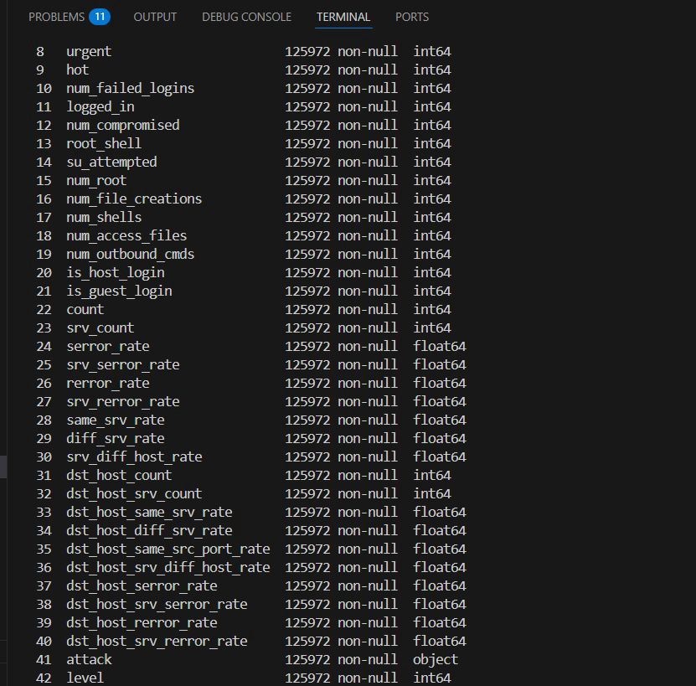
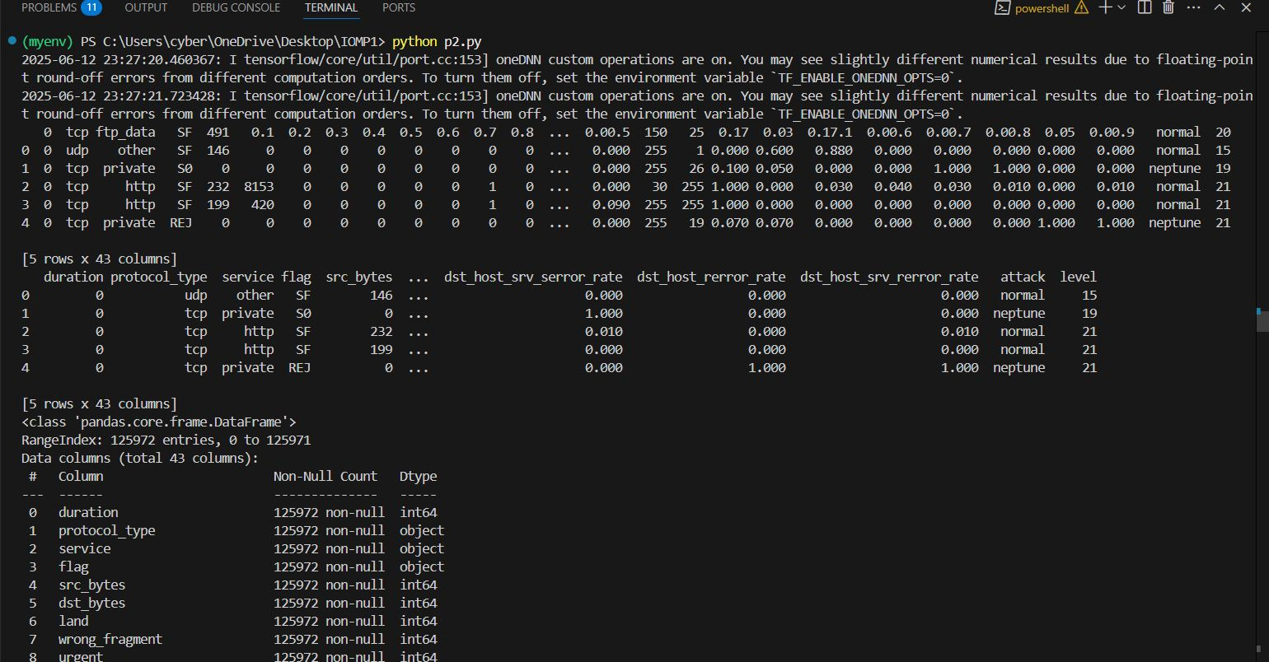
RESULTS:

Slide 26
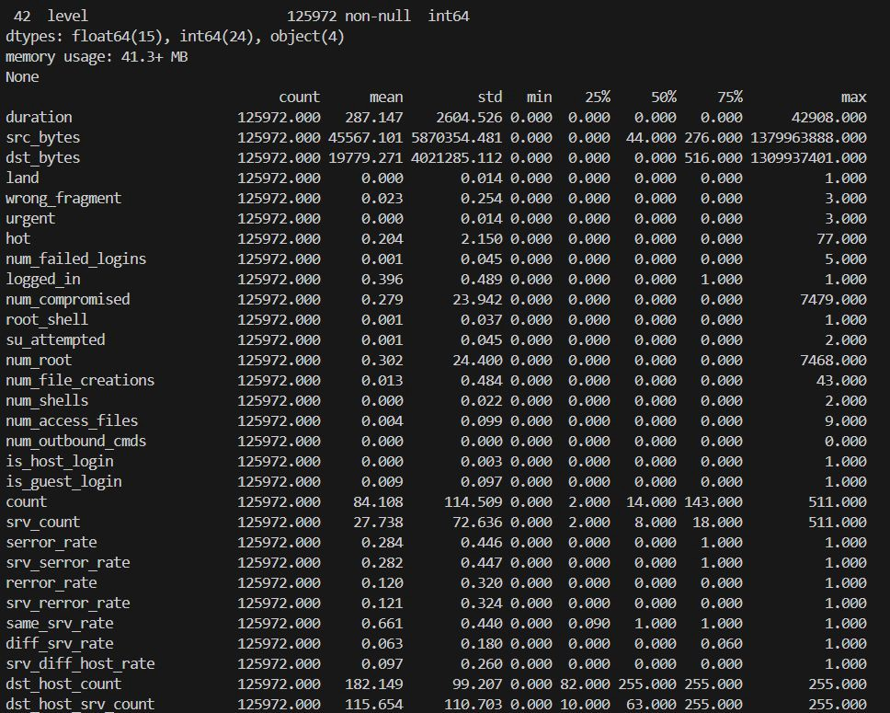
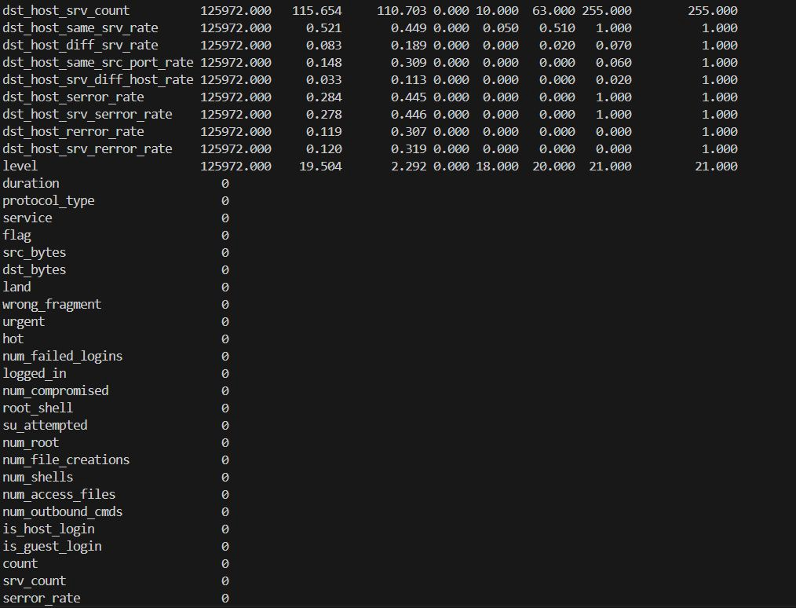

Slide 27
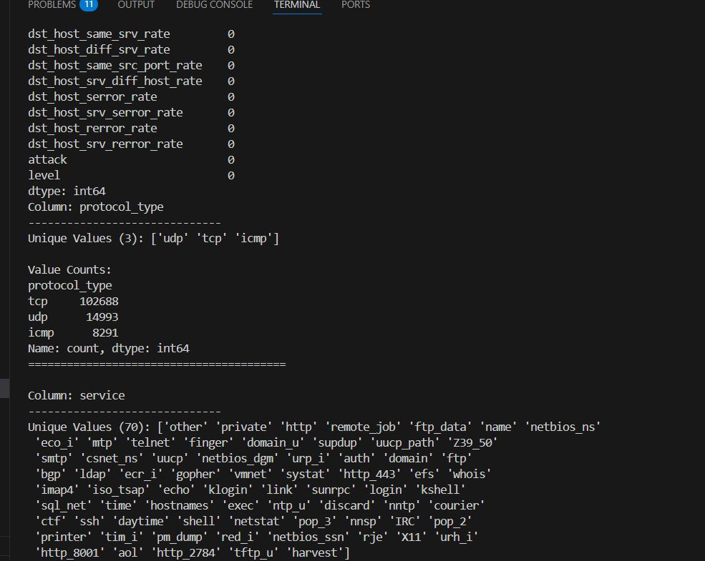
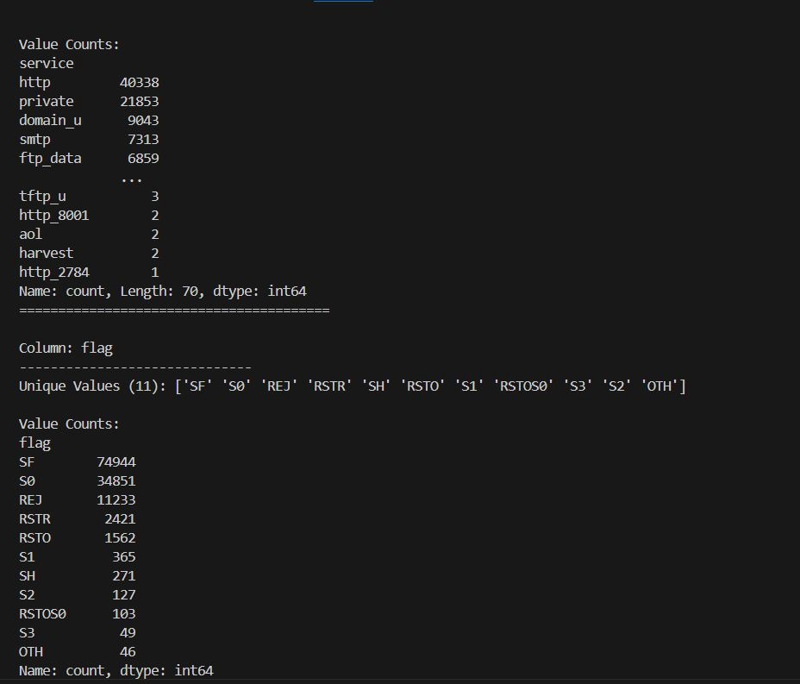

Slide 28
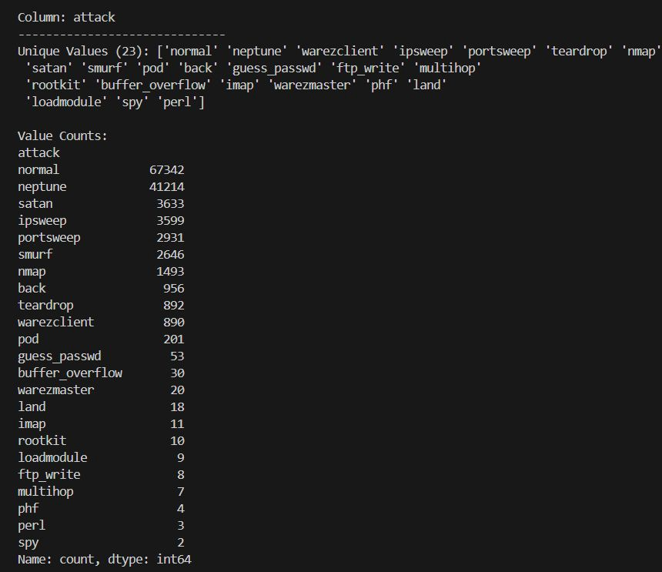
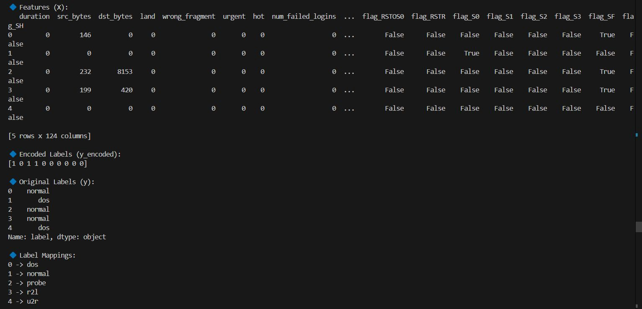

Slide 29
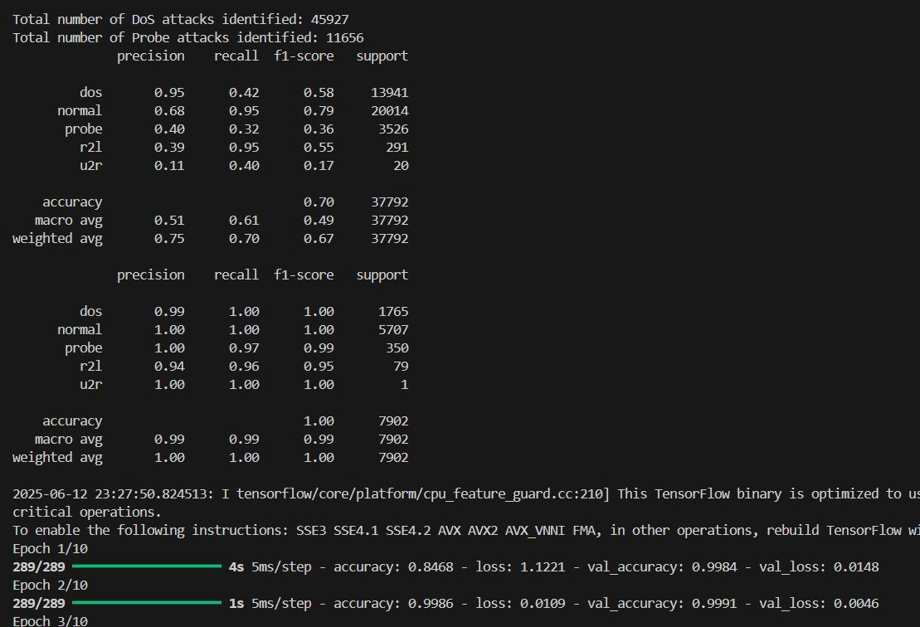
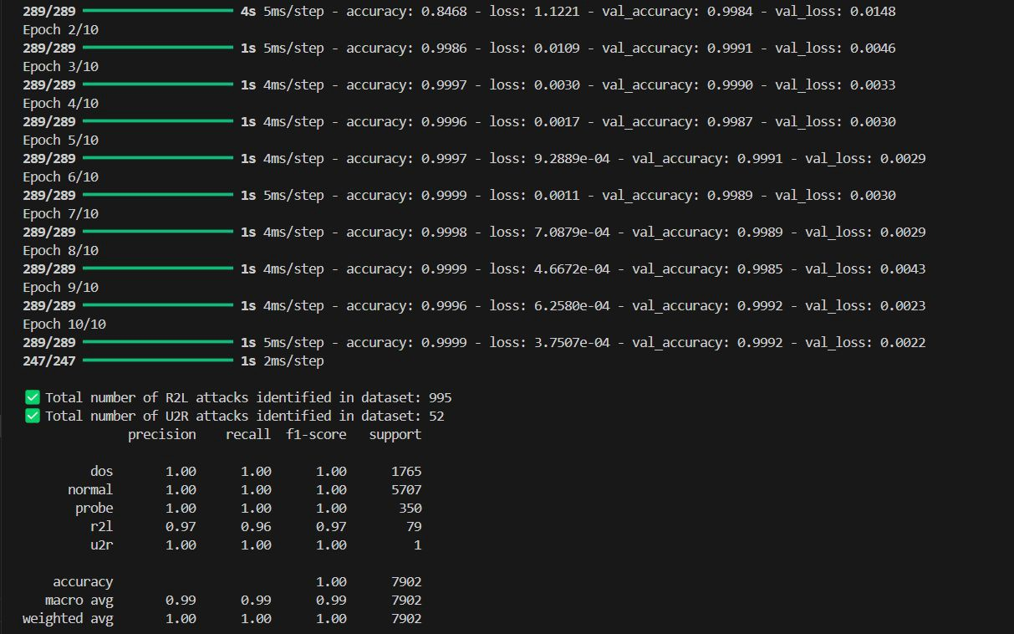

Slide 30
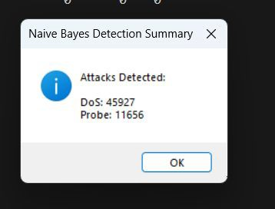
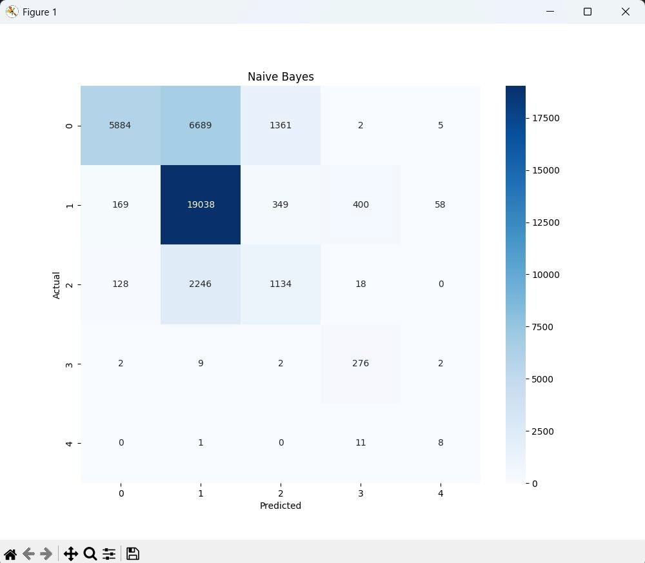
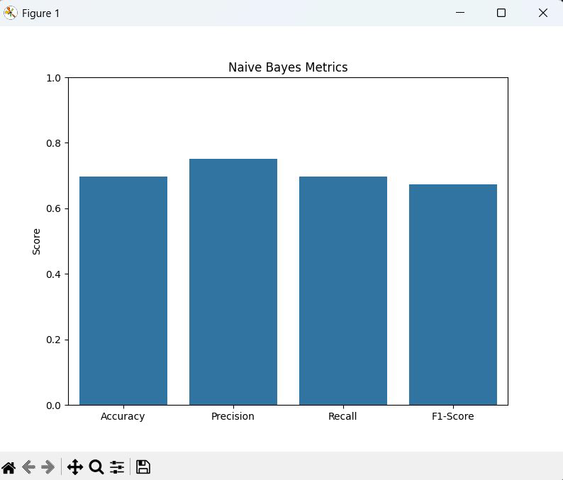

Slide 31
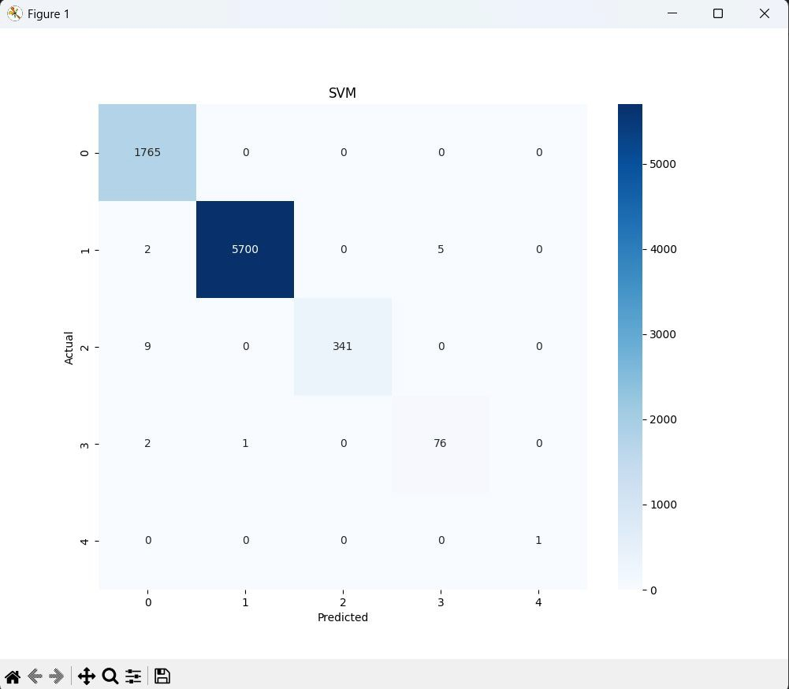
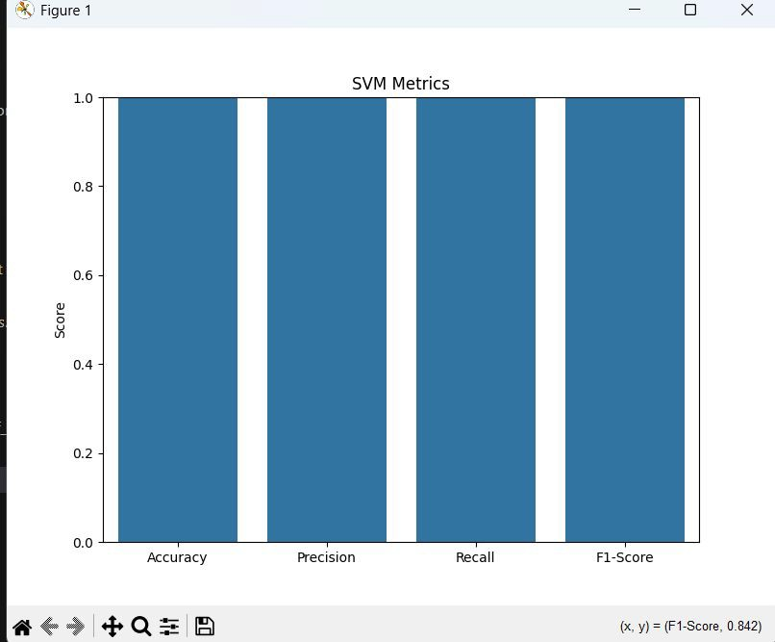

Slide 32
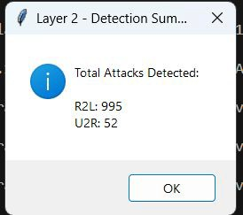
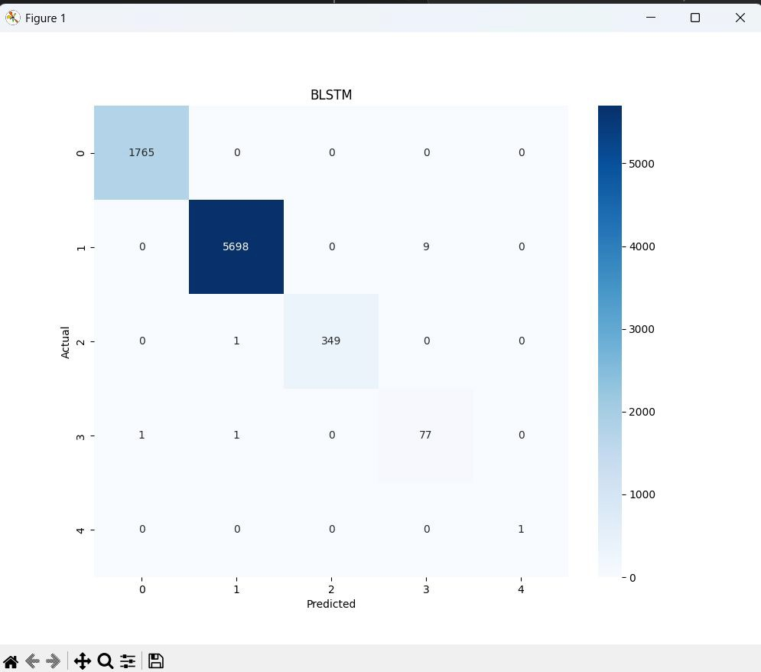
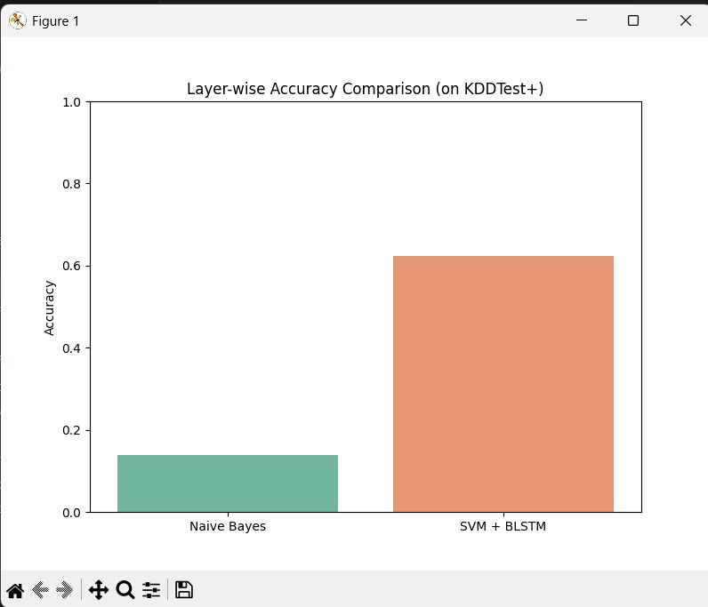

Slide 33
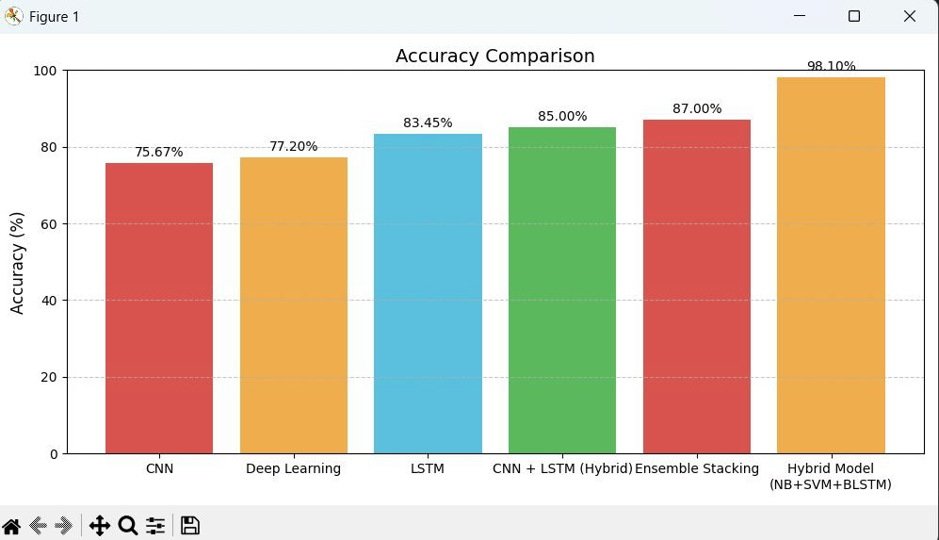
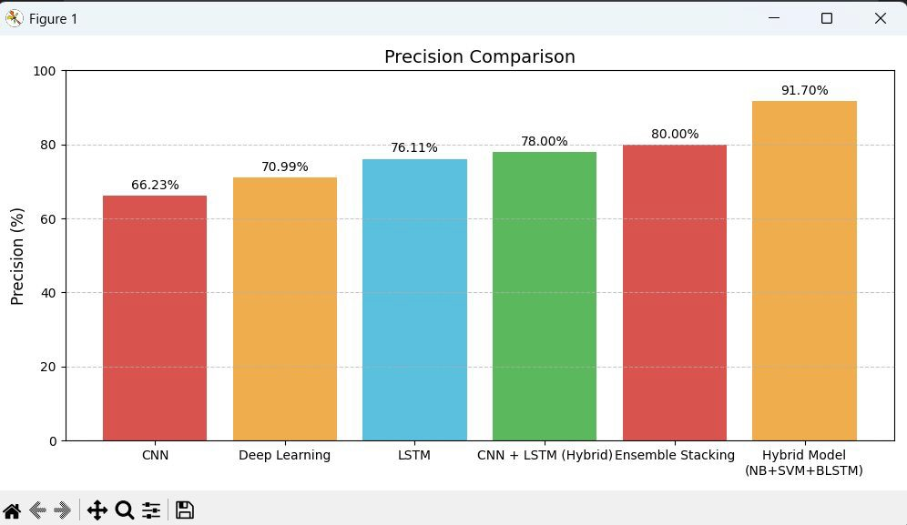

Slide 34
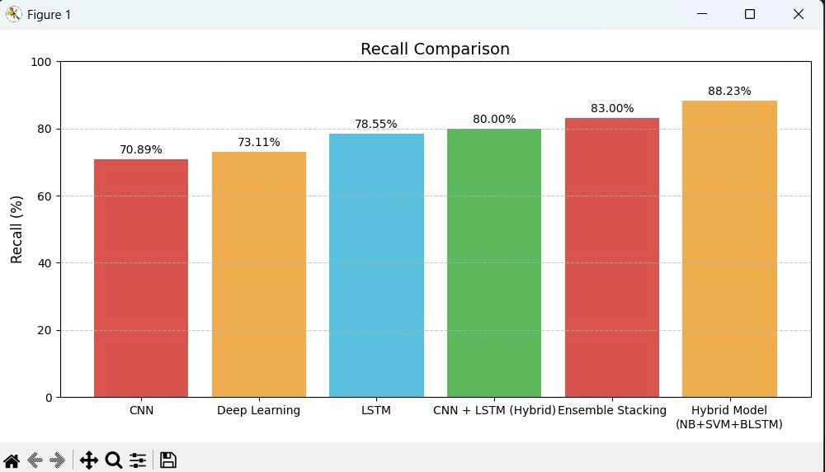
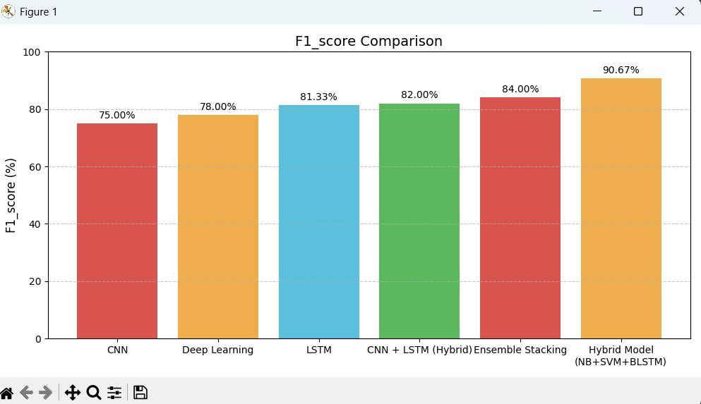

Slide 35
Conclusion:
Enhanced Detection Accuracy: The proposed Double Layered Hybrid Approach (DLHA), combining Naive Bayes, SVM, and BLSTM, significantly improves detection accuracy for both frequent (DoS, Probe) and rare (R2L, U2R) attack types compared to traditional methods.
Effective Use of PCA and BLSTM: The use of Principal Component Analysis (PCA) for dimensionality reduction and BLSTM for temporal pattern recognition enables the system to handle complex, sequential network traffic more efficiently.
Robust and Scalable Solution: DLHA provides a robust, scalable, and adaptable framework for real-time intrusion detection, making it suitable for modern dynamic network environments facing evolving cyber threats.

Slide 36
FUTURE SCOPE:
Real-time detection – Upgrade to monitor live network traffic.
System integration – Connect with firewalls and SIEM tools.
Adaptive learning – Enable the model to learn from new attacks.
IoT deployment – Optimize for use in smart and edge devices.
Multi-source analysis – Use logs and external data for better accuracy.

Slide 37
REFERENCES
M. Mohammadi, A. Navaras, & M. H. Amini (2021). Double Layered Hybrid Approach for Network Intrusion Detection System.IEEE Xplore. DOI: 10.1109/ICICT52614.2021.9562534.
S. Shi, D. Han, & M. Cui (2023). A Multimodal Hybrid Parallel Network Intrusion Detection Model. Connection Science, Taylor & Francis. 35(1), 2227780. DOI: 10.1080/09540091.2023.2227780
Muhammad Sajid, Kaleem Razzaq Malik, Ahmad Almogren, Tauqeer Safdar Malik, Ali Haider Khan, Jawad Tanveer, & Ateeq Ur Rehman (2024). Enhancing Intrusion Detection: A Hybrid Machine and Deep Learning Approach. Journal
Cloud Computing, Springer. Volume 13, Article number: 123. DOI: 10.1186/s13677-024-00685-x.
R. Jalili, S. Imani, & M. R. Aminzadeh (2021). A Hybrid CNN-LSTM Based Approach for Anomaly Detection Systems in SDNs. Proceedings of the 10th ACM International Conference on Security of Information and Networks, ACM Digital
Library. DOI: 10.1145/3465481.3469190.
Network Intrusion Detection and Prevention System Using Hybrid Machine Learning with Supervised Ensemble Stacking Model. (2024). Security and Communication Networks, Hindawi. DOI: 10.1155/2024/5775671.

Slide 38
Thank you

