Slide 1
FOOD-ORDERING-SYSTEM
BY-SURAGANI REVATHI

Slide 2
INTRODUCTION
Developed a full-stack Restaurant Food Ordering Web Application using React (frontend), FastAPI (backend), and SQLite (database).
Supports two user roles: Admin can manage the menu, orders, and dashboard, while Customers can browse food, add items to the cart, place orders, and track order status.
Includes an AI-powered natural language menu search that recommends available dishes based on customer queries such as "something spicy and vegetarian under ₹200".
Provides a complete digital restaurant workflow, including menu management, order processing, status tracking, and dashboard analytics through RESTful APIs.

Slide 3
OBJECTIVES
Develop a user-friendly restaurant food ordering system that simplifies the process of browsing menus and placing orders online.
Provide separate Admin and Customer interfaces to efficiently manage restaurant operations and enhance the customer experience.
Implement AI-powered natural language menu search to help customers quickly find food items based on their preferences.
Streamline restaurant order management by enabling menu management, order tracking, status updates, and dashboard analytics in a single application.

Slide 4
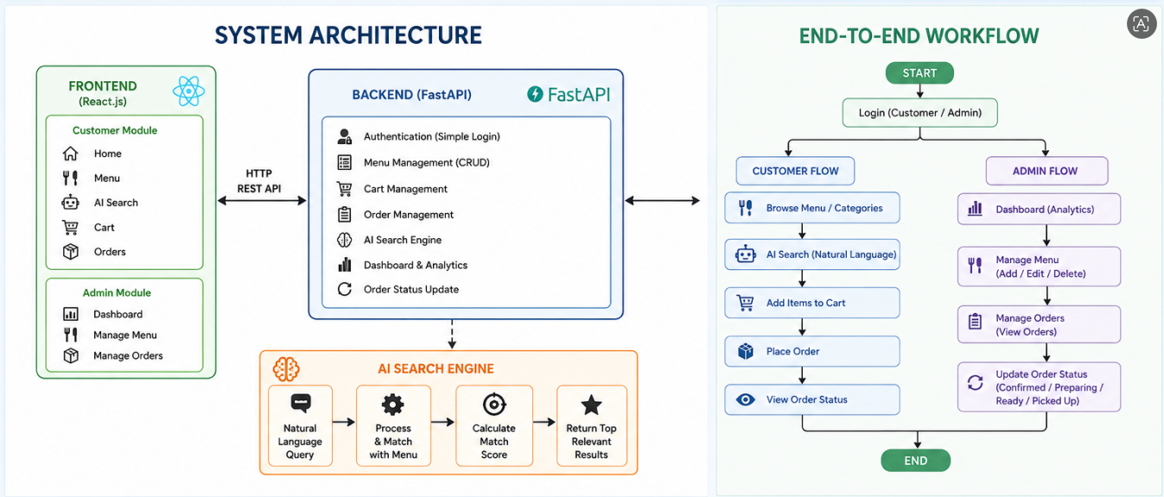
SYSTEM ARCHITECTURE

Slide 5
FEATURES
Separate Admin and Customer login.
Admin can add, edit, and delete menu items.
Customer can browse the menu, add items to the cart, and place orders.
AI-powered menu search using natural language.
Order status tracking from Placed to Picked Up.
Admin dashboard to view orders, revenue, and popular items.
Category-wise food menu (Tiffins, Lunch, Pizza, Desserts, etc.).
Data stored securely in an SQLite database using a FastAPI backend.

Slide 6
CONCLUSION AND FUTURE ENHANCEMENTS
Developed a complete restaurant food ordering web application.
Implemented separate modules for Admin and Customer.
Integrated an AI-powered menu search for better user experience.
Simplified menu management, order processing, and order tracking.
Add online payment integration.
Implement customer registration and profile management.
Add ratings and reviews for menu items.
Deploy the application to the cloud for real-time access.
Develop a mobile-friendly or Android/iOS version.
Add email/SMS notifications for order updates.

Slide 7
THANK YOU

