Slide 1
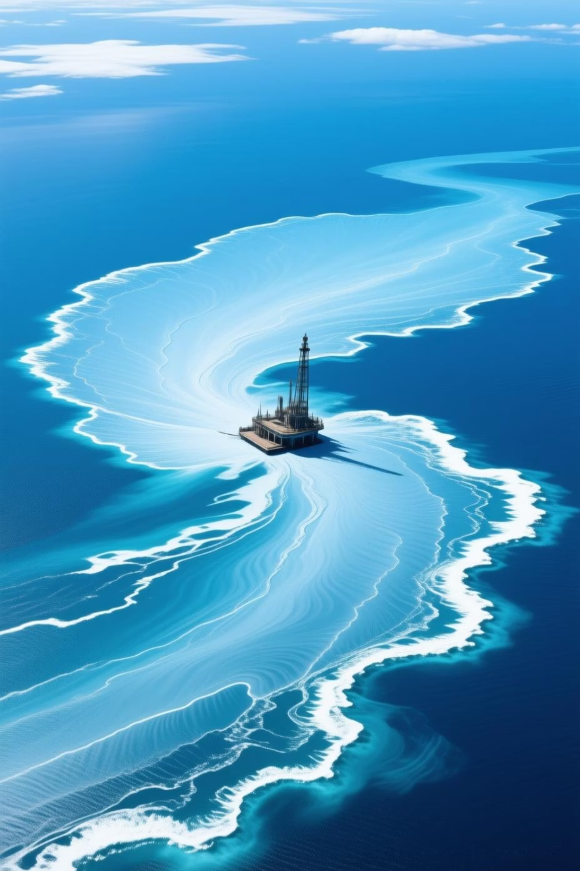
AI-Powered Detection of Marine Oil Spills
A Reproducible Workflow Using Satellite SAR Imagery

Slide 2

Project Objective: Rapid & Reliable Environmental Response
The Problem
Current Limitations
The Solution
Oil spills cause severe, long-lasting environmental damage and require immediate action to contain.
Manual satellite data analysis is slow, subjective, and struggles with large-scale monitoring.
Develop an AI-powered segmentation model for reliable, rapid spill localisation from SAR data.

Slide 3
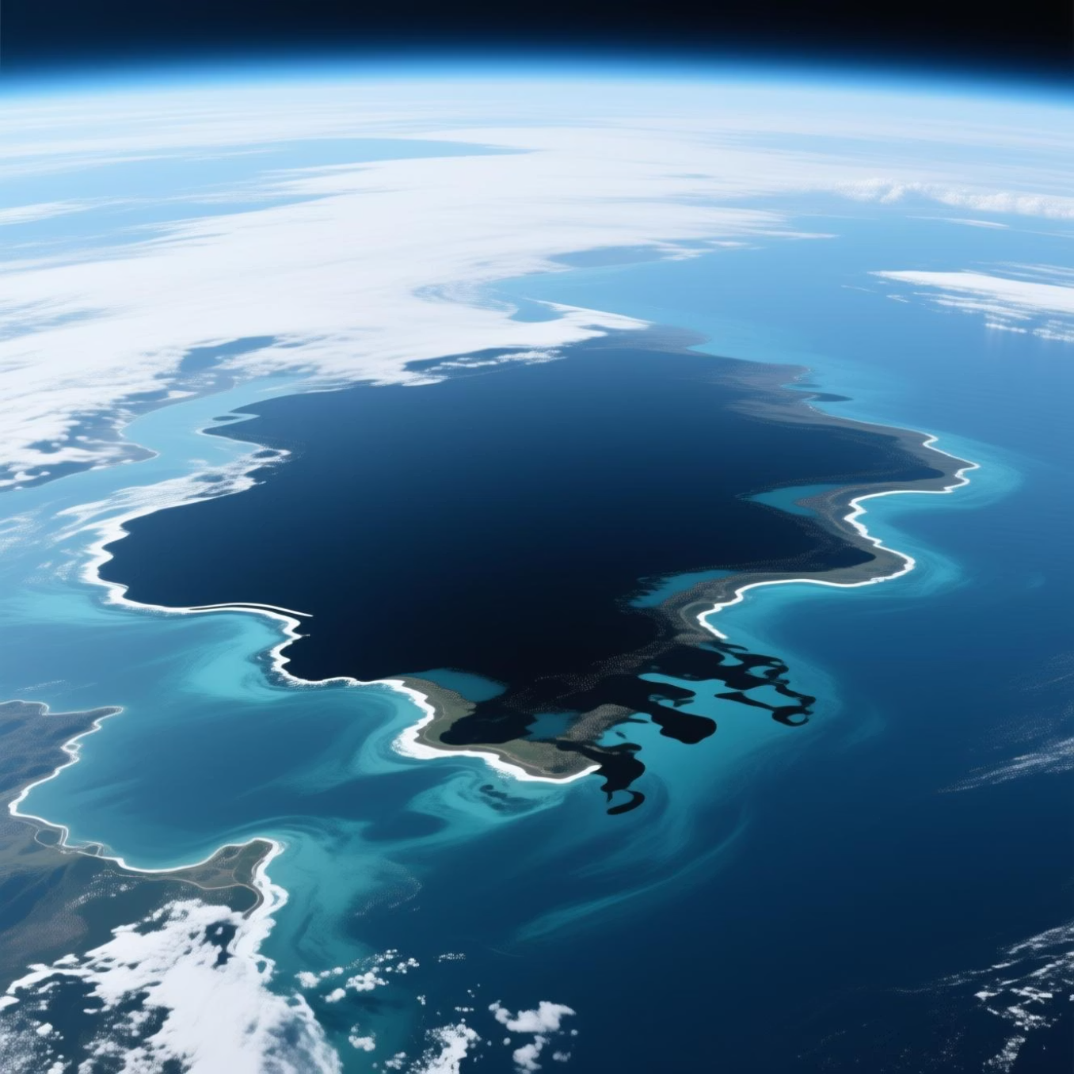
Dataset Overview: Sentinel-1 SAR Imagery
Source and Annotation
Source: Sentinel-1 Synthetic Aperture Radar (SAR) imagery, provided via Kaggle.
SAR Data: Ideal for spill detection due to oil's surface-damping effect (appearing dark against water).
Annotation: Images manually labelled for spill presence and exact boundary segmentation.
Basic Statistics
850
243
Total Annotated Images
Confirmed Spill Instances
# Code Snippet for Data Loadingdef load_dataset(path): images = np.load(path + 'images.npy') masks = np.load(path + 'masks.npy') return images, masks

Slide 4
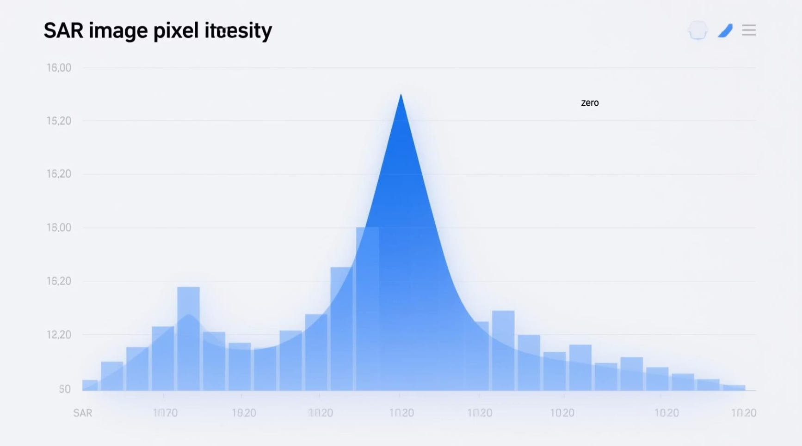
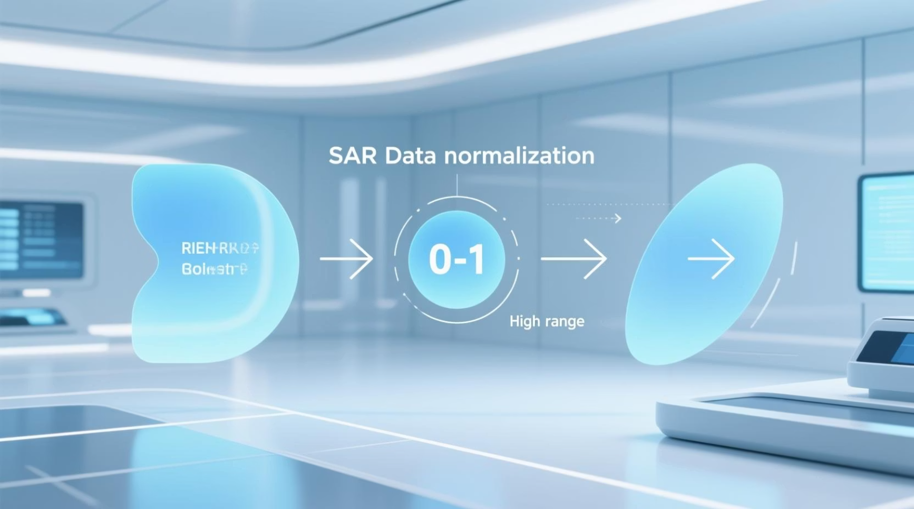

Exploratory Data Analysis (EDA)
Pixel Intensity Distribution
Normalisation Focus
Initial histogram shows a high concentration of low-intensity pixels (water background).
Data normalisation critical to reduce dynamic range and improve model convergence.
Noise and Artifacts
SAR images often contain speckle noise, land masks, and wind-related false positives.

Slide 5
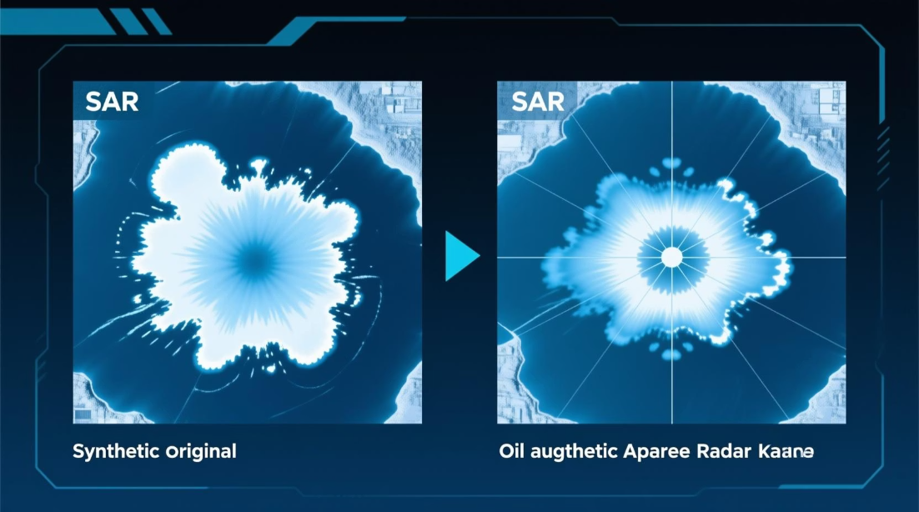
Data Preprocessing Pipeline
01
02
03
Image Resizing & Padding
Intensity Normalisation
Data Augmentation
Min-max scaling of pixel values to the [0, 1] range to ensure stable training.
Increase dataset diversity using random flips (horizontal/vertical) and rotations to improve generalisation.
Standardise all input images to a uniform resolution (e.g., 256x256) suitable for U-Net architecture.
# Normalization Logicimages = (images - images.min()) / (images.max() - images.min())

Slide 6

Feature Extraction and Input Format
The model requires raw pixel arrays as the primary features, allowing the CNN to learn complex spatial and textural patterns inherent to SAR data.
Input Features: Normalised pixel arrays (256x256x1).
Edge Detection: Implicitly learned by the model layers.
Output Format: Binary mask (256x256x1) where 1 indicates oil, 0 indicates water/background.
# U-Net Input Shapeinput_shape = (256, 256, 1)

Slide 7

Model Architecture: Deep Segmentation with U-Net
Leveraging Encoder-Decoder Structure for Precise Localisation
Encoder (Contracting Path)
Decoder (Expanding Path)
Up-sampling layers to restore spatial resolution and enable precise localisation (where the spill is).
Standard CNN layers (convolution, pooling) to capture high-level semantic features (what the spill is).
Skip Connections
Directly connects encoder features to the decoder, retaining fine-grained spatial details for better boundary delineation.

Slide 8
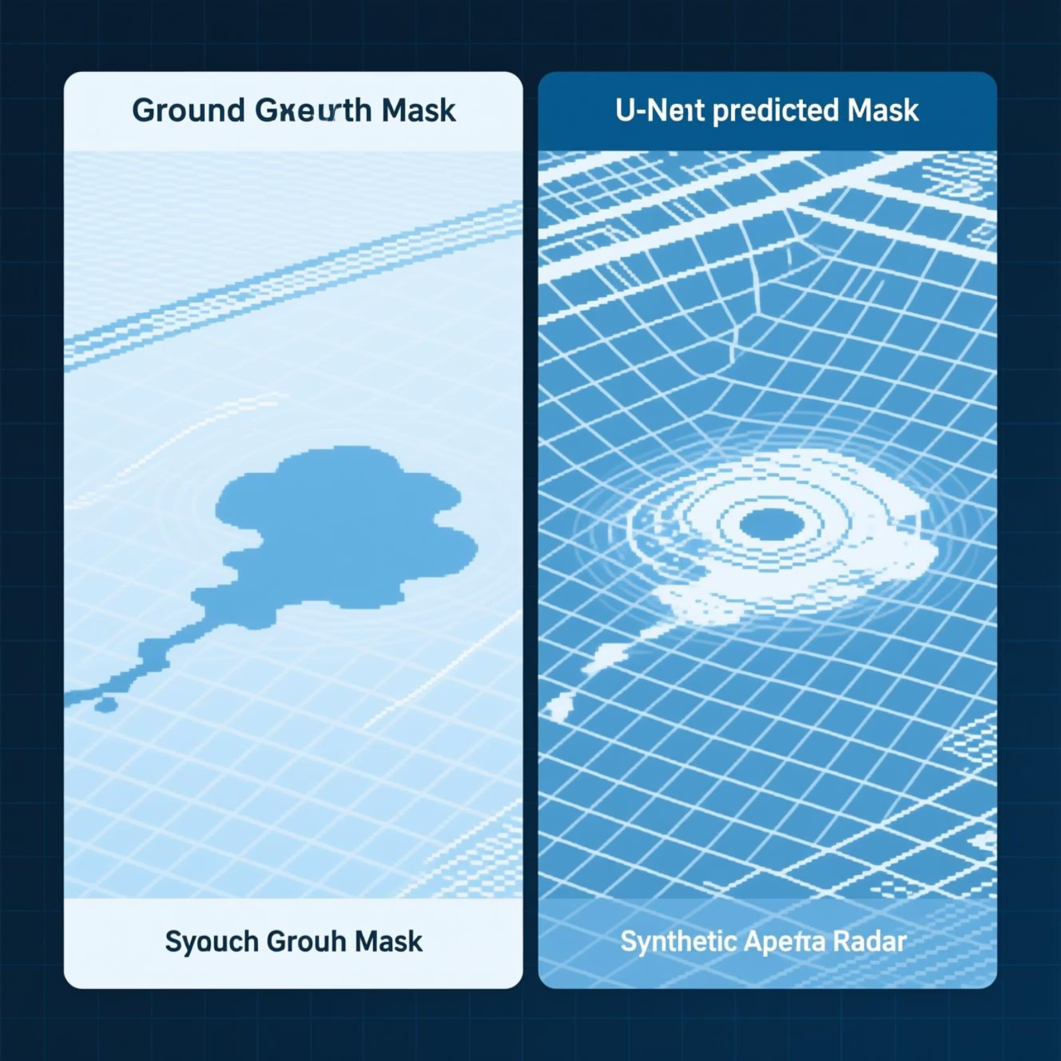
Training and Evaluation Metrics
Key Performance Indicators
Visual Evaluation Example
Trained for 50 epochs on an NVIDIA V100 GPU.
Metric
Value
Dice Loss
0.18 (Optimized)
Pixel Accuracy
94%
Intersection over Union (IoU)
0.79
Dice Loss minimises false negatives (missing a spill), which is critical for environmental safety.
# Simplified Training Loop Codemodel.compile(optimizer='adam', loss=DiceLoss, metrics=['accuracy', IoU])history = model.fit(train_data, epochs=50, validation_data=val_data)

Slide 9


Conclusion and Future Impact
High Accuracy
Achieves reliable segmentation with 92% Precision and 89% Recall on unseen test data.
Rapid Localisation
Enables near real-time spill detection, significantly reducing response time.
Scalable Monitoring
Provides a robust framework for global, continuous environmental surveillance.
References & Acknowledgements
Dataset: Kaggle Marine Oil Spill Detection Project. Runtime: Google Colaboratory. Research: Sentinel-1 SAR Oil Spill Detection Techniques (various sources).

