Slide 1

"Review of Mini Project”
for E-3 2017 Admitted Batch
Submitted as part of Mini Project.
Name of the Student – ID.NO
PAIDI REVATHI – S170286
UPPALA CHAITANYA –S170020
DEVUDALA HEMA KIRAN –S170914
Under the Supervision of:
Mr. Ch. Satish Kumar Sir
Department of Computer Science and Engineering
Rajiv Gandhi University of Knowledge Technologies
Srikakulam – 532402

Slide 2
Tentative Project Title
Bluetooth Attacks A survey on smart watches data leakage through open Bluetooth connection

Slide 3
Abstract
Bluetooth is a short-range wireless communication technology that are widely used in today’s world .It allows devices such as mobiles, computers, and peripherals(IOT devices) to transmit data or voice wirelessly over a short distance. The purpose of Bluetooth is to replace the cables that normally connect devices, while keeping the communications between them secure.
Now a day’s the usage of smart watches is widely spread in every age group because of various inbuilt features such as calling, messaging, health tracking, and GPS tracks etc. Some of these features collect sensitive data and store them for analytics purpose. The security aspects provided by these devices depends on the price range.
Our study is to identify the data leakages through open Bluetooth connections on smart watches. We conducted a survey on it and observed that, there might be a chance to connect to a Bluetooth without any Permission from master device. Our study aim’s at to find flaws regarding open Bluetooth connections and prevent attacks such as data leakage, identifying and protecting from hackers.

Slide 4
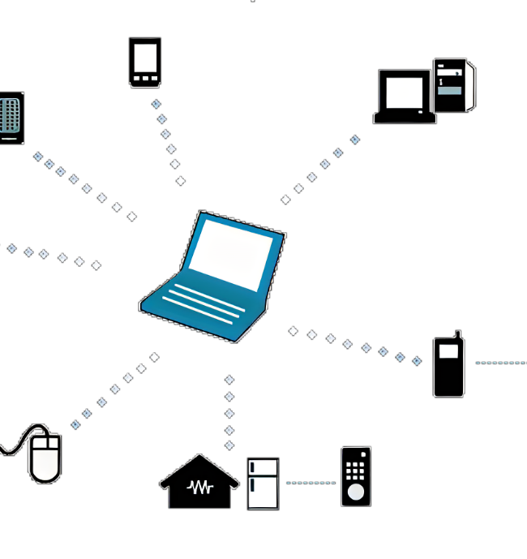
Introduction
Bluetooth devices are connected through Adhoc network system(PAN).
Every device in Bluetooth network plays a role as either master or slave.
Different of Bluetooth enabled devices.
major(classic & secured)
minor(BLE – Bluetooth Low Energy)
Bluetooth was maintained by a special group named as SIG BLUETOOTH
slave
master
slave

Slide 5


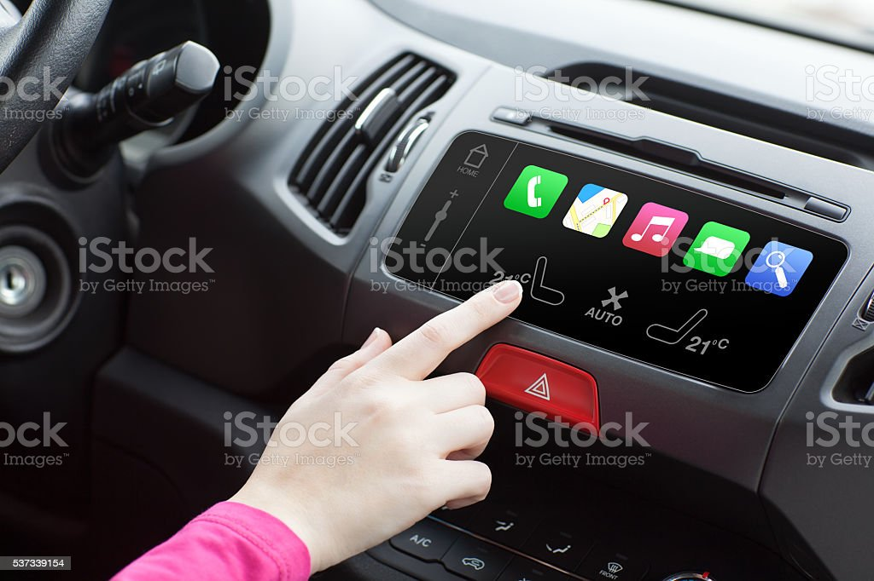


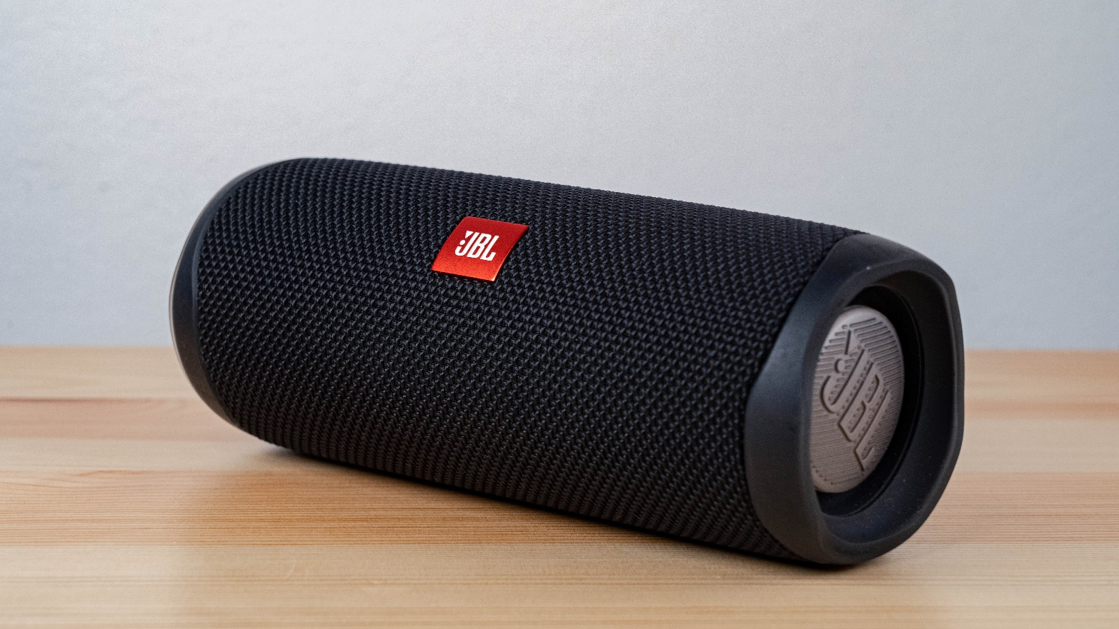
Major :
laptop
mobile
Car audio system
MINOR:
Audio output
Headset
speakers

Slide 6
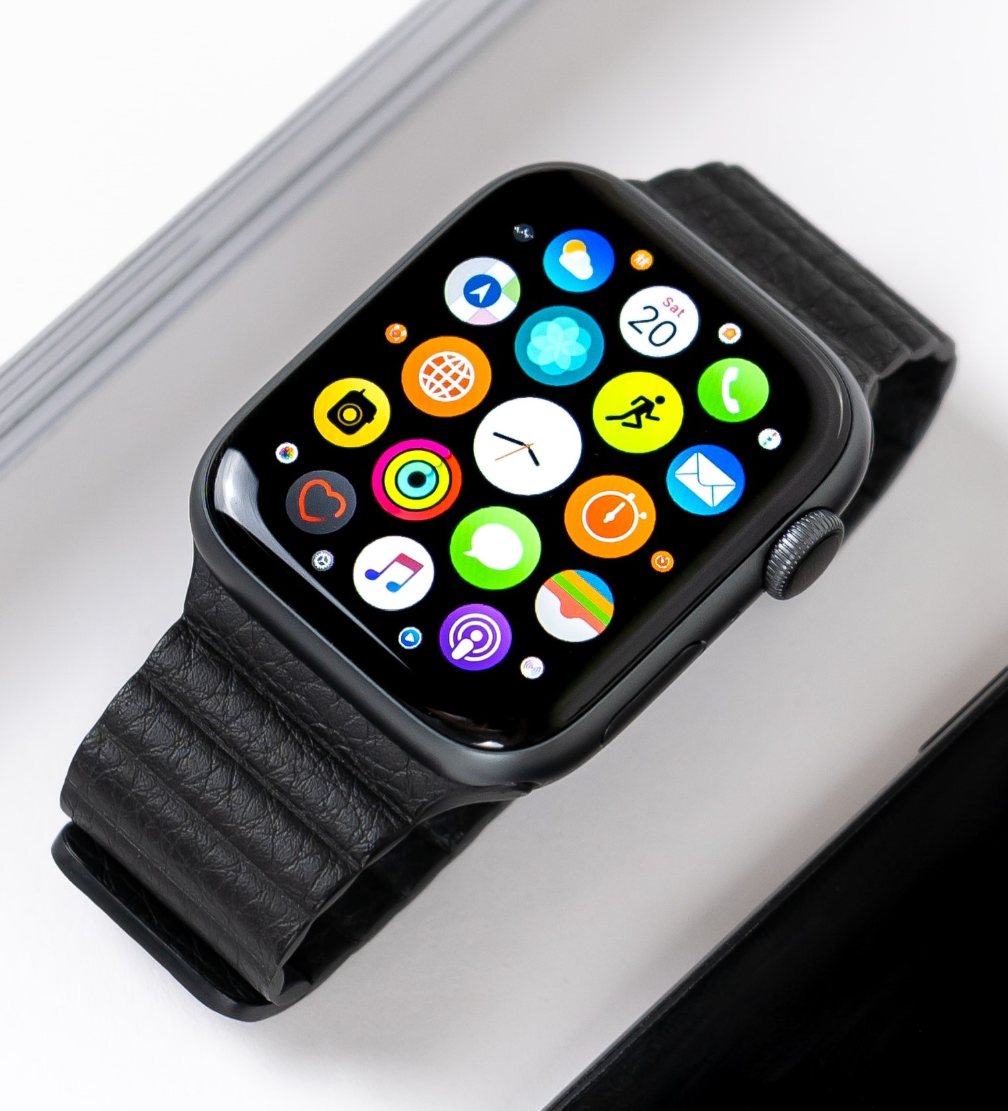
SMART WATCH:
Smart watches are wireless Bluetooth adapter capable of extending the capabilities of the wearer’s smart phone to the watch.
It is a BLE(Bluetooth Low Energy) device.
It stores more sensitive data when compared to all other minor sector Bluetooth devices.
Smart watch was designed in a manner that can be connected to major devices to communicate(like mobile, lappy)
As it stores more data attacks on such device may lead to cyber threats and data leakage.
So, we choose to do a special case study on smart watches.

Slide 7
Motivation of Project Work
Smartwatches provides various features of smartphone can utilize in easy way without using smartphone every time.
These features can be utilized when smartwatches are connected to mobile via Bluetooth.
Smartwatch gives features like calls ,messages ,health related sensors, GPS trackers.
This data is stored for further analysis.
SIG BLUETOOTH teams says eavesdropping can be possible if connection was established.
This may cause data leakage from smartwatch.

Slide 8
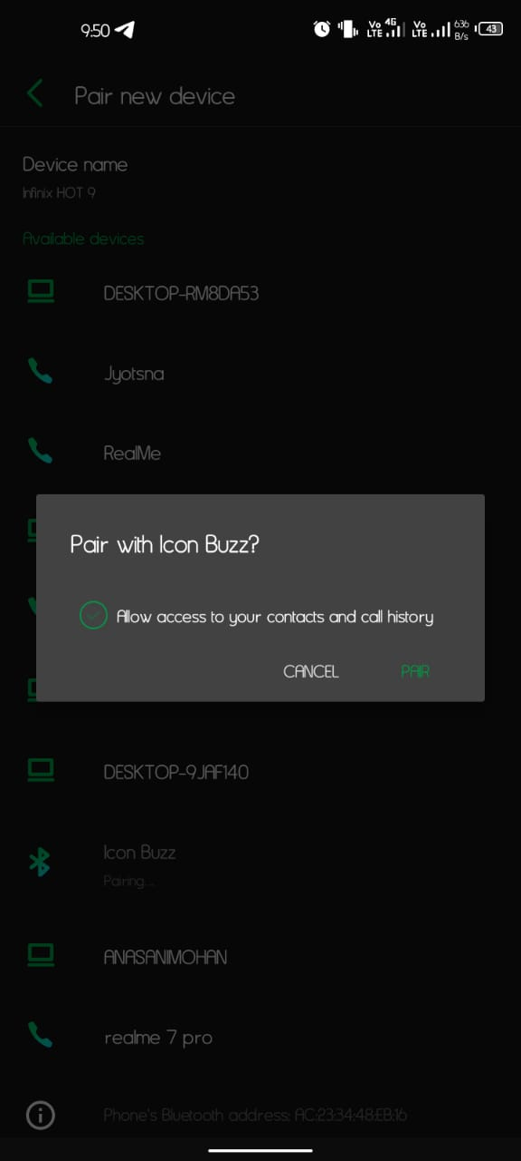
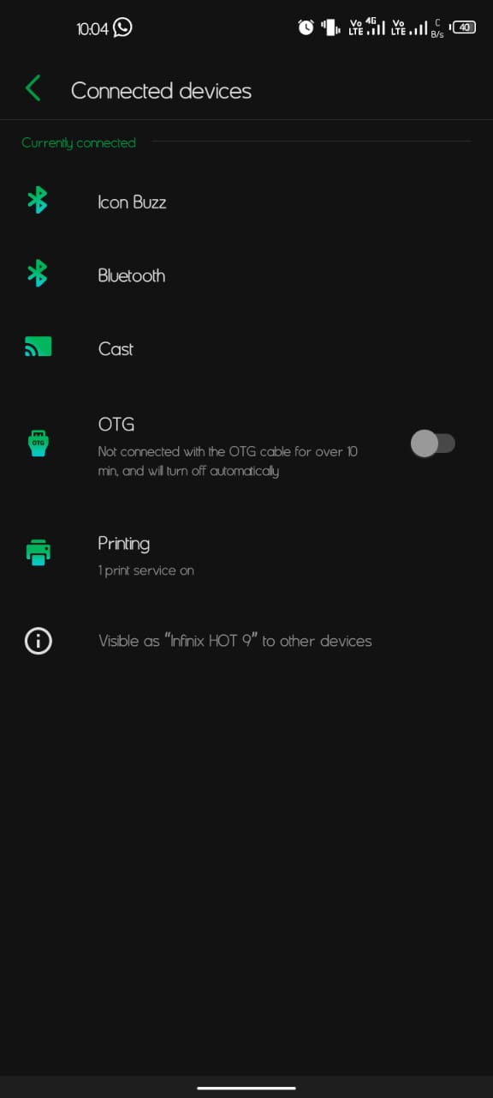
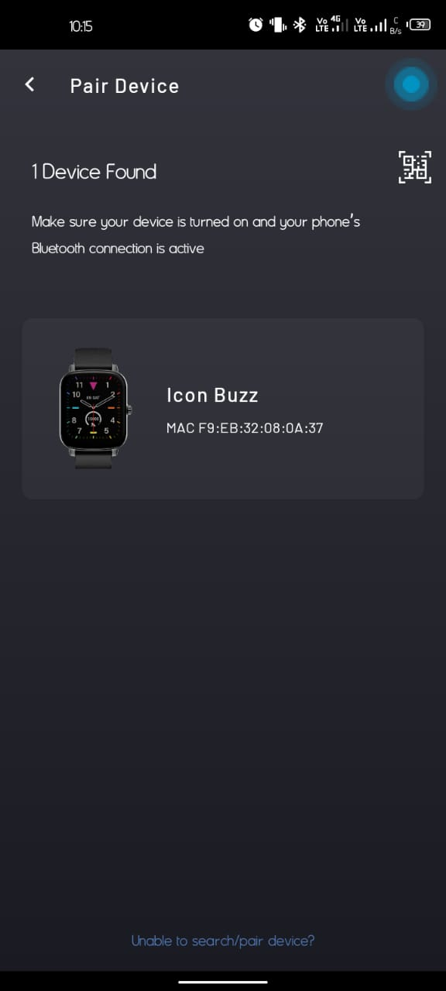
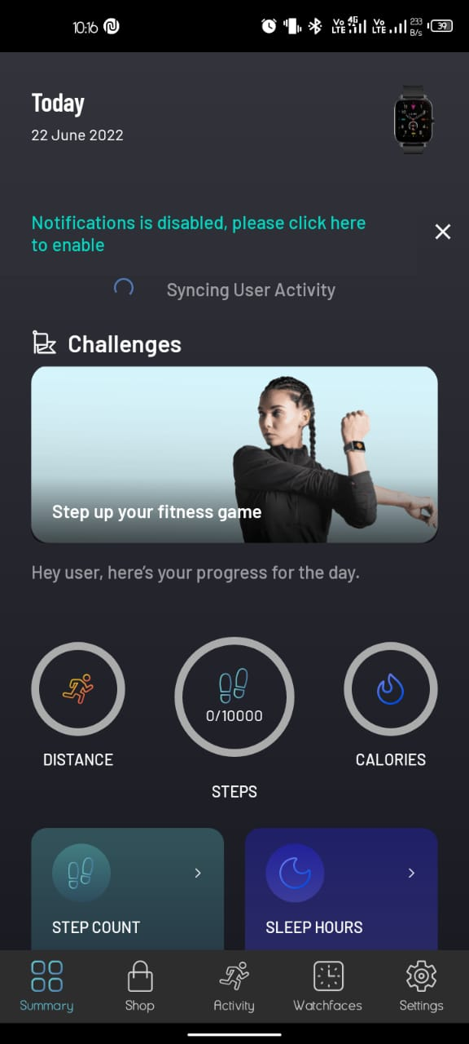
Our observation through open Bluetooth connection
Popup message
While connecting
Bluetooth connection
established
Binding with
smartwatch application
Data stored in app
for further analysis
we can observe that these screen shorts shows popup message in mobile while establishing a connection between mobile and smart watch, but no such popup message or alert is shown in smartwatch and connection is established without user’s knowledge.
NOTE:-open connection is established without owner’s acknowledgement.

Slide 9
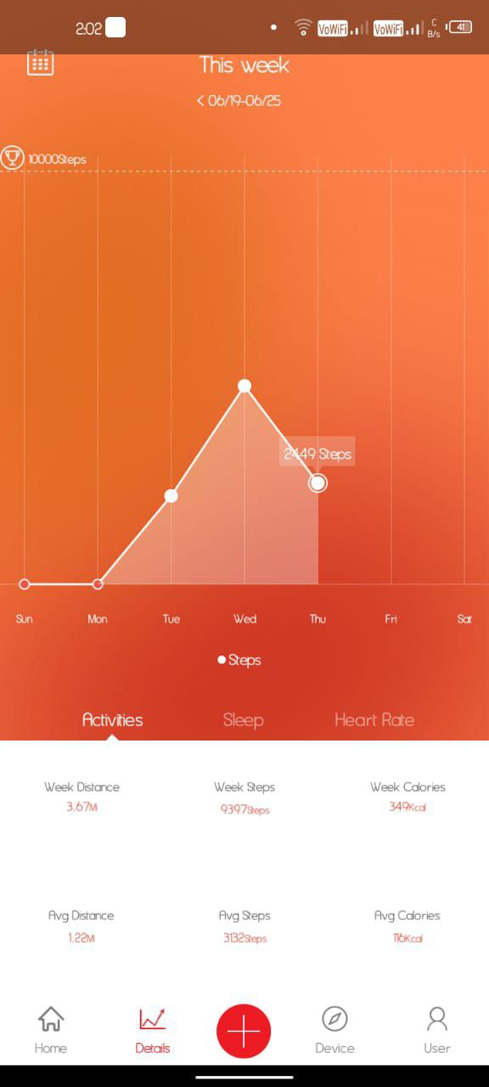
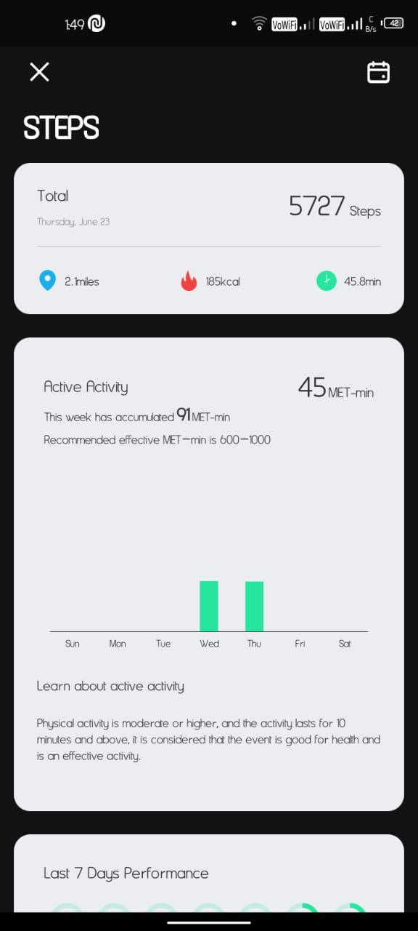
Result of our experiment
We can see that the data of the owner is been shown in our device via communication application.

Slide 10
Scope of Project
Now a days digital world is widely Spreading.
smart watches also uses Digital Technology. It uses Bluetooth technology to provides most of its features.
In digital world, data plays a major role which may lead to cyber attacks.
This project scope remains until smartwatch uses in this digital world.

Slide 11
Analysis of Existing Methods/Models/Algorithms
MAC Spoofing: It is a method of attack which is done at a time of pairing and connects to Bluetooth device using the trusted devices mac address to gain access to the device.
MITM Attack: The attacker intercepts a packet sent by one of the devices, modifies it and then send it to the other devices

Slide 12
Result and Analysis:
In our project we tried to provide security to BLE devices. we done some implementation
on it . Due to lack of proper resources to work on implantation we provide precaution measures which should be followed by users until proper security is provided to prevent data leakage through open Bluetooth connection.
Make connection in a private place when connecting to BLE devices.
When connection was established in private place there is no scope of establishing new connection to our smart watch.
Enable Bluetooth only when you need it.
Turning off Bluetooth when not required will avoid unnecessary troubles of losing sensitive data.
(can not be done in all BLE devices, but if some devices have this feature)

Slide 13
Make every connection slot occupied to our BLE devices.
Every BLE smart watch device have multiple connections to pair with different devices simultaneously, make all connections occupied to BLE devices to avoid open connections issues and establish unauthorized accesses
Synchronise the smart watch application with mail to store the sensitive data.
When we synchronise the smart watch application in mobile with mail id’s then when other unknown device or even a trusted second device connected to smart watch cannot access sensitive data until the mail was synchronised.
Extra tips for all other Bluetooth enabled devices
Reject all unexpected pairing requests
Update your mobile phone firmware to a latest version.
Keep the device in non-discoverable (hidden) mode

Slide 14
Screenshots of our project:

Slide 15
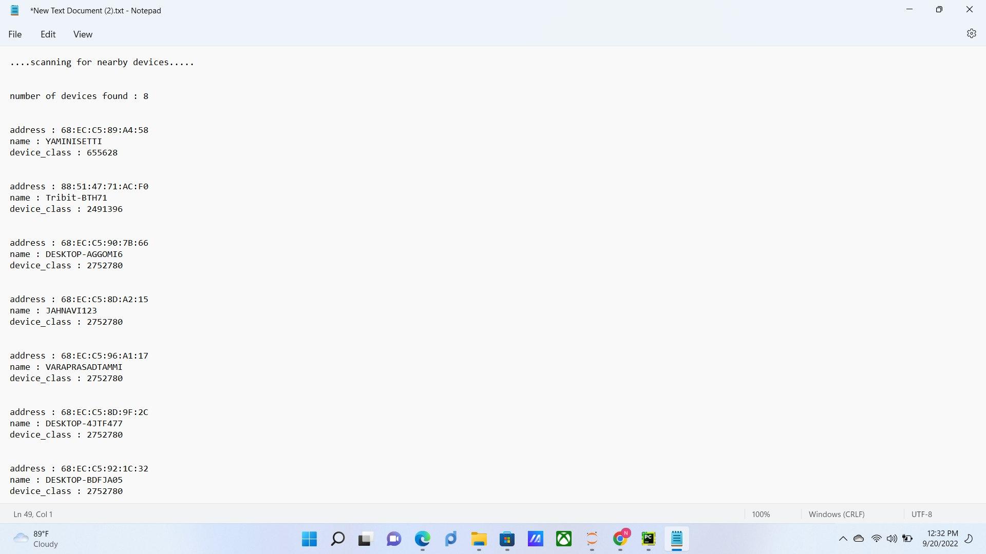
output1:
In this process of getting result we scanned every device around within range but unable to scan the smart watches
This was occurred due to the no proper module maintenance which supports Bluetooth functions.

Slide 16
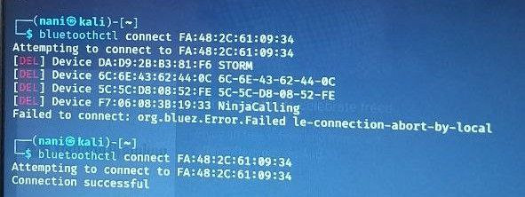
output2:
Connection establishment With “Qube 02” smartwatch
We have succeeded to connect to the target device once but afterwards we can not able to connect again.

Slide 17
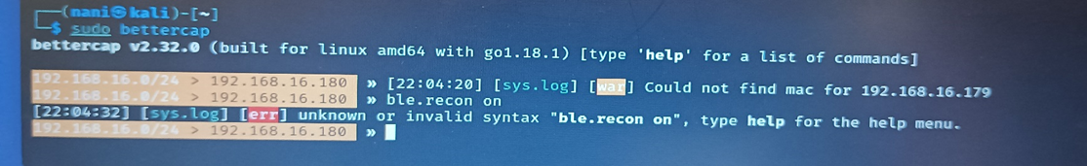
output3:
Using bettercap tool:
In this module their should be a BLE function to support Bluetooth function ,but no more available to do work on it.

Slide 18
Conclusion
According to our observation we can say that open connection is establishing in BLE devices.
this connection may cause data leakage.
there is no such knowledge in every user that data leakage is taking place through smartwatch which causes cyber threats.
this may lead to misusage afterwards.
our motive to identify the data leakage while open connection was established.
connect user’s and their BLE devices securely to utilizes provided features without any insecurity.

Slide 19
References (if any)
A survey on security threats and vulnerability attacks on bluetooth communication” Trishna Panse, Prashant Panse International Journal of Computer Science and Information Technologies 4 (5), 741-746, 2013
“A study on vulnerabilities and threats to wearable devices” Felton Blow, Yen-Hung Hu, Mary Hoppa Journal of The Colloquium for Information Systems Security Education 7 (1), 7-7, 2020
“Bluetooth security” Juha T Vainio Proceedings of Helsinki University of Technology, Telecommunications Software and Multimedia Laboratory, Seminar on Internetworking: Ad Hoc Networking, Spring 5, 2000
A. Barua, M. A. Al Alamin, M. S. Hossain and E. Hossain, "Security and Privacy Threats for Bluetooth Low Energy in IoT and Wearable Devices: A Comprehensive Survey," in IEEE Open Journal of the Communications Society, vol. 3, pp. 251-281, 2022, doi: 10.1109/OJCOMS.2022.3149732.

Slide 20

Thank You

