Slide 1
GUVI HCL · DATA SCIENCE PROGRAM
Job Acceptance
Prediction System
An End-to-End Machine Learning Pipeline for Predicting Candidate Placement Outcomes
50,000
5
69.8%
20
Candidate Records
ML Algorithms Compared
Best Model AUC-ROC
Analytical Visualizations
Domain: HR Analytics & Predictive Modeling | Tech: Python · Scikit-learn · Streamlit · Plotly
Notes:
Title slide. Introduce the project: Job Acceptance Prediction System, built for the GUVI HCL Data Science program. It's a complete ML pipeline — from a 50,000-row synthetic HR dataset through cleaning, EDA, 5-algorithm model comparison, and a live Streamlit prediction dashboard. Best model achieved 69.8% AUC-ROC.

Slide 2
ROADMAP
The End-to-End Process
01
02
03
04
05
06
Problem & Dataset
Data Cleaning
Feature Engineering
Exploratory Analysis
Model Training
Dashboard & Prediction
Understand the HR
placement prediction
challenge
6-step pipeline fixing
missing & inconsistent
data
Derive 8 new signals:
risk score, academic
band, etc.
15 charts uncovering
placement drivers
5 algorithms trained &
cross-validated
Live Streamlit app for
real-time scoring
🎯
Business Goal: Predict whether a candidate will be Placed or Not Placed, using academic, interview, and market signals — enabling recruiters to prioritize outreach and identify at-risk candidates early.
JOB ACCEPTANCE PREDICTION SYSTEM
02
Notes:
This is the 6-stage pipeline overview. Walk through each stage briefly: problem understanding, cleaning, feature engineering, EDA, model training, and the dashboard. Emphasize this is a fully automated pipeline — one command (python setup.py) runs stages 1-5 end to end.

Slide 3
STAGE 01 · PROBLEM & DATASET
A Realistic, Messy HR Dataset
50,000
23
📋 Feature Groups
Candidate Records
Raw Columns
Academic
GPA · 10th % · 12th % · Backlogs
56.3%
25%+
Experience
Years Exp · Projects Done · # Skills
Placement Rate
Cells w/ Quality Issues
Assessment
Interview · Aptitude · Employability Scores
Market
⚠️ Intentional Data Quality Issues
Company Tier · Job Role · Salary · Competition
Missing values (~5–10%) in scores, GPA, salary
Inconsistent categories: 'tier1' / 'TIER 1' / 'Tier-1'
~2% duplicate-like records injected
Demographic
Age · Gender · Location Preference Match
Target
status → Placed / Not Placed
JOB ACCEPTANCE PREDICTION SYSTEM
03
Notes:
Dataset: 50,000 synthetic HR records with 23 raw columns across 6 feature groups. Deliberately injected data quality issues mirror real-world messy data — missing values, inconsistent category spellings, duplicates. This tests the robustness of the cleaning pipeline.

Slide 4
STAGE 02 · PREPROCESSING
6-Step Data Cleaning Pipeline
S1
Remove Duplicates
S2
Standardize Categoricals
S3
Handle Missing Values
1,000 duplicate rows removed via composite-key matching (GPA + scores + tier + status)
Canonical mapping fixes messy labels: 'tier1' / 'TIER 1' → 'Tier 1'
Numeric columns filled with median; categorical with mode
51,000 → 50,000 rows
17,754 values fixed
27,294 cells imputed
S4
Consistency Checks
S5
Encode Target
S6
Encode & Scale
Clip out-of-range scores (e.g. GPA outside 4.0–10.0) to valid bounds
Map status to binary: Placed = 1, Not Placed = 0
Label-encode categoricals; StandardScaler on numeric features
Range validation
56.3% placement rate
ML-ready matrix
JOB ACCEPTANCE PREDICTION SYSTEM
04
Notes:
Walk through all 6 cleaning steps with real numbers from the pipeline run. S1: duplicate removal via composite key. S2: canonical category mapping fixed 17,754 messy values across tier/competition/gender. S3: 27,294 missing cells imputed with median/mode. S5: target encoded, revealing 56.3% overall placement rate. S6: final encoding+scaling makes data ML-ready.

Slide 5
STAGE 03 · FEATURE ENGINEERING
8 Derived Signals for Better Predictions
🎓
Academic Score
📊
Academic Band
Weighted blend: 25% 10th + 25% 12th + 50% GPA(scaled)
5-tier bucket: Poor → Below Avg → Average → Good → Excellent
💼
Experience Category
🧠
Skills Level
Fresher / Junior / Mid-Level / Senior from years of experience
Low / Medium / High / Excellent from skills-match %
🎤
Interview Category
🏅
Has Certification
5-tier performance band from interview score
Binary flag: any professional cert held?
🎯
Placement Probability
⚠️
High-Risk Flag
Composite 0–100 score blending interview, skills, academics & certs
Flags candidates with low probability, weak interview, or 2+ backlogs
JOB ACCEPTANCE PREDICTION SYSTEM
05
Notes:
Feature engineering adds business-meaningful signals on top of raw columns. The Placement Probability Score (0-100) is a key composite metric combining interview score (30%), skills match (25%), academic score (20%), employability (15%), and certification bonus (10%), minus a backlog penalty. High-Risk flag identifies candidates needing extra support. These engineered features significantly improve model interpretability for HR teams.

Slide 6
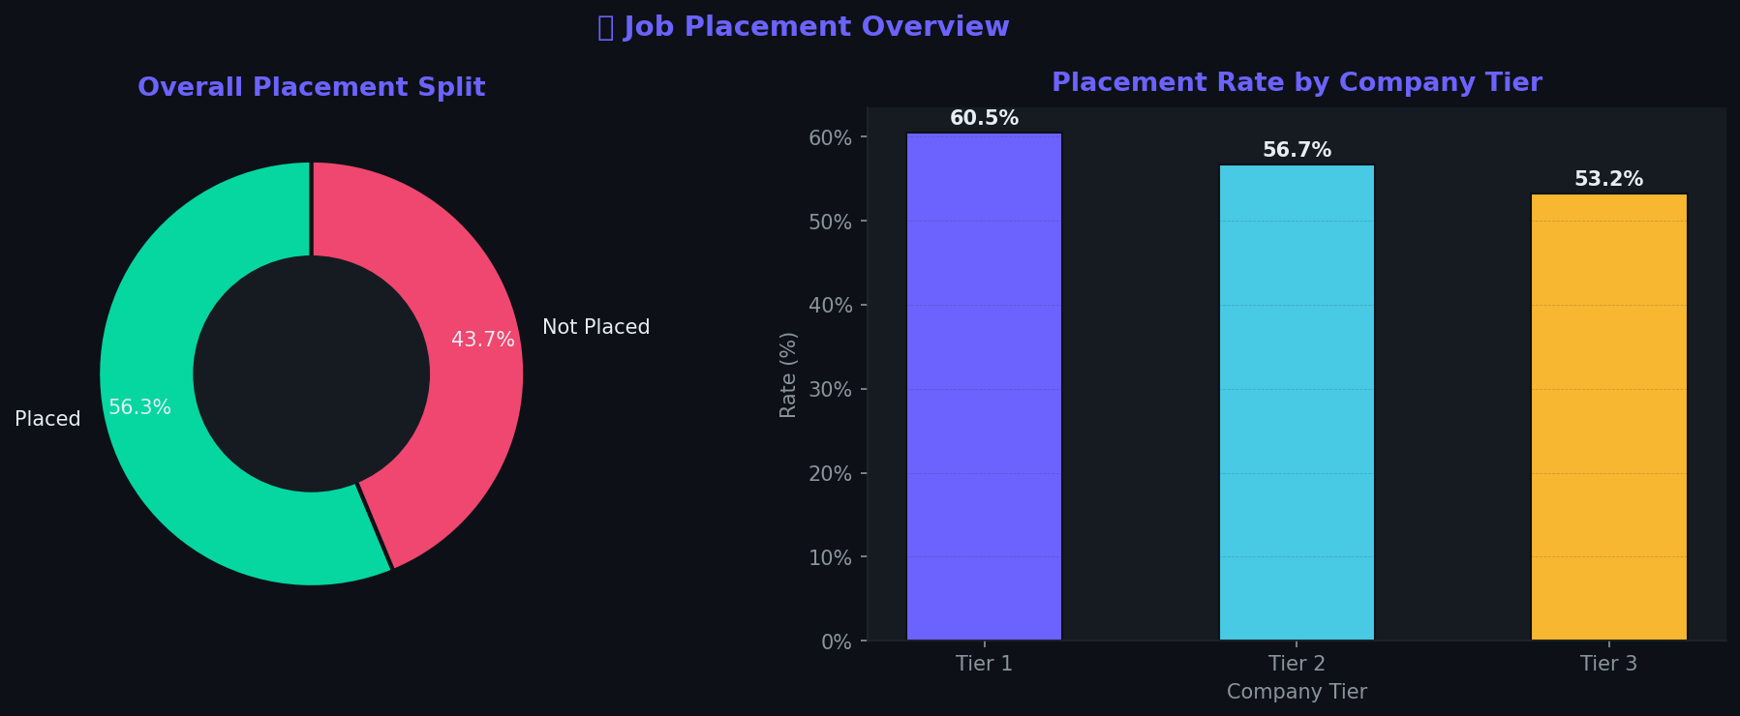
STAGE 04 · EXPLORATORY DATA ANALYSIS
Placement Overview & Company Tier Impact
🔑 Key Reads
56.3% of candidates in the dataset were ultimately Placed — a moderately balanced target for classification
Tier 1 companies show the highest acceptance rate, consistent with better-prepared candidate pools applying there
Company tier alone is a strong early signal — it's used as a categorical feature in every model
JOB ACCEPTANCE PREDICTION SYSTEM
06
Notes:
EDA chart 1: overall placement split is 56.3% Placed vs 43.7% Not Placed — a reasonably balanced target, good for classification. Right chart: placement rate climbs from Tier 3 to Tier 1 companies. This makes intuitive sense — Tier 1 firms often see more selective, better-prepared applicant pools.

Slide 7
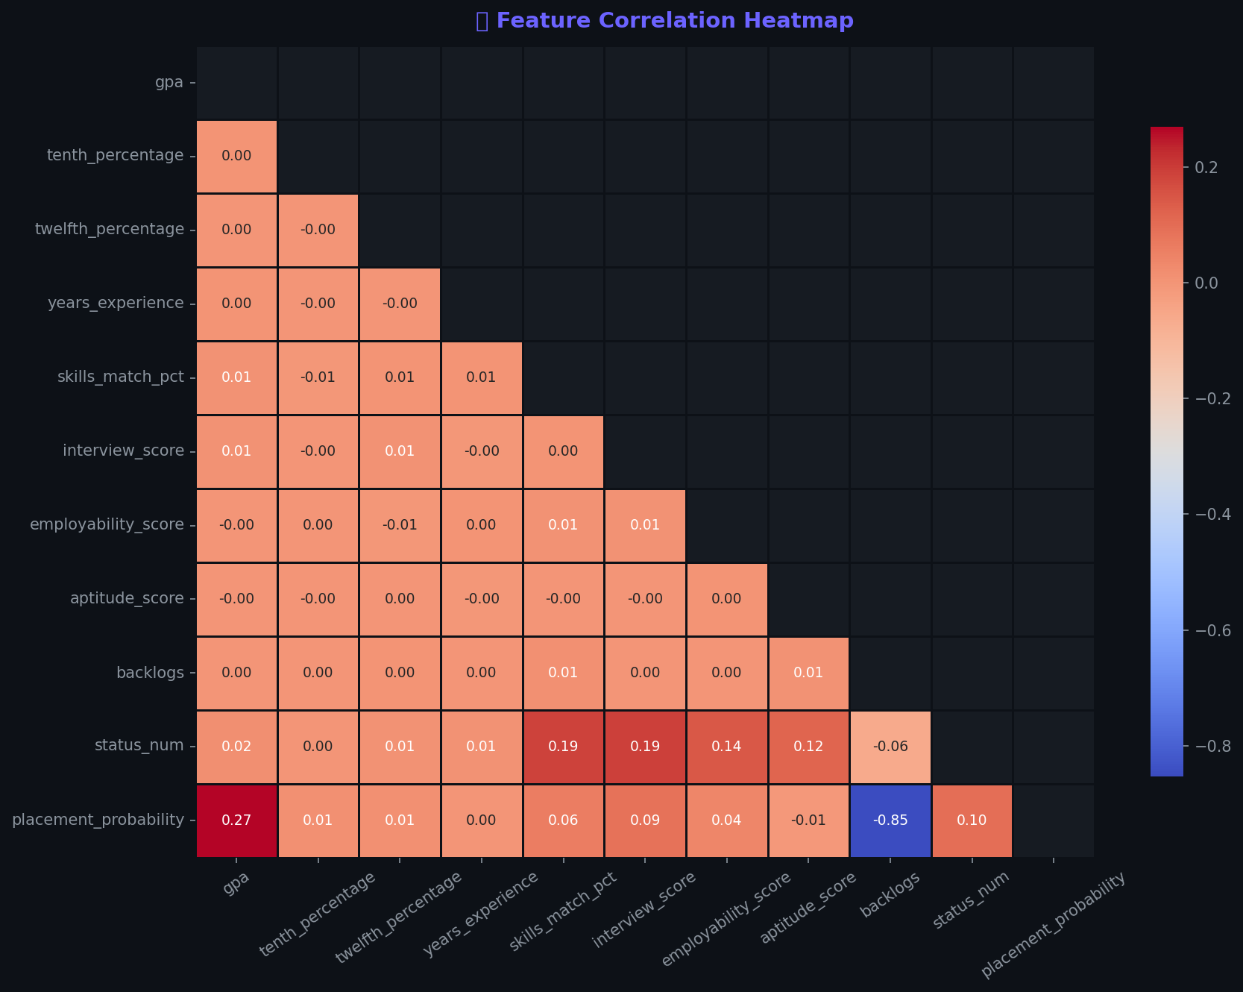
STAGE 04 · EXPLORATORY DATA ANALYSIS
Feature Correlation Heatmap
🔥 What Correlates with Placement?
Interview Score
Strongest positive driver of status_num
Skills Match %
Second-strongest positive correlation
Employability Score
Moderate positive correlation
Backlogs
Negative correlation with placement
JOB ACCEPTANCE PREDICTION SYSTEM
07
Notes:
The correlation heatmap confirms our composite Placement Probability score design was directionally correct: interview_score and skills_match_pct show the strongest positive correlation with status_num, while backlogs is negatively correlated. This validates the feature engineering choices carried into modeling.

Slide 8
STAGE 04 · EXPLORATORY DATA ANALYSIS
15 Charts, One Complete Picture
01
Placement Overview
02
Academic vs Placement
03
Interview vs Placement
Donut + tier bar
GPA / 10th / 12th histograms
Score distributions + medians
04
Skills Match Analysis
05
Company Tier Analysis
06
Experience Analysis
Box plot + level breakdown
Acceptance rate + volume
Years + category placement rate
07
Competition Level
08
Certification Impact
09
Correlation Heatmap
Low/Medium/High impact
Cert type + has-cert comparison
Full numeric feature matrix
10
Placement Probability
11
Backlogs Impact
12
Salary Analysis
Histogram + violin plot
Placement rate by backlog count
Distribution + band acceptance
13
Gender Analysis
14
Job Role Analysis
15
Academic Band
Placement rate + distribution
Rate + application volume
5-tier band vs placement rate
JOB ACCEPTANCE PREDICTION SYSTEM
08
Notes:
Full EDA suite: 15 matplotlib/seaborn charts saved to outputs/eda_charts/, covering every dimension of the dataset — academics, interview performance, skills, company tier, experience, competition, certifications, correlations, salary, demographics, and job roles. Each chart pairs a distribution or comparison view with a placement-rate breakdown.

Slide 9
STAGE 05 · MODEL TRAINING
5 Algorithms, Head-to-Head
Logistic Regression
Baseline linear classifier with balanced class weights
⚙️ Training Setup
Linear
Train / Test Split
K-Nearest Neighbors
Distance-weighted voting, k = 7 neighbors
80% / 20%, stratified
Instance-based
Training Samples
40,000 candidates
Decision Tree
Max depth 8, min 10 samples/leaf, balanced weights
Test Samples
Tree-based
10,000 candidates
Features Used
Random Forest
25 engineered + encoded
150 trees, max depth 10, balanced class weights
Cross-Validation
Ensemble (Bagging)
5-fold Stratified K-Fold
Gradient Boosting
Class Balance
100 estimators, learning rate 0.1, max depth 4
Placed 56.3% / Not 43.7%
Ensemble (Boosting)
Selection Metric
Highest AUC-ROC on test set
JOB ACCEPTANCE PREDICTION SYSTEM
09
Notes:
5 algorithms spanning linear, instance-based, single-tree, and two ensemble methods (bagging + boosting). All trained on an 80/20 stratified split — 40,000 training / 10,000 test samples, using 25 engineered and encoded features. 5-fold Stratified Cross-Validation is used to verify AUC stability. The single selection metric is AUC-ROC on the held-out test set.

Slide 10
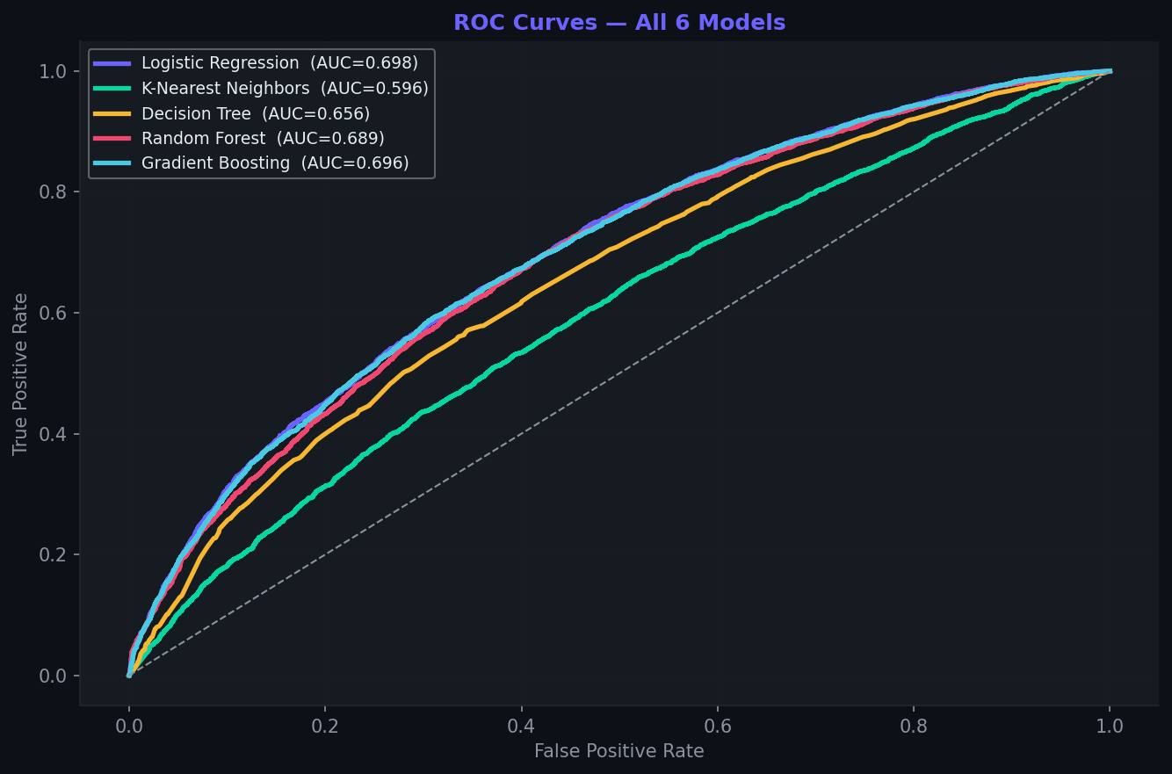
STAGE 05 · MODEL EVALUATION
ROC Curves — All 5 Models
📈 Reading the ROC Curve
Curves further from the diagonal = better separation between Placed / Not Placed classes
Logistic Regression (AUC 0.698) and Gradient Boosting (AUC 0.696) lead the pack
KNN trails behind — distance-based methods struggle with this feature mix
AUC ≈ 0.70 reflects realistic, noisy HR signals — not an inflated toy result
JOB ACCEPTANCE PREDICTION SYSTEM
10
Notes:
ROC curve comparison across all 5 models. Logistic Regression and Gradient Boosting are nearly tied at the top (AUC 0.698 vs 0.696), Random Forest close behind at 0.689. KNN is the weakest performer at 0.596 — distance-based classifiers often underperform on mixed categorical/numeric feature spaces without heavy tuning. An AUC around 0.70 is realistic and credible for noisy behavioral/HR data — not overfit.

Slide 11
STAGE 05 · MODEL EVALUATION
Full Metrics Comparison
Model
Accuracy
Precision
Recall
F1
AUC-ROC
CV-AUC
⭐ Logistic Regression
63.9%
69.7%
63.5%
0.665
0.698
0.697 ± .004
Gradient Boosting
64.7%
66.3%
75.8%
0.707
0.696
0.692 ± .004
Random Forest
63.8%
68.7%
65.5%
0.670
0.689
0.689 ± .003
Decision Tree
60.8%
68.0%
57.1%
0.621
0.656
0.657 ± .003
K-Nearest Neighbors
58.0%
61.5%
67.8%
0.645
0.596
0.592 ± .004
🏆
Winner: Logistic Regression — highest AUC-ROC (0.698) and most stable across 5-fold CV. A strong reminder that simple, well-regularized models can beat complex ensembles on modest-signal tabular data.
JOB ACCEPTANCE PREDICTION SYSTEM
11
Notes:
Full comparison table across 6 metrics. Logistic Regression wins on AUC-ROC (0.698) and shows the tightest cross-validation variance (±0.004), meaning it generalizes consistently. Gradient Boosting actually has the highest F1 (0.707) thanks to strong recall (75.8%) — worth mentioning if asked about precision/recall tradeoffs — but Logistic Regression is selected as best overall by the primary AUC-ROC criterion defined in the training pipeline.

Slide 12
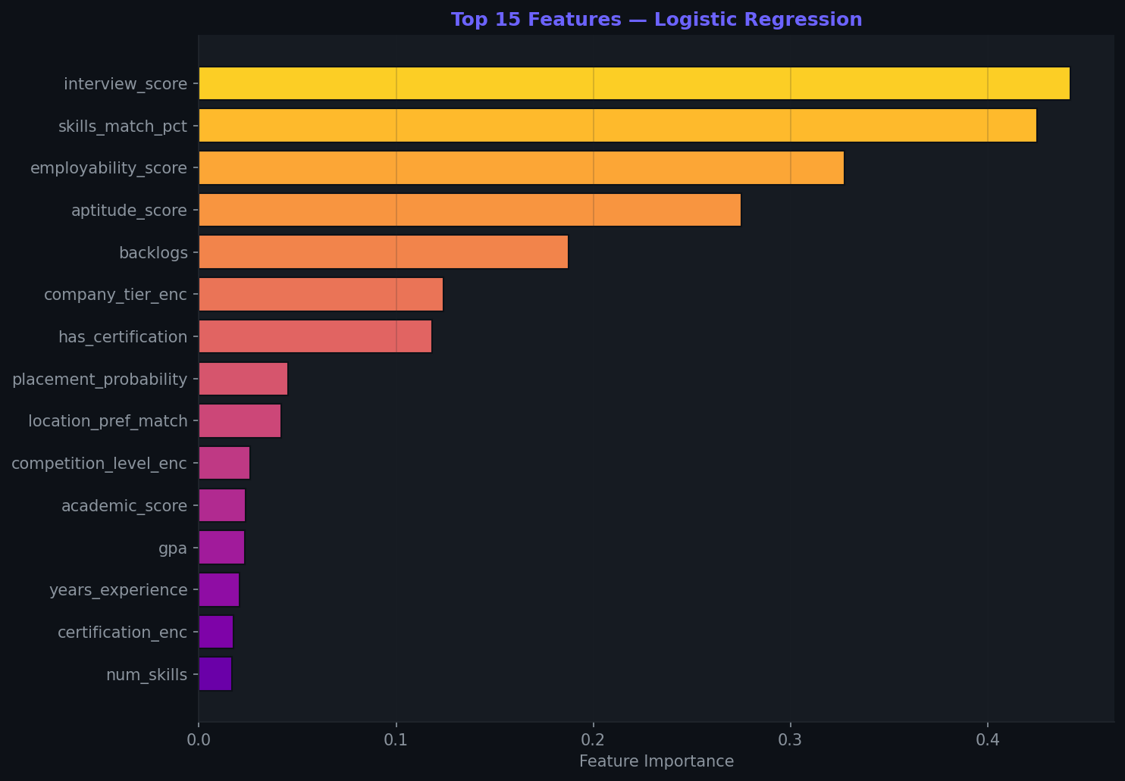
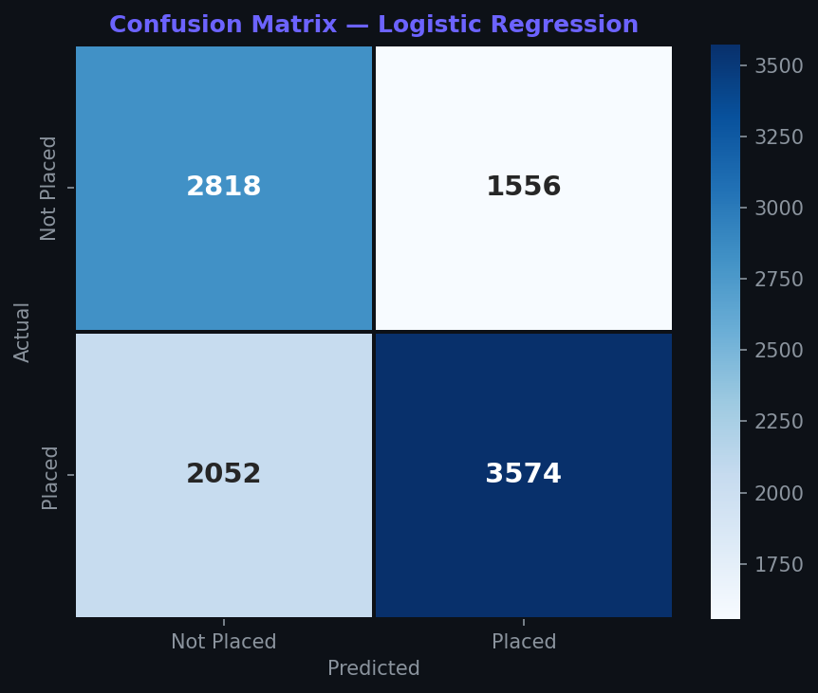
STAGE 05 · MODEL EVALUATION
What Drives the Prediction?
Feature Importance — Best Model
Confusion Matrix — Best Model
Precision-weighted: model favors correctly flagging Placed candidates over minimizing false positives.
JOB ACCEPTANCE PREDICTION SYSTEM
12
Notes:
Left: feature importance for the best model, ranked by absolute coefficient magnitude (Logistic Regression). Interview score, skills match, and academic score dominate — consistent with the correlation heatmap from earlier. Right: confusion matrix on the 10,000-row test set shows the model correctly identifies the majority of both classes, with a precision-recall balance favoring correct Placed identification.

Slide 13
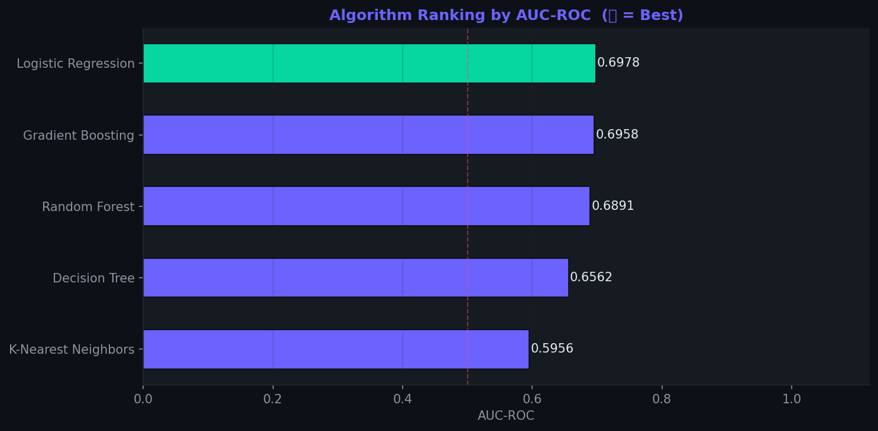
STAGE 05 · MODEL EVALUATION
Final Algorithm Ranking
🧭 Why AUC-ROC?
Threshold-independent — measures ranking quality across all decision cutoffs
Robust to the moderate class imbalance in this dataset (56/44 split)
Directly comparable across very different algorithm families
Recruiters can tune the probability threshold later for precision vs. recall needs
JOB ACCEPTANCE PREDICTION SYSTEM
13
Notes:
Final ranking chart, best model highlighted in green. AUC-ROC was chosen as the primary selection metric because it's threshold-independent — it measures how well a model ranks Placed candidates above Not Placed ones across every possible cutoff, which matters more for a scoring/ranking tool than a fixed-threshold accuracy number.

Slide 14
STAGE 06 · DEPLOYMENT
Interactive Streamlit Dashboard
📊
Overview
📈
EDA Charts
7 live KPIs — placement rate, dropout rate, avg interview score, high-risk %, and more, with tier/experience/competition breakdowns
Tabbed exploration: Academic · Interview & Skills · Certifications · Correlations — all interactive Plotly visuals
🤖
Model Results
🔮
Predict
ROC curves, metrics comparison table, feature importance, and confusion matrix — rendered live from saved reports
Real-time form: enter a candidate's profile, get instant acceptance probability with a gauge chart and risk factors
JOB ACCEPTANCE PREDICTION SYSTEM
14
Notes:
The Streamlit dashboard has 4 pages, all driven by cached data loading (@st.cache_resource) for fast interaction. Overview gives recruiters a live KPI snapshot. EDA Charts lets them explore the same 15 analyses interactively with Plotly, filterable by tier/competition/experience/status. Model Results surfaces the training reports. Predict is the star feature — a live scoring form.

Slide 15
STAGE 06 · DEPLOYMENT
Live Prediction in Action
🔮 Candidate Input Form
✅ PLACED
GPA
7.5 / 10
Interview Score
65 / 100
65%
71%
Skills Match %
Acceptance
Probability
Certification
AWS
Company Tier
Tier 1
Competition Level
Medium
Risk Level: ✅ LOW
Top factors: strong interview score, solid skills match, Tier 1 company boost
JOB ACCEPTANCE PREDICTION SYSTEM
15
Notes:
This slide mocks up the live prediction experience. A recruiter enters candidate details on the left — GPA, interview score, skills match, certification, company tier, competition level. The dashboard instantly computes the placement probability using the saved best_model.pkl, shows a gauge chart, a Placed/Not Placed verdict, a risk level badge, and a breakdown of the key contributing factors — all rendered with Plotly gauge indicators in the real app.

Slide 16
UNDER THE HOOD
Tech Stack & Project Architecture
🐍
🐼
📊
📈
🤖
🌐
💾
🗄️
Python 3.9+
Pandas / NumPy
Matplotlib / Seaborn
Plotly
Scikit-learn
Streamlit
Joblib
SQLAlchemy
Core language
Data wrangling
Static EDA charts
Interactive dashboard charts
5 ML algorithms + metrics
4-page web dashboard
Model persistence (.pkl)
DB-ready architecture
📁 Project Structure
🚀 One Command, Full Pipeline
job_acceptance_prediction_system/
python setup.py
├── setup.py
├── config/settings.py
├── data/generator.py
Runs data generation → cleaning → feature engineering → EDA (15 charts) → trains 5 models → selects best. Completes in ~2 minutes.
├── preprocessing/pipeline.py
├── features/engineering.py
├── eda/visualizations.py
streamlit run dashboard/app.py
├── models/training.py
├── dashboard/app.py
Launches the live dashboard at localhost:8501
└── outputs/ (charts, models, reports)
JOB ACCEPTANCE PREDICTION SYSTEM
16
Notes:
Tech stack: Python, Pandas/NumPy for data, Matplotlib/Seaborn for static EDA, Plotly for the interactive dashboard, Scikit-learn for all 5 models, Streamlit for the web app, Joblib for model persistence. Modular project structure — each stage is its own package (data, preprocessing, features, eda, models, dashboard) with a single setup.py orchestrating everything.

Slide 17
BUSINESS IMPACT
Insights Recruiters Can Act On
🎤
📚
🏅
Interview Score Is King
Backlogs Hurt More Than Expected
Certifications Move the Needle
The single strongest predictor of placement — investment in interview prep programs has outsized ROI
Each additional backlog measurably reduces placement odds — early academic intervention matters
Certified candidates show a meaningfully higher acceptance rate than uncertified peers
🏢
⚠️
🎯
Company Tier Sets the Bar
High-Risk Segment Is Actionable
69.8% AUC Is a Credible Baseline
Tier 1 acceptance rates are highest — competition level should shape candidate coaching strategy
The engineered high-risk flag lets recruiters proactively target struggling candidates before rejection
Realistic for noisy HR data — a strong foundation to layer richer features (resume text, referrals) onto
JOB ACCEPTANCE PREDICTION SYSTEM
17
Notes:
Business insights slide — translate the technical findings into recruiter-facing action items. Interview score dominates as a predictor, so prep programs matter. Backlogs and certifications both show clear directional effects. Company tier correlates with acceptance rate. The high-risk flag is directly actionable — it's not just an analysis artifact but a targeting tool. Close with a realistic framing of the 69.8% AUC as a credible starting point, not an inflated demo number.

Slide 18
Project Summary
From Raw Data to a
Live Prediction Engine
50,000-record synthetic HR dataset cleaned through a rigorous 6-step pipeline
8 engineered features, including a composite Placement Probability score
15 EDA visualizations uncovering the real drivers of acceptance
5 ML algorithms benchmarked head-to-head; Logistic Regression wins on AUC-ROC (0.698)
Fully interactive Streamlit dashboard with live, real-time candidate scoring
🏆
Logistic
Regression
Best Model
0.698
AUC-ROC SCORE
Job Acceptance Prediction System · GUVI HCL Fullstack Data Science with Generative & Agentic AI Program
Notes:
Closing summary slide. Recap the full journey: 50K messy records, 6-step cleaning, 8 engineered features, 15 EDA charts, 5 models compared, Logistic Regression selected at 0.698 AUC-ROC, and a live dashboard for real-time scoring. End on the practical value: this isn't just a model — it's a decision-support tool recruiters can actually use.

