Slide 1
Covid_19_in_India_dashboard
File created on: 6/4/2022 1:35:55 PM

Slide 2
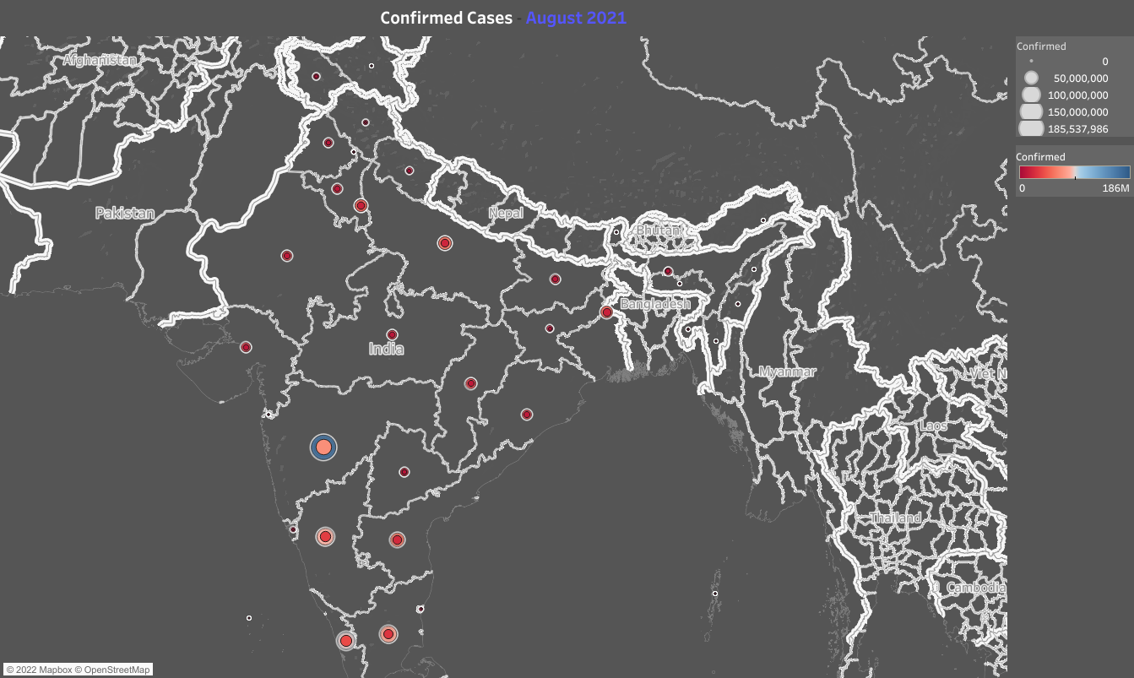

Slide 3
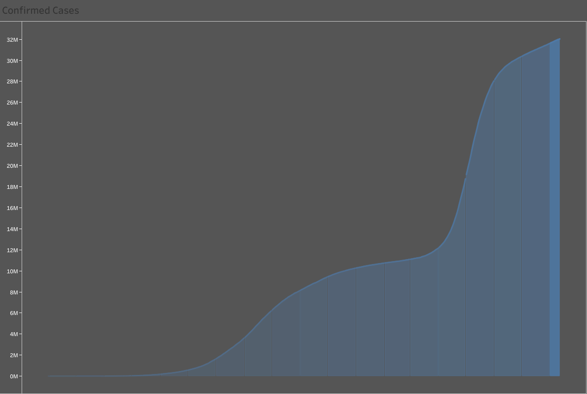

Slide 4
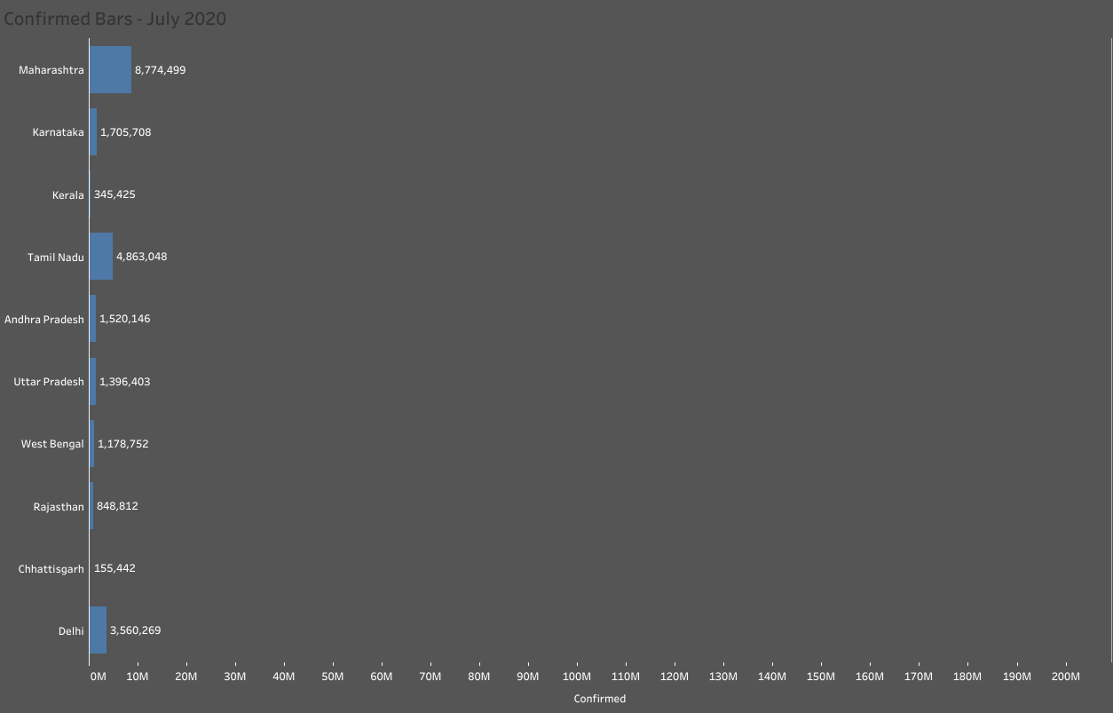

Slide 5
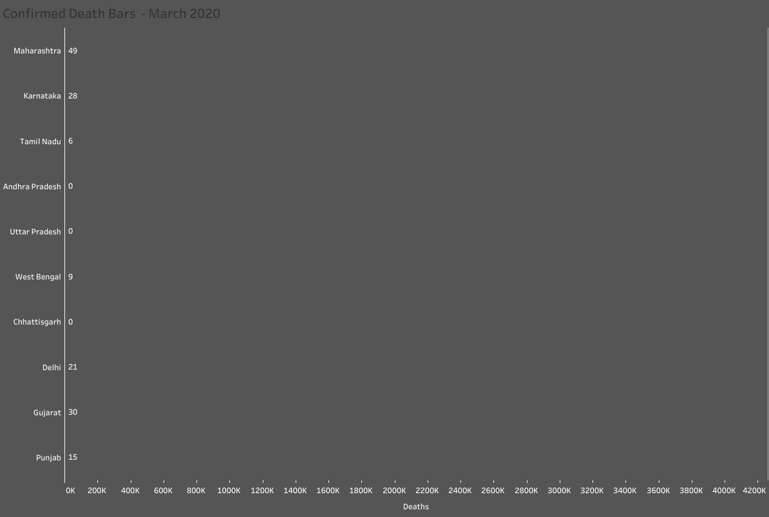

Slide 6
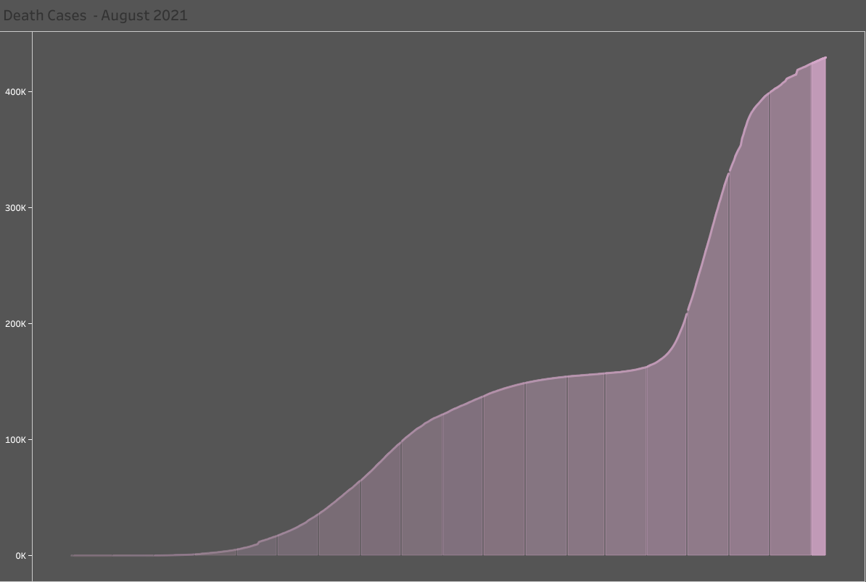

Slide 7
