Slide 1



🏆 DECK 1
THE FAST FOOD
TRAP 🍔🚫
It's fast to eat.
The damage is SLOW.
What your favourite meal is really doing to your body 🤔
Pete Brown Jr. Tennis Program — Building Champions On and Off the Court

Slide 2


You'd Be Shocked What's Inside 😱
Fast food is engineered to make you addicted — not healthy.
🧂 SALT: 2,000–3,000mg — your whole DAY's limit in ONE meal
🍬 SUGAR: Hidden in buns, sauces & drinks — up to 20 teaspoons!
🛢️ FAT: Unhealthy trans fats that clog your arteries over time
🧪 CHEMICALS: Artificial flavours, colours & preservatives
🔥 CALORIES: One combo meal = a child's ENTIRE daily need
⚡ Food scientists design it to hook you — not heal you!
Pete Brown Jr. Tennis Program — Building Champions On and Off the Court

Slide 3

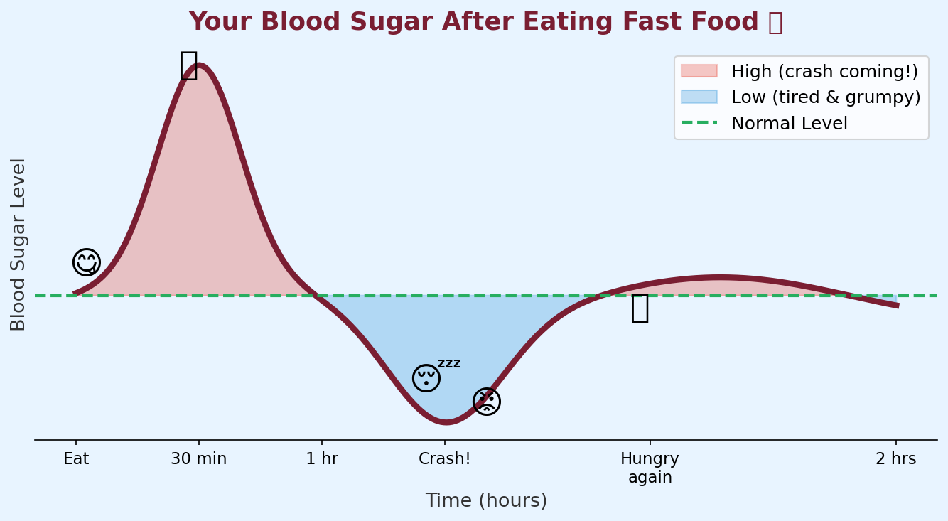
Your Body After Fast Food 🎢
Hour by hour — here's what really happens
Pete Brown Jr. Tennis Program — Building Champions On and Off the Court

Slide 4

Fast Food Hurts Your Grades Too 🧠📉
What you eat directly affects how well you think.
🔴 High sugar + fat meals REDUCE blood flow to the brain
🔴 Kids eating fast food regularly score LOWER on maths & reading tests
🔴 The crash after eating makes it hard to focus in class
🟢 After a home-cooked lunch → alert, focused, energised
🟢 Omega-3s (fish, nuts) = brain food. Fast food has almost NONE!
💡 Your brain is still GROWING. Every meal either helps it
grow — or slows it down.
🧠 DID YOU KNOW?
20 minutes of walking before a test = HIGHER scores!
Exercise + healthy food = your best brain day.
🏆 PBJTP kids who eat well
perform better ON and
OFF the court!
Pete Brown Jr. Tennis Program — Building Champions On and Off the Court

Slide 5

Smart Swaps — Better Choices, Better You ✅
You don't have to be perfect. You have to be CONSISTENT.
❌ Fast Food Choice
✅ Smart Home Swap
10+ teaspoons of sugar
Over a day's salt in one meal
Energy crash in 30 min
Hungry AGAIN in 1 hour
Hurts focus at school
Costs $10–$15 per person
🍌 Banana + peanut butter (30 sec!)
🥚 Hard boiled egg + crackers
🧀 Cheese + apple slices
🥜 Trail mix — nuts & dried fruit
🍝 Leftovers from home dinner
💰 Costs $1–$3 per person
⚡
VS
⚡
Pete Brown Jr. Tennis Program — Building Champions On and Off the Court

Slide 6

🏆 Your Fast Food Challenge This Week!
🍌 Replace ONE fast food meal with a home-cooked version
💧 Drink ONLY water instead of soda for 3 days
🏷️ Read the label on one thing before eating it
📓 Write down how you FEEL 2 hours after eating healthy vs fast food
💬 Tell your parents ONE thing you learned today about fast food
🌟 The 80/20 Rule: Eat healthy 80% of the time. The other 20%? Relax and enjoy! 🌟
Pete Brown Jr. Tennis Program — Building Champions On and Off the Court

Slide 7

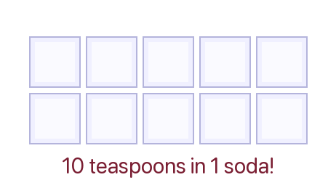
🏆 DECK 2
THE SUGAR
SECRET 🍬😬
It tastes amazing.
Here's what it's REALLY doing.
The truth candy companies don't want you to know! 🤫
Pete Brown Jr. Tennis Program — Building Champions On and Off the Court

Slide 8

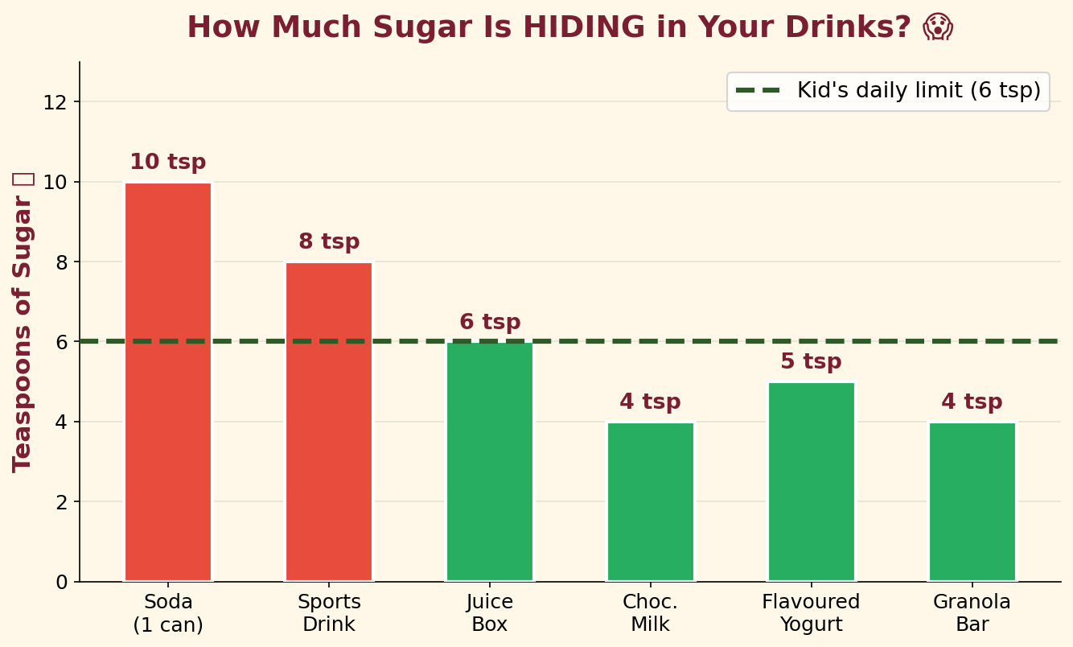
How Much Sugar Is HIDING In Your Drinks? 👀
Your daily limit: only 6 teaspoons (25g). Look what's really in there!
Pete Brown Jr. Tennis Program — Building Champions On and Off the Court

Slide 9

The Sugar Rollercoaster 🎢
Every time you eat lots of sugar your body goes on a wild ride!
Pete Brown Jr. Tennis Program — Building Champions On and Off the Court

Slide 10

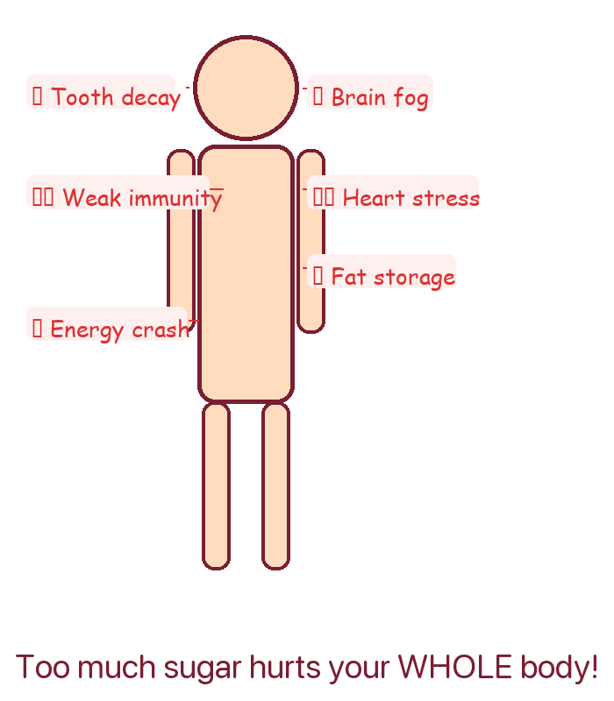
What Too Much Sugar Does Over Time ⏳
A little occasionally is fine. Daily excess causes real damage.
🦷 TEETH: Sugar feeds bacteria → acid → cavities
⚡ BODY: Stored as belly fat when eaten in excess
💉 DIABETES: Now showing up in kids as young as 10!
❤️ HEART: Causes inflammation in blood vessels
🛡️ IMMUNITY: Weakened for up to 5 hours after a sugar binge
🧠 BRAIN: Linked to anxiety & poor memory
📈 1900s: 4 lbs sugar/year per person
Today: 150+ lbs sugar/year per person!
Pete Brown Jr. Tennis Program — Building Champions On and Off the Court

Slide 11

Sugar Has 56 Disguises! 🕵️
Food companies hide sugar under different names — here's how to catch them!
🔍 Hidden Sugar Names:
✅ The Detective Rule:
→ High fructose corn syrup
→ Dextrose, Maltose, Sucrose
→ Evaporated cane juice
→ Agave nectar
→ Brown rice syrup
→ Fruit juice concentrate
→ Molasses, honey, maple syrup
If any form of sugar is in the first 3 ingredients on the label — PUT IT BACK! 🙅
💧 Best Drinks for Kids:
#1 💧 Water (always first — zero sugar!)
#2 🥛 Plain milk (calcium + protein)
#3 🍵 Unsweetened tea (zero sugar)
Pete Brown Jr. Tennis Program — Building Champions On and Off the Court

Slide 12

🏆 Your 5-Day Sugar Challenge!
Day 1 — Replace soda or juice with WATER all day 💧
Day 2 — Read the label on 3 things in your fridge 🔍
Day 3 — Count the teaspoons of sugar in everything you drink
Day 4 — Choose fresh fruit instead of a sweet snack 🍓
Day 5 — Tell your parent ONE thing you learned about sugar! 💬
🌟 After 5 days: Write down how you feel. More energy? Better mood? Less tired? 🌟
Pete Brown Jr. Tennis Program — Building Champions On and Off the Court

Slide 13



🏆 DECK 3
FAST FOOD
vs HOME
COOKING 🍳
VS
Which wins for your
💚 health AND 💰 wallet?
The answer might surprise you!
Pete Brown Jr. Tennis Program — Building Champions On and Off the Court

Slide 14

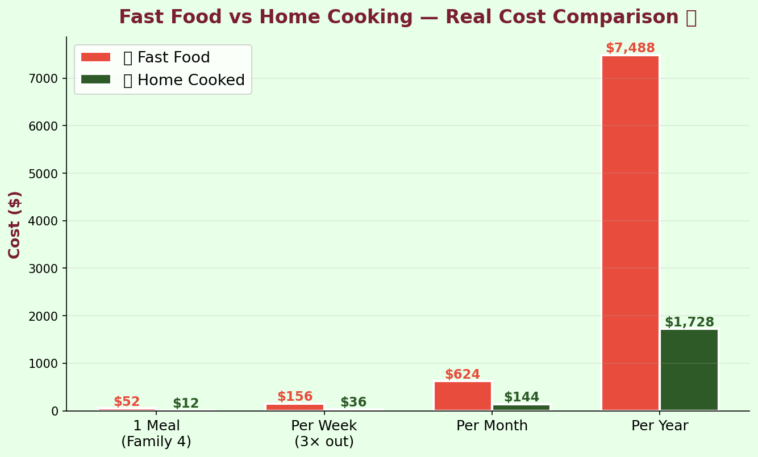
Fast Food Is SO Much More Expensive! 💸
It feels cheap per visit — but the yearly total will SHOCK you.
Pete Brown Jr. Tennis Program — Building Champions On and Off the Court

Slide 15

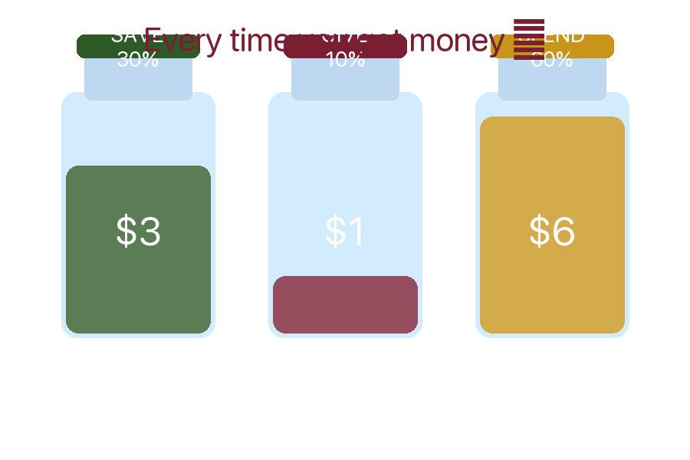
What Home Cooking Actually Costs 🏡
Home-cooked meals cost 3–5× LESS than the same meal from a restaurant!
🍝 Pasta + sauce + turkey for 4
$8 total
→ $2 per person
🍗 Chicken + veg + rice for 4
$12 total
→ $3 per person
🥚 Eggs + toast + fruit for 4
$5 total
→ $1.25 per person
🌮 Bean tacos with toppings for 4
$10 total
→ $2.50 per person
💰 Annual saving for a family of 4 switching to home cooking: $4,000 – $6,000 per year!
Pete Brown Jr. Tennis Program — Building Champions On and Off the Court

Slide 16

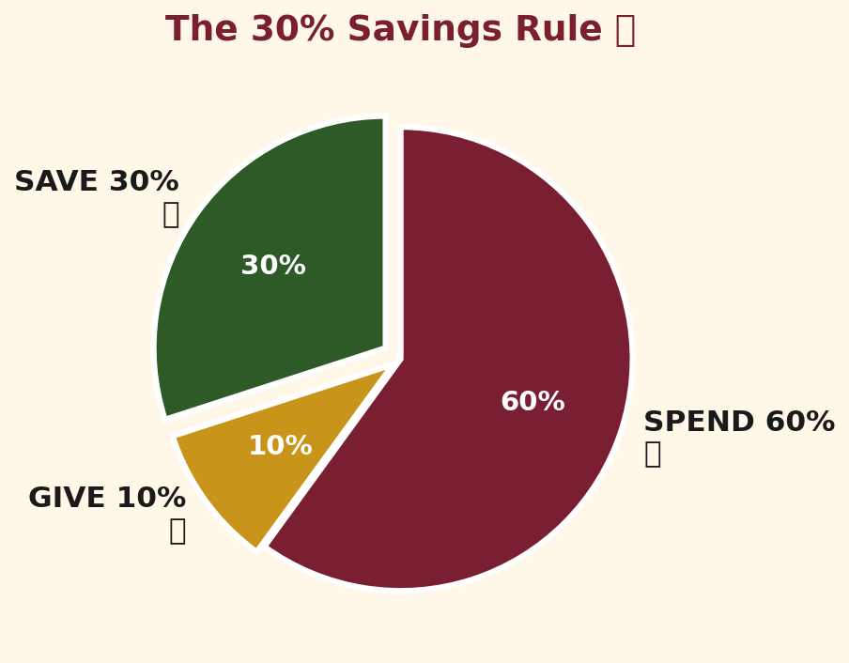
The 30% Savings Rule — Every Single Time! 🐷
Pay YOURSELF first. Always. This is how wealthy adults think.
💡 Example — You earn $10:
🐷 $3.00 → Savings jar (30%)
💛 $1.00 → Giving jar (10%)
🛒 $6.00 → Spend wisely (60%)
📅 If you save $5 every week:
1 month → $20 saved
6 months → $130 saved
1 year → $260 saved! 🎉
5 years → $1,300! 🏆
Pete Brown Jr. Tennis Program — Building Champions On and Off the Court

Slide 17

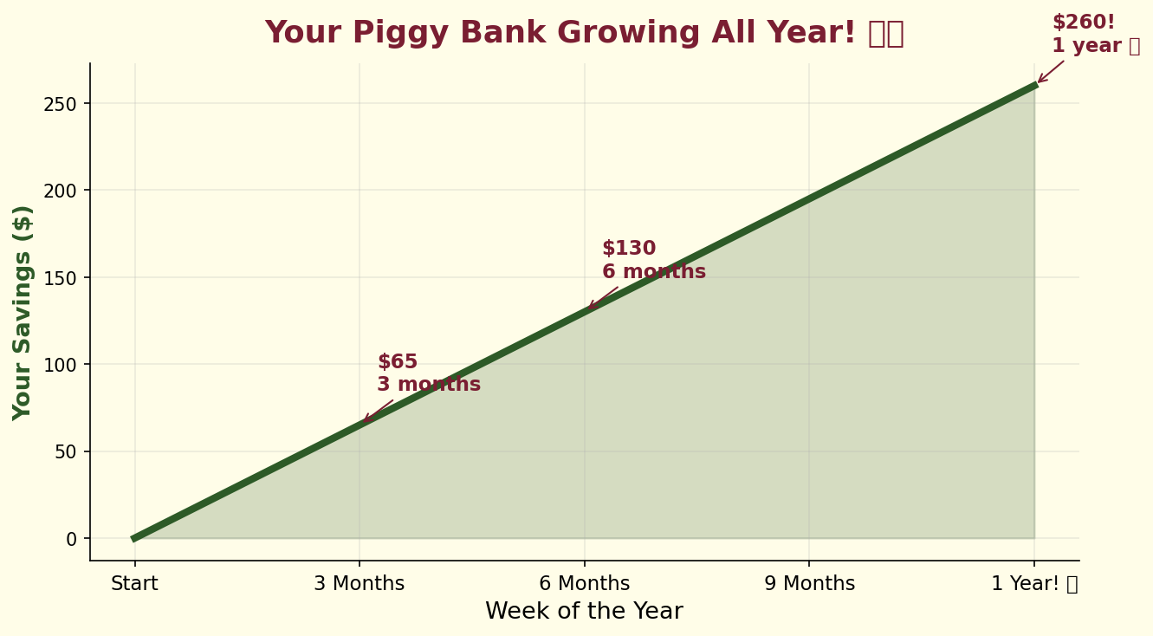
Watch Your Piggy Bank Grow All Year! 🐷📈
Small + consistent = BIG. You don't need a lot — you just need to START!
Pete Brown Jr. Tennis Program — Building Champions On and Off the Court

Slide 18

🏆 Cook It · Track It · Save It This Week!
Step 1 — Pick a simple recipe (eggs, pasta, rice bowl, or sandwich) 🍝
Step 2 — Go to the store with a parent and buy ONLY what you need 🛒
Step 3 — Cook it together and write down what it cost ✏️
Step 4 — Compare: What would that meal cost at a restaurant? 🤔
Step 5 — Put 30% of the savings STRAIGHT into your piggy bank 🐷
Example: Home pasta dinner = $8. Restaurant = $45. You saved $37 → $11 goes in your piggy bank! 🐷
Pete Brown Jr. Tennis Program — Building Champions On and Off the Court

Slide 19


🏠 TEACH YOUR PARENTS TONIGHT — AND EARN YOUR CUT! 🐷
💬 Say This Tonight:
🐷 The Piggy Bank Deal:
"Mom/Dad — cooking dinner at home instead
of ordering out saves $35–$40 every meal!"
Meal cooked at home
Your cut
Saves ~$35 vs fast food
$3–$5 in piggy bank
"Can I get my cut of what we save
and put it in my piggy bank? I'll save it!"
Cook 3×/week
Up to $15/week!
"Let's track it — I'll keep the notebook!"
1 full month
Up to $60 saved! 🎉
1 full year
Up to $720! 🏆
👨‍👩‍👧 Parent Promise: "Every time we cook at home instead of eating out, I will give you your cut for your piggy bank!"
Pete Brown Jr. Tennis Program — What we teach on the court, we teach for life.

