Slide 1
Motif analysis using the BlueSTARR model – K562 data
Rotation 1
Revathy Venukuttan X Majoros Lab
08/26/2024 - 10/18/2024

Slide 2
Steps
Step 1: To insert GATA4 motif into the background sequence and compare the reference scores with and without the motif inserted
Step 2: Mutate every base pair of GATA4 and compare the scores of mutation with the background sequence with GATA (new reference sequence)
Step 3: Insert GATA and AP1 into the background sequence in varying distance from each other and compare the variation of logFC of reference scores for every distance variation
Calculate logFC as ref_score(AP1_GATA) – ref_score(GATA) instead of background sequences
Step 4: Insert TAL1_GATA4 complex into the background sequences at fixed position and compare the activations with background
a. Increase the distance between TAL1 and GATA4 in the TAL_GATA complex by 1bp and check for variations
Step 5: Insert TAL1_GATA4 complex along with AP1 where TAL1_GATA4 complex is fixed and AP1 is moved (step_distances). Compare the logFC variation when it is calculated over background sequences and TAL_GATA complex
Step 6: Repeat the steps with changing model architectures – add attention layers
Step 7: Interactions between RUNX3 and GATA4
Step 8: Model interactions between AP1 and all other TF motifs reported from JASPAR.

Slide 3
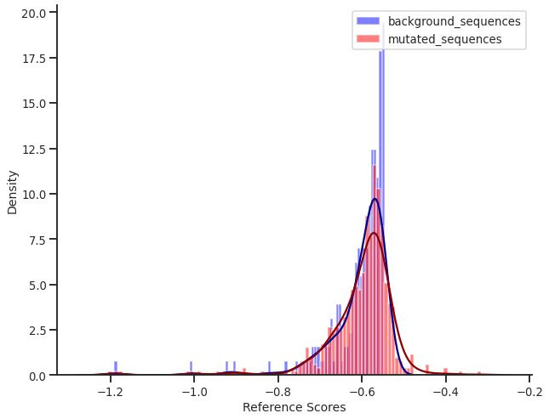
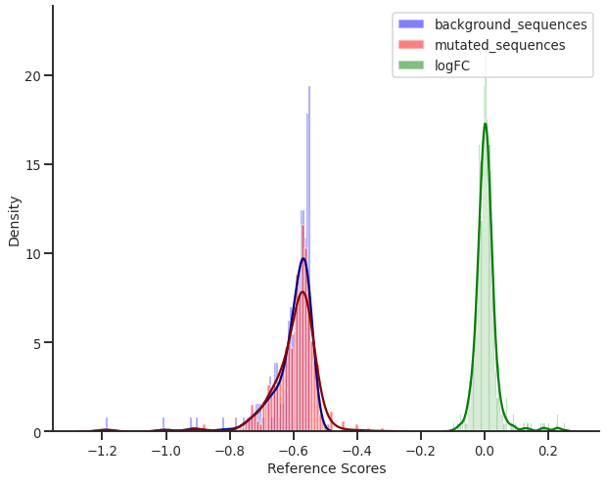
Step 1: GATA in background sequence
GATA4 inserted to 3 positions in a 300bp sequence – 100, 150, 200
Result:
As expected, position of GATA4 in the background sequence don’t seem to affect the scores much. Hence mid-point position which is position 150 chosen for Step 2
Notes:
Note: Check the reference scores - strongest score can go up to -2

Slide 4

Step 2: Mutate every base pair of GATA
Every base pair position in GATA1 motif is mutated for the remaining 3 nucleotides and then compared to the background sequence (GATA1 inserted motif sequence).
logFC = log (mutated_sequence_score) – log (reference_sequence_score)
Mutated sequence = sequence with GATA nucleotides mutated
Reference sequence = background sequence with GATA motif inserted in the 150th position
GATA motif used: GATA4

Slide 5
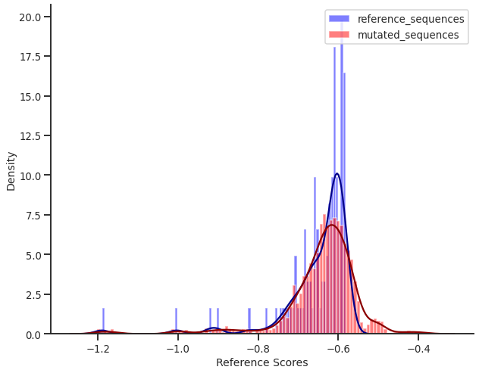
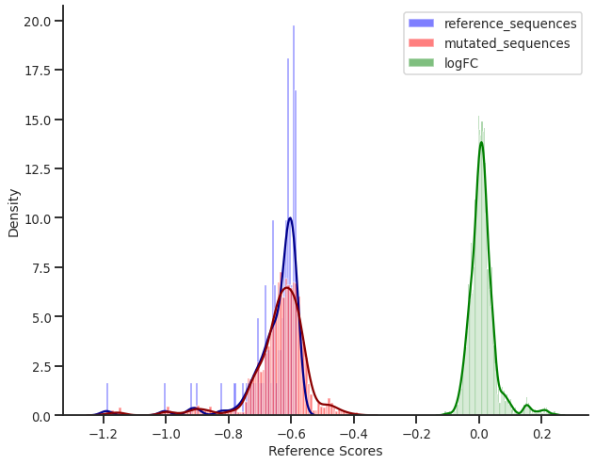
Step 2: Mutate every base pair of GATA
Every base pair position in GATA1 motif is mutated for the remaining 3 nucleotides and then compared to the background sequence (GATA1 inserted motif sequence).
Result: logFC for most of the sequences is near zero, with range being -0.1 to 0.2.

Slide 6
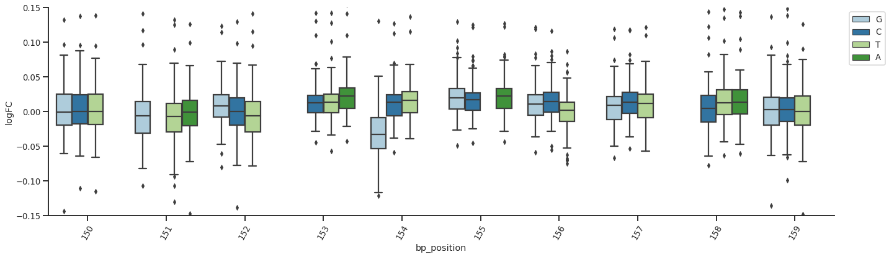
Step 2: Mutate every base pair of GATA
Mean and Std. dev for every base pair mutated in the GATA4 motif – forward sequences

Slide 7
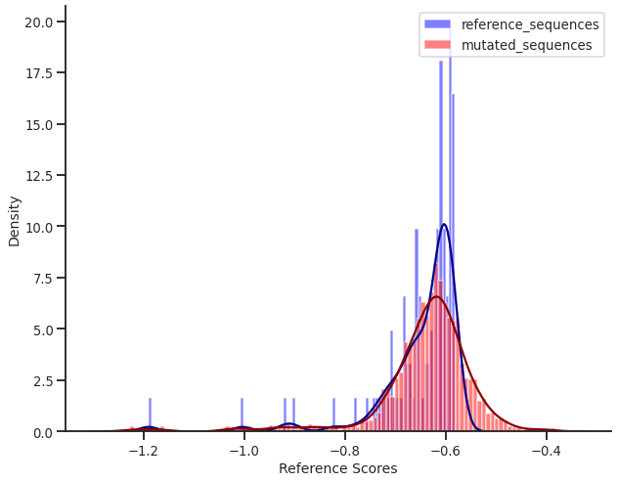
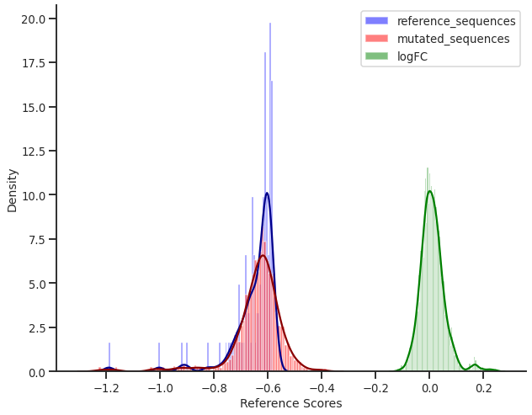
Step 2: Mutate every base pair of GATA
Trend for reference scores and logFC - Backward sequences

Slide 8
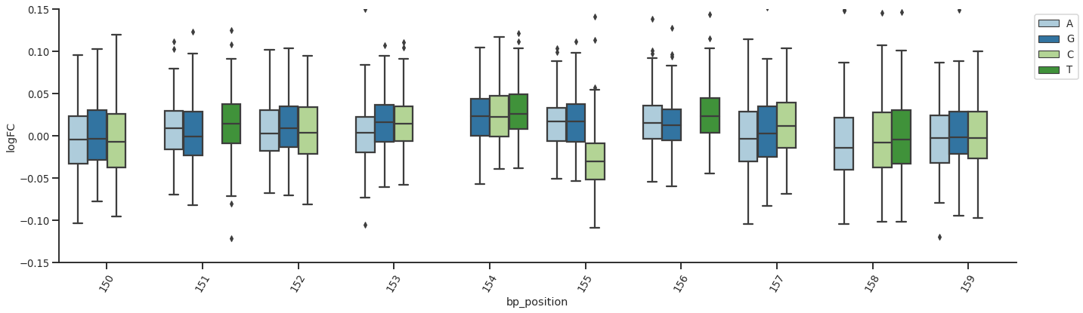
Step 2: Mutate every base pair of GATA
Mean and Std. dev for every base pair mutated in the GATA4 motif – backward sequences

Slide 9
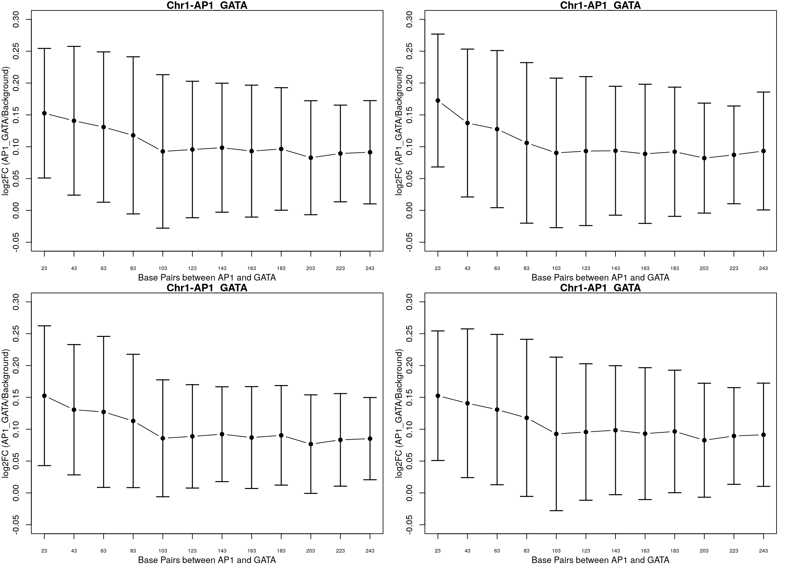
Step 3: AP1-GATA interaction
Insert GATA and AP1 into the background sequence in varying distance from each other and compare the variation of logFC of reference scores for every distance variation
Notes:
Background with GATA v/s background with GATA+AP1
T-tests between different distances. Paired tests

Slide 10
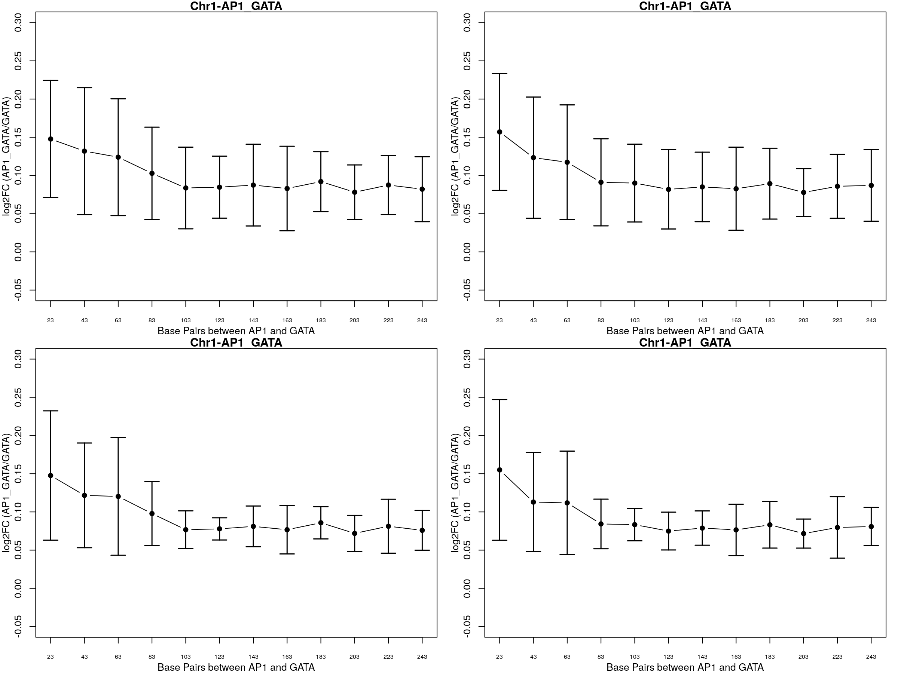
Step 3 (a) : AP1-GATA interaction – with sequences with GATA as background
Insert GATA and AP1 into the background sequence in varying distance from each other and compare the variation of logFC of reference scores for every distance variation and calculate logFC as ref_score(AP1_GATA) – ref_score(GATA) instead of background sequences

Slide 11
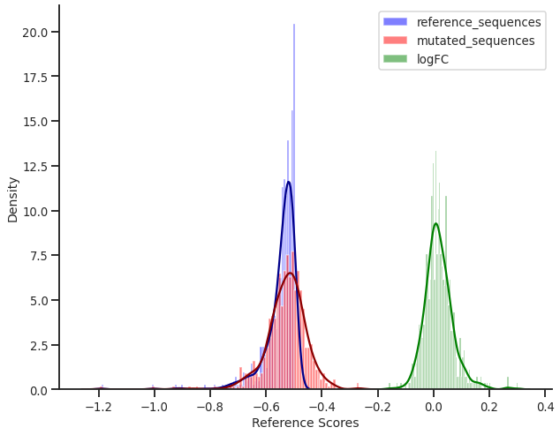
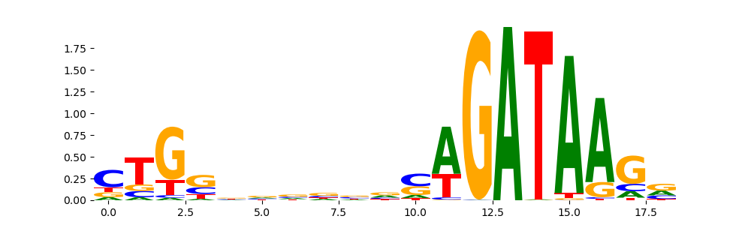
Step 4: TAL1_GATA4 motif in the background sequence
Insert TAL1_GATA4 complex into the background sequences at fixed position and compare the activations with background

Slide 12
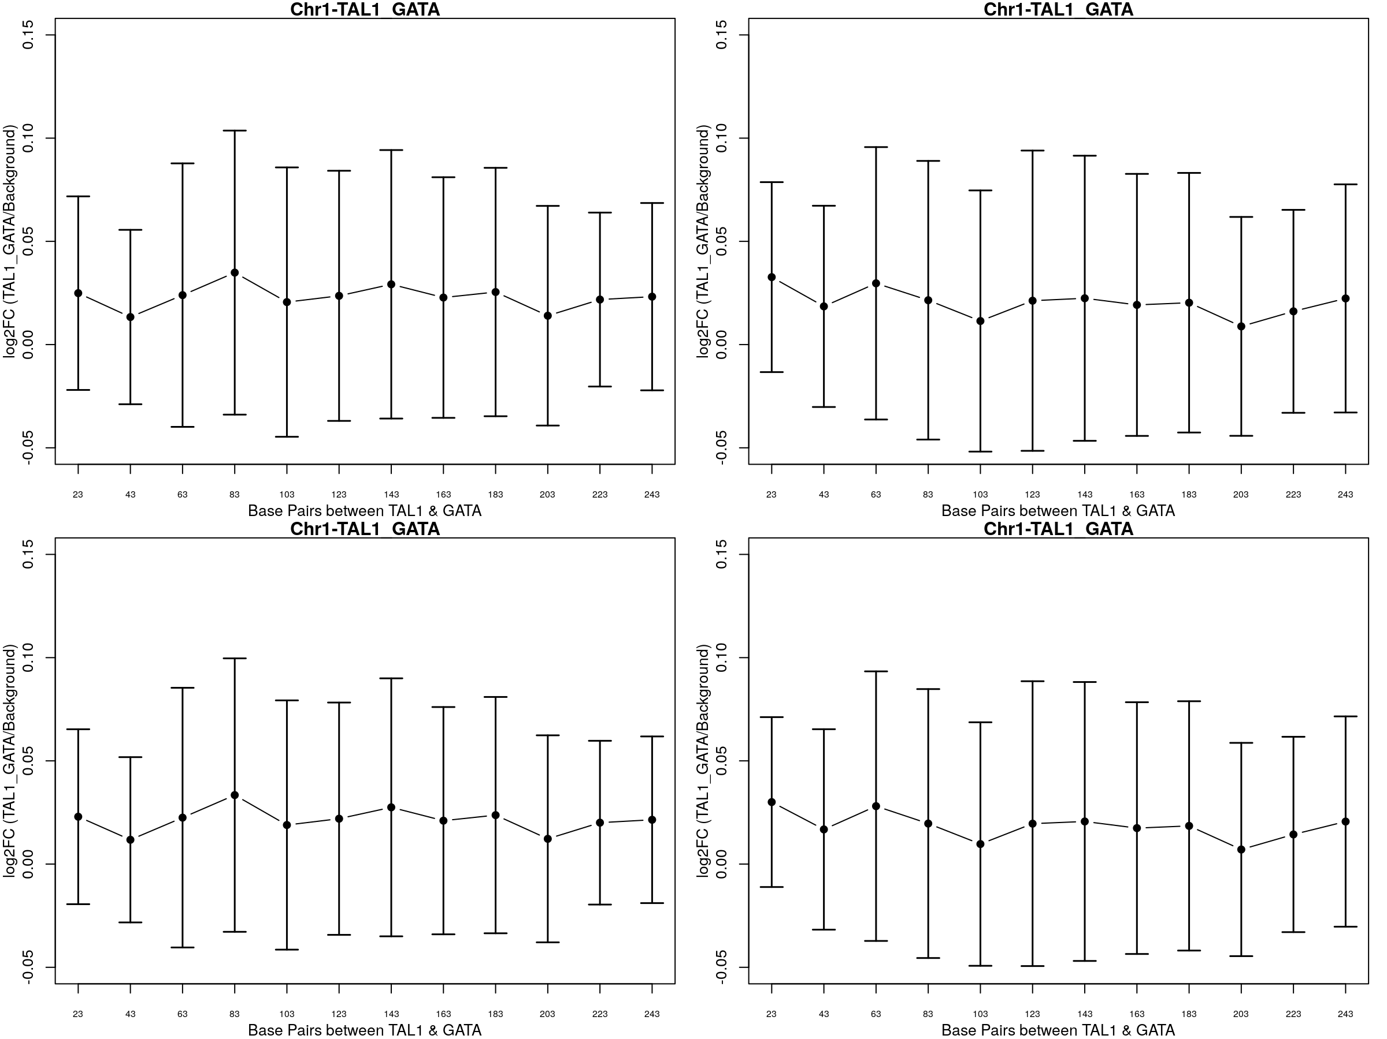
Step 4a: Increasing distance between TAL and GATA
TAL-GATA complex that TF modisco reported had TAL and GATA at a 6bp difference in the sequence. This step explores the difference in activations/logFC when the distance between TAL and GATA complex is increased.
Notes:
Distance between TAL1 and GATA – 1bp

Slide 13
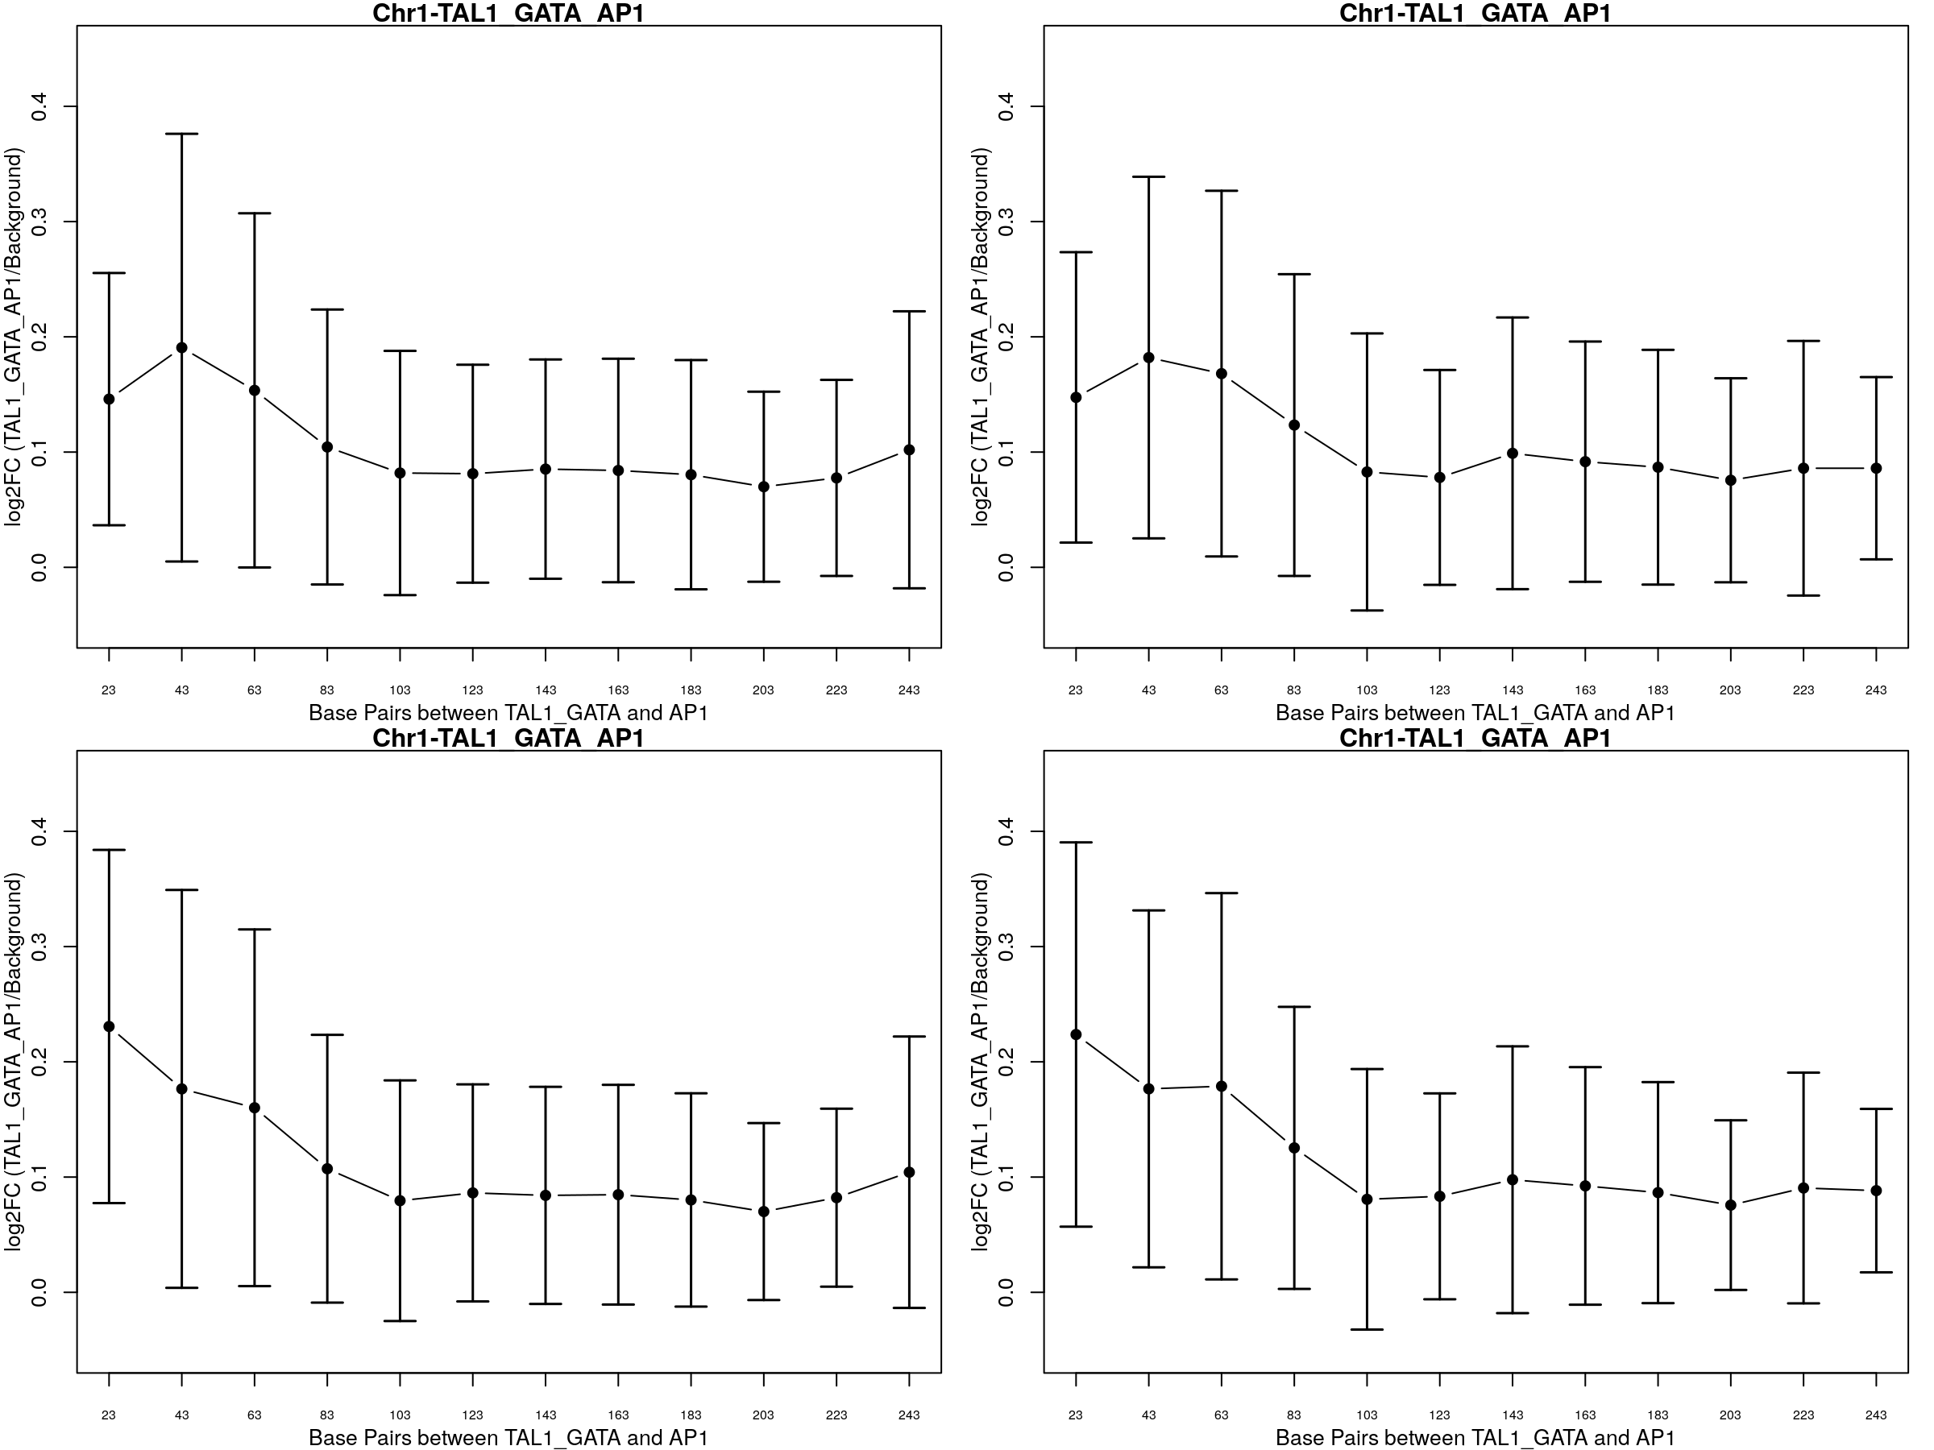
Step 5: TAL1_GATA_AP1 interactions
Insert TAL1_GATA4 complex along with AP1 where TAL1_GATA4 complex is fixed and AP1 is moved (step_distances). Compare the logFC variation when it is calculated over background sequences and TAL_GATA complex

Slide 14
Step 6: TAL1_GATA complex with AP1 interactions with attention layers
Repeating the same steps from Step 5 but changing the model architecture and using attention layers
Notes:
Predictions at 23 vs predictions at 103

Slide 15
Step 5/6a: ANOVA between positions
 | Sum of squares | Degrees of Freedom | F-statistic | P-value
Position | 11.646732 | 1.0 | 717.478863 | 9.551049e-151
Residual | 116.844109 | 7198.0 | NaN | NaN
Between group variation for various positions = 11.646
F-stat = 717.47 for between group variation (”Position”) – significant with p val. of 9.5e-151

Slide 16
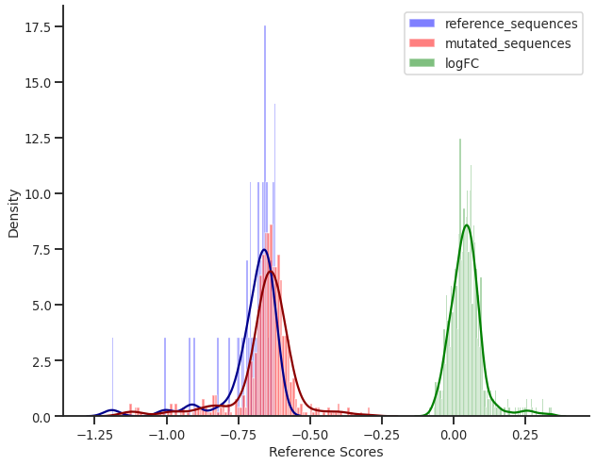
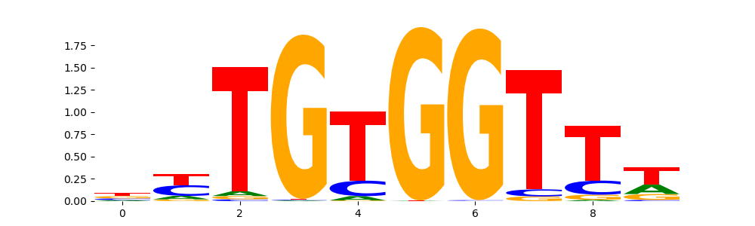
Step 7:Interaction between RUNX3 and GATA4
Replicating the analysis with different combinations of TF motifs that were pulled out using TF-modisco
RUNX3 motif

Slide 17
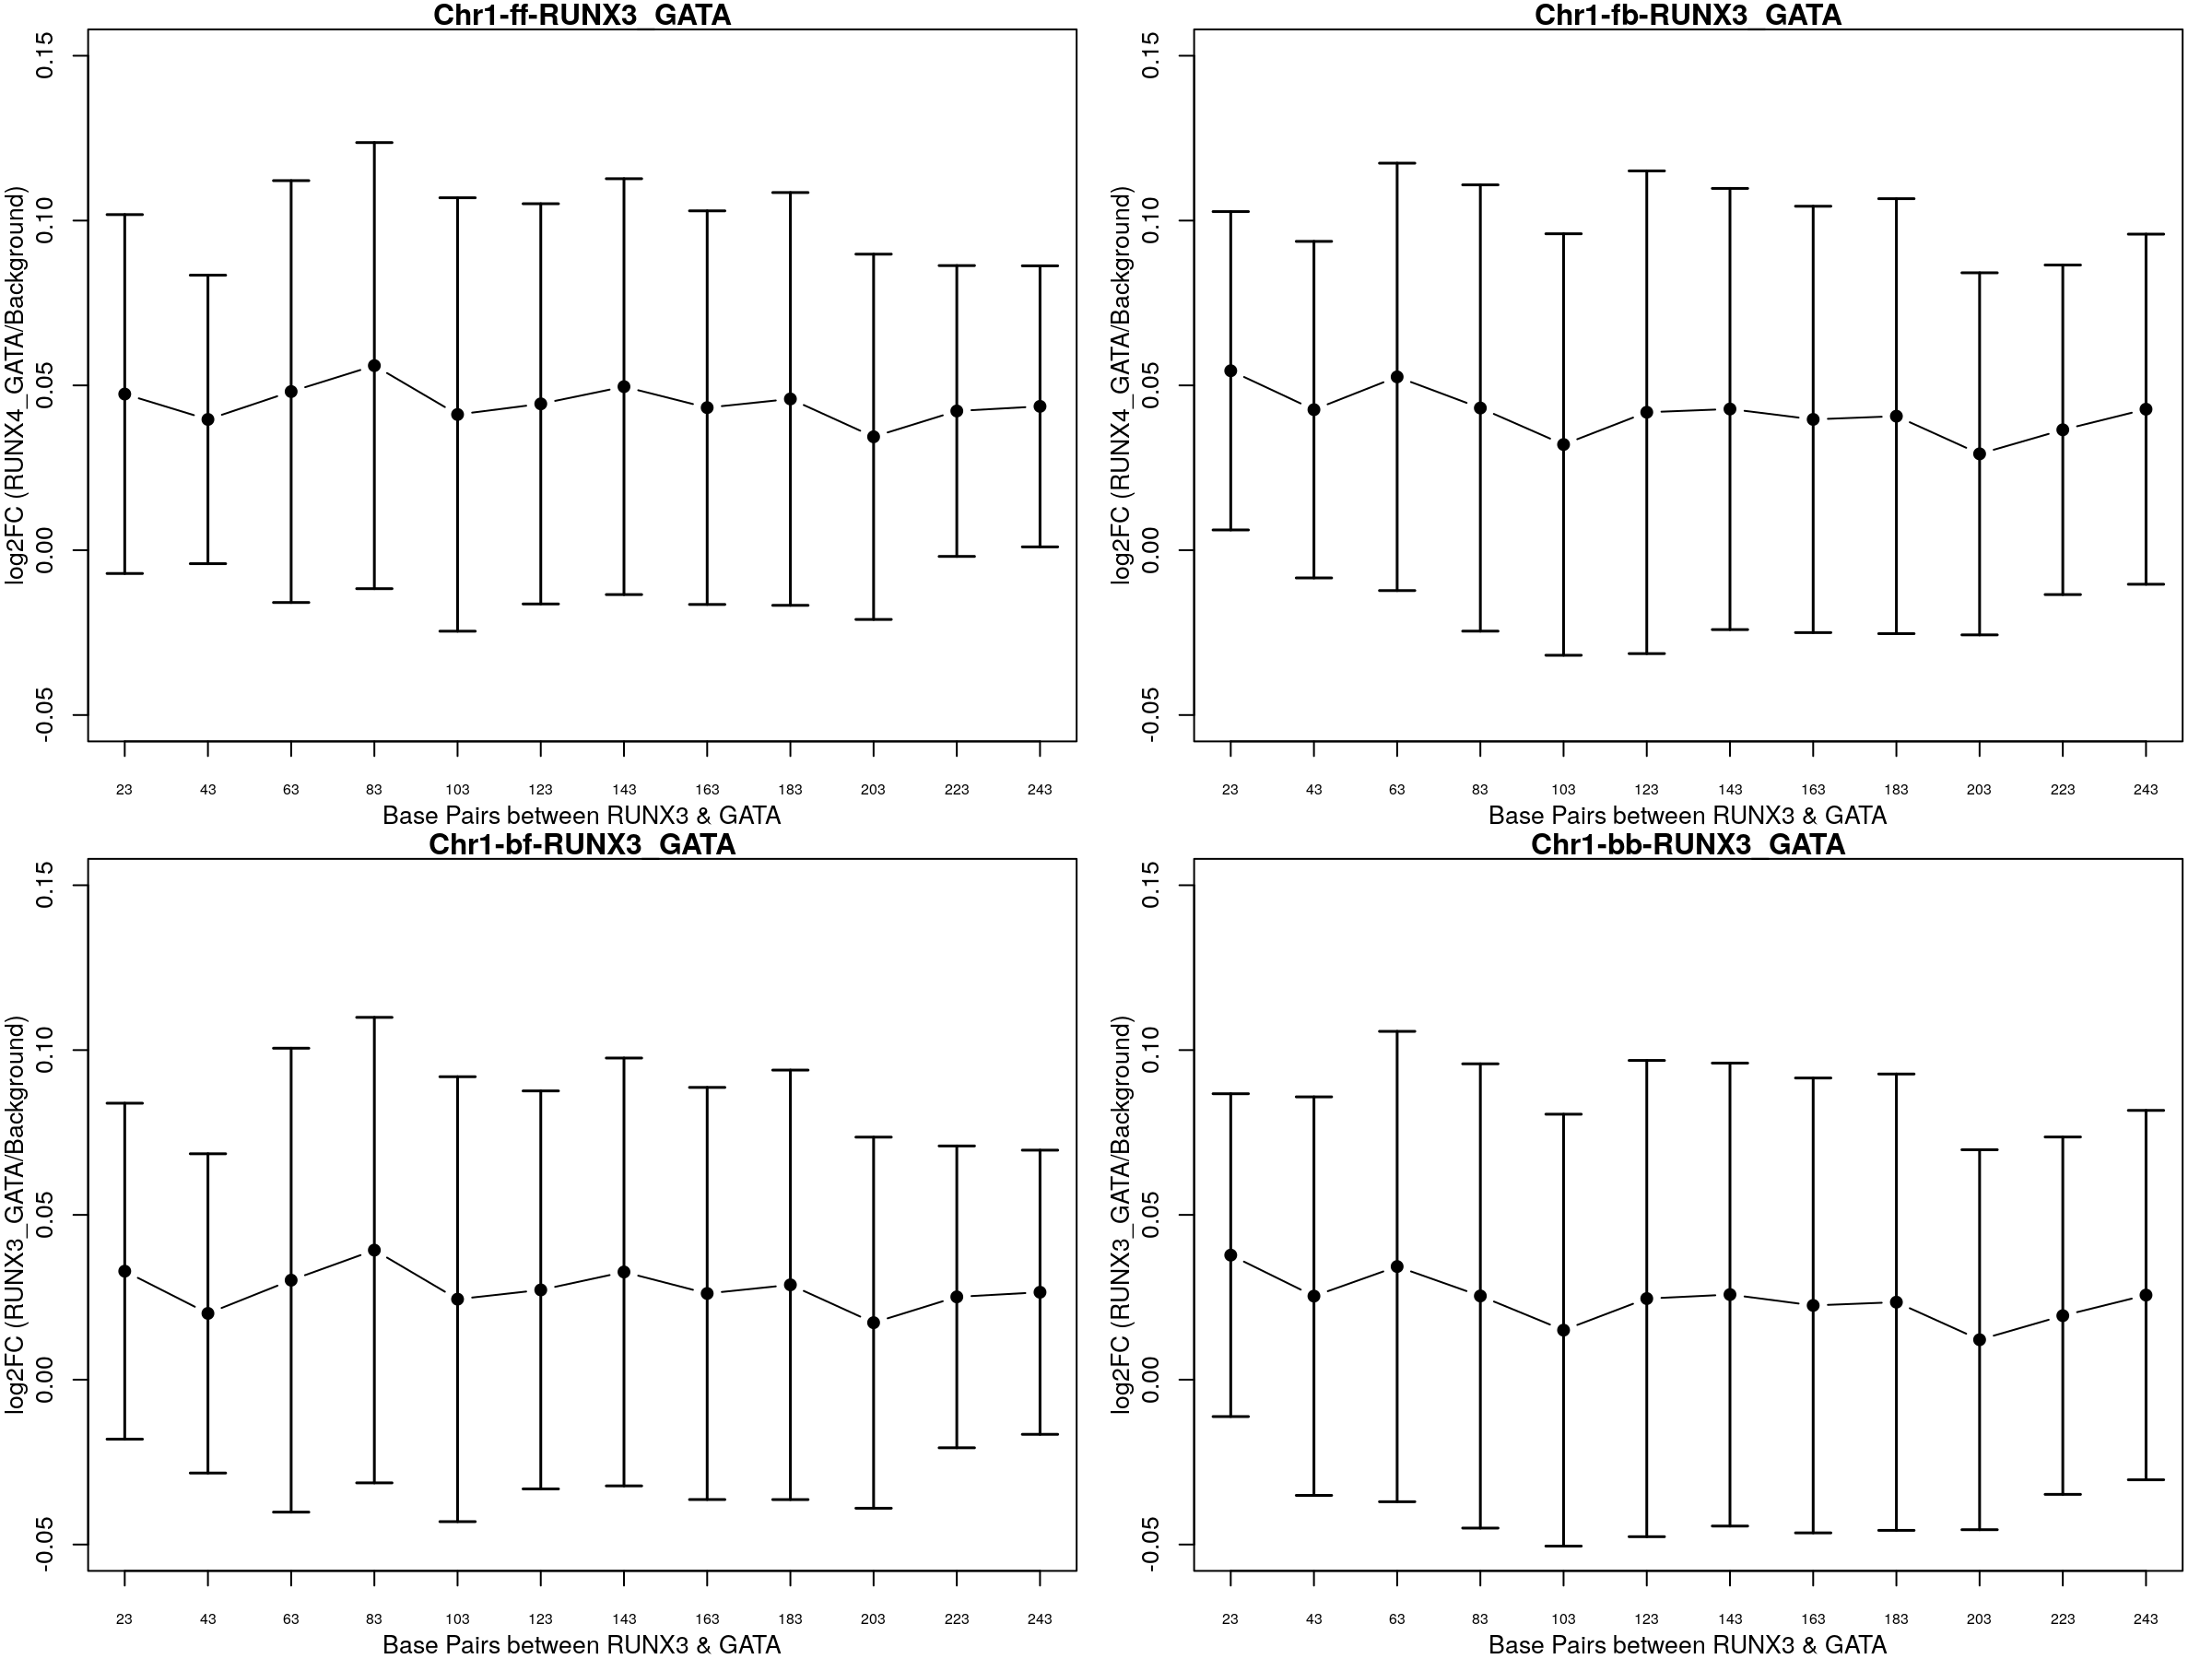
Step 7: Interaction between RUNX3 and GATA4
logFC calculated as:
Ref_score (RUNX3_GATA4) – Ref_score(Background_Sequences)
Both these reference scores are obtained from the BlueSTARR model

Slide 18
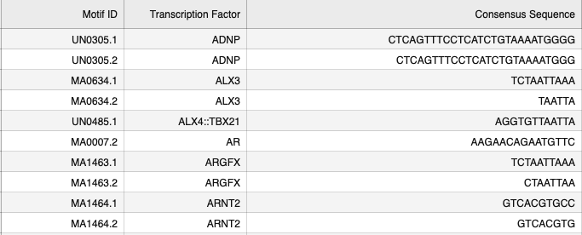
Step 8: Running the model for all TFs from JASPAR comparing against AP1
Retrieve all TF motifs from JASPAR for Homo sapiens (Taxonomy ID:9606) using the API.
There were 2038 TF motifs for humans retrieved from JASPAR
A python script was used to scrape data – the script retrieves the Position Weighted Matrix (PWM) scores from JASPAR and converts it into Consensus sequence for each TF motif
There are TFs with multiple consensus sequences.
Create mutated sequences where AP1 is fixed at the 10th position and the 2nd motif for comparison is placed at different positions starting with 23rd and extending to 244th position with a step increase of 20bp in a 300bp sequence. This step is repeated for all 2038 TF motifs retrieved from the JASPAR database.
Ran the model on all the sequences and logFC was computed.

Slide 19
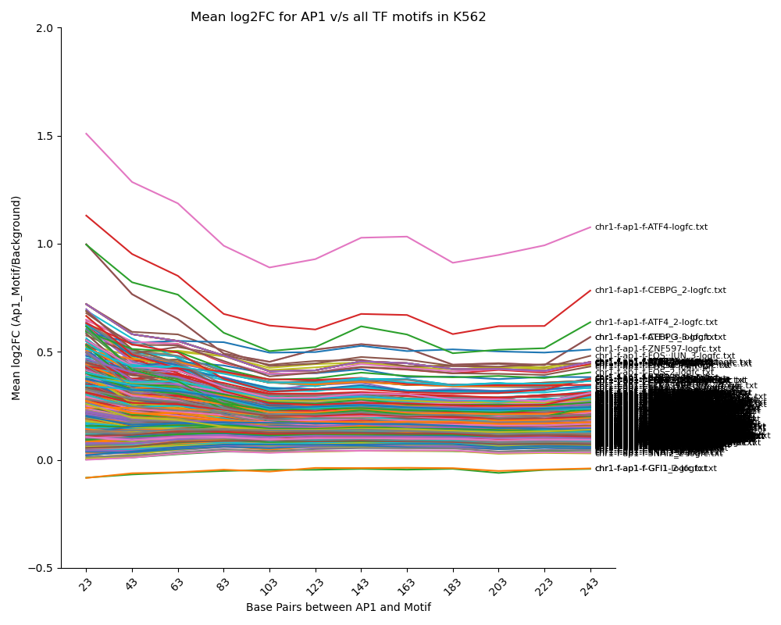
Results:
The figure shows mean logFC at different positions of motif2 when AP1 is fixed at 10th position in the 300bp sequence.
logFC = ref_score(AP1+motif2) – background_ref_score
ATF4 and CEBPG has a negative slope in the distances up to 103 and then there is an increase in activation at 123, 143 and 163rd positions
ATF4 belongs to the ATF/CREB family of TFs (activating transcription factors). It is a member of the activating protein-1 (AP1) transcription factor family that regulates gene expression through homo-dimerization or hetero-dimerization with other AP1 family members (Ref: https://doi.org/10.1016/j.phrs.2017.02.004)
Notes:
Rank the TFs based on the ref_score at the first position (23rd position)
Create 2 new graphs- one with the top 10 TFs from the ranklist, 2nd with the top 20 TFs from the rank list

Slide 20
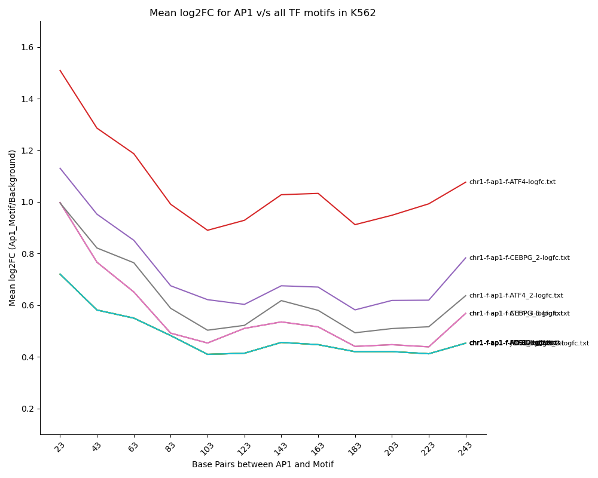
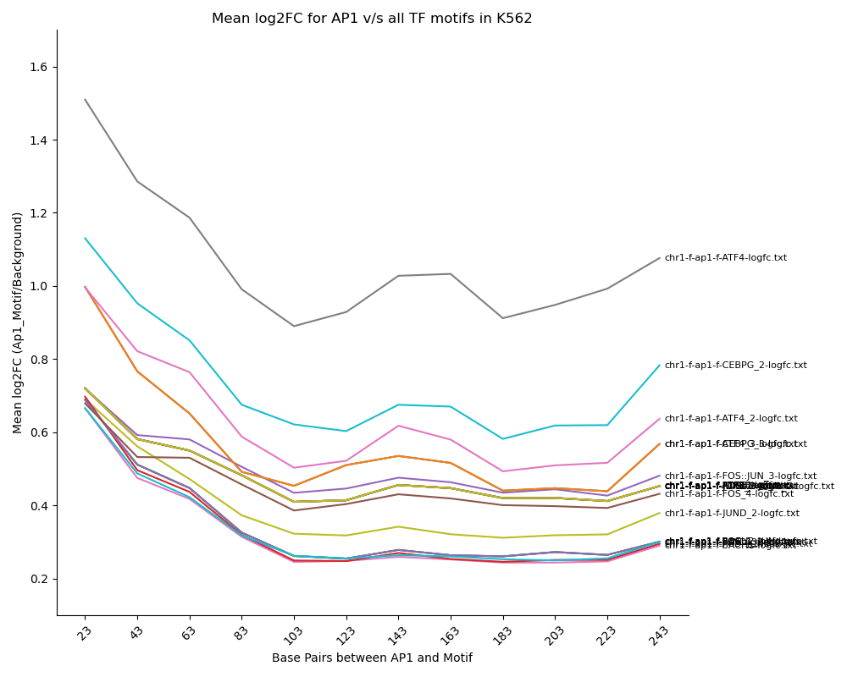
Line plots indicating the top 10 and top 20 TFs based on their logFC at position 23
All TFs (TF + AP1 complex) were ranked based on logFC when AP1 is at the 10th bp position and 2nd TF is at the 23rd bp position of the background sequence.

Slide 21
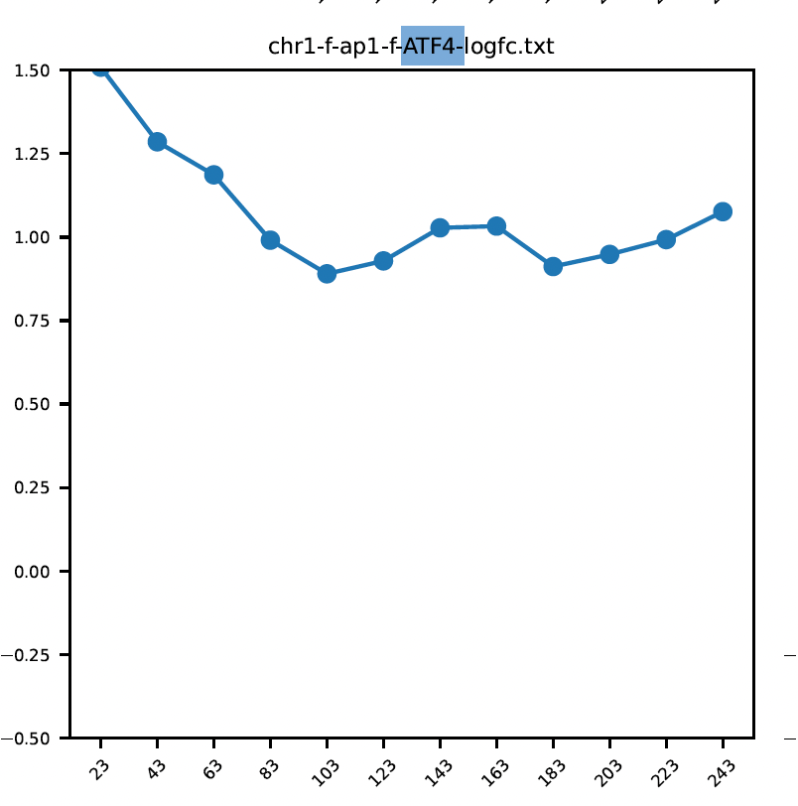
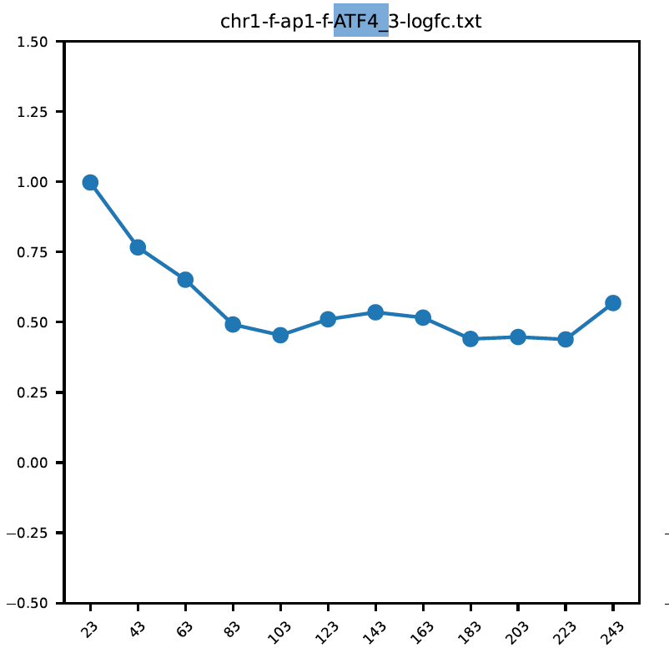
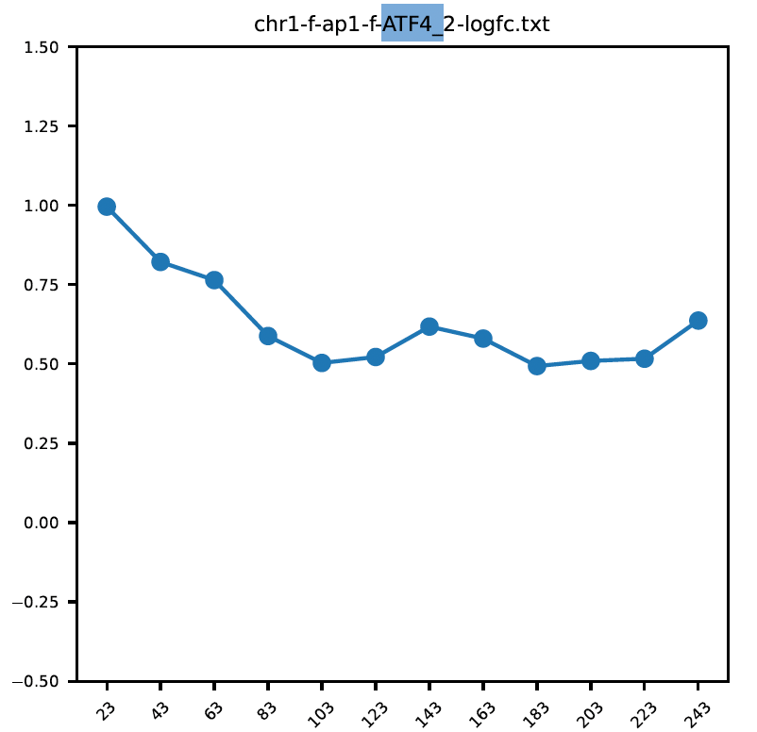
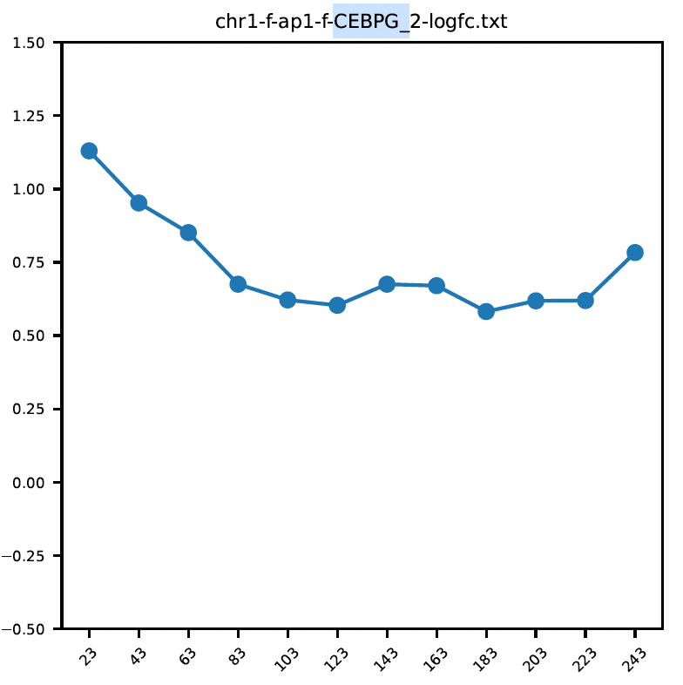
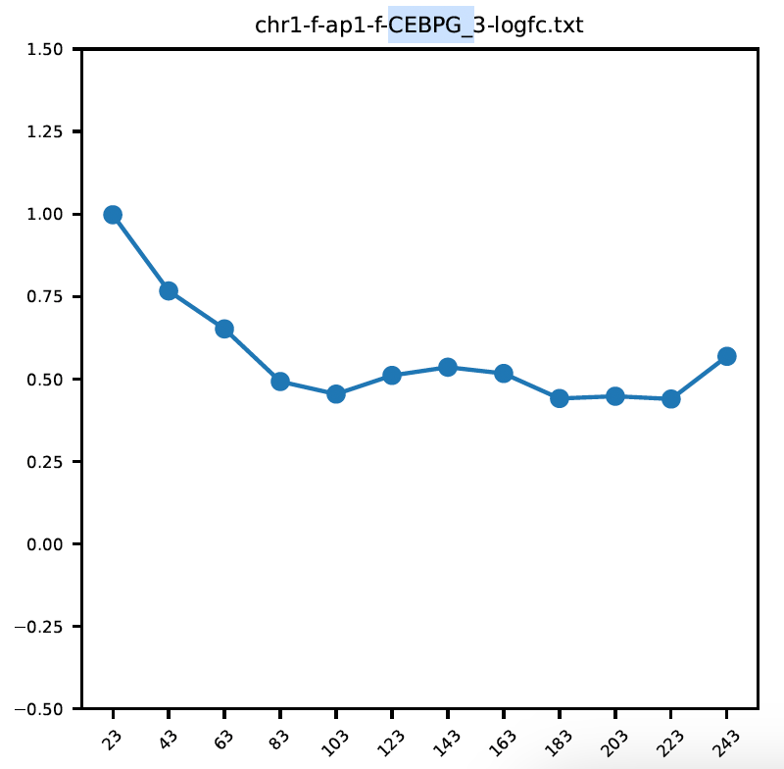
Zooming into sequences of ATF4 and CEBPG

Slide 22
