Slide 1
ChatList Using Linked List

Slide 2

INTRODUCTION
The program serves as a communication platform within a terminal environment, allowing users to exchange messages with each other.
Users can interact with the program through a series of menu options, enabling them to perform actions such as adding/deleting users, sending/receiving messages, and viewing chat history.

Slide 3
TABLE OF CONTENTS
01
03
02
Data Structers
Code Snippets
Functions

Slide 4
01
Data Structures

Slide 5
Data Structures
Linked List :
The primary data structure used is a linked list to store user information (`User` struct). Each node of the linked list represents a user, and each user contains an array (`chatHistory`) of pointers to messages, forming a linked list of messages for each user.
2. Arrays
Arrays are used to store messages within each user's `chatHistory` array. This array holds pointers to `Message` structs, representing the messages exchanged between users.

Slide 6
Data Structures
3. Structures
Two structures are defined: `Message` and `User`, which encapsulate the data associated with messages and users, respectively. These structures provide a way to organize and manage related data efficiently.
Global Variable
The global variable `head` is used to maintain the head pointer of the linked list of users, facilitating easy access and manipulation of the user data throughout the program.

Slide 7
Why we used Linked List
Linked List is better for dynamic memory allocation as compared to other available Data structures
The process of inserting and deleting nodes is easier in Linked list
Easy to modify the position of nodes, which is used while we update the list of most recently contacted user while we are logged into a user
Provides better time complexity during traversal.

Slide 8
02
Functions

Slide 9
Functions.
createMessage():
- Data Structure: Structure (Message)
- Task: Allocates memory for a new message, initializes its attributes such as sender, receiver, timestamp, content, and read status, and returns a pointer to the created message.
- Time complexity of this function is O(1).
2. createUser():
- Data Structure: Structure (User), Array
- Task: Allocates memory for a new user, sets its name, assigns a user number, initializes the chat history array, and returns a pointer to the created user.
- Time complexity of this function is O(n).

Slide 10
Functions.
3. logout():
- Data Structure: N/A
- Task: Logs out the current user by setting the `currentUser` pointer to `NULL`.
- Time complexity of this function is O(1).
4. addUserToList ():
- Data Structure: Linked List (User)
- Task: Adds a new user to the linked list of users, checking for duplicate usernames, and deallocating memory if the username already exists.
- Time complexity of this function is O(n).

Slide 11
Functions.
5. calculateUnreadMessages:
- Data Structure: Array
- Task: Counts the number of unread messages for a given user by iterating through their chat history.
- Time complexity of this function is O(1).
6. displayUsersWithUnreadMessages ():
- Data Structure: Linked List (User), Array
- Task: Displays users with unread messages, including the logged-in user, by iterating through the user list and checking unread message counts.
- Time complexity of this function is O(1).

Slide 12
Functions.
7. displayChatHistoryWithUnreadMessages ():
- Data Structure: Linked List (User), Array
- Task: Displays chat history with unread messages for the current user, iterating through other users' chat history and displaying unread messages.
- Time complexity of this function is O(1).
8. displayAllUnreadMessages ():
- Data Structure: Linked List (User), Array
- Task: Displays unread messages from other users for the current user, iterating through all users' chat history and printing unread messages.
- Time complexity of this function is O(n).

Slide 13
Functions.
9. displayAllUsers ():
- Data Structure: Linked List (User)
- Task: Displays all available users by iterating through the linked list of users and printing their names.
- Time complexity of this function is O(n).
10. deleteUser ():
- Data Structure: Linked List (User)
- Task: Deletes a user from the linked list by finding and removing the user node, freeing memory allocated for the user.
- Time complexity of this function is O(n).

Slide 14
Functions.
11. displayUserChatHistory ():
- Data Structure: Structure (User), Array
- Task: Displays the chat history of a specified user by iterating through their chat history array and printing messages.
- Time complexity of this function is O(1).
12. getMenuChoice ():
- Data Structure: N/A
- Task: Displays the main menu and prompts the user to enter their choice, returning the selected menu option.
- Time complexity of this function is O(1).

Slide 15
Functions.
13. getUserMenuChoice ():
- Data Structure: N/A
- Task: Displays the user menu for a logged-in user and prompts them to enter their choice, returning the selected option.
- Time complexity of this function is O(1).
14. appendMessageToChatHistory ():
- Data Structure: Structure (User), Array
- Task: Appends a message to the chat history of a user, finding an empty slot in the chat history array or shifting messages if all slots are filled.
- Time complexity of this function is O(1).

Slide 16
Functions.
15. sendMessage ():
- Data Structure: Structure (User), Array
- Task: Sends a message from one user to another, adding the message to both the sender's and receiver's chat history.
- Time complexity of this function is O(1).
16. startChat ():
- Data Structure: Structure (User), Array
- Task: Initiates a chat session between the current user and a specified receiver, allowing the user to send messages and view the conversation.
- Time complexity of this function is O(1).

Slide 17
Functions.
17. displayConversation ():
- Data Structure: Structure (User), Array
- Task: Displays the conversation between the current user and a specified receiver, printing all exchanged messages.
- Time complexity of this function is O(1).
18. displayAllUsersExceptCurrentUser ():
- Data Structure: Linked List (User)
- Task: Displays all available users except the current user, iterating through the linked list of users and printing their names.
- Time complexity of this function is O(1).

Slide 18
03
Important Code Snippets

Slide 19
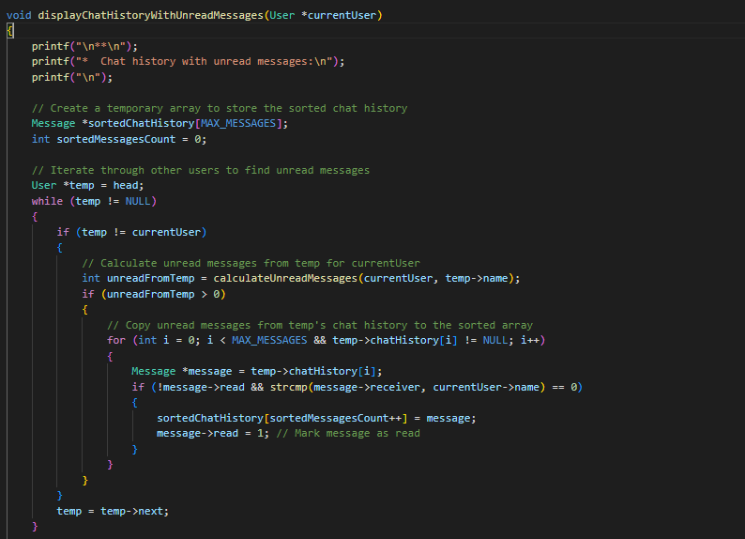
1.

Slide 20
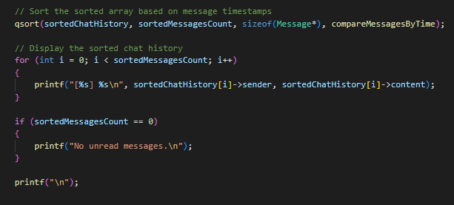

Slide 21
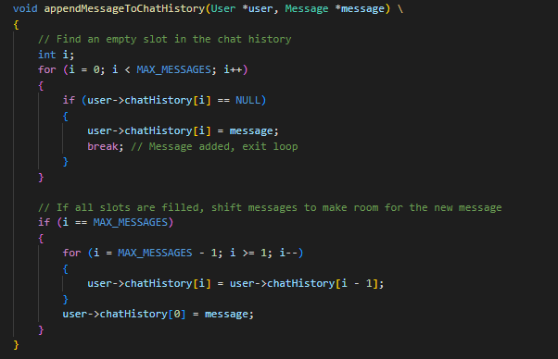
2.

Slide 22
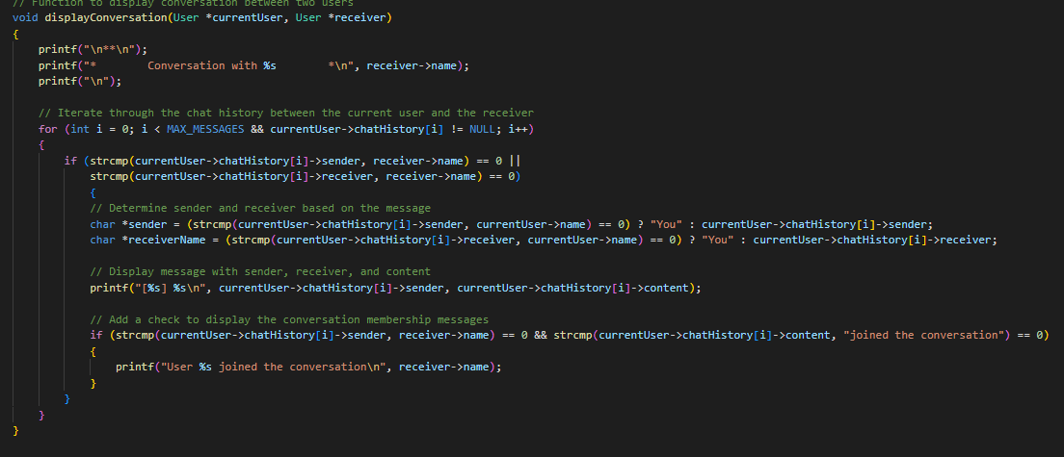
3.

Slide 23
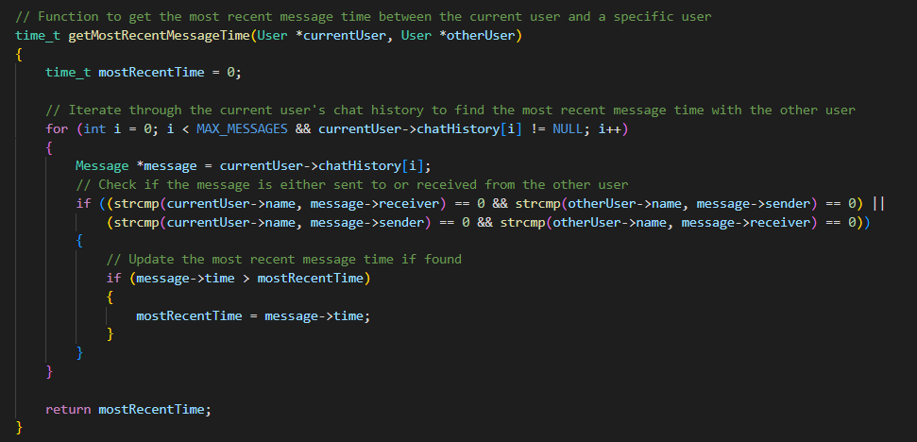
4.

Slide 24
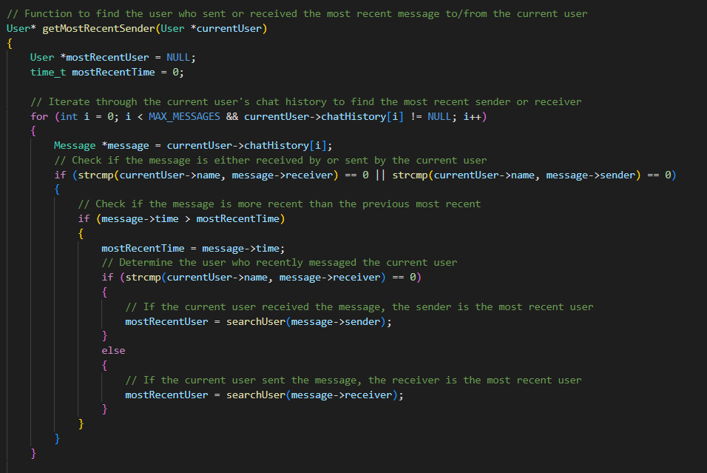
5.

Slide 25
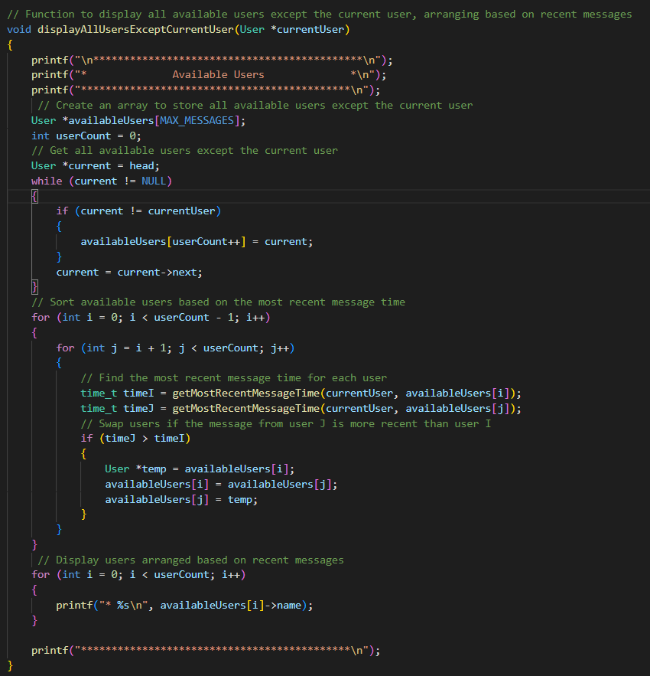
7.

Slide 26
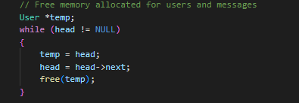
6.

Slide 27
THANKS!
Under The Guidance of Pratiksha Deshmukh ma’am
Amey Shinde (612203165)
Revati Patare (612203131)
Tanuja Patil (612203138)
Project By :-

