Slide 1
PowerBi infographics
Power Bi
Here is where this template begins

Slide 2
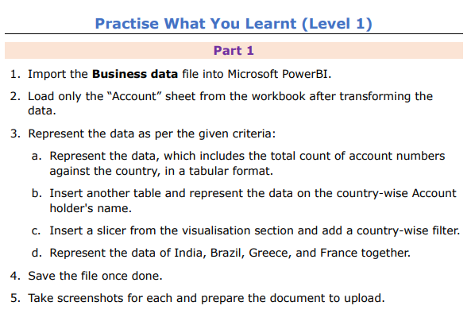
Task1

Slide 3
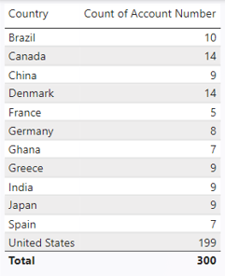
1. Import the Business data file into Microsoft PowerBI. 2. Load only the “Account” sheet from the workbook after transforming the data. 3. Represent the data as per the given criteria: a. Represent the data, which includes the total count of account numbers against the country, in a tabular format.
TASK1-PART1

Slide 4
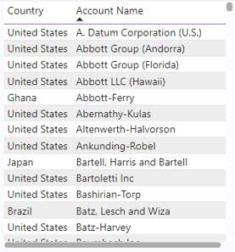
b. Insert another table and represent the data on the country-wise Account holder's name.
TASK1-PART1

Slide 5
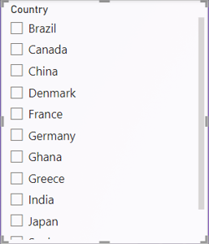
c. Insert a slicer from the visualisation section and add a country-wise filter.
TASK1-PART1

Slide 6
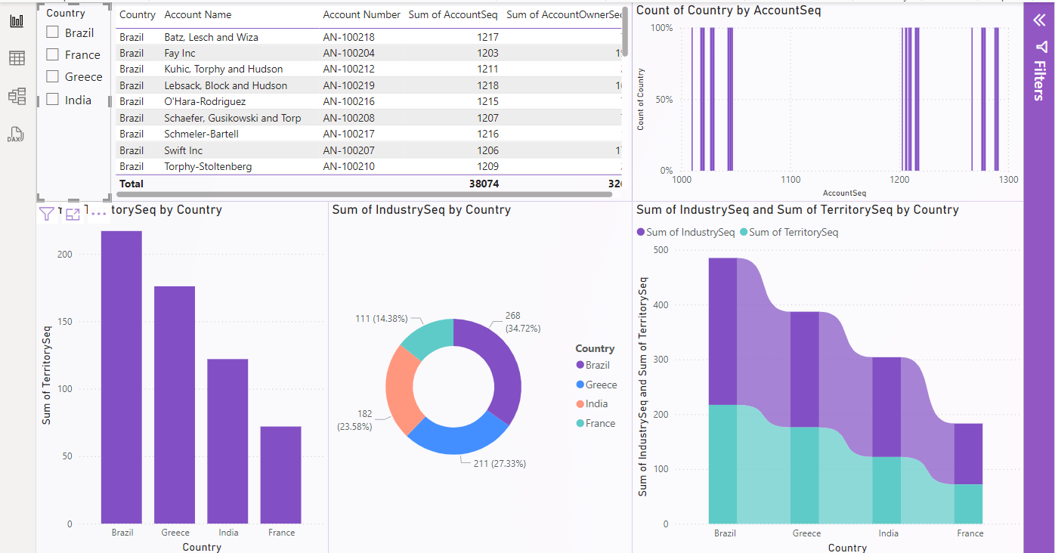
d. Represent the data of India, Brazil, Greece, and France together.
TASK1-PART1

Slide 7
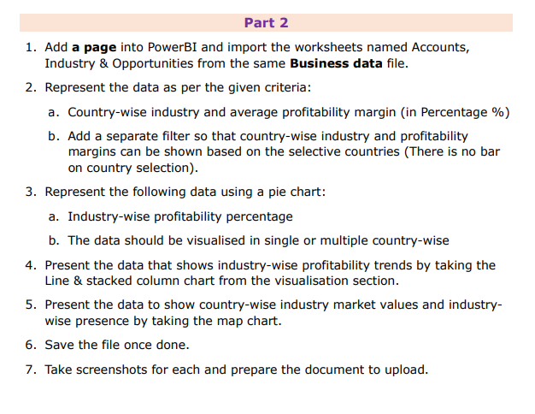
TASK1-PART2

Slide 8
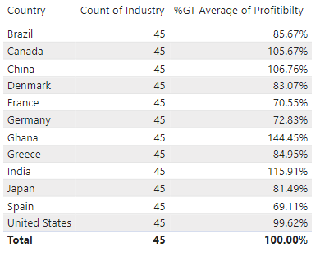
1. Add a page into PowerBI and import the worksheets named Accounts, Industry & Opportunities from the same Business data file. 2. Represent the data as per the given criteria: a. Country-wise industry and average profitability margin (in Percentage %)
TASK1-PART2

Slide 9
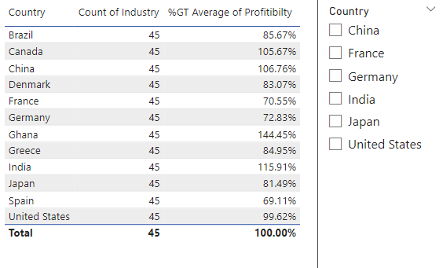
b. Add a separate filter so that country-wise industry and profitability margins can be shown based on the selective countries (There is no bar on country selection).
TASK1-PART2

Slide 10
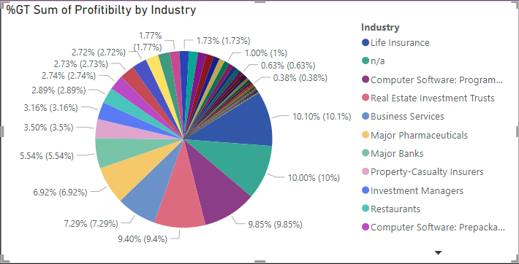
3. Represent the following data using a pie chart: a. Industry-wise profitability percentage
TASK1-PART2

Slide 11
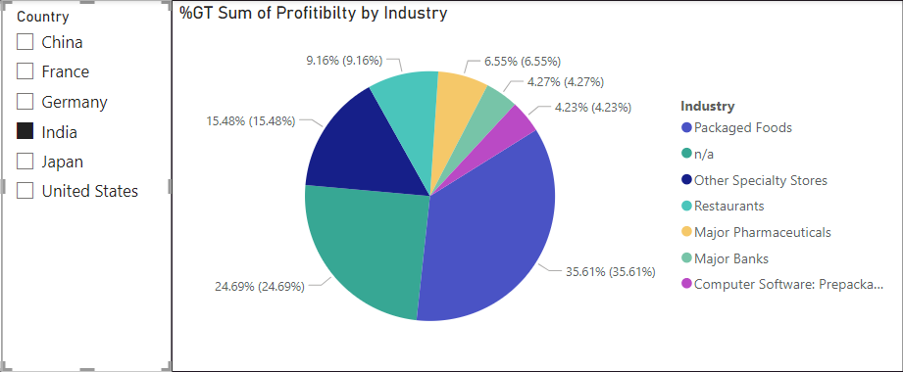
3. Represent the following data using a pie chart: b. The data should be visualised in single or multiple country-wise: it shows the country-wise profitability by industry of India.
TASK1-PART2

Slide 12
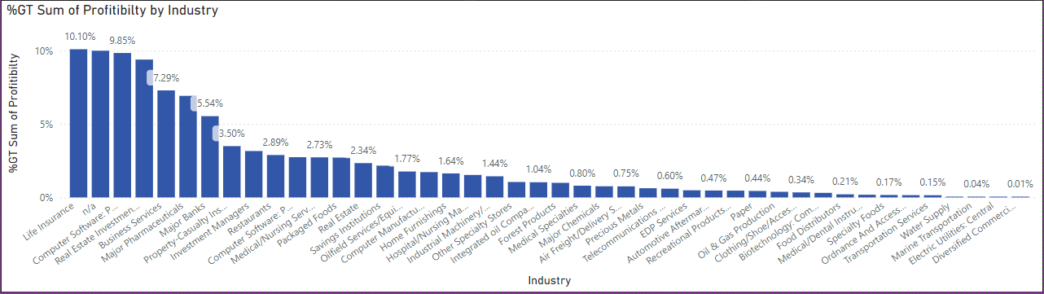
4. Present the data that shows industry-wise profitability trends by taking the Line & stacked column chart from the visualisation section.
TASK1-PART2

Slide 13
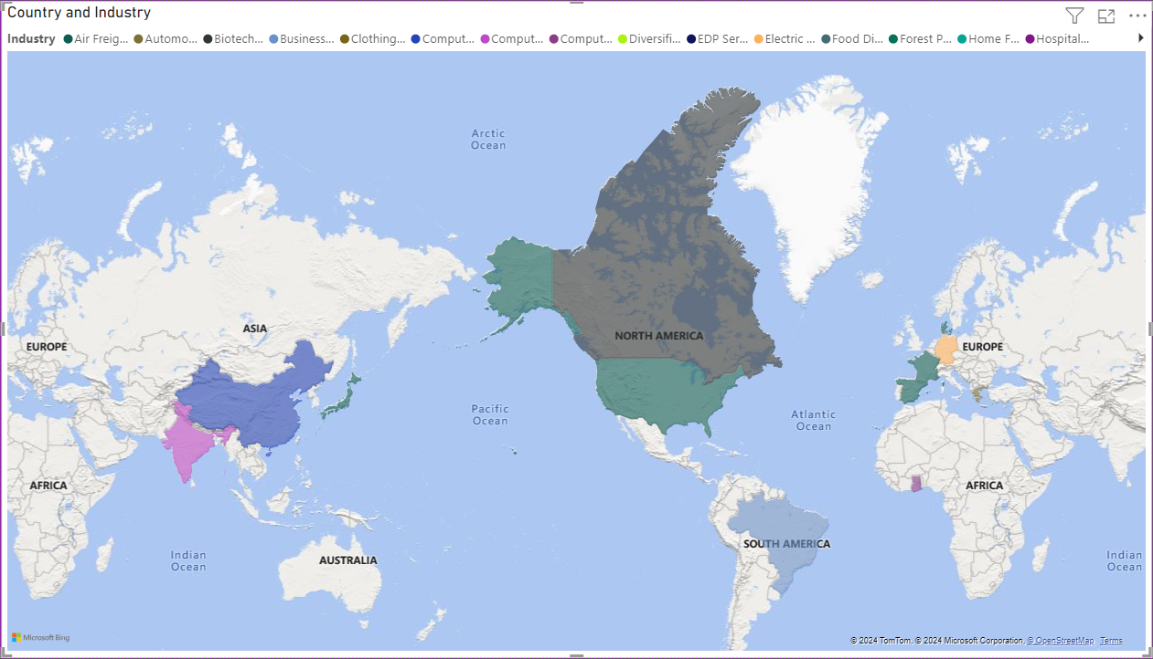
5. Present the data to show country-wise industry market values and industrywise presence by taking the map chart.
TASK1-PART2

Slide 14
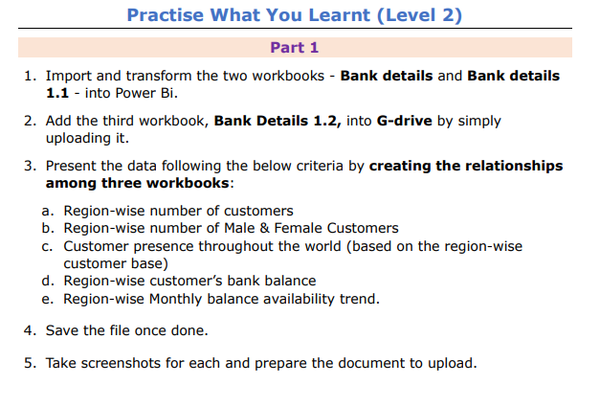
Task2

Slide 15
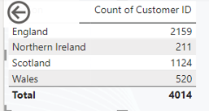
1. Import and transform the two workbooks - Bank details and Bank details 1.1 - into Power Bi. 2. Add the third workbook, Bank Details 1.2, into G-drive by simply uploading it. 3. Present the data following the below criteria by creating the relationships among three workbooks: a. Region-wise number of customers
TASK2-PART1

Slide 16
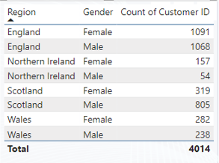
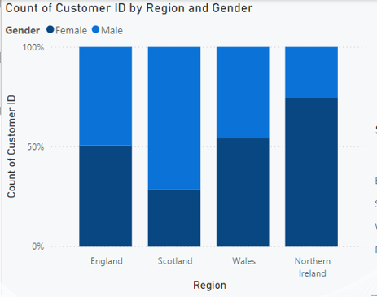
b. Region-wise number of Male & Female Customers
TASK2-PART1

Slide 17
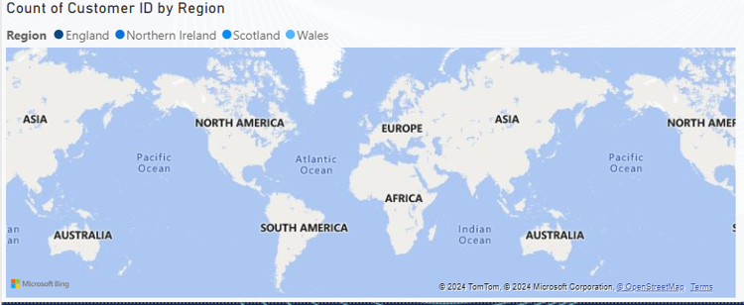
c. Customer presence throughout the world (based on the region-wise customer base)
TASK2-PART1

Slide 18
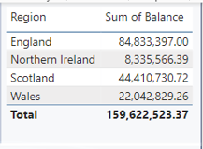
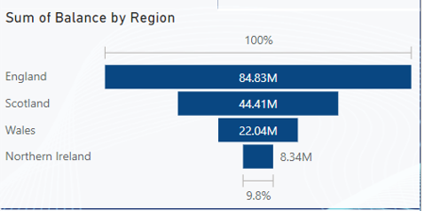
Region-wise customer’s bank balance
TASK2-PART1

Slide 19
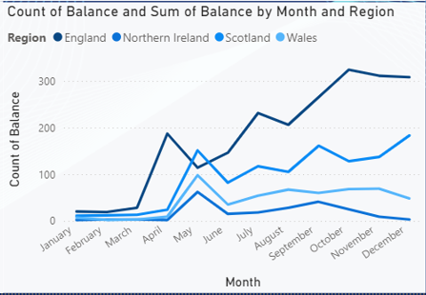
Region-wise Monthly balance availability trend.
TASK2-PART1

Slide 20

1. Import and transform the data from the Sales Data file to Power BI. 2. Represent the data as per the given criteria: a. Overall profit percentage and commission for sales against each sales representative
TASK2-PART2

Slide 21
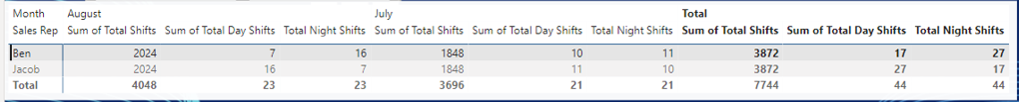
b. Sales representative-wise total number of work shifts (monthly basis) and work shifts (day & night) trends against the sales representative
TASK2-PART2

Slide 22
A.What are the areas you find for further improvement in terms of business product sales? As per my opinion In india the software peoduction ,major banks and major pharmacuticals must be improved instied of food and packaging. b. In which work shift does the sales representative mostly work? In both day shift and night shift the sales representative mostly works. c. Is there any additional impact you find in business in terms of product sales trends No there is no any additional impact in business in terms of preduct sales trends.
TASK2-PART2

Slide 23
Infographics
You can add and edit some infographics to your presentation to present your data in a visual way.
Choose your favourite infographic and insert it in your presentation using Ctrl C + Ctrl V or Cmd C + Cmd V in Mac.
Select one of the parts and ungroup it by right-clicking and choosing “Ungroup”.
Change the color by clicking on the paint bucket.
Then resize the element by clicking and dragging one of the square-shaped points of its bounding box (the cursor should look like a double-headed arrow). Remember to hold Shift while dragging to keep the proportions.
Group the elements again by selecting them, right-clicking and choosing “Group”.
Repeat the steps above with the other parts and when you’re done editing, copy the end result and paste it into your presentation.
Remember to choose the “Keep source formatting” option so that it keeps the design. For more info, please visit our blog.

