Slide 1
Tuition Reimbursement Management System
The TRMS system will allow your organization to easily manage education request and approvals. Benefits are approved by your organizations supervisors, department heads and benefit coordinator.

Slide 2
Key Advantages
Management can easily monitor all reimbursement requests.
Employees can submit and track their request on any device.
Clear record of company expenses.
Clarity investing in your employees.

Slide 3
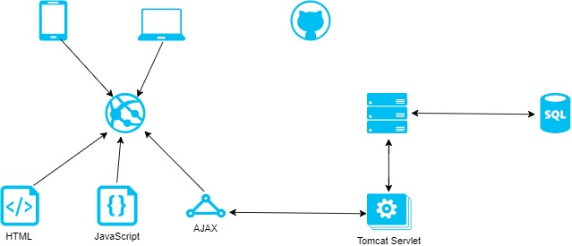
Technology Diagram

Slide 4
Technology Description
Single page application
Java Tomcat Servlets
Requests with AJAX using JSON
Persistence with Oracle PL/SQL

Slide 5
Demo
grumpyp@gmail.com Is an employee
sleepyb@gmail.com Is his supervisor

Slide 6
Next sprint
Department Head and Ben Co approval (database supports this)
Styling
Document upload

