Slide 1
Capstone Project
404 Slayers - ECommerce

Slide 2
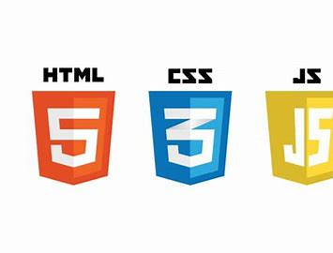












Technologies Used

Slide 3
GitFlow and Branching Architecture
Central Team GitHub Repository
Link to repo here
Branching was done on a per-feature or major update basis
Initial connection branch
‘Per question’ branching
Registering and login
Presentation branch

Slide 4
Team Structure
Front End
Joshua Cho
Twain Toussaint
Daniel Gutierrez
Courtney Hart
Back End
Jacob Ramsey
Colleen Lynch
Leonardo Molina
Testing
Troy Cogdell
Christopher Crawford
DevOps
Erik Thomas
Michael Lee

Slide 5
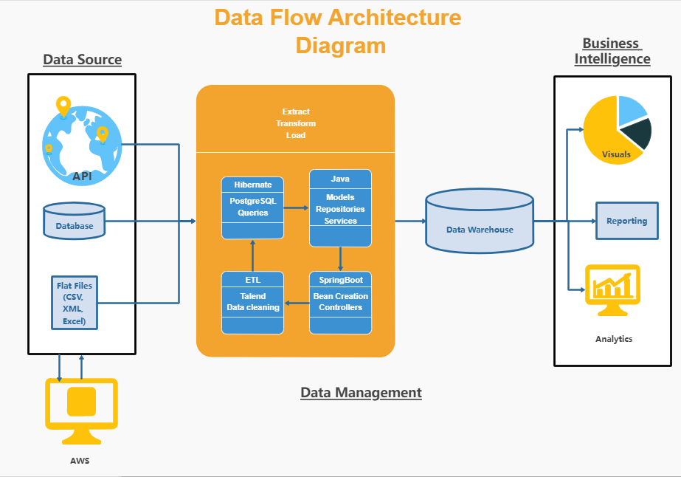
Architecture
Testing

Slide 6
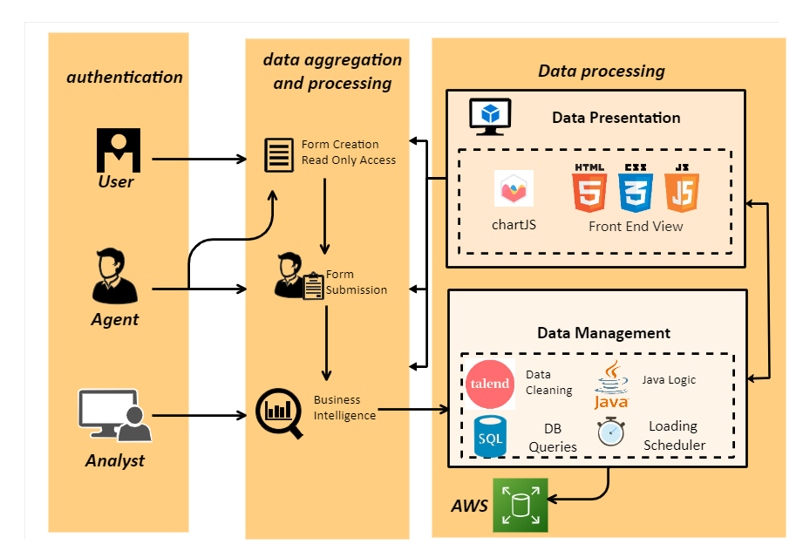
Pipeline Structure
Costumer

Slide 7
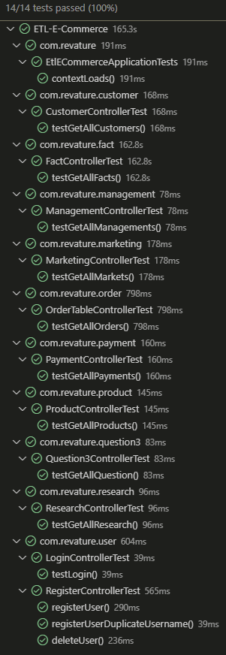
Code Test Coverage - JUnit
JUnit was used to test all controllers to make sure request were properly received and servlets were created appropriately.

Slide 8
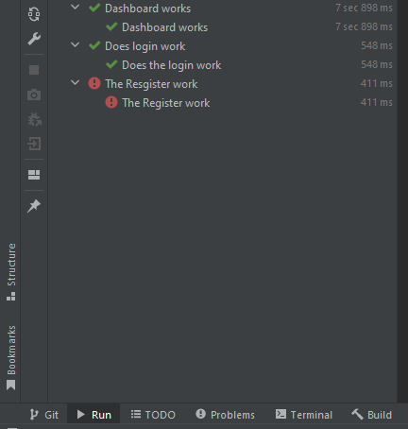
Code Test Coverage – Selenium
Web Browser automation was conducted using Selenium/Cucumber/Gherkin to test key functions of the application and predict user behavior.

Slide 9
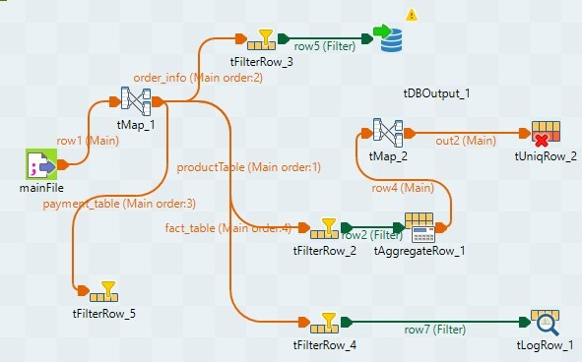
ETL Process
Image 9.1 – Talend structure for data transform process.

Slide 10
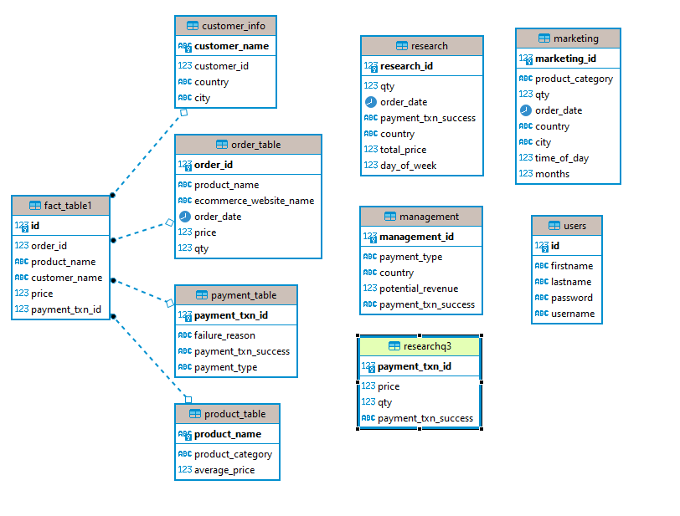
ERD Diagram
Table 13.1
Table 13.1 (left) is a unique schemas inside our DBeaver constructed to answer specific questions and gather specific business intelligence data in Star schema form.
Next, data was further divided into data marts for research, management, and .marketing functions.

Slide 11
Features Implemented
Customer | Analyst
Form Creation | Data Gathering
Read Only Permissions | ETL Tools
Form Submission | Graphical Visualization
 | Parameter Control
 | Transaction Management
 | RDS Management
 | Component Testing

Slide 12
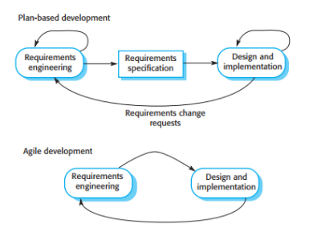
Team Workflow Implementation
Agile/Scrum
Simultaneous front end and back-end development
Daily scrums and offline communication
Technology conflict resolutions
Waterfall
Per question development
On demand function development
Image 11.1 - Agile Framework

Slide 13
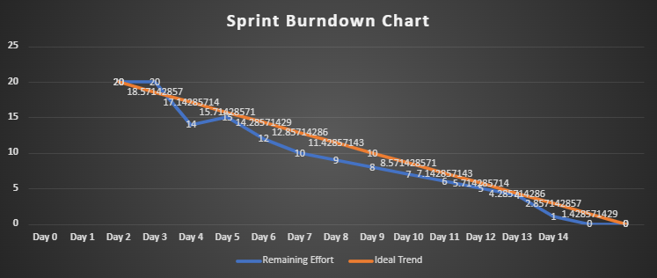
Sprint Breakdown
Graph 12.1
Graph 12.1 is a visual breakdown of the team's sprint breakdown. The blue line represents our true progress compared to the ideal path in orange.

Slide 14
Outstanding Defects
As much as we would like to boast that our application is capable of it all…
Application is limited to pre-created csv file
Limited flexibility and rigid features.

Slide 15
Challenges and Pinch-points
Front End
JavaScript algorithms
JavaScript Execution
Back End
Transform Complexities
Dimensional Schemas
Testing
Compatibility
Alert Buttons
Version Control
Project Management
Code Priority
Merging Difficulties

Slide 16
Thank you for your attention!
Any Questions?

