Slide 1
P2: Bank of CLI Full Stack
Revature
2026 / October
Group 3

Slide 2
P2: Bank of CLI Full Stack
Contents
2026 / October
1.
Full-Stack Integration
2.
Architecture
3.
Demos
4.
Questions?

Slide 3
Full-Stack Integration

Slide 4
P2: Bank of CLI Full Stack
Communication
1
2
3
4
Accounts
Transactions
Transaction History
Balance
2026 / October
HTTP communication between the frontend and backend
Users register and login through /api/auth. Backend validates the request and returns the account details along with a JWT. Frontend sends that token with every request to prove who the user is.
Transactions are executed depending on the type the user chooses. Calls the Transaction Service and returns the completed transaction.
The backend returns an updated list of past transactions to display in a table on the dashboard.
Balance is returned to the frontend along with transaction responses instead of being calculated locally, to remain in sync with the database.

Slide 5
P2: Bank of CLI Full Stack
JWT Security
User Authentication
Users log in using their registered email and passwords.
1
Password Protection
Passwords are securely hashed rather than stored in plaintext.
2
JWT Generation
After successful login, the backend generates a signed JSON Web Token.
3
Protected API Endpoints
The frontend includes the JWT in Authorization header when accessing secured endpoints.
4
Stateless Authentication
Spring Security validates the token, allowing users to access protected banking features without maintaining server-side login sessions.
5
2026 / October

Slide 6
P2: Bank of CLI Full Stack
Access Security
2026 / October
Secure Registration
Validates user information before account creation.
Prevents duplicate accounts by checking registered email addresses.
Uses BCrypt to hash passwords before storing them in the database
Secure Login
Authenticates users using their registered email and password.
Uses Spring Security’s PasswordEncoder to compare passwords against stored hashes.
Rejects invalid Credentials to prevent unauthorized access.
Testing
We wrote a simple test for the authorization services using Mockito.
Notes:
During registration, our backend validates the user's information and checks for duplicate email addresses. Instead of storing passwords directly, we use BCrypt to hash them.
When a user logs in, Spring Security compares their submitted password against the stored hash. This allows us to verify their identity without ever needing to retrieve their original password.
We included a test to ensure that security worked. It test

Slide 7
Architecture

Slide 8
P2: Bank of CLI Full Stack
Tech Stack
Database: AWS, ECS, PostgreSQL
Backend: Spring Boot (Java)
Security: JWT (JSON Web Tokens)
Frontend: React and Angular (TypeScript)
Communication: REST / JSON
2026 / October
Hosts the database online via Cloudfront instead of locally
Automatically configures dependencies with Maven
Stateless, scalable, decentralized verification of user identity
Standard, stateless HTTP methods for CRUD, and allows client-server decoupling
The two frontends from P1
Both connect to the same backend

Slide 9
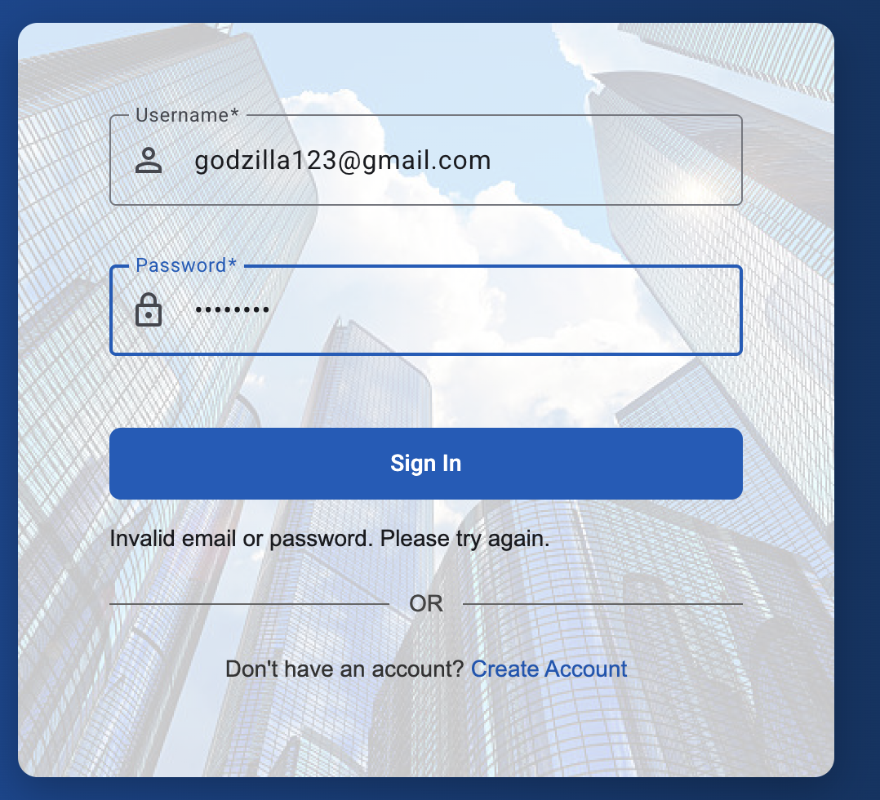
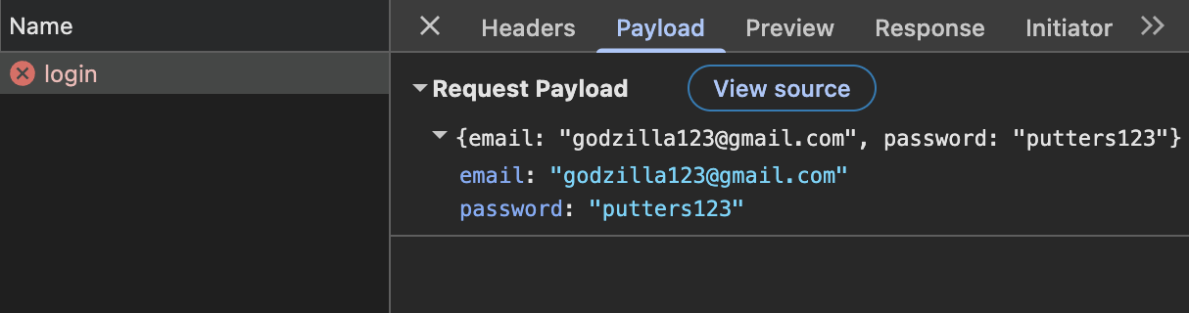
P2: Bank of CLI Full Stack
Angular Integration
2026 / October
Refactored login, registration, and transfers to communicate with the Spring Boot REST API using Angular’s HttpClient
Centralized HTTP requests in a shared injectable service, using Observables to handle backend responses
Notes:
My main responsibility was connecting our Angular frontend to the backend. Previously, login and registration used mock accounts, and transfers calculated balance changes locally. I refactored these features to send HTTP requests through our shared API service and handle the responses asynchronously.

Slide 10
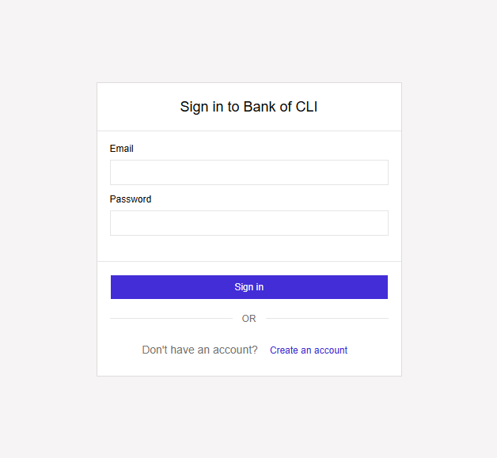
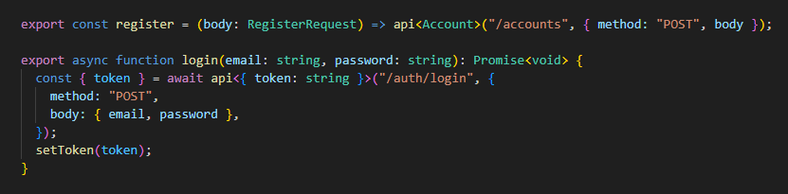
P2: Bank of CLI Full Stack
React Integration
2026 / October
Mock database calls in our React project were refactored to route through our REST endpoints using the fetch API
One file stores and exposes all API-related functionality, making the logic more maintainable
These methods are imported as needed into components

Slide 11
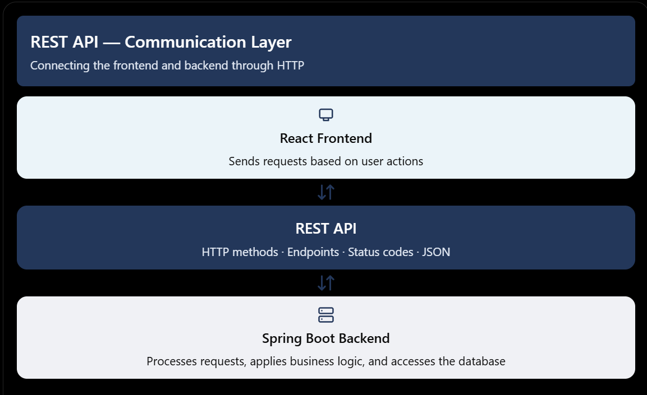
P2: Bank of CLI Full Stack
REST API
2026 / October
Concepts
HTTP Methods: GET retrieves data, POST creates data, PUT/PATCH updates data, and DELETE removes data.
Endpoints: URLs identify resources, such as /api/accounts or /api/account/[transaction_type].
JSON: A common format for exchanging structured data between the frontend and backend.
HTTP Status Codes: Communicate results, such as 200 (OK), 201 (Created), 400 (Bad Request), and 404 (Not Found).

Slide 12
P2: Bank of CLI Full Stack
Spring Boot
2026 / October
Transaction Service, Exceptions, Domain And Repository
Transaction Service
Repository
Global Exception Handler
Handles valid deposit, withdrawal, and transfer transactions. Uses @Transactional to enforce ACID on transactions.
Contains Interfaces used to persist accounts and transactions to the database using Spring Data JPA (Hibernate).
Catches exceptions from any controller, including validation errors and unexpected runtime errors. Returns the correct HTTP status and error body.
Domain
Row Locking
Custom Exceptions
Contains entities and the relationships between them, mapped to the database tables using JPA annotations such as @Entity and @Table. Example entities include transaction and types of transactions.
Prevents lost updates when two requests hit the same account at once. Each transaction locks the account row, and transfers lock the lower account ID first to avoid deadlocks.
Represent failed or invalid transactions. Each one carries its HTTP status and contract message and they are thrown from the service layer.
15 JUnit 5 and Mockito unit tests cover deposits, withdrawals and transfers. MockMvc tests confirm that each error returns the correct status and contract message. CI runs every test on each pull request.

Slide 13





P2: Bank of CLI Full Stack
AWS
2026 / October
Hosting Database And Deploying Application
Request Queried
User
Amazon CloudFront
Amazon ECS
Amazon RDS
Request Forwarded
API Forwarded
Amazon ECR

Slide 14
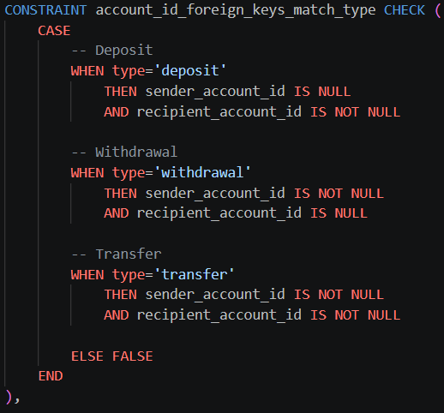
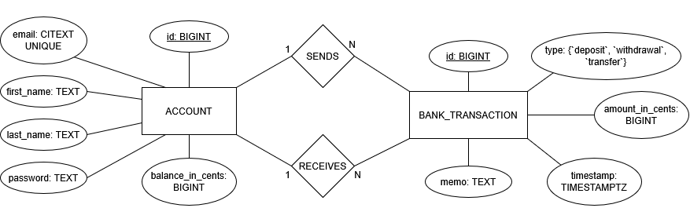
P2: Bank of CLI Full Stack
Database Schema
2026 / October
The structure of our PostgreSQL database
Account
Bank Transaction
ID (auto-incremented)
Email (unique and case-insensitive)
First and last name
Hashed password
Balance in cents (default 0, never negative)
ID (auto-incremented)
Type (‘deposit’, ‘withdrawal’, or ‘transfer’)
Money amount in cents (always positive)
Timestamp
Memo (for use in the future)
Sender and recipient accounts
Bank Transaction Constraints
Last line of defense for data integrity
Relationships NULLed depending on type
Self-transfers are forbidden
Bank transactions handle $10,000 maximum

Slide 15
Demos

Slide 16
Questions?

