Slide 1
Bank of CLI
Revature
Project 1, Team 3
Notes:
Joaquin: do introduction

Slide 2
Revature
A reliable front-end for a bank experience.
We built a single-page application for Bank of CLI that is ready to integrate with a future backend
October 2026
Notes:
Joaquin: do introduction

Slide 3
Revature
Technology Stack
1.
Angular – Single Page Application Framework (SPA)
2.
TypeScript – Typed Models and Predictable Data Structures
3.
HTML – Structure & semantic elements for the website.
4.
CSS – Interactive/Responsive Styling and Presentation
5.
JSON – Mock API responses for the Service Layer
6.
Git/Github – Version Control and Team Collaboration
7.
Git/Github – Version Control and Team Collaboration
Notes:
Joaquin
Angular allow us to build SPAs websites that can have dynamically changing content without requiring the page to refresh. The general trade-off is an initial load time with a quick runtime. Angular organizes the application into components, services and structures while providing tools to develop an interactive site.
TypeScript adds static typing to JavaScript. It’s used by Angular to add intractability and functionality
CSS is used to adds the visual element like shape, color, size and position allowing us to style the user interface
JSON is a lightweight data format used to store and exchange structured information. It organizes data into key-value pairs and arrays, making it easy for different parts of an application to read and exchange data.
GitHub provides a remote repository where we can store and share our project's code. It works with Git to track changes, manage branches, and allow team members to collaborate on the same project.

Slide 4
Revature
Architecture
A description of our service-based architecture
Component layer
1
The component layer is responsible for the user-facing parts of our application and how users interact with them
Service layer
2
The service layer handles the application's business logic and communication between the components and backend systems.
Contract layer
3
The contract layer defines the structure and format of the data exchanged between different parts of the application.

Slide 5
Revature
Git/Github
Utilization
Group Member Develops A User Story
Group Member Develops A User Story
Group Member Develops A User Story
Component’s Branch
Main Repository
Group Member Develops A User Story
How did collaboration amongst us happen?
Conflicts
Pull Request w/ Rules
git push
Github
Github

Slide 6
Revature
Frontend Experience
1
2
3
4
Secure access
Dashboard
Transaction center
Professional UX
An overview of our responsive, interactive web dashboard
The user is prompted to log into their account. Pages such as the dashboard and transactions page can’t be accessed when not logged in.
The user has access to their balance, recent transactions and a navigation bar hosting 3 transactions.
The transaction center contains the Deposit Withdraw and Transfer functions of the Bank. It will prompt the user with a popup UI.
Features smooth animations, pop ups, easy navigation with back buttons, user-readable error messages, UI responsiveness, and a consistent style.
Notes:
Taylor

Slide 7
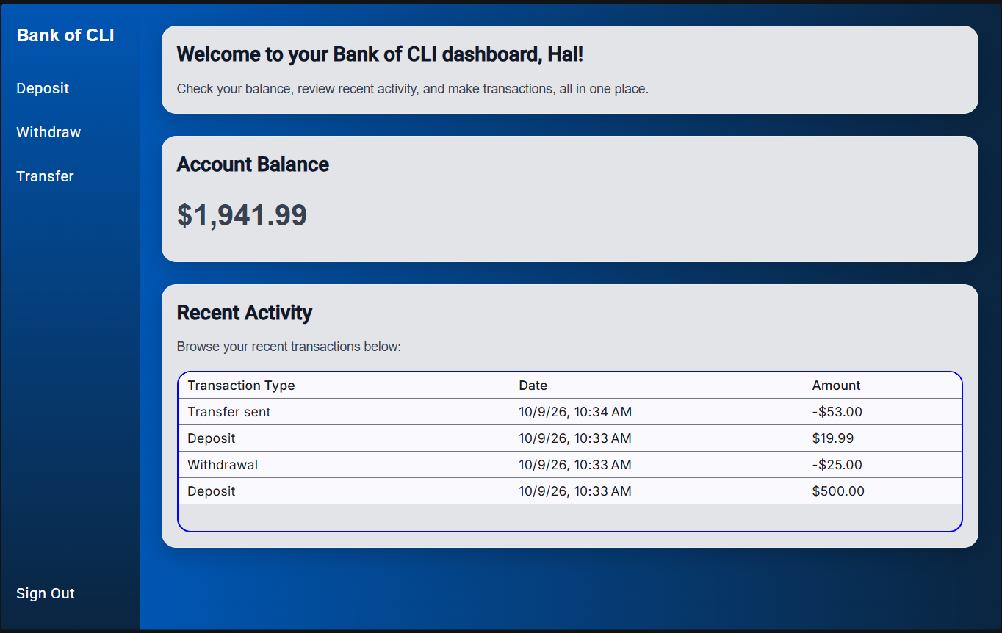
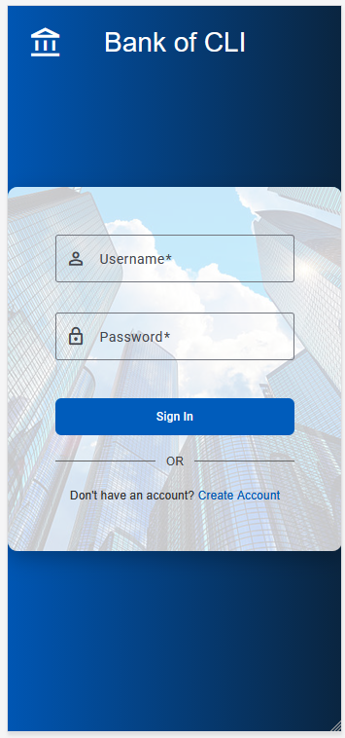
Authentication
Menu Animation
Login & Logout
Register
Ethan Duarte
Revature
How users register, login, and logout
Signs the user into account
Creates a new account
→ saves the logged-in a signal the whole app can read
→ Sends the user to their dashboard on success
→Sign out clears the logged-in user and returns them to log in
→ Loads starter accounts from a mock Json file.
→ Auto Generates each accounts id
→ Sends the user to the login once the account is created
→ Menu only appears while a user is logged in.
→ Waits for the slide-out to finish before removing the menu
→ On sign out, the menu slides off before the user returns to login
Notes:
Ethan

Slide 8
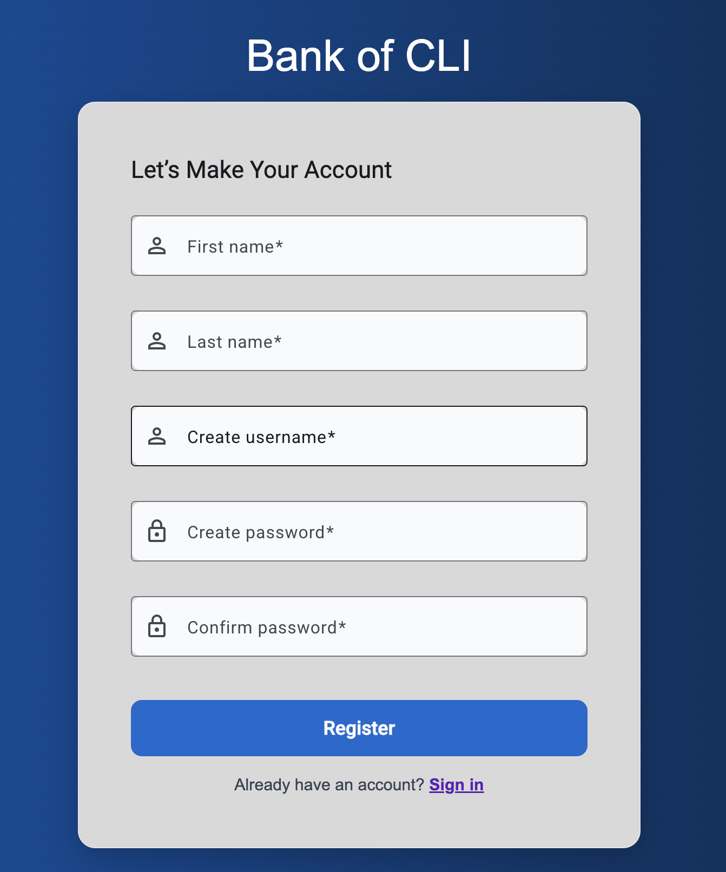
Revature
Registration
U.I. Implementation
Component
How users can register an account
→ User Interface for the Login and Registration pages was developed using Angular Material components such as MatFormField, MatInput, MatButton, MatCard, and MatIcon.
→ User information is entered through Reactive Forms, allowing values such as username and password to be collected and validated before being passed to the application’s service layer.
→ Login and Registration page styling, including colors, spacing, form fields, buttons, and card layout, is implemented within each component’s CSS.
→ Like other components, the Login and Registration pages are connected through Angular routing, allowing users to navigate between the two pages within the Single Page Application.
Notes:
Yoram

Slide 9
Revature
Transaction Center
Deposit
Withdraw
Transfer
Overview
Features
Validation
Allows the user to add money into their balance.
Allows the user to take out money from their balance.
Allows users to send money to another user’s account.
Prevents invalid inputs.
Provides a responsive UI for the user to interact with.
Carries over features from deposit.
Ensures users have enough balance for the transaction.
Carries over features from both deposit and withdraw.
Allows the user to input the recipient’s account with validation checks.
Ensures the user inputted a positive number greater than $0.00.
Same number input validation as Deposit.
Prevents user from inputting a number greater than the balance.
Same input validation as both Deposit and Withdraw.
Ensures the recipient’s account input is valid and that the account exist.
Notes:
Taylor: talk about the number validation directive
Jimmy
The Transaction Center provides the user interface for the three main banking operations: deposits, withdrawals, and transfers. Each option allows the user to interact with their account through a consistent interface
The deposit feature allows users to add money to their account, while the withdrawal feature allows them to take money out. The transfer feature allows users to move money between accounts.
We designed these interactions to be straightforward and consistent using the same angular material components as the dash and login, using popup dialog windows to guide users through entering the necessary information and completing each transaction.
I’ll hand it off to Taylor to explain the validation..

Slide 10
Revature
Transaction Table
U.I. Implementation
Component
How users can view their transactions
→ User Interface for the transaction was developed using the MatTableModule from the Angular Material Library.
→ User’s transactions will appear row by row, with a max of 5 rows before the ability to scroll is allowed to see the additional rows.
→ Transaction Table’s style (size, font, padding, etc.) is implemented within the component’s CSS.
→ Like other components, placement of the component is made inside the encompassing dashboard component.
Notes:
Taylor: talk about how it gets the data--held in authservice and transactionservice, will be able to access persisted data from a real backend , also pipes the amounts through our money formatter
Joaquin: talk about UI

Slide 11
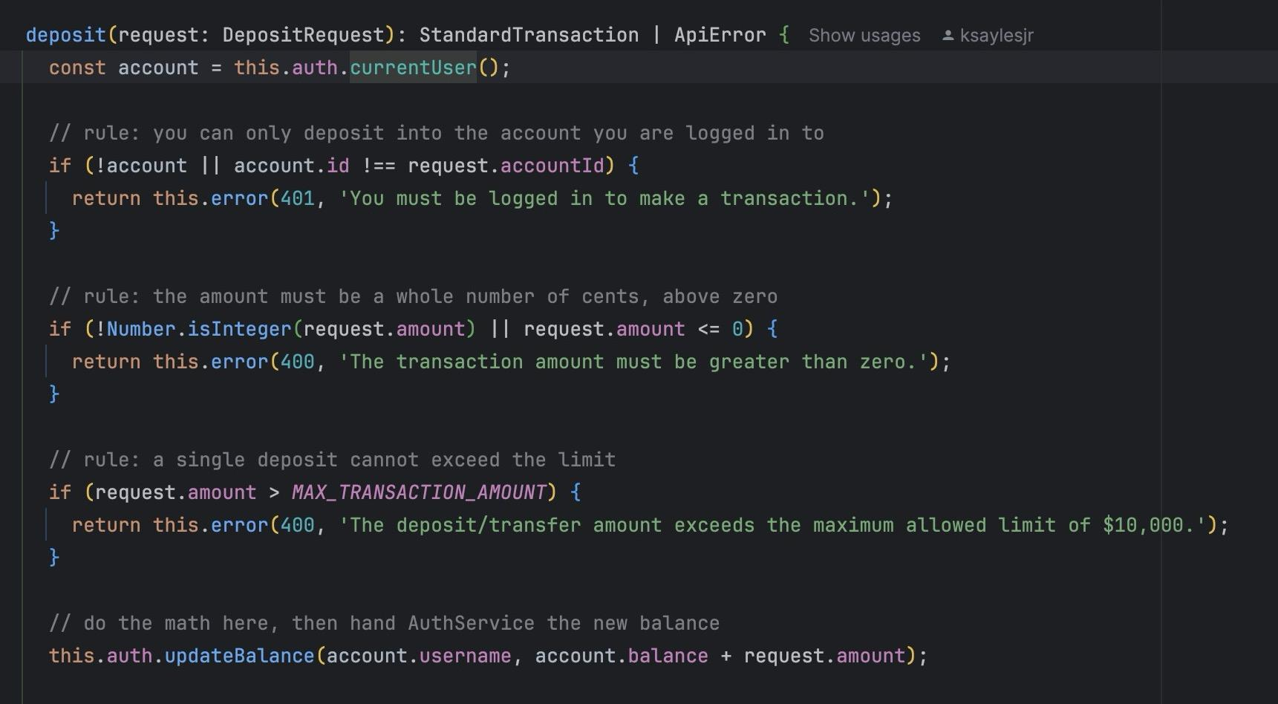
Revature
Transaction
Service
Rules enforced: logged in - within the $10,000 limit - sufficient funds - recipient exists
Requirement: The Service Layer “handles all data logic” and components should ask a Service for it
One Service owns the logic
Deposit, withdraw, transfer and transaction history all live in TransactionService
Rules first, then the change
All rules are checked before any balance changes. A rejected request changes nothing
One of two results
Returns the transaction or an error message from our contract. Confirmed by 17 tests
Notes:
Kenya

Slide 12
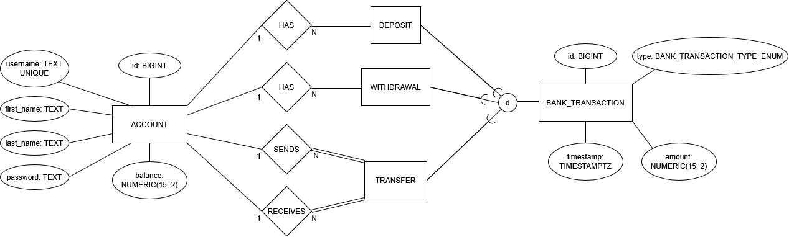
Revature
API Contract
EER Diagram
The structure of the data exchanged between the frontend and the service
To inform our data structure and API design, we modeled a database in advance
Database structure does not directly affect frontend, but we took it into account for designing the contract layer
Notes:
Aarej

Slide 13
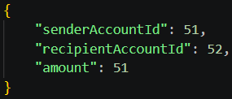
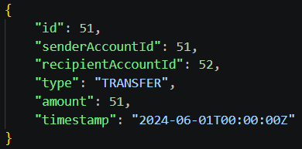
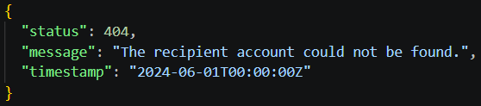
Revature
API Contract
Successful Response: Get Transfer
Request: Transfer Money
JSON Structure
Unsuccessful Response: Transfer Recipient Does Not Exist
The structure of the data exchanged between the frontend and the service
We defined consistent JSON structures for:
  Requests
  Successful Responses
  Unsuccessful responses
The frontend reads simulated backend responses that follow these structures
Our future backend will also follow this contract, so it will connect seamlessly with the frontend
Notes:
Aarej

Slide 14
Demo

Slide 15
Questions?

