Slide 1


VAXIFY
BILLY HUYNH, ABEIL ADILOW, EMILIO BARAJAS , ANTHONY ESCALANTE

Slide 2
WHAT IS VAXIFY?
Vaxify will be an application that checks your vaccine status based off of the information in the database. There will be two accounts Customer and Professionals, customers will have to sign up for an account and link their account and medical information through their SSN. Customers will be able to check the vaccine status of themselves or the status of someone else through scanning a QR code while being able to generate their own from the app. The professional side will be for inputting or updating customer data, the customer side will never have access on this side so there is not any risk of Sensitive Data Exposure. We are assuming this is a government assigned program so we will have every American in as a baseline with everyone being unvaccinated and update the list when a person gets their first shot and second shot along with what type of vaccine, where they got it, when they got it, and what batch it was in.

Slide 3
WHY?
We created this application because we noticed people are getting the covid vaccines in greater numbers and some businesses, like bars, are starting to require you to have the vaccine to get into places, so we came up with a solution to carrying your vaccine card with you where you go but still be able to show you are vaccinated. With our application you are able to register your account with your medical record and be able to generate a QR code that can be scanned and show you are vaccinated.

Slide 4
USER STORIES
Patient
Provider
Login
Create account and link it with medical information
Reset password
Get vaccine status
Generate QR code with vaccine status
Get other customers information from a QR code
Login
Update customer medical information
Get statistics on individual people

Slide 5
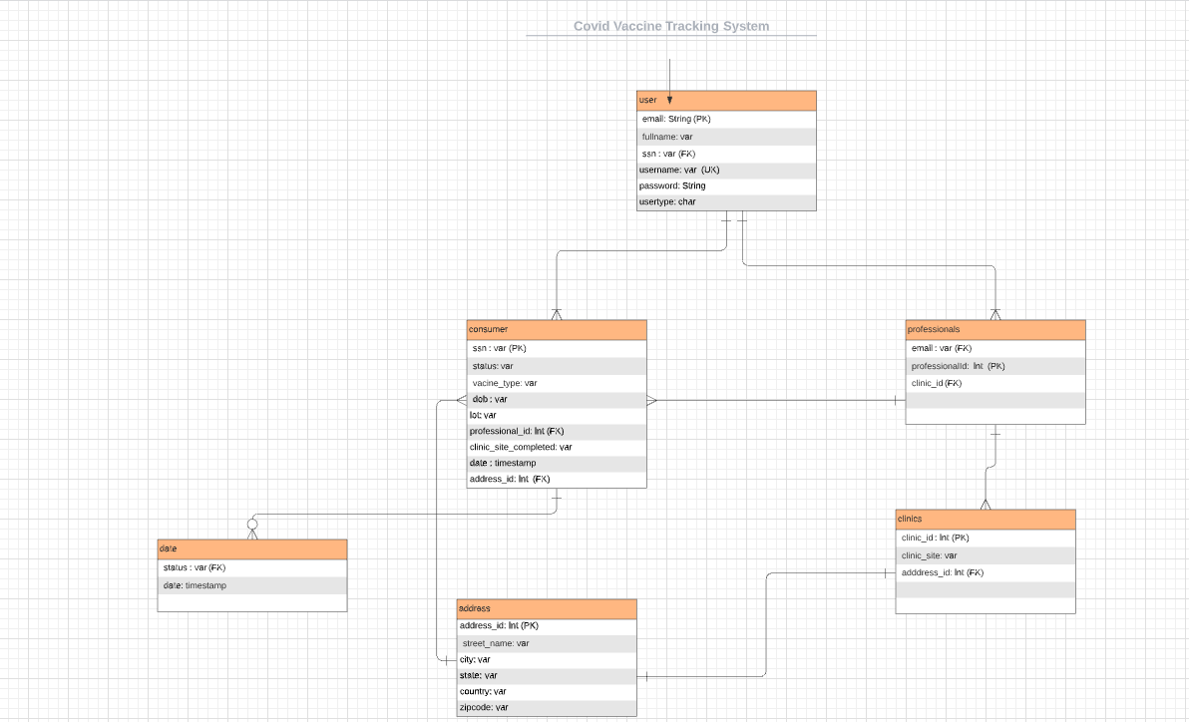
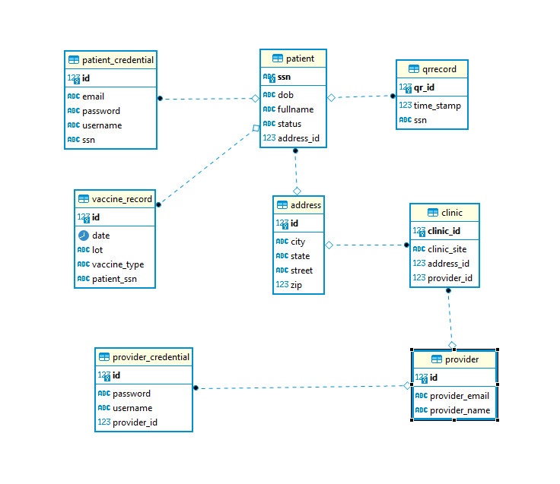
ERD DIAGRAM
Old ERD Diagram
Current ERD Diagram

Slide 6
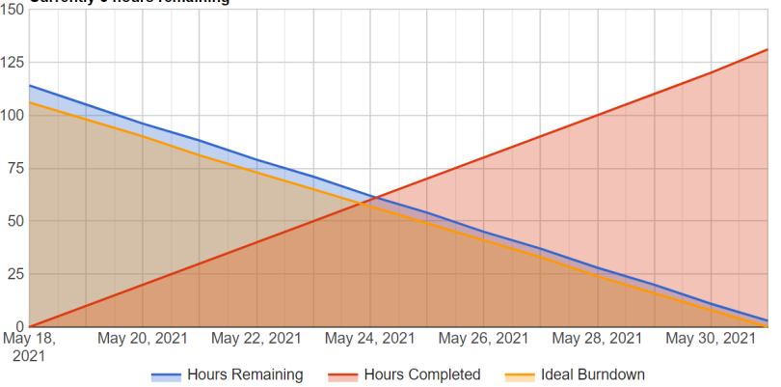
BURNDOWN CHART

Slide 7







TECHNOLOGIES USE
Backend
JAVA 8
Spring Boot
PostgreSQL
AWS (RDS, S3, EC2)
Log4j
Frontend
HTML/CSS/Bootstrap
Angular 11+
TypeScript
Testing
Junit
Mockito
Jacoco
Postman
Devops
Jenkins
Git
Gradle
Trello

Slide 8
LIVE DEMO

Slide 9
ACCOMPLISHMENT
Most of the features are fully functional
  Patient can log in, register, reset password, generate QR code, display their own vaccine record
  Provider can update the patient’s vaccine record and status
Enhance knowledge in multi-tiered web application design
Strengthen programming and debugging skills
Experience adapting to a fast-paced working environment with deadlines

Slide 10
CHALLENGES
Communication and Time Conflict
Lack of experience in Devops and Agile

Slide 11
Future Developments
Implement displaying statistics on charts based on location feature
Improve the web application security
Implement resetting password through email account feature
Running on mobile devices

Slide 12

THANK YOU & QUESTIONS

