Slide 1
TEAM: Alchemy
Kathryn Olsen
Alex Griggs
Nathan Keppler
Charles Zablon
Reis Taylor

Slide 2
Online Video Game store
Video Game Products
Sales Cloud: Leads & Opportunities, Paths, web-to-lead
Service Cloud: Cases, Case Paths, Web-To-Case
Data Model

Slide 3
Online Video Game Store
Security: Org wide defaults, Role Hierarchy , Sharing Rules
Process Automation: Automatic processes, flows, before-save flow, and after-save flow.
Reports and Dashboards: One Standard and One Custom Report.
Lightning App Builder: Created a Video Game App

Slide 4
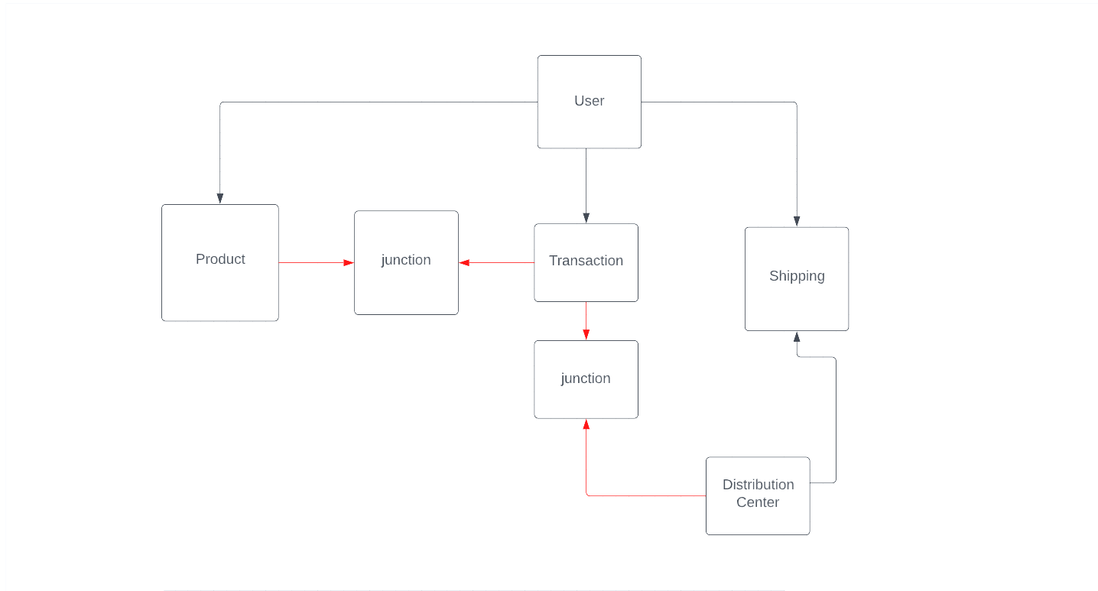
ERD: online video game store

Slide 5
P1 TOOLS THAT AIDED COMPLETION
SDLC Practices: KANBAN board, Scrumban, Outlines
Trailmixes, Security Badges
Working in Salesforce and gaining hands on experience.
Working with Team members and non team members, proved very helpful

Slide 6
Lets check out the final product!
Next up: Alex Griggs

