Slide 1

FIND KONTESTS
And take your skills to new heights!

Slide 2
01
Hackathons
Push yourself and learn from others!
Notes:
AKA Competitive Programming
Makes you a desirable candidate to major companies
Makes you faster and more focused
Helps you solve complicated problems
Teaches you how to work in teams

Slide 3

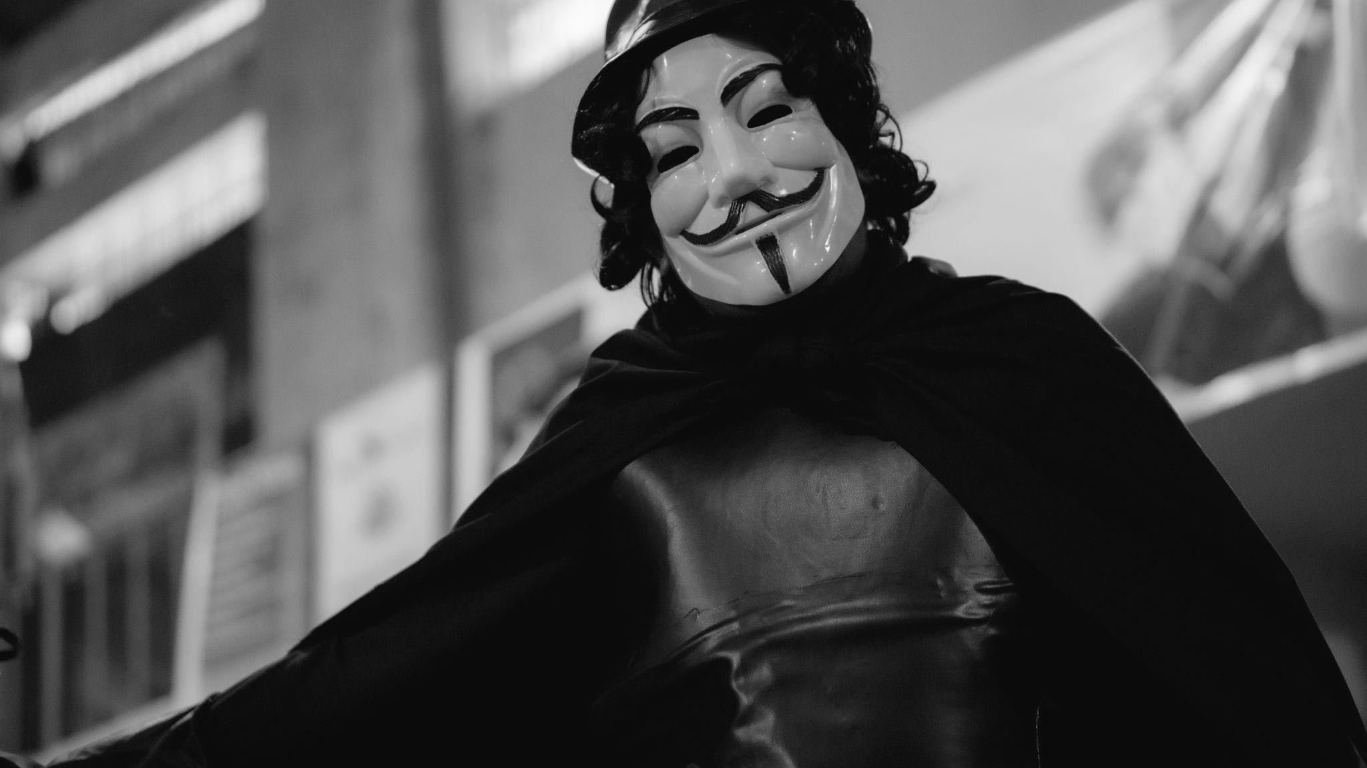
Notes:
We’re not talking about this guy

Slide 4
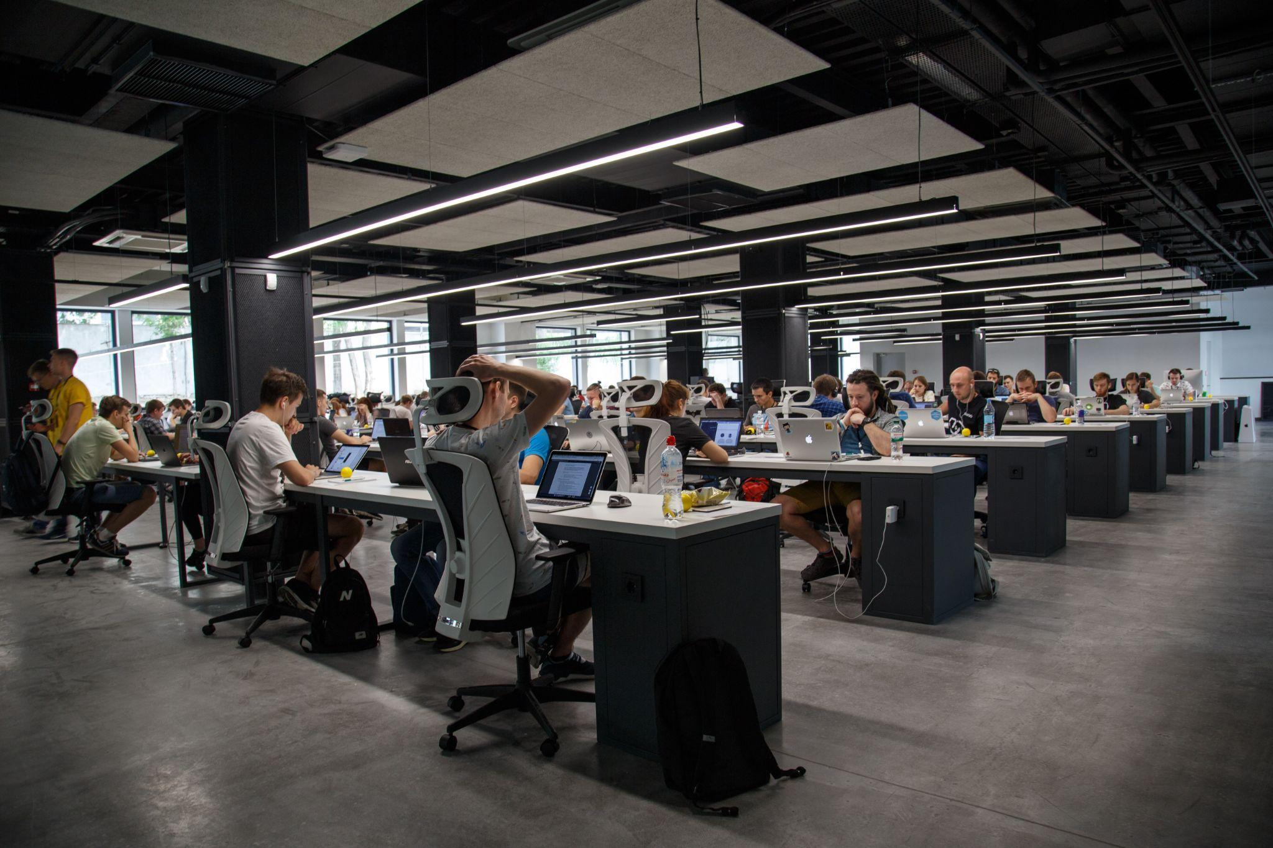
Notes:
We’re talking about these people

Slide 5

Tools Used
01
04
02
05
03
HTML
Responsive Design
Structure
Accessibility
CSS
External API
Design
Retrieving Information
JavaScript
Functionality

Slide 6
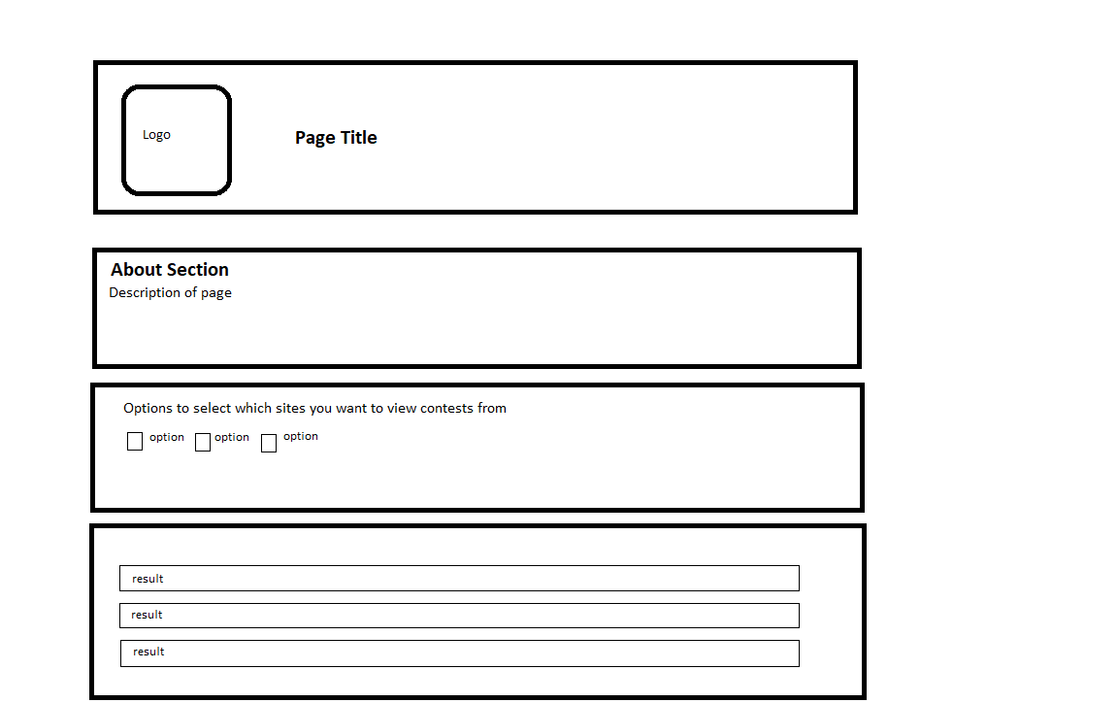
Notes:
My design team was on vacation!

Slide 7
02
DEMO
Let’s see it!

Slide 8
?
Questions
About the project

Slide 9
RESOURCES
Images
Guy Fawkes
Hacker Group
API
KONTESTS Donation
KONTESTS GitHub
Other
Contest Benefits

