Slide 1

Git
Daniel sidhu & Rhys Yamasaki

Slide 2
What is git?
A version control system
Managing source code
Tracking changes made to code

Slide 3
What is the git work flow?
Start by creating a repository to store code
Have common branches shared by all (master, dev, staging, ect.)
Developers create separate branches (features) to work on applications locally
After completion, the branch is combined back into the main branch

Slide 4
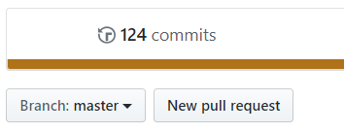
The git approach
All local branches will follow feature/”feature-name”
Using command git checkout –b feature/”feature-name”
IMMEDIATELY create a new pull request!

Slide 5
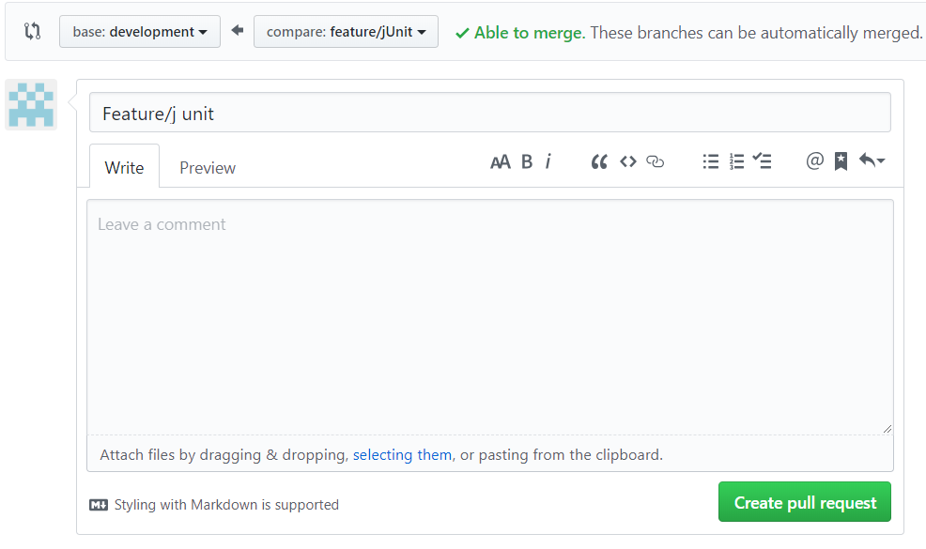
The git approach
Merge the feature to the dev branch
If you merge late, you can still create a merge request
Leave a description of the branch
E.g. what you are doing, the feature functionality, ect.
What if your branch needs the code of another?
What would we do?

Slide 6
Git merge & git rebase
Is a git utility that allows us to integrate changes from one branch to another
Pull from dev, create magnificent code, push
Dev
M1
M2
Feature
M2
F1

Slide 7
Git merge & git rebase
Is a git utility that allows us to integrate changes from one branch to another
When would we use this?
Another developer merge their code to dev
We need M3 code
Dev
M1
M2
M3
Feature
M2
F1

Slide 8
Git merge & git rebase
Is a git utility that allows us to integrate changes from one branch to another
When would we use this?
Cmd [ git rebase dev ]
Must be within YOUR feature branch
Dev
M1
M2
M3
F1’
Feature
M2
F1

Slide 9
Git merge & git rebase
Is a git utility that allows us to integrate changes from one branch to another
When would we use this?
Cmd [ git merge feature ]
Must be within dev branch
Known as a fastforward merge
Dev
M1
M2
M3
F1’
Feature
M2
F1

Slide 10
Git No No
Do not pull from someone else’s branch, only the dev.
Do not work in dev
More of these are within the guidelines in the google drives folder (Git) and refer to the Git Documentation
https://docs.google.com/document/d/1QrvuLWv8IrFu3-86Q0KSCuIxq3V3EN0Nan9gJKeiGDs/edit
https://git-scm.com/book/en/v2

