Slide 1
Predictive Modeling for Employee Attrition
Identifying Key Drivers of Turnover

Slide 2
Agenda
Problem & objectives
Dataset overview
Data quality & preprocessing
EDA highlights
Modeling approach
Results & validation
Recommendations & next steps
Live demo
Notes:
Quick roadmap of the presentation.

Slide 3
Problem & Objectives
Attrition is costly and disruptive
Goal: predict risk and identify key drivers
Deliverables: clean data, EDA, multiple models, actionable insights
Notes:
Set context and goals.

Slide 4
Dataset Overview
IBM HR Analytics dataset
1,470 rows, 35 columns
Target: Attrition (Yes/No)
Class imbalance: ~16% attrition
Notes:
Emphasize target and imbalance.

Slide 5
Data Quality & Preprocessing
No missing values or duplicates
Outliers: IQR-flagged (no row drops)
Feature engineering: AgeGroup, TotalSatisfaction, *_outlier
Dropped constant/ID columns
Notes:
Outliers handled without losing data.

Slide 6
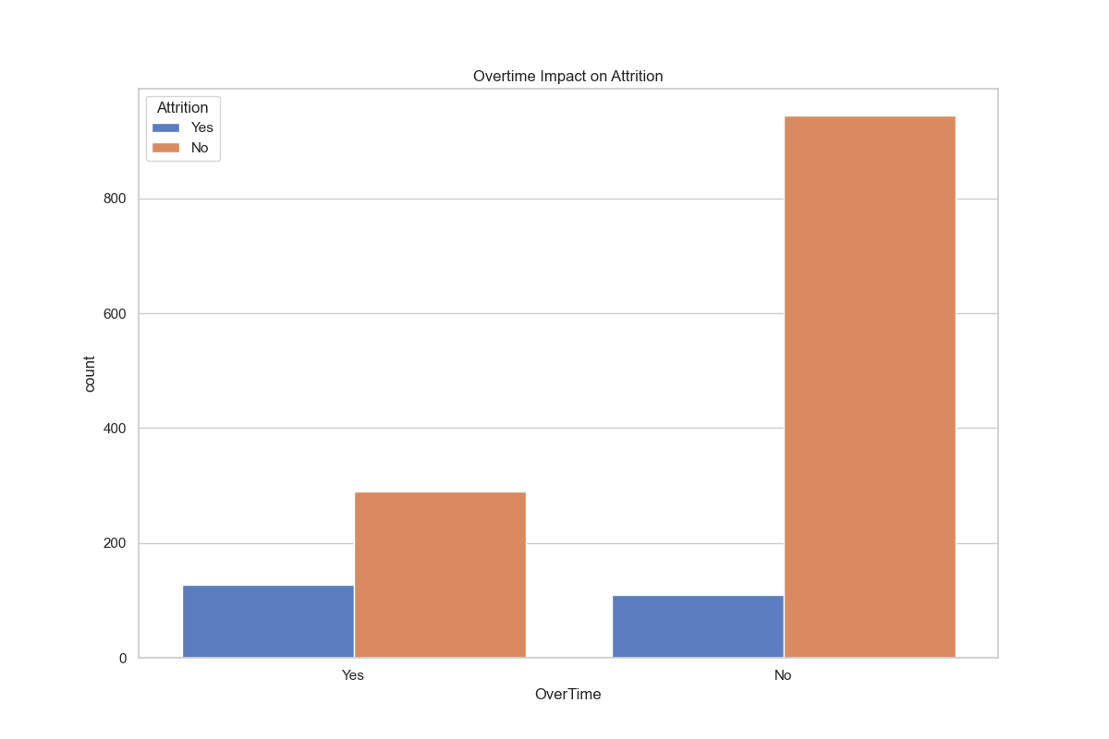
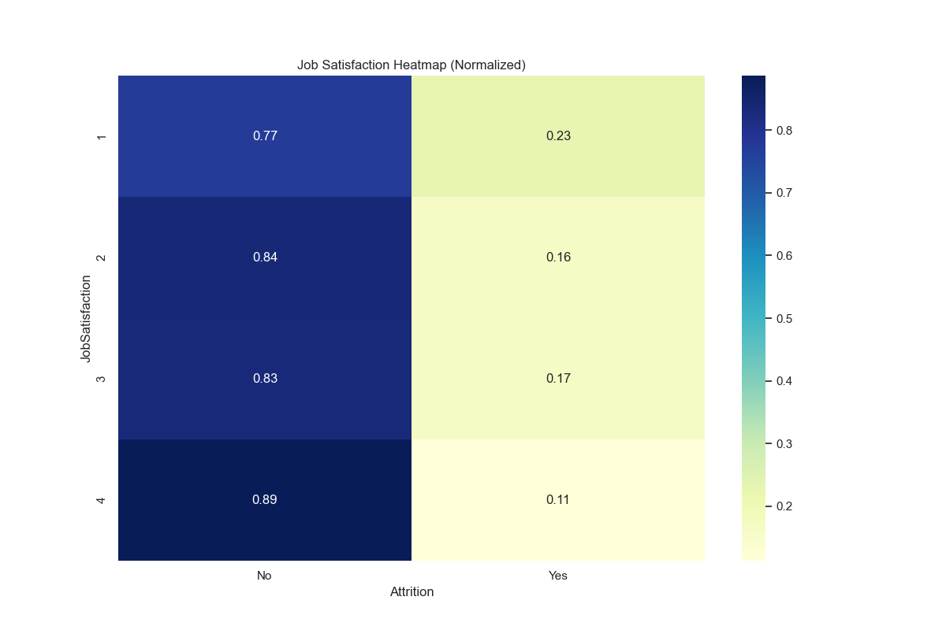
EDA Highlights
Notes:
Overtime and satisfaction stand out as attrition drivers.

Slide 7
Key Insights
Overtime strongly associated with attrition
Lower income bands show higher attrition
Younger + shorter tenure = higher risk
Satisfaction metrics correlate with retention
Notes:
Summarize EDA conclusions.

Slide 8
Modeling Approach
80/20 stratified split
SMOTE for class imbalance
Models: Logistic Regression, Random Forest, Gradient Boosting, Decision Tree
Evaluation: confusion matrices, ROC/PR curves, threshold tradeoffs
Notes:
Show rigorous evaluation pipeline.

Slide 9
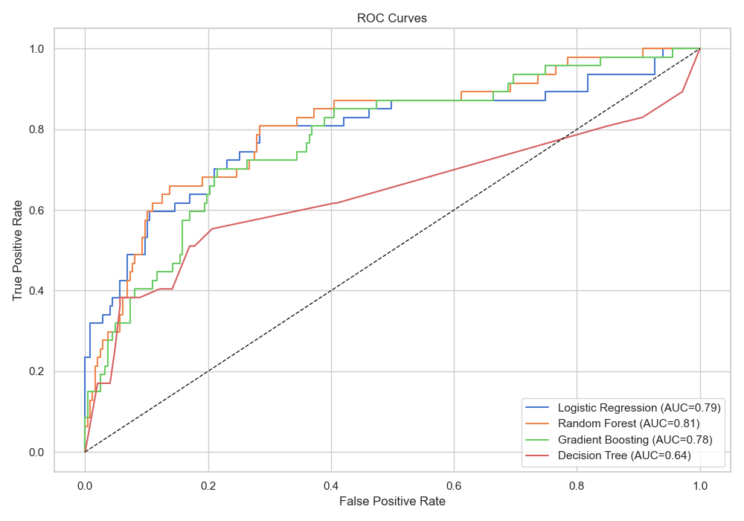
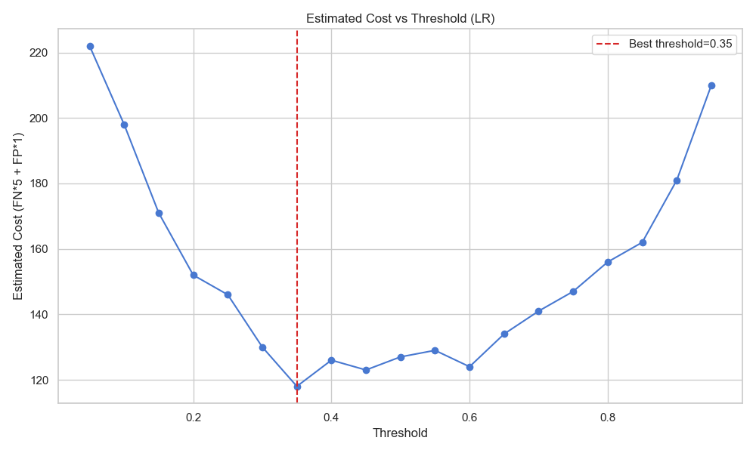
Results & Validation
Notes:
LR has best recall; cost curve supports threshold choice.

Slide 10
Results Summary
Logistic Regression: acc 0.80, recall 0.64
Random Forest: acc 0.85, recall 0.30
Gradient Boosting: acc 0.85, recall 0.26
Decision Tree: acc 0.84, recall 0.38
SMOTE improves recall: 0.64 vs 0.36
Notes:
Highlight recall vs accuracy tradeoff.

Slide 11
Recommendations & Next Steps
Review overtime policy and staffing
Target early-tenure + low-income employees
Use risk scores to prioritize HR outreach
Next: external holdout + drift monitoring
Live demo: reports + scripts
Notes:
Wrap up with actions and demo cue.

