Slide 1
Graph mining

Slide 2
Results of dcut
Create density tree
Cut density tree
Find all neighbors of the two cutted nodes
Create two new trees with this nodes
Repeat until n-trees were created
Find nodes in original graph
Color them in clusters

Slide 3
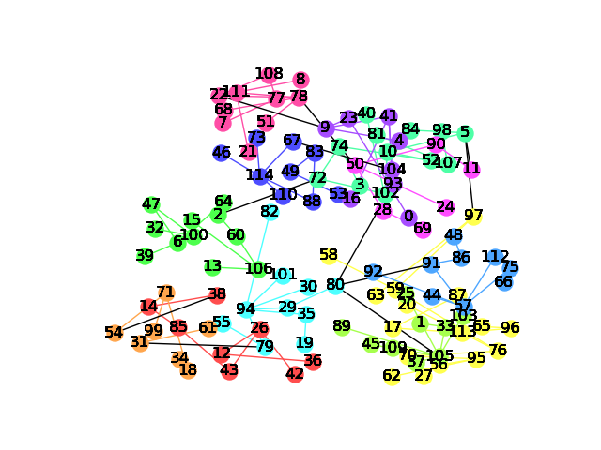

Slide 4
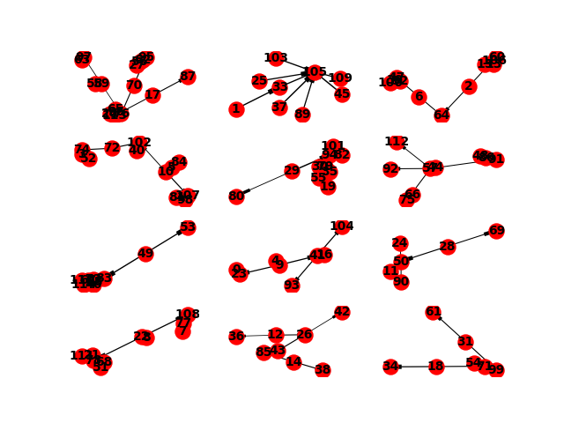
Density trees after 12 cuts

Slide 5
gspan
Load graphs
Split data in training and test data
Create matrices with results of gspan algorithm
Column should be freq patterns
Rows should be the input graphs
1 if pattern in graph else 0
Hand train matrix to an RandomForest classifier
Check performance with the test matrix

Slide 6
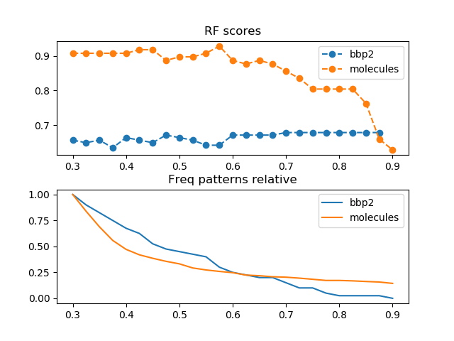
Different rf scores depending on
Threshold of the gspan
Development of the amount of
found patterns

