Slide 1
Clustering
Data Mining

Slide 2
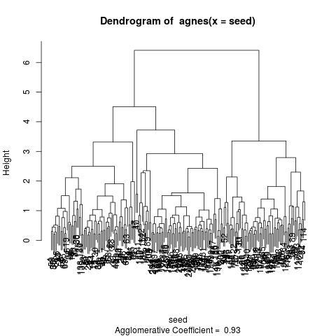
Agnes
Bottom-up – from many to one
Starts with every element as single cluster
Join the closest clusters in every step based on distance function
Dendrogram shows joining of clusters

Slide 3
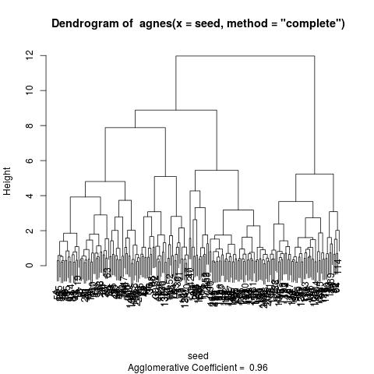
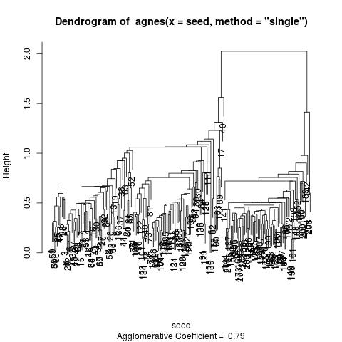
Distance methods

Slide 4
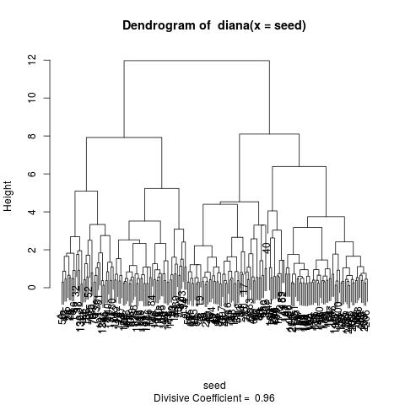
Diana
Top-down – from one to many
Begin with one cluster and split farthest element
Check with cluster is nearer an add to this cluster
Dendrogram shows joining of clusters – in fact shows splitting

Slide 5
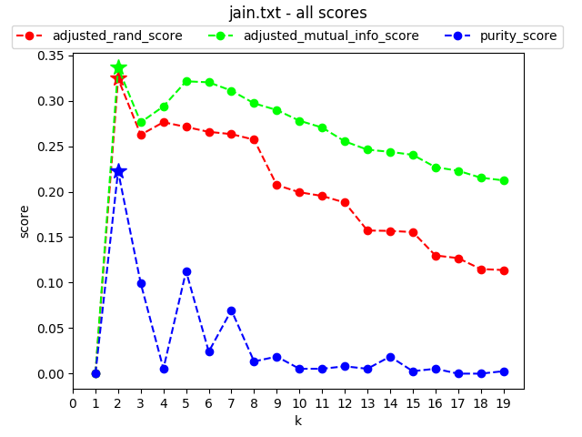
K-Means
Clustering with defined number of clusters
Scoring methods “rank” clustering compared to a perfect cluster example
For good results clustering have to be repeated more often for one k to get overall best

Slide 6
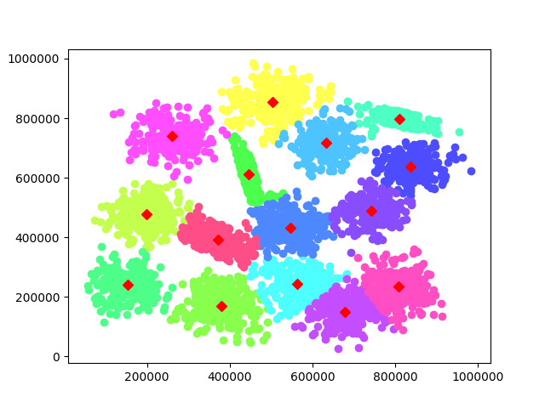
Result of K-Means
s2 dataset – k=15
Plot clusters with different colors
Good overview
Visual check how well clustering did

Slide 7
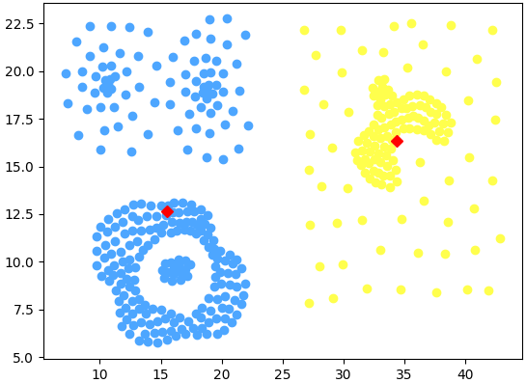
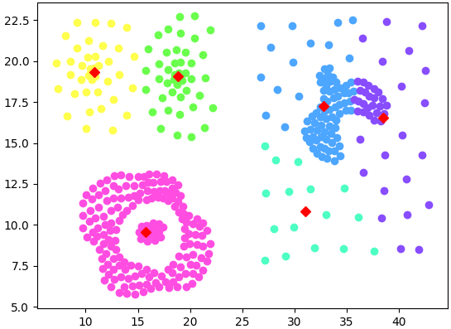
Special case – Compound dataset
Purity score – k=2
Adjusted mutual info score – k=6

Slide 8
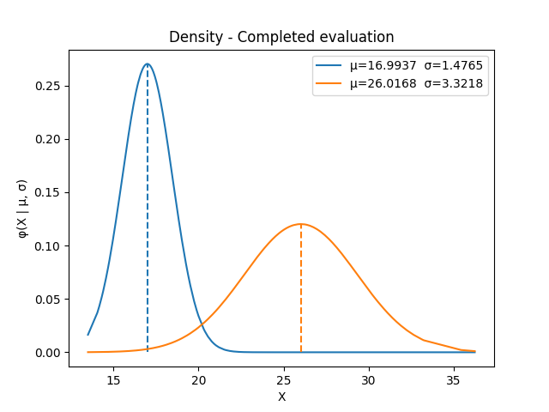
EM
Model based clustering
Try to find a model which fits the best for data
Change parameters for model until best likelihood is found
Plot shows density for clusters
μ is marked for every cluster

Slide 9
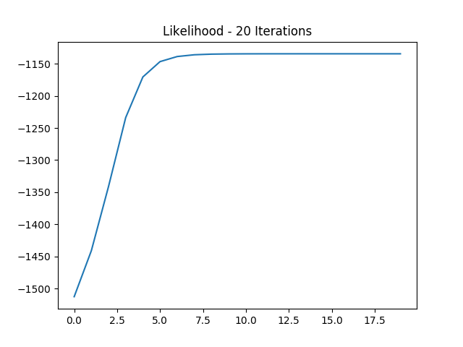
Likelihood
Likelihood score describes how well created models fit the data
The higher the score, the better the models
Converges to local optimum for given start parameters

