Slide 1
Graph mining

Slide 2
Results of dcut
Create density tree
Cut density tree
Find all neighbors of the two cutted nodes
Create two new trees with this nodes
Repeat until n-trees were created
Find nodes in original graph
Color them in clusters

Slide 3
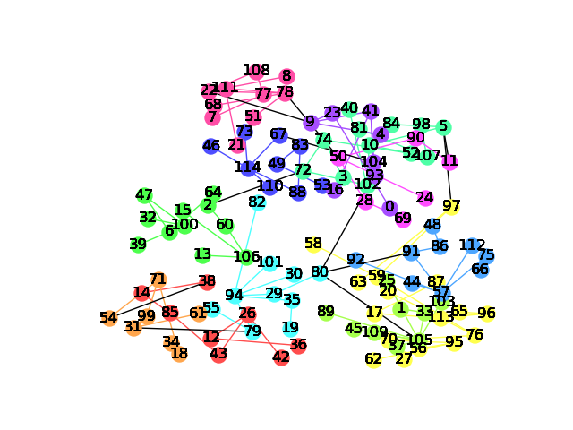

Slide 4
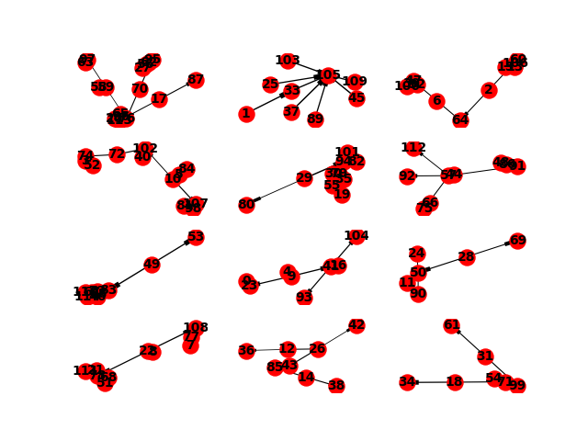
Density trees after 12 cuts

Slide 5
gspan
Load graphs
Split data in training and test data
Create matrices with results of gspan algorithm
Column should be freq patterns
Rows should be the input graphs
1 if pattern in graph else 0
Hand train matrix to an RandomForest classifier
Check performance with the test matrix

Slide 6
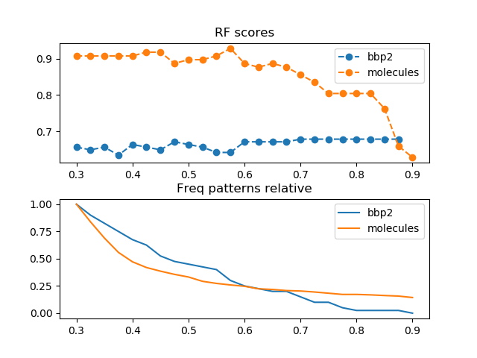
Different rf scores depending on
Threshold of the gspan
Development of the amount of
found patterns

Slide 7
SLR-kit
Basic run + -showAUC -pruneSingletons -pruneZeroKnowledge
Statistics used:
Average graph degree
Density
Subgraphs

Slide 8
cora_cite
Size of graph 4240
Average degree 5.31
Density 0.0025
Nodes with degree 0 , ausgangsgrad, eingangsgrad (657, 657)
Full connected graph, size of the subgraphs (False, [3385, 34, 11, 9, 6, 5x2, 4x6, 3x2, 2x46

Slide 9
Count Min Sketch
CMS table with murmurhash
Read twits & perform estimate over the drugs
Epsilon --> how much error is added to our counts with each item we add to the cm sketch
Delta --> with what probability do we want to allow the count estimate to be outside of our epsilon error rate

Slide 10
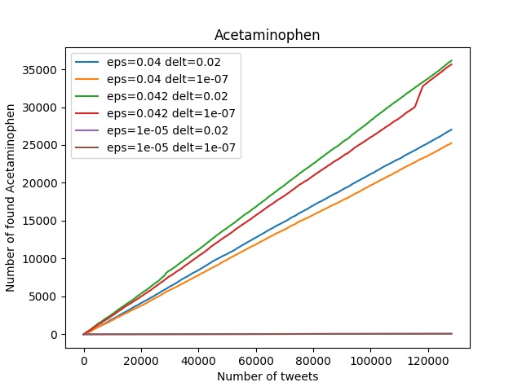
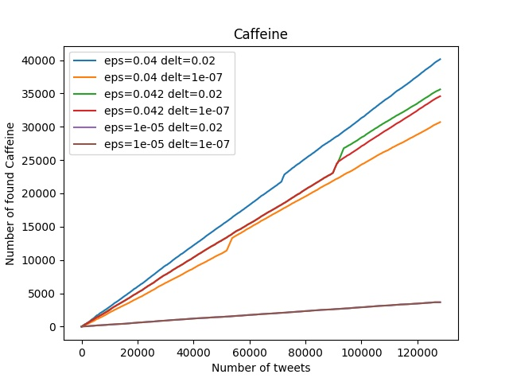
Acetaminophen
Caffeine

Slide 11
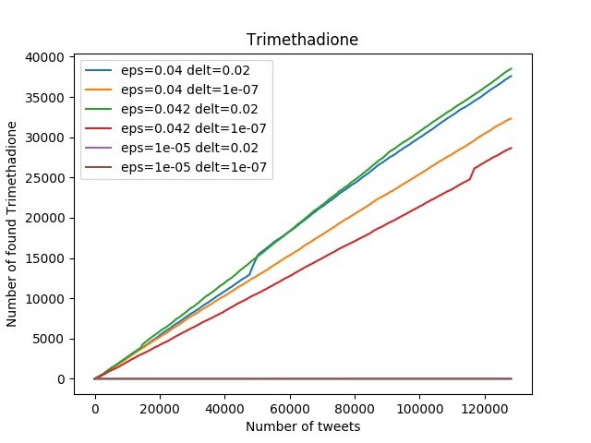
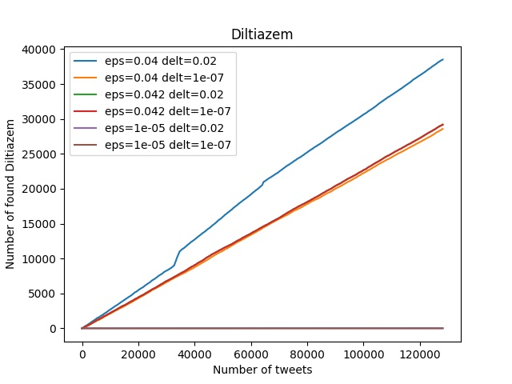
Trimethadione
Diltiazem

Slide 12
Stream Classification
Hallo

