Slide 1
One plan the whole
squadron steers by
121 SQN · FLYING AND DUTY PLANNING
Flying and duty crew planning unified
ME2 Brandon Ng
Notes:
Open on the idea, not the product: one plan the whole squadron works from. Don't name the system yet; the problems come first and the solution is revealed after them.

Slide 2
How the flying programme is built today
THE PROBLEM
01
Oracle runs on heavy macros
02
Five Excel files, five styles
Macros slow it down to open and to update.
Data from each department is planted into Oracle by hand.
03
Department files built years ago
04
Flights retyped in every department
Many of their macros no longer work.
Master Planner data is transferred by hand into each planning Excel.
The result: double work, missed changes, and a programme that falls out of step.
121 SQN
2
Notes:
Four problems with how the programme is built today. One: Oracle runs heavily on macros, which slows it down. Two: data has to be planted into it by hand from five different department Excel files, each with its own style. Three: those department files were built years ago and many of their macros no longer work. Four: flight data from the Master Planner is transferred by hand into each department's own Excel for planning. Any change in a department has to be made again by hand and passed to the Ops Room. Let the problems land before showing the solution.

Slide 3
Plan each thing once, in one place, and let every department see the same answer.
WHAT THE SQUADRON NEEDS
One source of truth for flights
One view across departments
One set of rules
One picture on the day
Same flight codes, duty rules and warnings, so red means the same thing everywhere.
The Ops Room board pulls every crew seat straight from the department plans.
The Master Planner holds every flight. Departments copy it, never retype it.
Each department owns its plan and sees everyone else’s.
121 SQN
3
Notes:
Before showing anything, set out what the squadron needs: plan each thing once, in one place, and let every department see the same answer. The next slide introduces the system built to do exactly that.

Slide 4

INTRODUCING
From the Master Planner to the Ops Room board,
one source the whole squadron steers by.
Notes:
The reveal. LODESTAR is named after the North Star that navigators steer by: the Master Planner is the fixed reference every department plans against. Pause here, then show how it answers each of the four problems.

Slide 5

The star navigators steer by
WHY THE NAME
lodestar (n.): a star that guides navigation course, especially the North Star.
A fixed point
The North Star holds still while the sky turns. The Master Planner is the fixed reference every plan is checked against.
Every department steers by it
Pilot, TACCO, Loadmaster, SUP 1 and SUP 2 plan from the same source, so the squadron keeps one course.
Made for a maritime patrol squadron
Maritime patrol is what we do. The compass rose logo points gold to north.
5
Notes:
Why LODESTAR. A lodestar is the star a navigator steers by, usually the North Star, because it stays fixed while everything else moves. That is the role of the Master Planner: one fixed reference that every department plans against. Every department steers by the same star, so the squadron keeps one course. And for a maritime patrol squadron, a navigation name fits; the logo is a compass rose with its north point in gold.

Slide 6

How LODESTAR solves each problem
THE SOLUTION
TODAY
WITH LODESTAR
Oracle runs on heavy macros
No macros at all
Slow to open and slow to update.
A light dashboard reads the files directly, fast in Edge.
Five Excel files, five different styles
One template for every department
Data is planted into Oracle by hand.
Same layout and codes, so the Ops Room board fills itself.
Department files built years ago
Rebuilt fresh, macro-free
Many of their macros no longer work.
Clean Excel files that open on SharePoint and still work alone.
Flights retyped in every department
Flights copied in one click
Master Planner data is transferred by hand.
Departments pull them straight from the Master Planner.
LODESTAR · 121 SQN
6
Notes:
Go back through the same four problems and show the answer to each. No macros: the dashboard reads the Excel files directly, so it is fast in Edge. One template for every department, so the Ops Room board fills itself instead of being planted by hand. Freshly built, macro-free department files that open on SharePoint and still work on their own. Flights copied from the Master Planner in one click instead of being retyped. A department’s saved change shows on the Ops Room board straight away.

Slide 7



The dashboard is the hub that connects everything
HOW IT WORKS
Master Planner
Department files
Every flight, ground programme and SQN programme
Pilot, TACCO, Loadmaster, SUP 1, SUP 2. Each edits only its own.
The dashboard
One dashboard, reads every file and saves back to your own.
Duty Roster
Ops Room board
Which department has BDO and SDO each day
Crew seats, duties and movements, on the projector
Everything sits in one SharePoint folder
LODESTAR · 121 SQN
7
Notes:
The dashboard is the main hub that connects everything together. It is a single web page opened in Edge from SharePoint. It reads the Master Planner, the Duty Roster and all five department files, and shows the combined picture, including the Ops Room board. Each department saves only to its own file, so nobody fights over one shared workbook, and a change saved by a department shows on the Ops Room board straight away. Excel still works on its own if the dashboard is unavailable. Personal data (the Personnel Info sheet) is never shown on the dashboard.

Slide 8
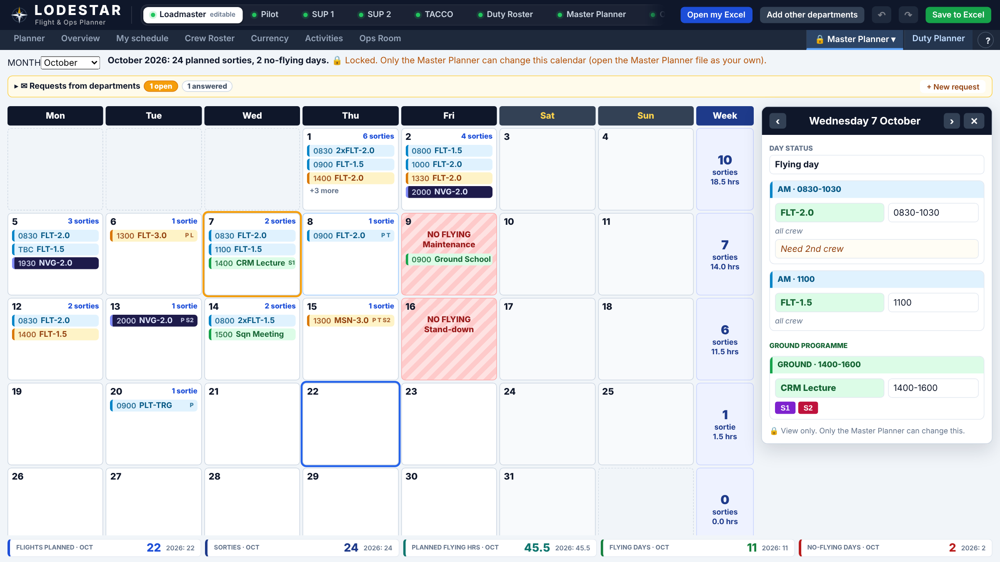
Every flight is planned once, at the top
1 · MASTER PLANNER
A month at a glance
Flights, ground programme and no-fly days, with sorties per week.
Crew needed per flight
Each flight code says which departments fly it.
One click to copy
Departments pull the flights into their own plan.
LODESTAR · 121 SQN
8
Notes:
The Master Planner is the source of truth for flights. Only its owner can edit it; every department sees it read-only. Each flight has a date, shift, flight code, time and the crew it needs (Pilot, Loadmaster, TACCO, SUP 1, SUP 2). No-flying days (maintenance, stand-down, public holiday) grey out across every department's plan. If a department's plan drifts from the Master Planner, its planner shows the differences in amber.

Slide 9
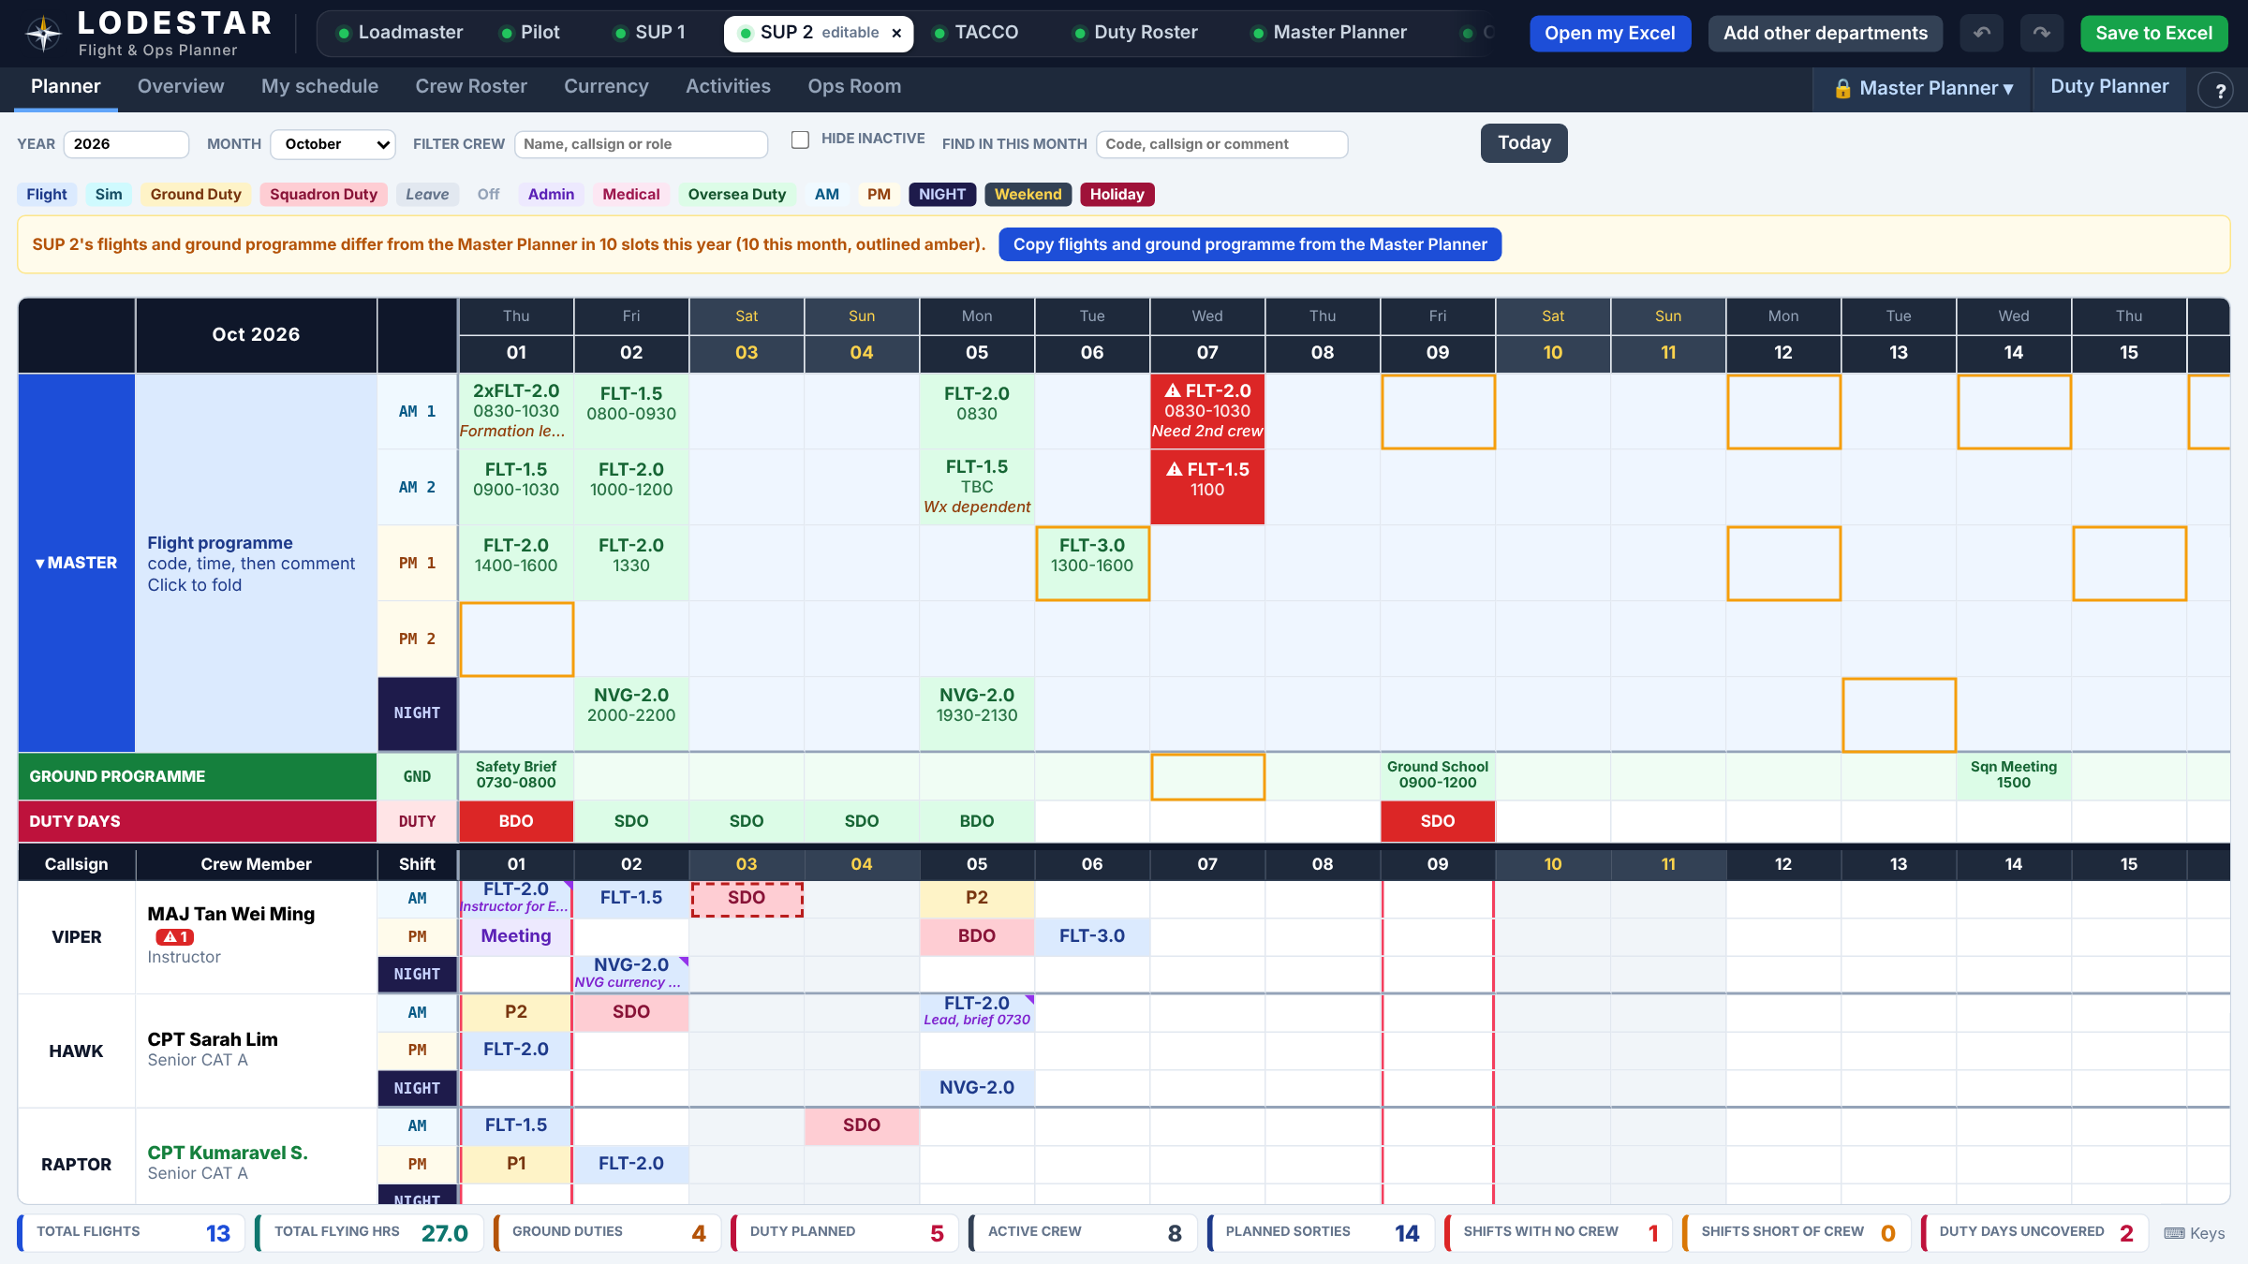
Each department plans its own people
2 · DEPARTMENT PLANNER
AM, PM and night
One row per shift per person, picked from one activity list.
Warnings while planning
Short of crew, on MC, out of currency, or five flying days in a row.
Totals for free
Sorties, ground duty, duties and leave each month.
LODESTAR · 121 SQN
9
Notes:
Shown here: the SUP 2 planner. The Master Planner flights sit at the top; red means a flight with no crew, and amber outlines show slots that differ from the Master Planner, with one button to copy them across. Below are the ground programme, duty days and each person’s AM, PM and night. A crew member on MC is down-chitted, so their days are striped and the planner warns before they are put on a flight, until someone up-chits them. Shifts with flights but no crew turn red, shifts short of crew turn amber. Currency checks flag crew falling out of currency using rules the squadron sets. Each department can also view the other departments' plans side by side, read-only.

Slide 10
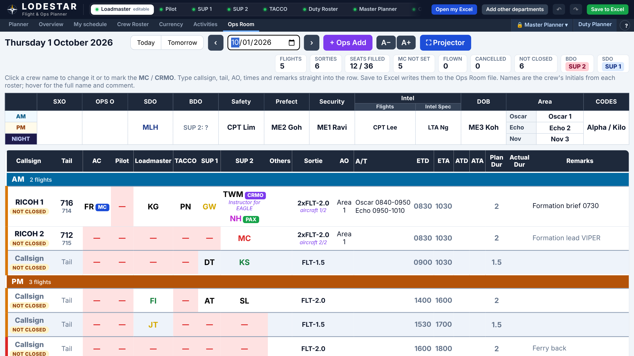
The day’s board builds itself from the planning
3 · OPS ROOM BOARD
Every seat, every flight
Pilot to SUP 2, filled from the plans. Empty seats show red.
Duties and movements
SXO, OPS O, SDO, BDO, standby, leave and MC in one place.
Made for the Ops Room
Full screen at the Ops Room, flown or cancelled logged.
LODESTAR · 121 SQN
10
Notes:
For the SDO and AOS. The board opens every department's file and lays out each flight with its seats: Aircraft Captain, Co-Pilot, Loadmaster, TACCO, SUP 1 and SUP 2, plus MC and CRMO, tail numbers and times. The Day Board shows SXO, OPS O, SDO and BDO per shift. Ad hoc flights can be added in the Ops Room, flights are marked flown or cancelled with a reason, and down-chitted crew are listed with a one-click up-chit. Nobody has to phone round the departments.

Slide 11
Plan once, and every department follows
KEY FUNCTIONS · PLANNING
01
Master Planner flights
02
No-fly days
03
One-click copy
Add or remove flights per shift, with crew tags for who flies.
Stand-down, maintenance and public holidays grey the day for all.
Flights and ground programme copied into each plan. Differences show amber.
04
One flight code list
05
Block of days
06
Duty Planner
Codes, sorties and hours set once and shared by every department.
Leave or a detachment over a date range in one go, skipping weekends.
BDO and SDO by department, copied into each plan with gap warnings.
LODESTAR · 121 SQN
11
Notes:
The planning functions. Flights are entered once on the Master Planner, with crew tags saying which departments fly. No-fly days and the ground programme sit there too. Each department copies them into its own plan with one button, and anything that no longer matches is outlined amber. Flight codes are one shared list. Long bookings like leave or a detachment take one step with Block of days. The Duty Planner gives BDO and SDO to a department per day.

Slide 12
Warnings before anyone is put on a flight
KEY FUNCTIONS · CREW SAFETY
01
Crewing status
02
Currency checks
03
Crew rest
Each shift shows red with no crew, amber when short, green when covered.
Rules per role or category. Red and amber badges by the name.
Warns when one person is planned to fly 5 days in a row.
04
Down-chit and up-chit
05
Category at a glance
06
Notes on any cell
MC blocks the days until the up-chit, with a DOWN badge and seat warning.
Name colour shows CAT A to D and trainee; SANS and NSmen listed last.
A comment on a crew cell shows in the plan and on the Ops Room board.
LODESTAR · 121 SQN
12
Notes:
Crew safety functions. The system warns rather than blocks, so the planner keeps the final say. Crewing status shows gaps days ahead. Currency rules are open: each department can set what counts and how often. Crew rest flags a fifth flying day in a row. A medical chit keeps the person flagged until someone up-chits them. Pilot currency rules still need pilot input; that is on the next steps slide.

Slide 13
Run the day from one board
KEY FUNCTIONS · OPS ROOM AND DAILY USE
01
Seats from the plans
02
Standby crew
03
Ops Add
Seats auto filled from the department plans
P1, P2 and BU per shift, with tail and alert status.
Ad hoc flights added in the Ops Room go straight onto department plans.
04
Flown or cancelled
05
Timings
06
Everyday tools
Actual times logged; cancelled crew are struck off plans and totals.
Planned against actual duration, and area time.
Today, My schedule, Find, Undo, help on every tab and projector mode.
LODESTAR · 121 SQN
13
Notes:
Ops Room and everyday functions. The board fills the seats from the department plans and suggests the senior pilot as Captain. Standby crew show under each shift. Ad hoc flights added in the Ops Room land on the department plans by themselves. Flights are closed as flown or cancelled, and cancellations come off everyone's totals and currency. For daily use there is a Today button, a personal schedule, search, undo and a help pop-up on every tab. Then hand over to the demo.

Slide 14
Safer crewing, less re-typing, and a faster brief
WHAT THE SQUADRON GAINS
Less double entry
Gaps show up early
Safer crewing
Flights entered once, copied to every plan in one click
A short-crewed flight turns red or amber days ahead
MC, currency and crew rest warnings before anyone is put on a flight
Faster morning brief
One squadron, one plan
Low cost, low risk
The Ops Room daily board is always ready on the projector
Every department sees the same flights, duties and crew in a single dashboard
Our own SharePoint and Excel. Nothing to buy or install. Excel still works alone.
LODESTAR · 121 SQN
14
Notes:
Land the last card for the CO: it runs entirely on the intranet with tools the squadron already has, so there is no licence, server or approval for new software. If the dashboard is ever unavailable, each department still has its own Excel file.

Slide 15



Built, working and ready to show
WHERE IT STANDS
READY NOW · FULL WORKING DEMO
NEXT
Master Planner
Department planners
Pilot flight currency
Flights, ground programme, no-fly days
AM, PM and night, with live warnings
Rules that go beyond simple 45 and 180-day checks.
Duty Planner
Ops Room board
Squadron-wide on SharePoint
BDO and SDO by department
Every seat, duty and movement
Final checks, then every department live.
LODESTAR · 121 SQN
15
Notes:
LODESTAR is not a concept: a full working demo is ready now, covering the Master Planner, the department planners, the Duty Planner and the Ops Room board. Two things come next. Pilot flight currency is more complex than a simple 45-day and 180-day check, so its rules need working out with the pilots. Then a final round of checks on SharePoint and every department goes live.

Slide 16
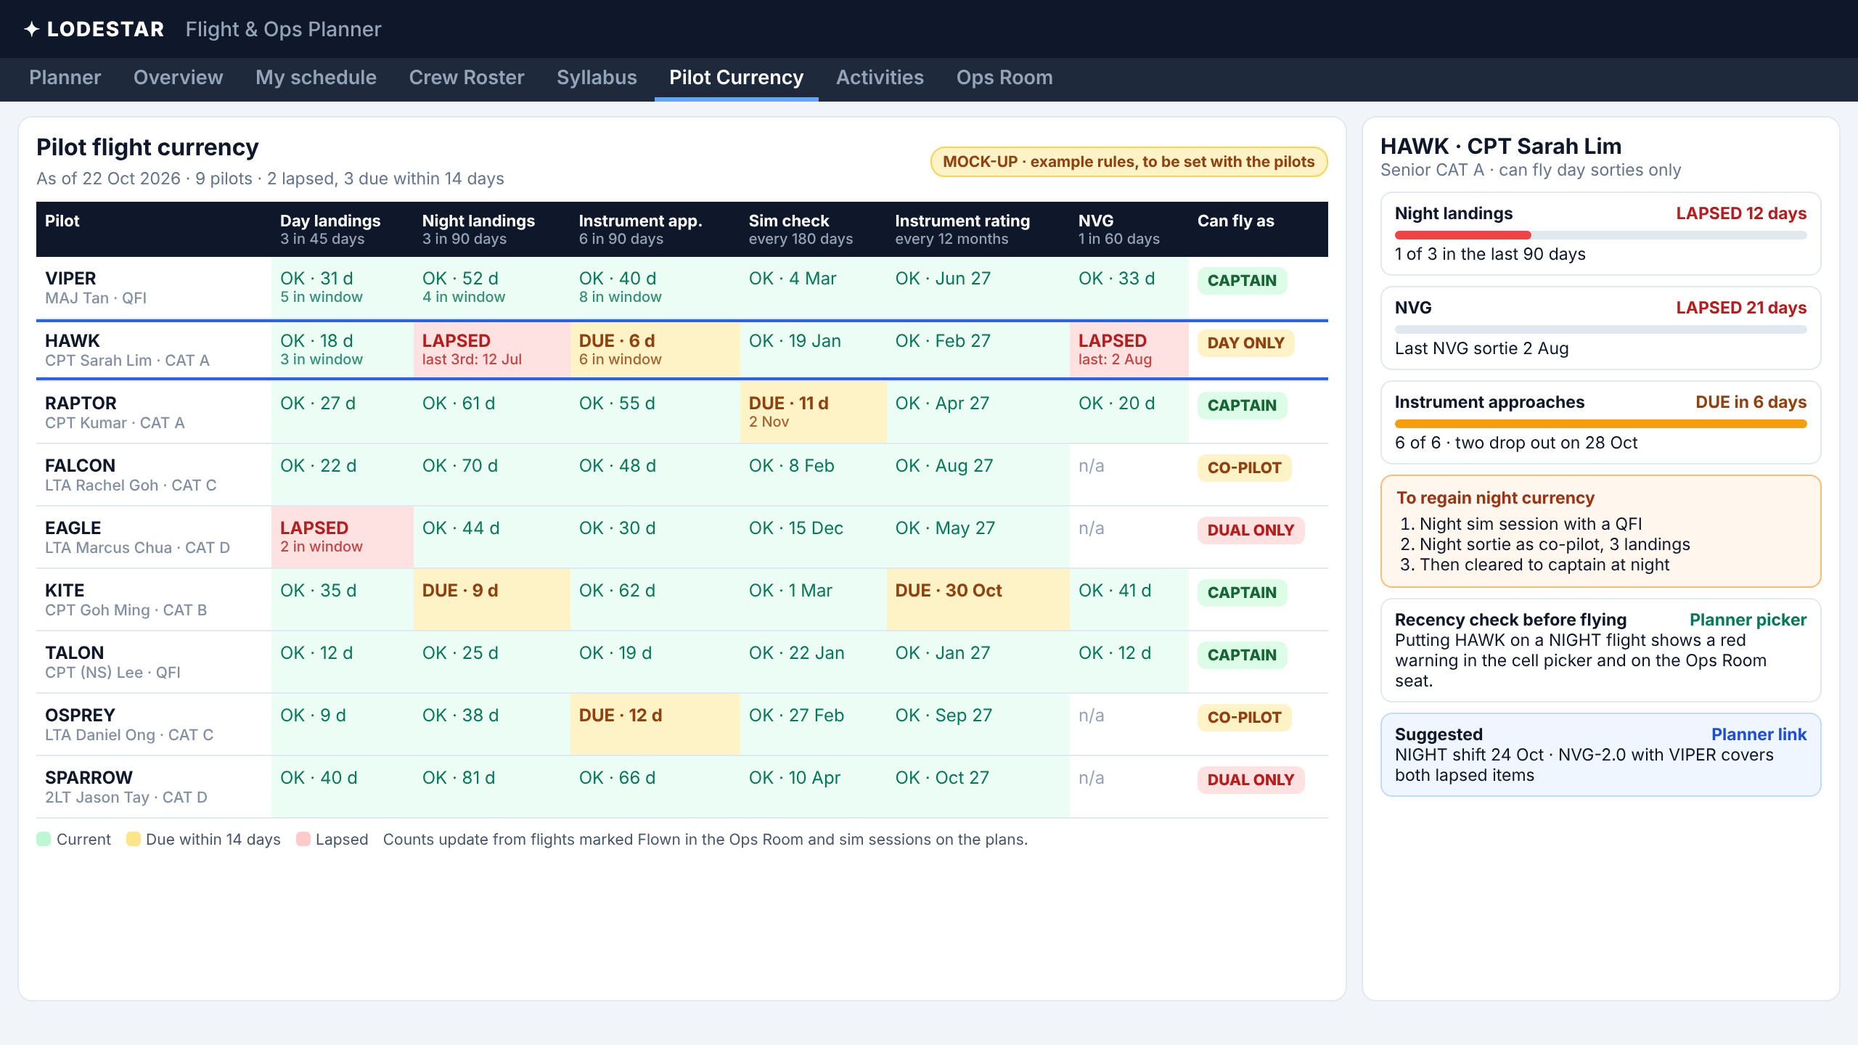
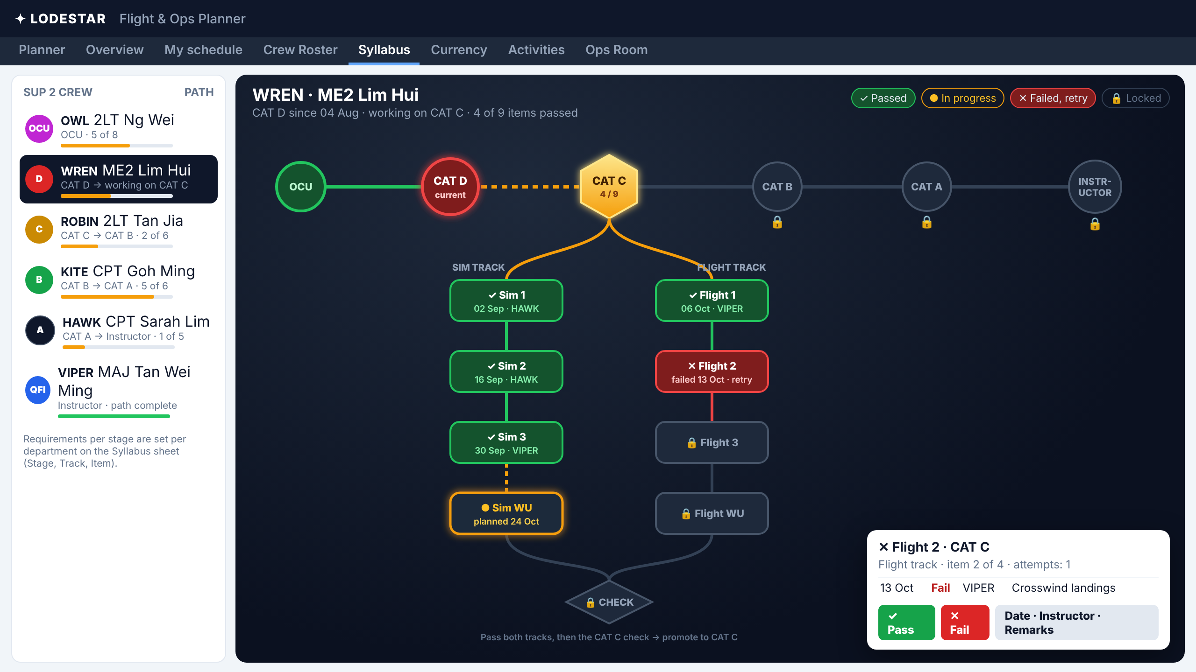
Functions we want to add
WHAT COMES NEXT · MOCK-UPS
Pilot flight currency
Training syllabus tracker
Rules beyond 45 and 180-day checks, set with the pilots.
OCU to Instructor, sim and flight stages marked pass or fail.
16
Notes:
Close on where LODESTAR can go next. Both screens are mock-ups, not built yet. Pilot flight currency comes first. The rules shown are examples only: pilot currency is more complex than simple 45-day and 180-day checks, so the real rules need to be set with the pilots. The tracker would show what each pilot can fly as, and what they need to regain a lapsed item. The training syllabus tracker follows each person from OCU to Instructor, with sim and flight stages marked pass or fail by hand by the instructor. Then switch straight to the live demo: the Master Planner, a department plan, then the Ops Room board on the projector.

