Slide 1


MACHINE LEARNING · WEEK 7 ACTIVITY 2
Credit Card Fraud Detection
using Support Vector Machine (SVM)
284,807
0.17%
LinearSVC
98%
88.7%
Transactions
Fraud Rate
Algorithm
Accuracy
Recall

Slide 2
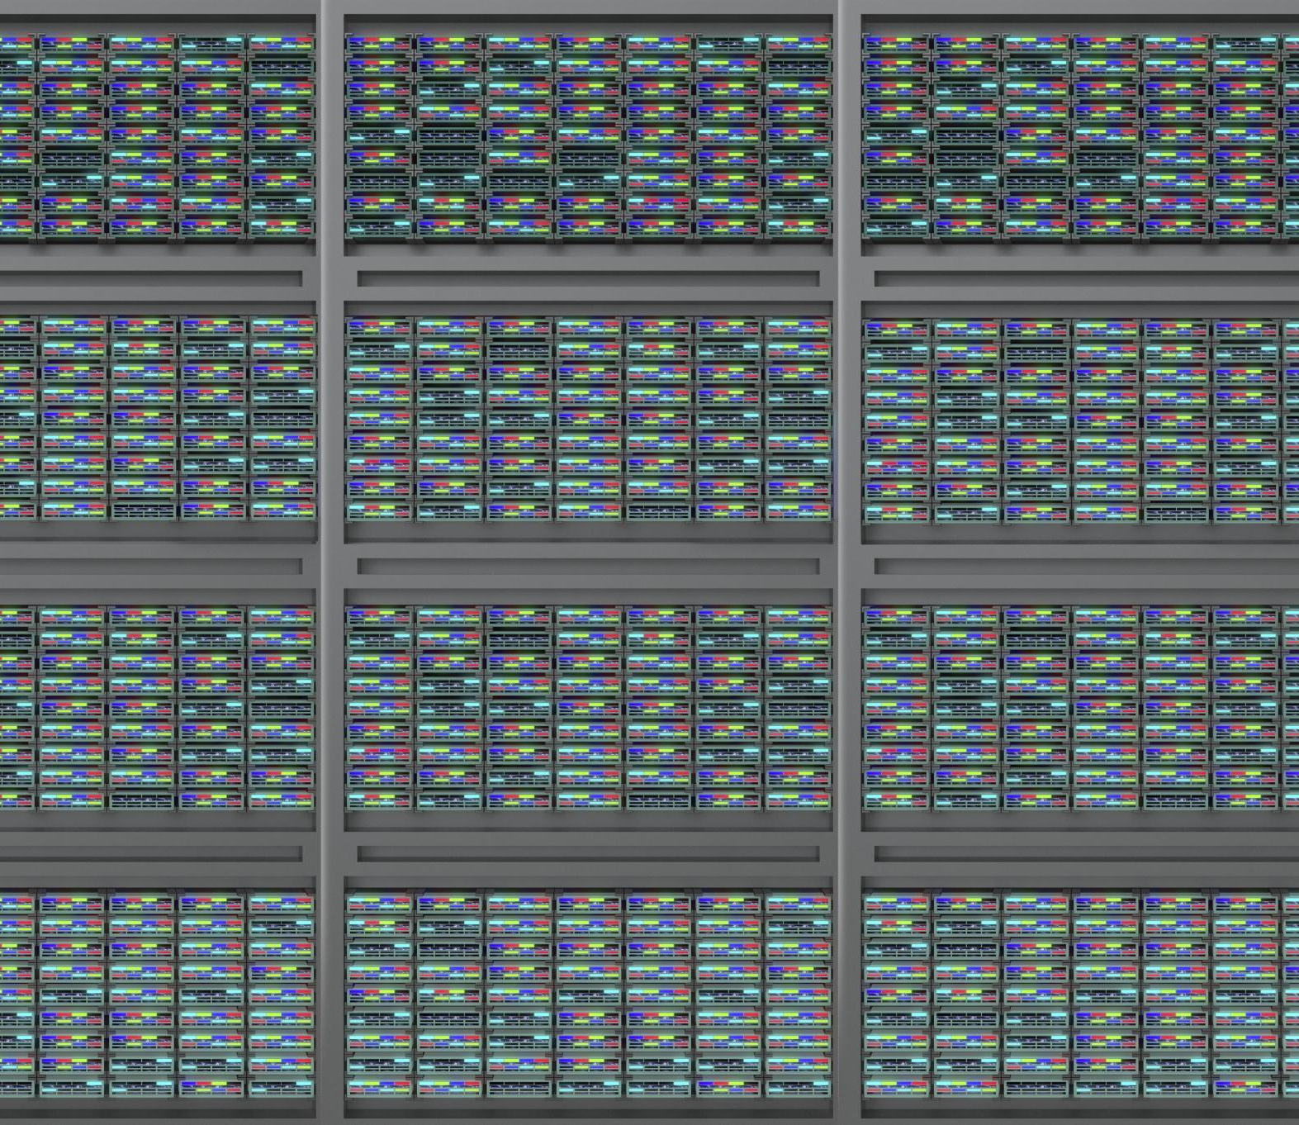
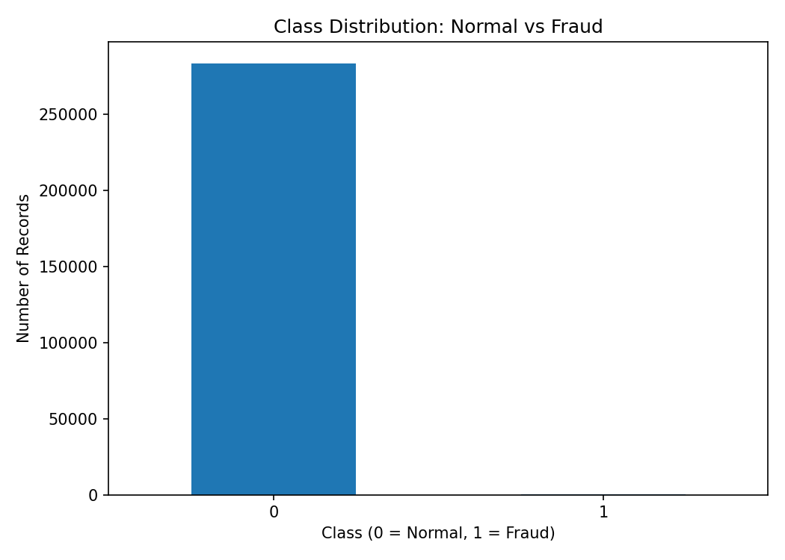
INTRODUCTION
Dataset & Problem Statement
Dataset
Class Distribution
European credit card transactions (Sep 2013). 284,807 records with 31 numeric features (Time, V1-V28 via PCA, Amount, Class).
Problem
Binary classification: detect fraudulent transactions (Class=1) among predominantly normal ones (Class=0).
Challenge
Highly imbalanced data, only 0.17% fraud. Accuracy alone is misleading; recall & precision matter most.
Approach
LinearSVC with class balancing, StandardScaler pipeline, and multi-metric evaluation.
⚠ Normal: 283,253 (99.83%) | Fraud: 492 (0.17%)

Slide 3

PREPROCESSING
Data Preprocessing & Cleaning
Load Dataset
Missing Values Check
01
02
284,807 CSV rows read with Pandas. 31 columns: Time, V1-V28, Amount, Class.
Zero missing values found in all columns, no imputation needed.
Remove Duplicates
Feature Selection
03
04
1,081 duplicate rows removed. Final dataset: 283,726 records.
Class column isolated as target y. Remaining 30 columns used as features X.
StandardScaler
Stratified Split
05
06
Applied to all features inside a Pipeline. Critical for SVM, equalize scale of Amount/Time vs V1–V28.
70% train (198,608 rows) / 30% test (85,118 rows). Stratify=y preserves class ratio.

Slide 4
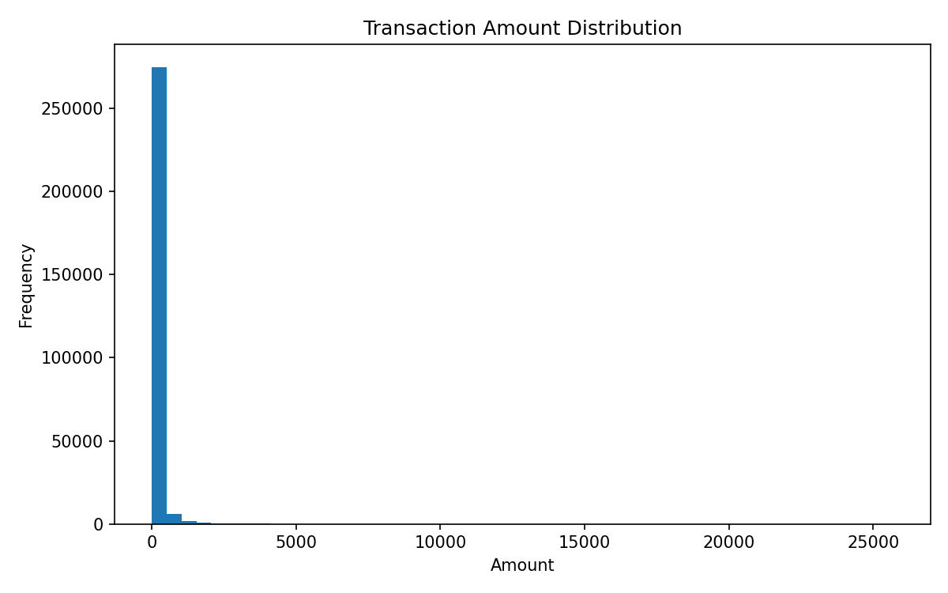
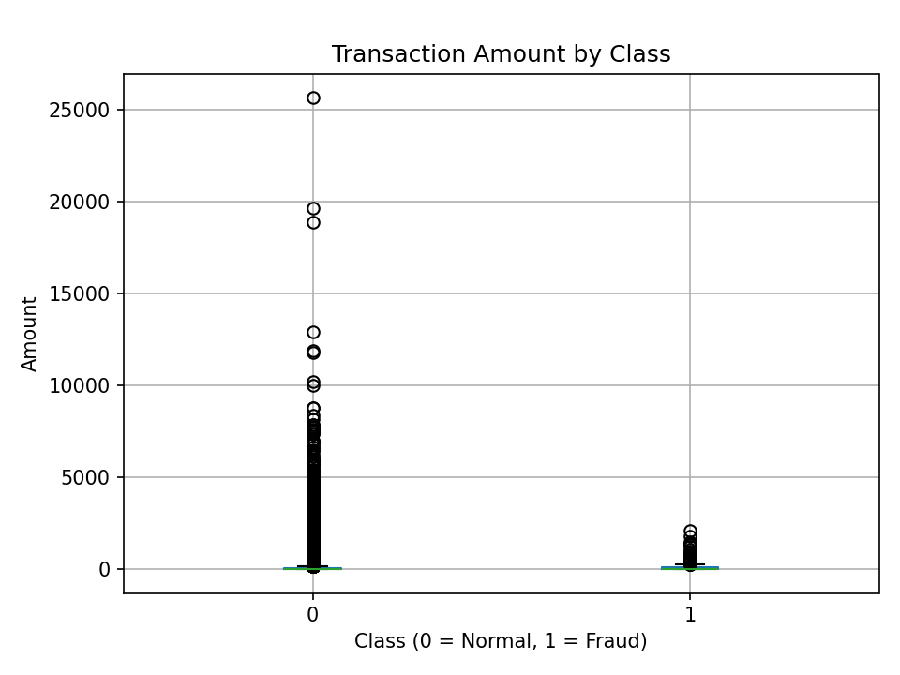
EDA
Exploratory Data Analysis
Transaction Amount Distribution
Amount by Class (Boxplot)
Key Insight: Most transactions are low-value (< $100). Fraud transactions tend to cluster at lower amounts, making amount alone insufficient for detection.

Slide 5
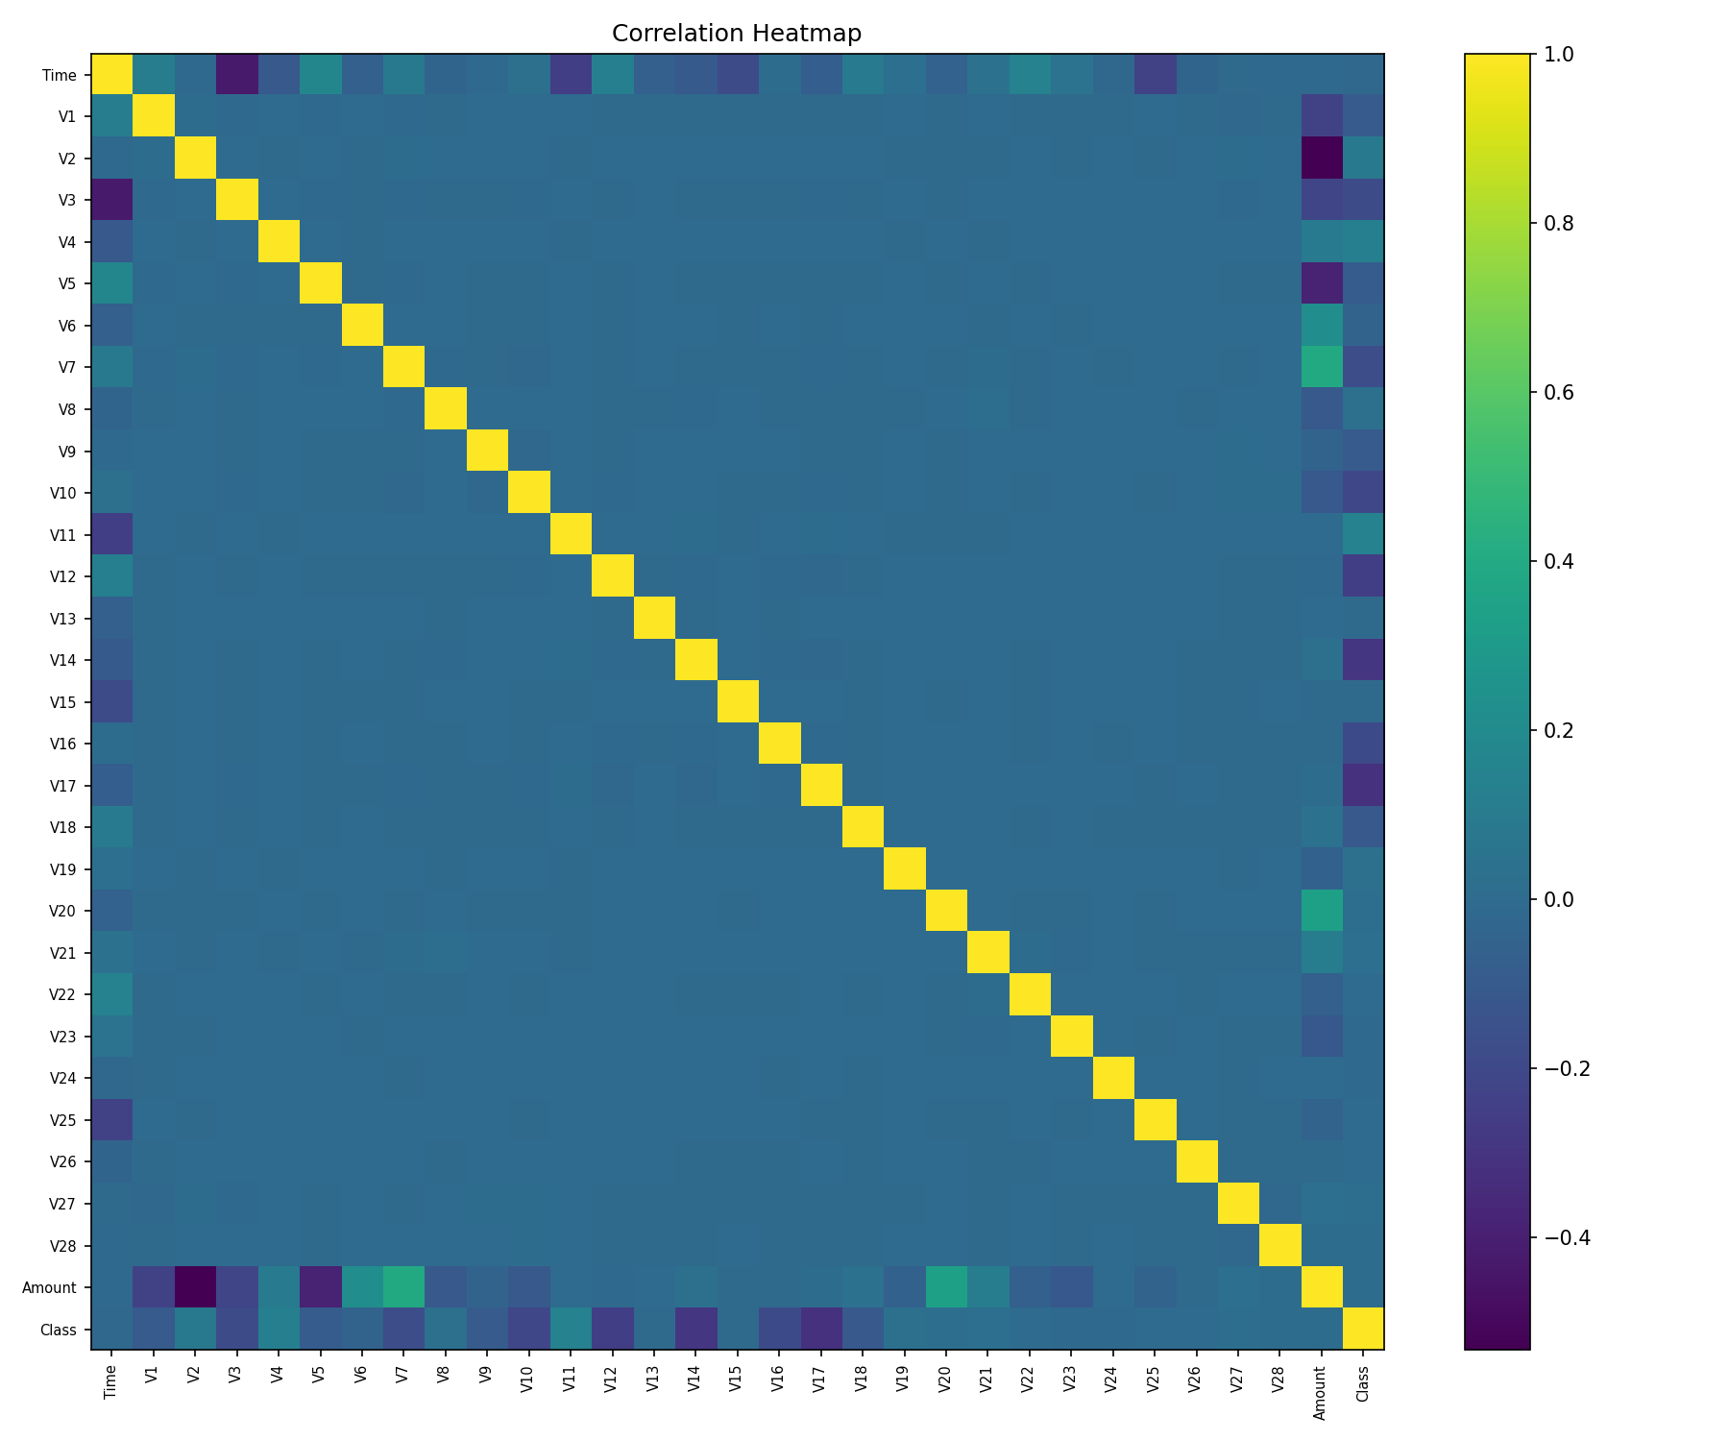
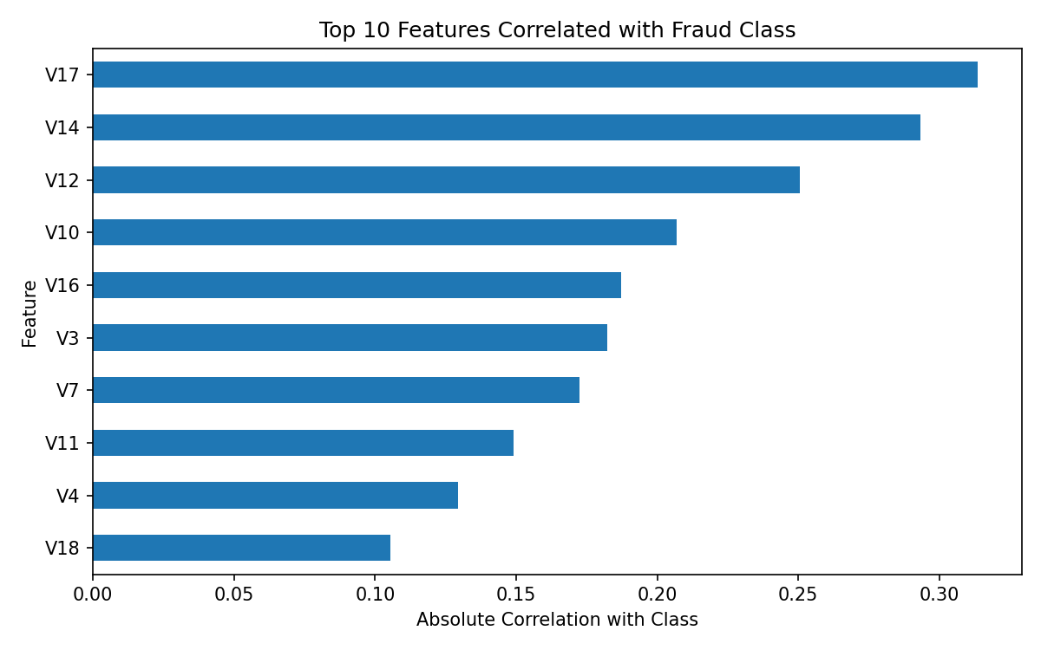
EDA
Feature Correlations & Importance
Correlation Heatmap
Top 10 Features Correlated with Fraud
V17, V14, V12, and V10 have the strongest correlations with the fraud label (|r| > 0.20), making them the most discriminative PCA features.

Slide 6
MODEL
ML Model Development & Implementation
Algorithm:
# SVM Fraud Detection Pipeline
LinearSVC
Efficient linear SVM variant optimised for large datasets (283K rows). Uses squared hinge loss with dual=False for scalability.
from sklearn.pipeline import Pipeline
from sklearn.preprocessing import StandardScaler
from sklearn.svm import LinearSVC
Class Weighting:
class_weight='balanced'
pipeline = Pipeline([
("scaler", StandardScaler()),
Automatically adjusts weights inversely proportional to class frequency, boosting fraud detection on the minority class.
("svm", LinearSVC(
class_weight="balanced",
max_iter=2000
Pipeline:
))
StandardScaler → LinearSVC
])
Scaler normalises all features before the SVM sees them, essential since SVM is distance-based.
pipeline.fit(X_train, y_train)
y_pred = pipeline.predict(X_test)
Why not RBF-SVM?:
Computational cost
Standard kernel SVM with 280K rows would take hours. LinearSVC trains in seconds with comparable performance.
Train: 198,608 rows · Test: 85,118 rows · Stratified 70/30

Slide 7
TRAINING
Training & Testing Process
Raw Data
(283,726 rows)
Feature
Engineering
Stratified
Train/Test Split
StandardScaler
Fit on Train
LinearSVC
Training
Predictions
on Test Set
Evaluation
& Metrics
Training Set
Normal (Train)
Fraud (Train)
198,608
Records
70%
198,319
Records
99.9%
344
Records
0.17%
Testing Set
Normal (Test)
Fraud (Test)
85,118
Records
30%
84,976
Records
99.8%
142
Records
0.17%
Stratify=y ensures both train and test sets maintain the same 0.17% fraud ratio, preventing data leakage and biased evaluation.

Slide 8
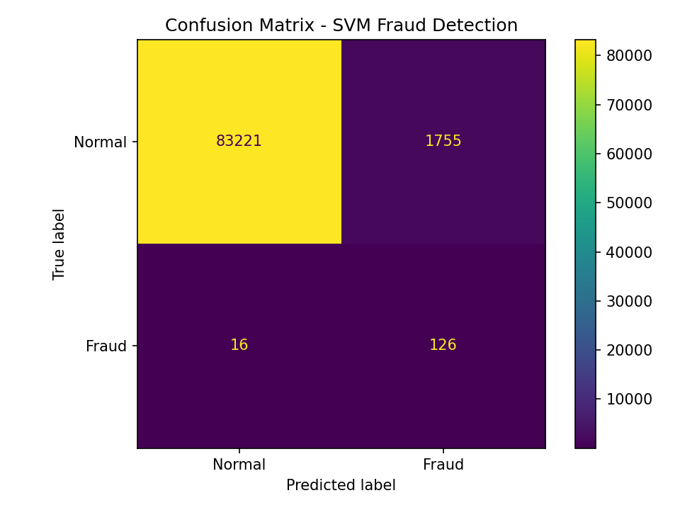
EVALUATION
Evaluation Metrics & Results
97.9%
88.7%
96.8%
64.6%
12.5%
Accuracy
Recall
ROC-AUC
PR-AUC
F1-Score
⚠ Precision: 6.7% — Low precision means many false alarms. Acceptable trade-off when missing fraud is far costlier.
Class | Precision | Recall | F1-Score | Support
Normal | 1.00 | 0.98 | 0.99 | 84,976
Fraud | 0.07 | 0.89 | 0.12 | 142
Macro Avg | 0.53 | 0.93 | 0.56 | 85,118
Confusion Matrix

Slide 9
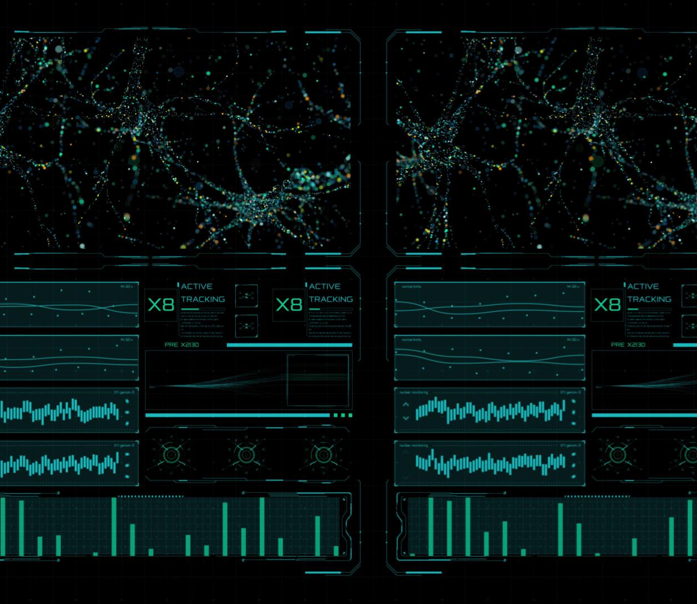
DISCUSSION
Discussion of Results & Findings
High Recall (88.7%)
Low Precision (6.7%)
The model caught 126 of 142 fraud cases in the test set. Only 16 fraudulent transactions were missed, critical for financial security.
1,755 normal transactions were flagged as fraud (false positives). In practice, these would be flagged for human review, an acceptable cost vs. missed fraud.
Strong ROC-AUC (96.8%)
Moderate PR-AUC (64.6%)
The model has excellent discriminative ability across all decision thresholds, indicating the features carry strong fraud signal.
Precision-Recall AUC is lower because precision degrades as recall increases. Reflects the inherent difficulty of the imbalance problem.
Class Imbalance Effect
Feature Importance
Despite class_weight='balanced', the extreme 1:579 ratio means precision remains low. SMOTE oversampling could improve this in future iterations.
V17, V14, and V12 (PCA components) had the highest correlation with fraud, suggesting the original confidential features they represent are the key discriminators.

Slide 10
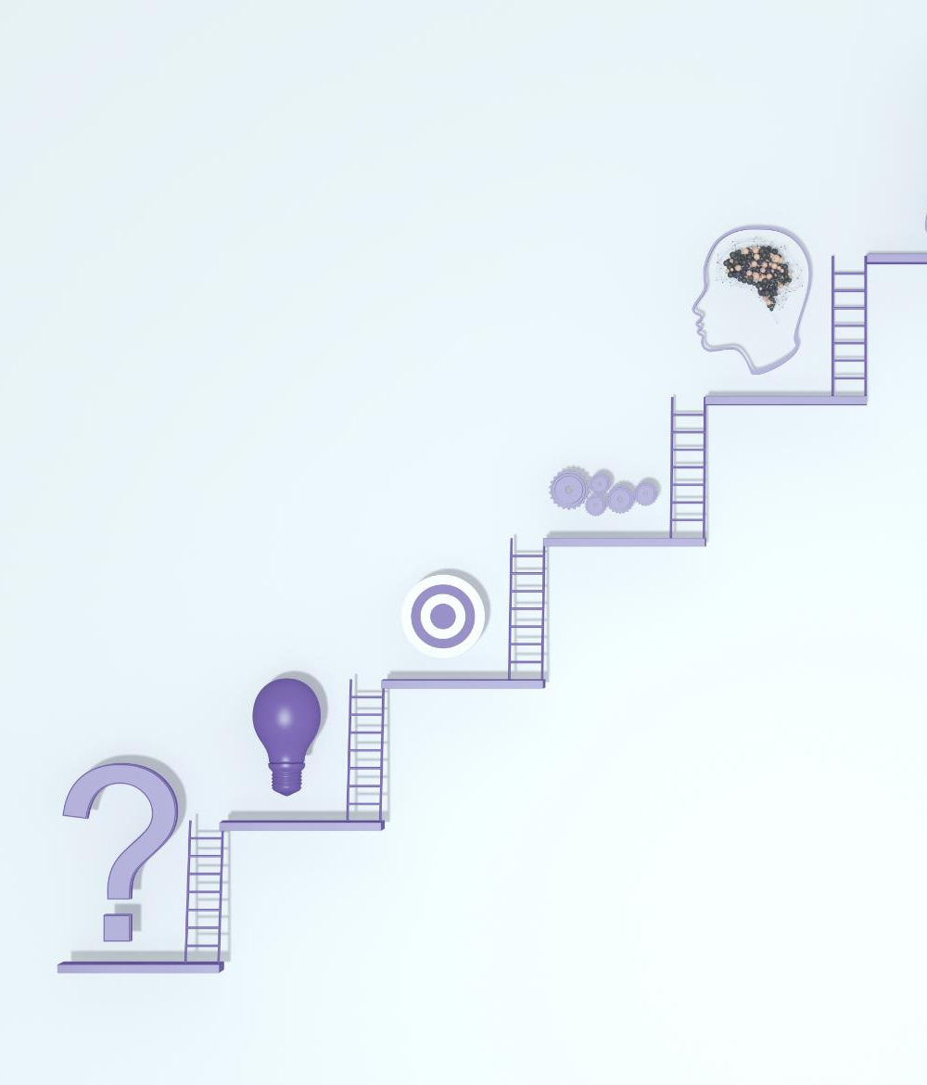
CONCLUSION & FUTURE WORK
What We Achieved
Future Improvements
Full ML pipeline: load → clean → EDA → train → evaluate
SMOTE / Oversampling
Address class imbalance at data level to improve precision.
88.7% recall, detected most fraud transactions
Threshold Tuning
Adjust decision threshold to balance precision vs recall.
96.8% ROC-AUC, strong overall discriminability
Ensemble Methods
Random Forest or XGBoost for potentially better F1.
Saved trained model (.joblib) for deployment
Cross-Validation
k-fold CV for more robust performance estimates.
Feature Engineering
Create interaction features from top correlated PCA components.
Real-Time Pipeline
Deploy model as REST API for live transaction scoring.

