Slide 1
📊
Presentation Scope
This report presents a structured pipeline for raw data quality assessment, remediation, bivariate linear correlation analysis (Pearson), and statistical outlier identification applied to a small employee dataset.
Data Cleaning,
Correlation
& Visualisation
Data Quality Audit
1
The CSV have missing value, broken date, text-as-number, duplicate row.
Data Remediation
2
File: messy_dataset_Mukesh.csv
Python code clean all 7 problem. After this, 9 good row ready for analysis.
Tool: Python + SciPy
Correlation Analysis
3
Method: Pearson Correlation
Pearson method check if Age and Salary move together. Result: yes, moderate!
Benjelyn Reves Patiag · 29 April 2026
Outlier Detection
4
Subject: MSE803 Data Analytics
Professor: Dr. Mohammad Norouzifard
IQR and Z-score check for outlier. Result: nobody is extreme, all normal.
1 / 7

Slide 2
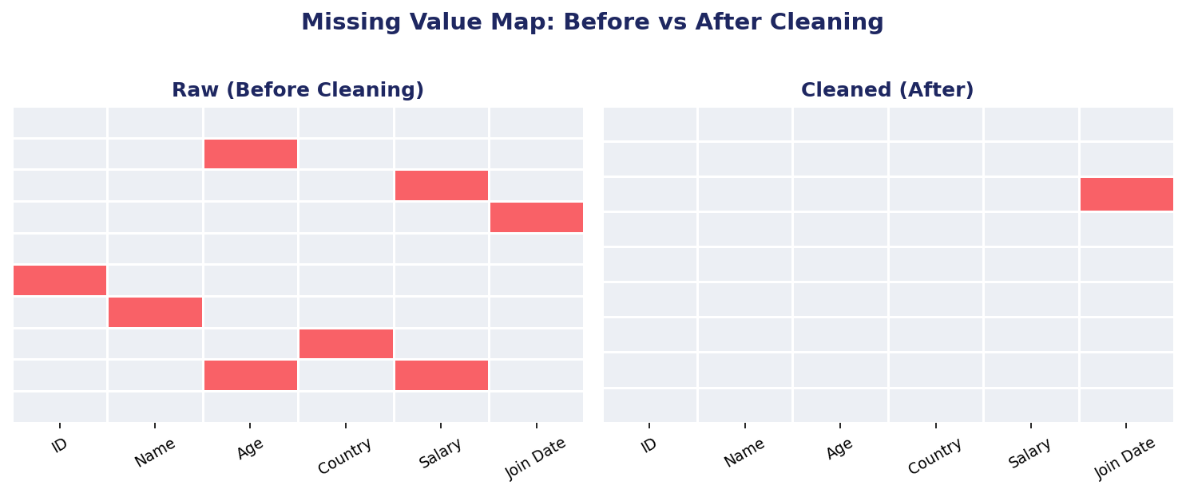
Data Quality Assessment & Remediation
Before any analysis can happen, the data must be clean first. Each defect was remediated prior to statistical analysis.
What Problem
What Was Found
How It Was Fix
Missing Value Map
Duplicate row
"Bob" appear 2 time
Second Bob was delete
Missing Age (×2)
No number, just empty
Fill with middle number: 29
Missing Salary (×2)
No number, just empty
Fill with middle number: $62,000
Age written as word
"thirty-eight"
Change to real number: 38
Salary written as word
"sixty five thousand"
Change to real number: 65,000
Date is broken
Month 13? That not exist!
Fix to correct date: Jan 2019
Name is missing
No name in that row
Put 'Unknown' as name
Red square = missing value.
Right side show after clean, almost no red left! ✅
Country is missing
No country in that row
Fill with most common: NZ
✅ After fix: 10 row become 9 clean row. All defects resolved.
2 /7

Slide 3
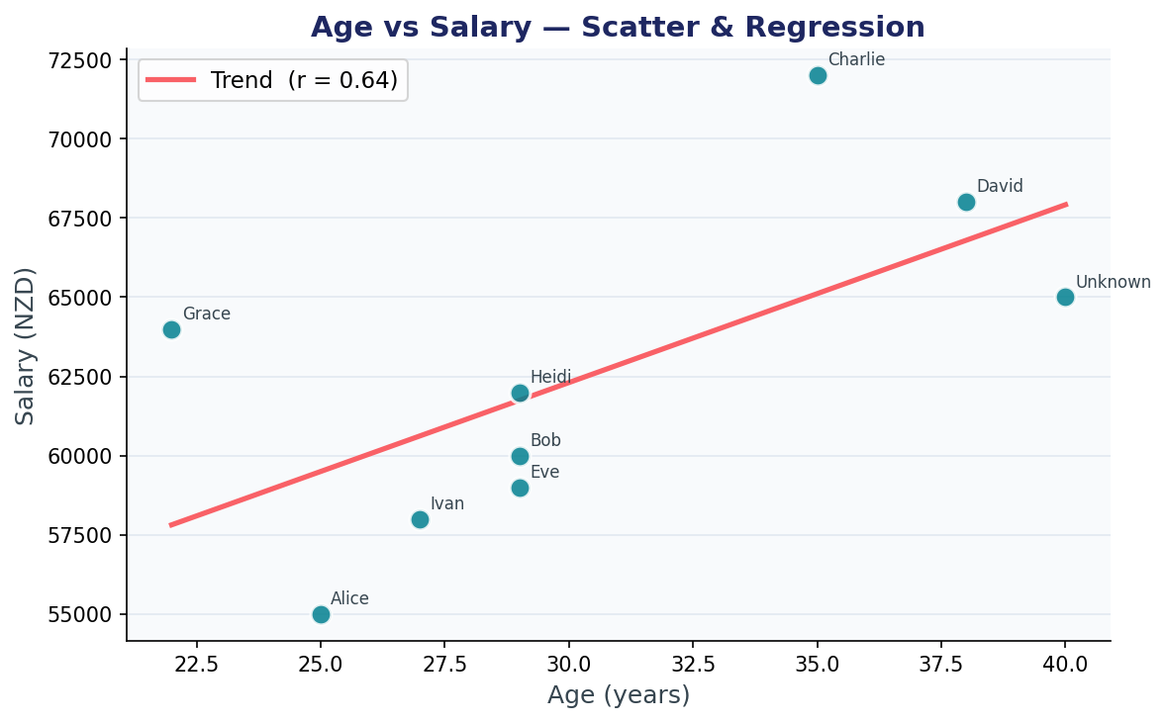
Correlation Analysis: Pearson's r (Age vs. Salary)
Pearson method was used. It give a number between -1 and +1 that say how strong two thing are connected.
Each Dot Is One Person. Line Show The Trend.
📏 What is the red line?
Trend line. It go up to the right, mean older age = higher salary. This is the pattern!
📍 Pearson r = 0.636
Indicates a moderate positive linear relationship. As age increases, salary demonstrates a consistent upward tendency.
🔢 Regression slope = 561.30
Each additional year of age is associated with an estimated NZD 561 increase in annual salary (intercept = 45,467).
📊 p-value = 0.065
Marginally above the α = 0.05 threshold. The association is directionally consistent. Sample is small: only 9 person. More data would make result stronger.
3 / 7

Slide 4
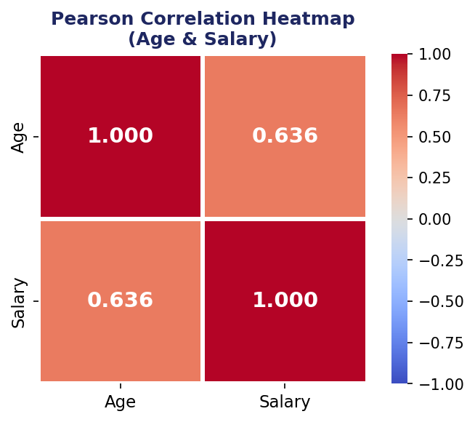
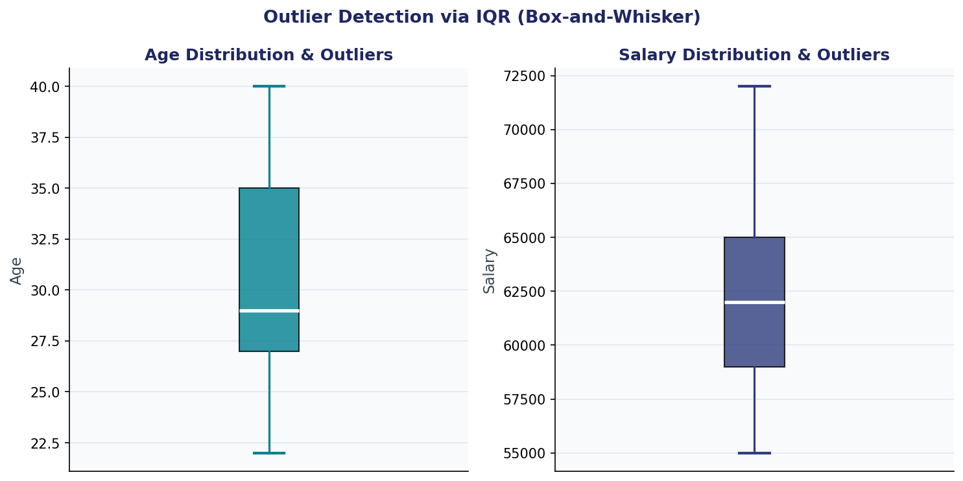
Correlation Heatmap & Outlier Detection via IQR
The colour grid show all correlation in one picture. The box plot check if anyone age or salary is way too high or way too low.
Colour Correlation Grid
Box Plot: Look For Outlier
0.636
0.065
Moderate+
📦 The box = middle 50% of people. Normal range is here.
Pearson r
Correlation value
p-value
Significance test
Strength
📏 The whisker line = how far normal can go.
🔴 Red dot outside = outlier. That person is too extreme.
✅ No red dot in this picture! Nobody is outlier. All normal!
4 / 7

Slide 5
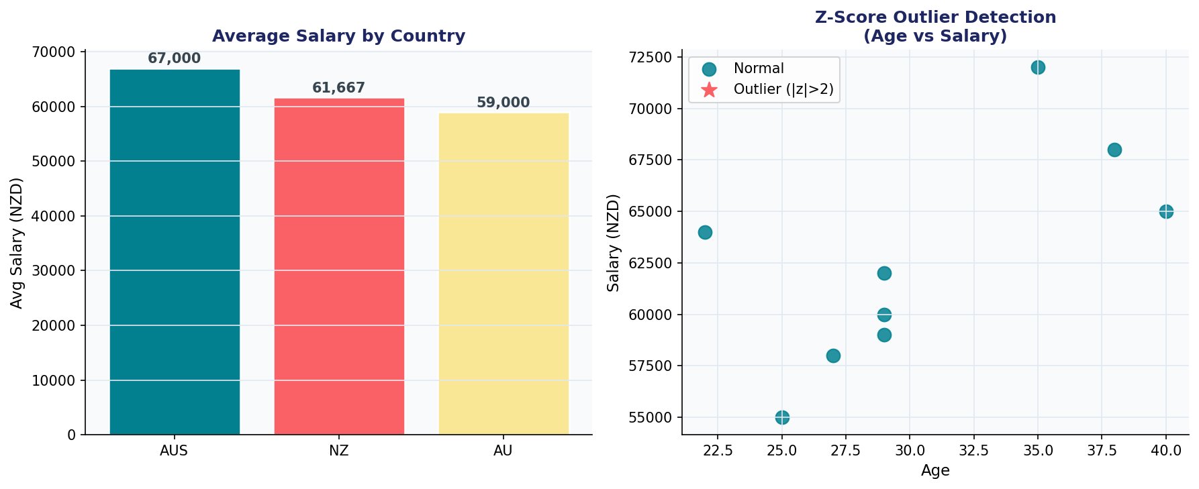
Country-Level Salary Analysis, Z-Score Detection
Bar chart show average salary for each country. Z-score check confirm: no extreme person exist in this data.
Average Salary Per Country + Outlier Check (Z = # of standard deviations from the mean)
Moderate Connection Found
F1
r = 0.636. Older employee tend to earn more money. Make sense, more experience, higher pay!
Australia Pay The Most
F2
AUS = $67,000. NZ = $61,667. AU = $59,000. Australia is highest in this data.
7 Problem Was Fixed
F3
Duplicate, wrong date, missing value, text-as-number, all was clean before analysis.
Zero Outlier Found
F4
⚠️ Note: This data only have 9 person. That is very small number! p-value = 0.065 is little bit above 0.05. So the finding is good but with more data, the result would be much stronger.
Both IQR method and Z-score method say: nobody is extreme. All age and salary is normal.
5 / 7

Slide 6
Clean data = better and more reliable outcome
Age ↑ and Salary ↑ (clear positive trend)
No outliers means data is stable and normal
Australia highest pay, but sample is small so results are limited.
📊
Conclusion
File: messy_dataset_Mukesh.csv
Benjelyn Reves Patiag · 29 April 2026
6 / 7

Slide 7
📊
Thank you!
Data Cleaning,
Correlation
& Visualisation
Benjelyn Reves Patiag · 29 April 2026
7 / 7

