Slide 1

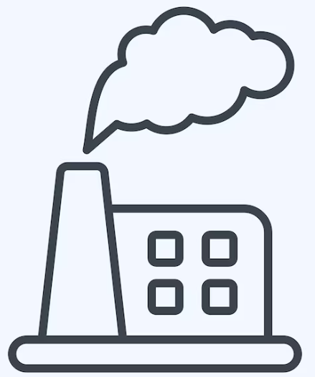
Beijing Air Quality
Statistical Data Analysis
📊
420,768
📍
12
📅
2013–2017
Records
Stations
Years
Data from 12 air monitoring stations around Beijing. Each row is one hour of measurement for pollution (PM2.5, PM10, SO2, NO2, CO, O3) and weather (temperature, wind, pressure).
Prepared by: Benjelyn Reves Patiag
Week 1 · Activity 2
Date: 21 Apr 2026
Subject: MSE803 Data Analytics
Professor: Dr. Mohammad Norouzifard

Slide 2
Data Cleaning & Basic Statistics
Task 2 & Task 3
🔧 Data Cleaning
📊 Key Statistics
Found missing values in 11 columns
CO had most missing: 20,701 rows
Replaced number gaps with column mean
Removed rows still missing (text columns)
Final dataset: 418,946 rows ✓
Pollutant | Mean | Median | Std Dev
PM2.5 | 79.71 | 57.0 | 79.94
PM10 | 104.54 | 84.0 | 91.05
SO2 | 15.84 | 8.0 | 21.44
NO2 | 50.59 | 45.0 | 34.60
CO | 1228.96 | 900.0 | 1129.81
O3 | 57.51 | 47.0 | 55.81
💡 Key Insight
PM2.5 mean (79.71) is much higher than median (57.0). This mean few very high pollution day pull up the average. WHO daily guideline is only 15 µg/m³, Beijing is well above safe level.

Slide 3
Data Filtering by Station
Task 4: Which area in Beijing have most pollution?
📍 Station Type
High pollution (city centre)
Medium (urban area)
💡 What This Mean
Lower (suburb / rural)
• Dongsi (city centre) have highest average PM2.5: 86.01 • Dingling (suburb) have lowest: 66.19 • Difference is ~30% , city area significantly more polluted • More cars and factories in city centre = more pollution

Slide 4
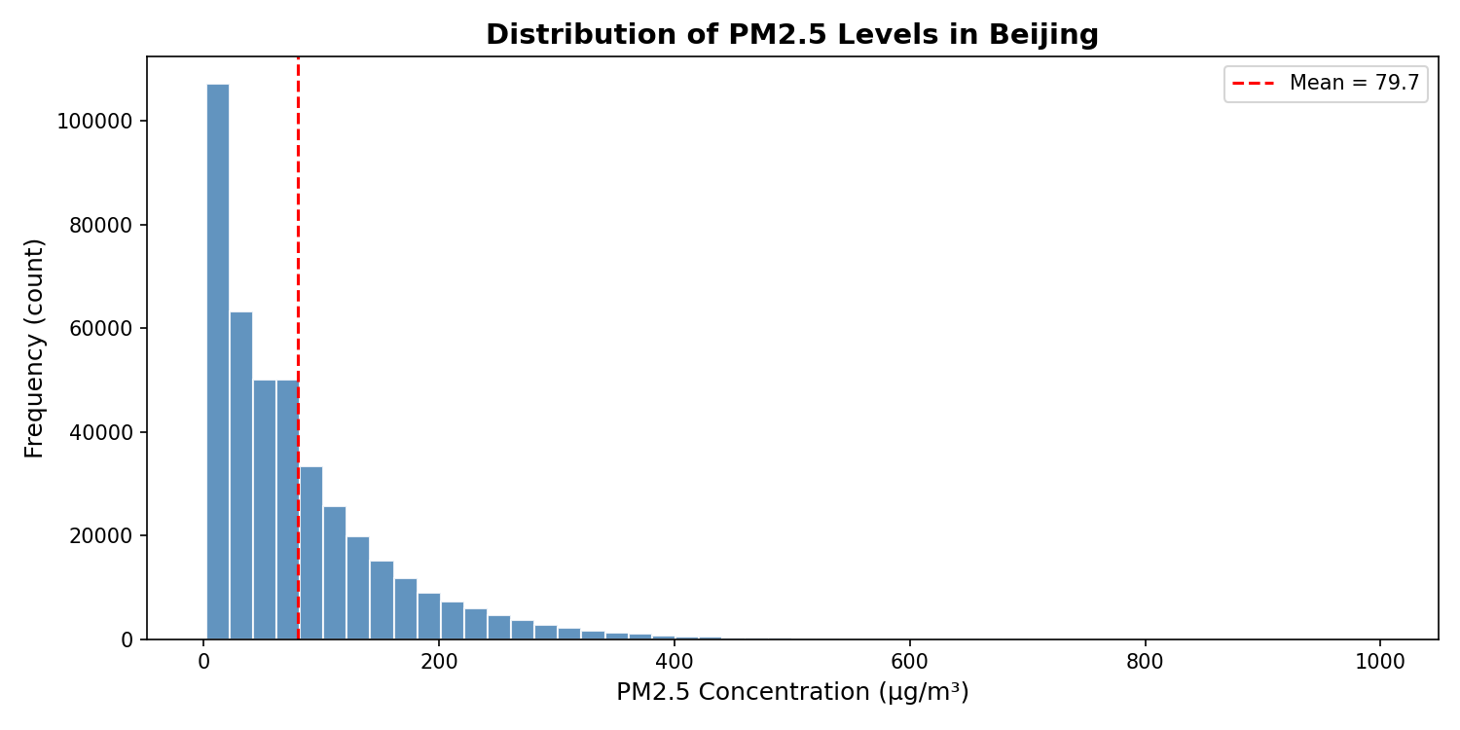
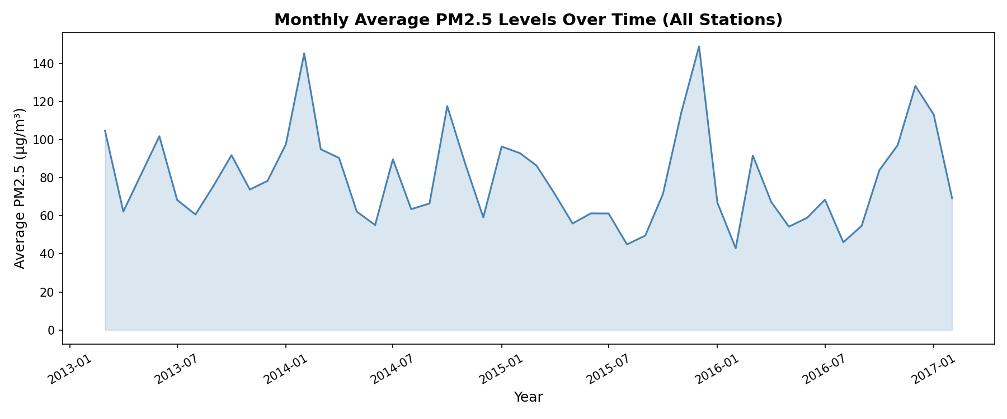
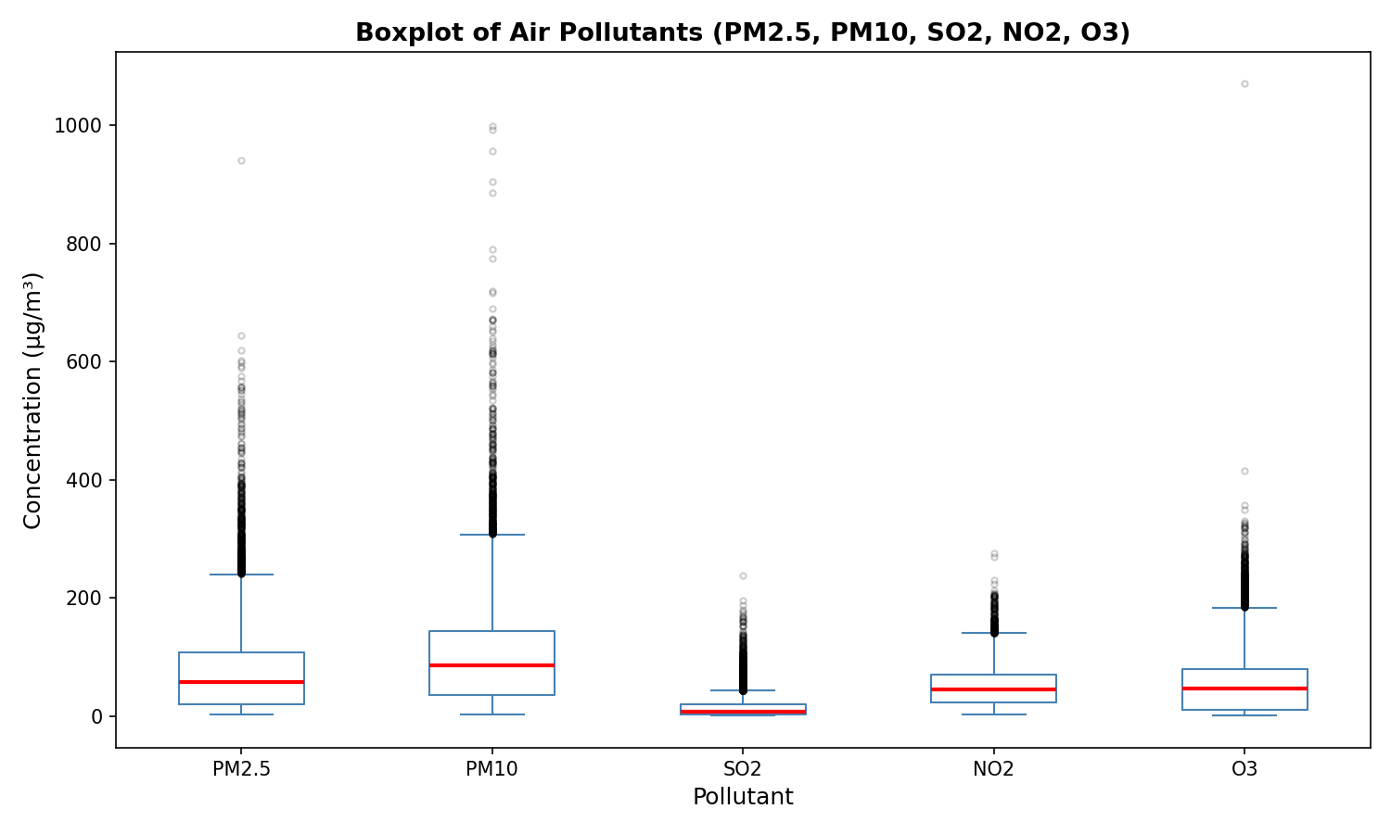
Data Visualization
Task 5: Seeing the data as pictures
1. Histogram of PM2.5
2. PM2.5 Over Time
3. Boxplot of Pollutants
Most hours have low-medium PM2.5. But some very bad days push to 999 µg/m³.
Pollution spikes every winter. Summer months are cleaner.
PM10 has widest spread. SO2 is most stable. Many outliers visible.

Slide 5
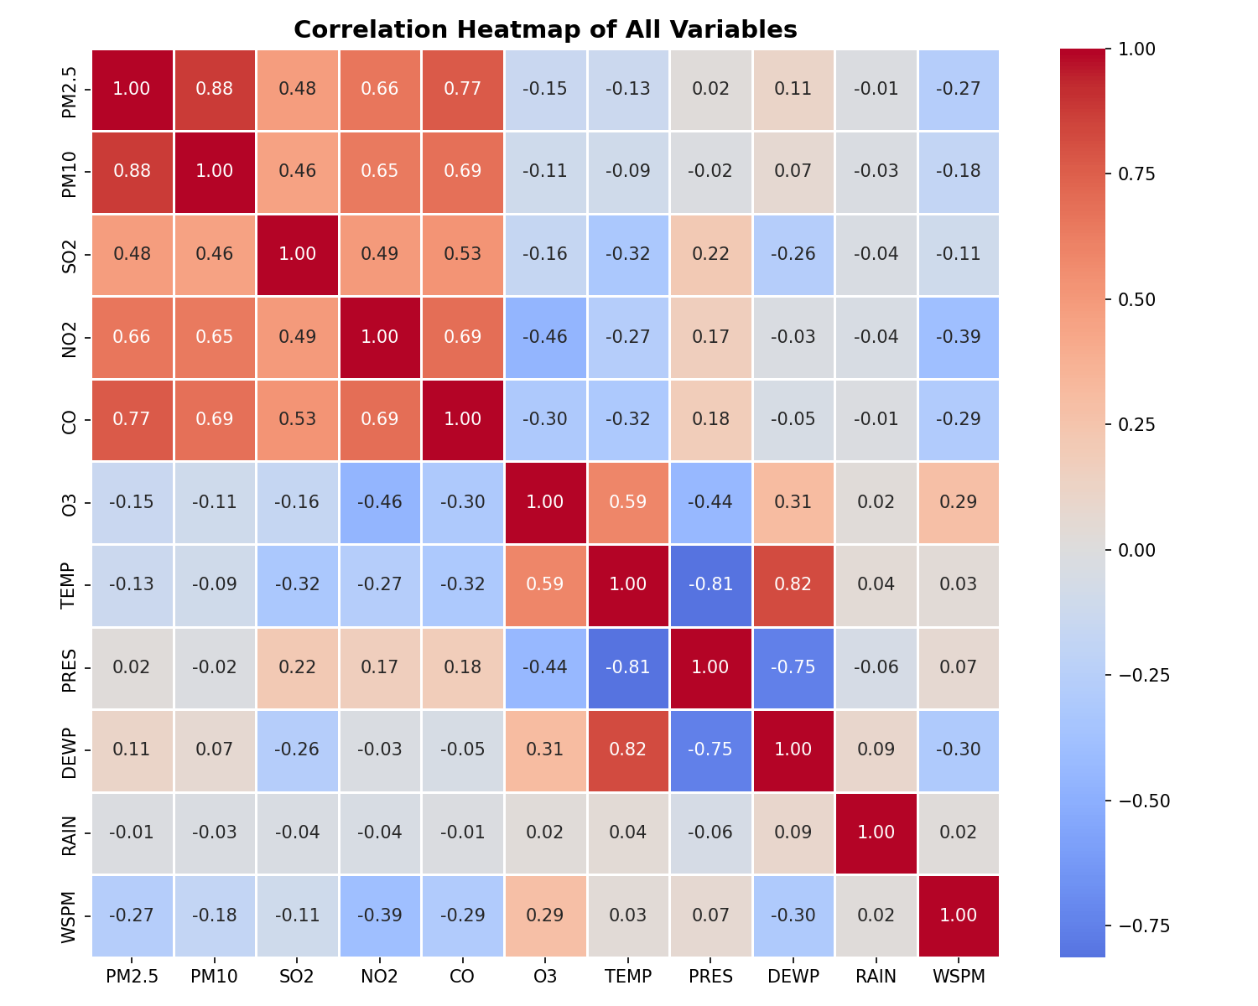
Correlation Analysis
Task 6: Which things are connected to PM2.5?
🔗 What Most Affect PM2.5?
PM10
+0.879
Very strong
CO
+0.769
Strong
NO2
+0.658
Moderate
SO2
+0.478
Moderate
WSPM
-0.269
Weak negative
TEMP
-0.129
Very weak
🏁 Analysis:
PM10 is #1 most related to PM2.5 (r=0.879). Wind help clean air (negative). Temperature alone not strongly predict pollution, but winter season is worse because more burning for heat.

Slide 6
Conclusions
Beijing air pollution is significantly above safe levels, especially PM2.5, indicating serious environmental and health concerns
Pollution is not balanced, most days are okay, but some extreme values make the average higher
Urban areas have higher pollution than suburban areas, showing strong impact of human activity like traffic and industry
PM10 is the strongest factor influencing PM2.5, while wind helps reduce pollution levels and temperature has weak effect
Data analytics and visualization clearly reveal patterns, trends, and relationships, supporting better decision-making and understanding of real-world problems

Slide 7
Thank you!

