Slide 1

Housing Price Analysis
What is the story behind house prices?
Descriptive Analytics | Dataset: Housing.csv | Tools: Python · Pandas · Matplotlib
🏠 545 Houses
📋 13 Features
💰 Avg ~4.8M
🎯 1 Goal
Total records analyzed
Size, rooms, amenities & more
Average selling price
Find what drives house prices
Prepared by: Benjelyn Reves Patiag
Week 1 · Activity 2
Date: 13 Apr 2026
Subject: MSE803 Data Analytics
Professor: Dr. Mohammad Norouzifard

Slide 2
About the Dataset - 13 Features
💡 Numeric columns show size and count. Yes/No columns show which features the house has. Furnishing status shows how move-in-ready it is.
Column
Type
What it tells us
price
Number
Selling price of the house
area
Number
Total floor size in square feet
bedrooms
Number
How many bedrooms (1 – 6)
bathrooms
Number
How many bathrooms (1 – 4)
stories
Number
Number of floors / levels (1 – 4)
parking
Number
Number of car parking spaces (0 – 3)
mainroad
Yes / No
Is the house on a main road?
guestroom
Yes / No
Does it have a guest room?
basement
Yes / No
Does it have a basement?
hotwaterheating
Yes / No
Is there a hot water heating system?
airconditioning
Yes / No
Does it have air conditioning?
prefarea
Yes / No
Is it in a preferred / premium area?
furnishingstatus
Category
Furnished, Semi-Furnished, or Unfurnished

Slide 3
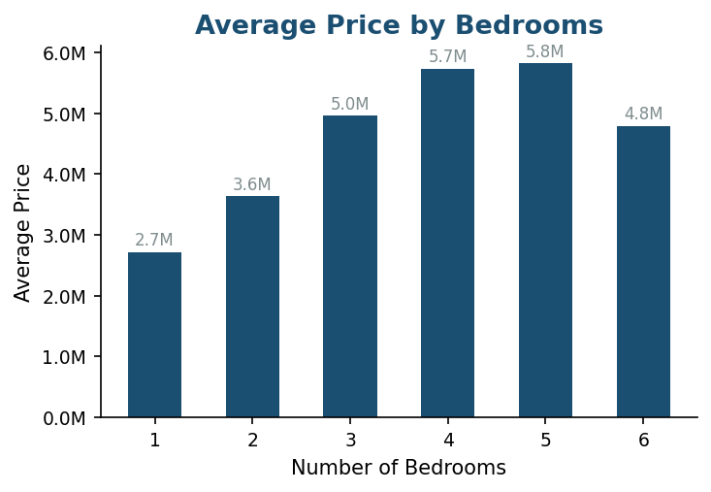
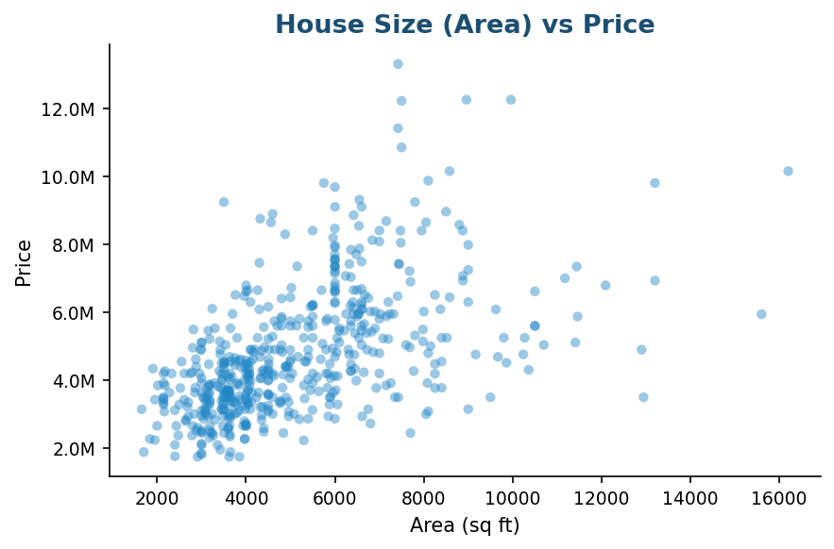
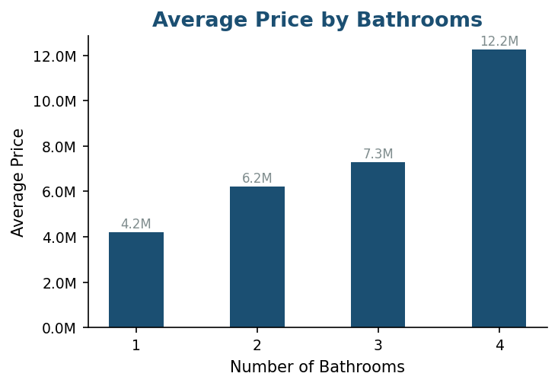
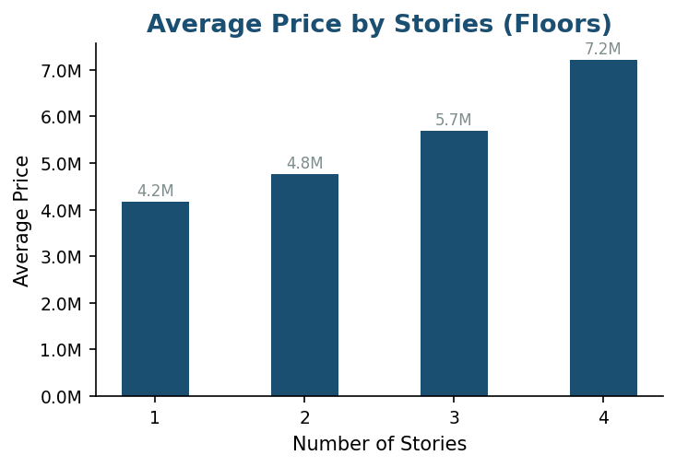
Finding 1: Size & Structure Drive Price
Area, bedrooms, bathrooms, and stories all affect how much a house costs.
Key Finding: Larger area is the #1 price driver. Each extra bedroom, bathroom, and floor also adds significant value.

Slide 4
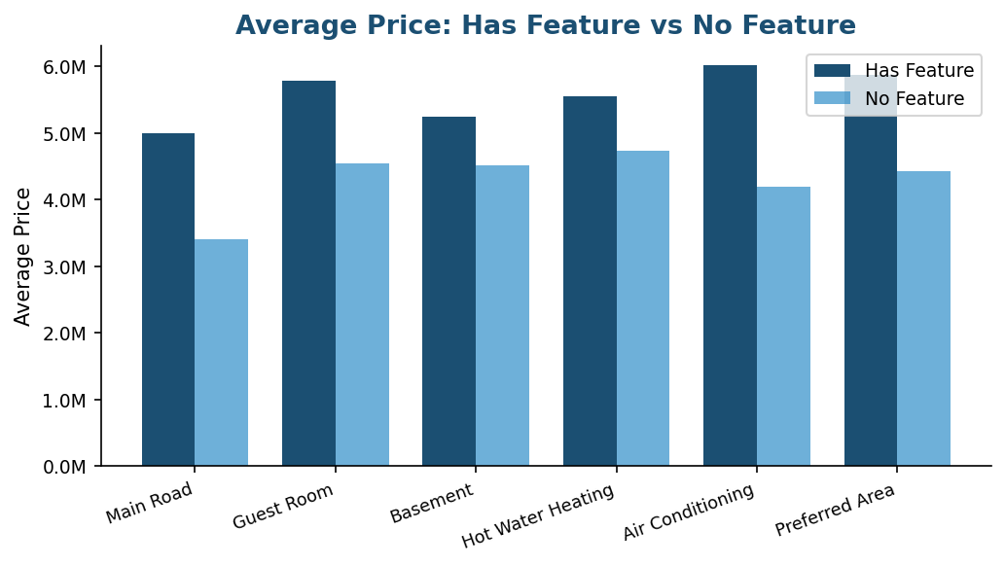
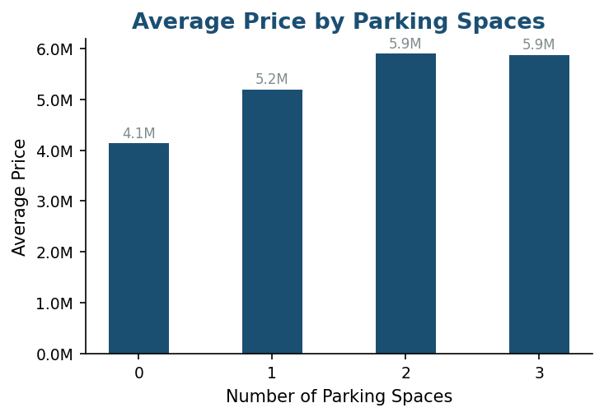
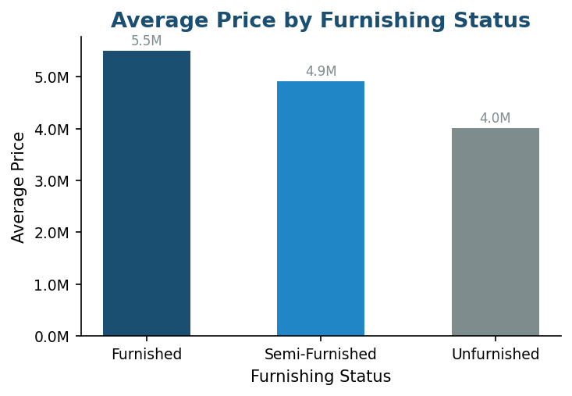
Finding 2: Amenities & Extras Add Value
Yes/No features, parking spaces, and furnishing status all influence price.
More parking = higher price
Furnished homes sell for the most

Slide 5
Conclusion: What Drives House Prices?
A summary of all key findings from the Housing dataset (545 houses, 13 features).
1
Area is the #1 factor
Larger houses consistently cost more. The scatter plot shows a clear upward trend — size matters most.
2
More rooms = more money
Each extra bedroom (+~1M avg), bathroom (+~2M avg), and story (+~1M avg) raises the price.
3
Amenities significantly boost value
Air conditioning (+1.8M), preferred area (+1.5M), guest room (+1.2M), and main road (+1.6M) all increase price.
4
Parking and furnishing count too
3 parking spaces adds ~1.7M over no parking. Furnished homes average 5.5M vs 4.0M unfurnished (+37%).
5
No single feature tells the whole story
Price is shaped by a combination of size, rooms, amenities, and extras. Top homes score well across all factors.
Overall: House price depends on SIZE + ROOMS + AMENITIES + EXTRAS. Bigger, better-equipped homes in good locations always cost more.

