Slide 1
World Happiness
Dataset Analysis
Exploring what makes countries happy, data cleaning, outlier detection,
correlation analysis, and visual insights across 20 countries.
20
8
0
0
Countries
Features
Outliers
Missing
Benjelyn Reves Patiag - 6 May 2026
Subject: MSE803 Data Analytics
Professor: Dr. Mohammad Norouzifard

Slide 2
Data Cleaning & Outlier Detection
✓ Duplicate Check
Dataset Summary
No duplicate rows found across 20 records.
Column | Type | Clean?
Happiness_Score | Numeric | ✓
GDP_per_Capita | Numeric | ✓
Social_Support | Numeric | ✓
Life_Expectancy | Numeric | ✓
Freedom | Numeric | ✓
Generosity | Numeric | ✓
Corruption | Numeric | ✓
Column
Type
Clean?
✓ Whitespace Strip
Trimmed string columns (Country names).
✓ Missing Values
0 missing values — all 160 cells are complete.
✓ Outlier Detection
Applied IQR × 1.5 rule to all 7 numeric columns. No outliers detected in any column.
IQR Method: Outlier if value < Q1 − 1.5×IQR or value > Q3 + 1.5×IQR: No outliers found in any of the 7 numeric columns.

Slide 3
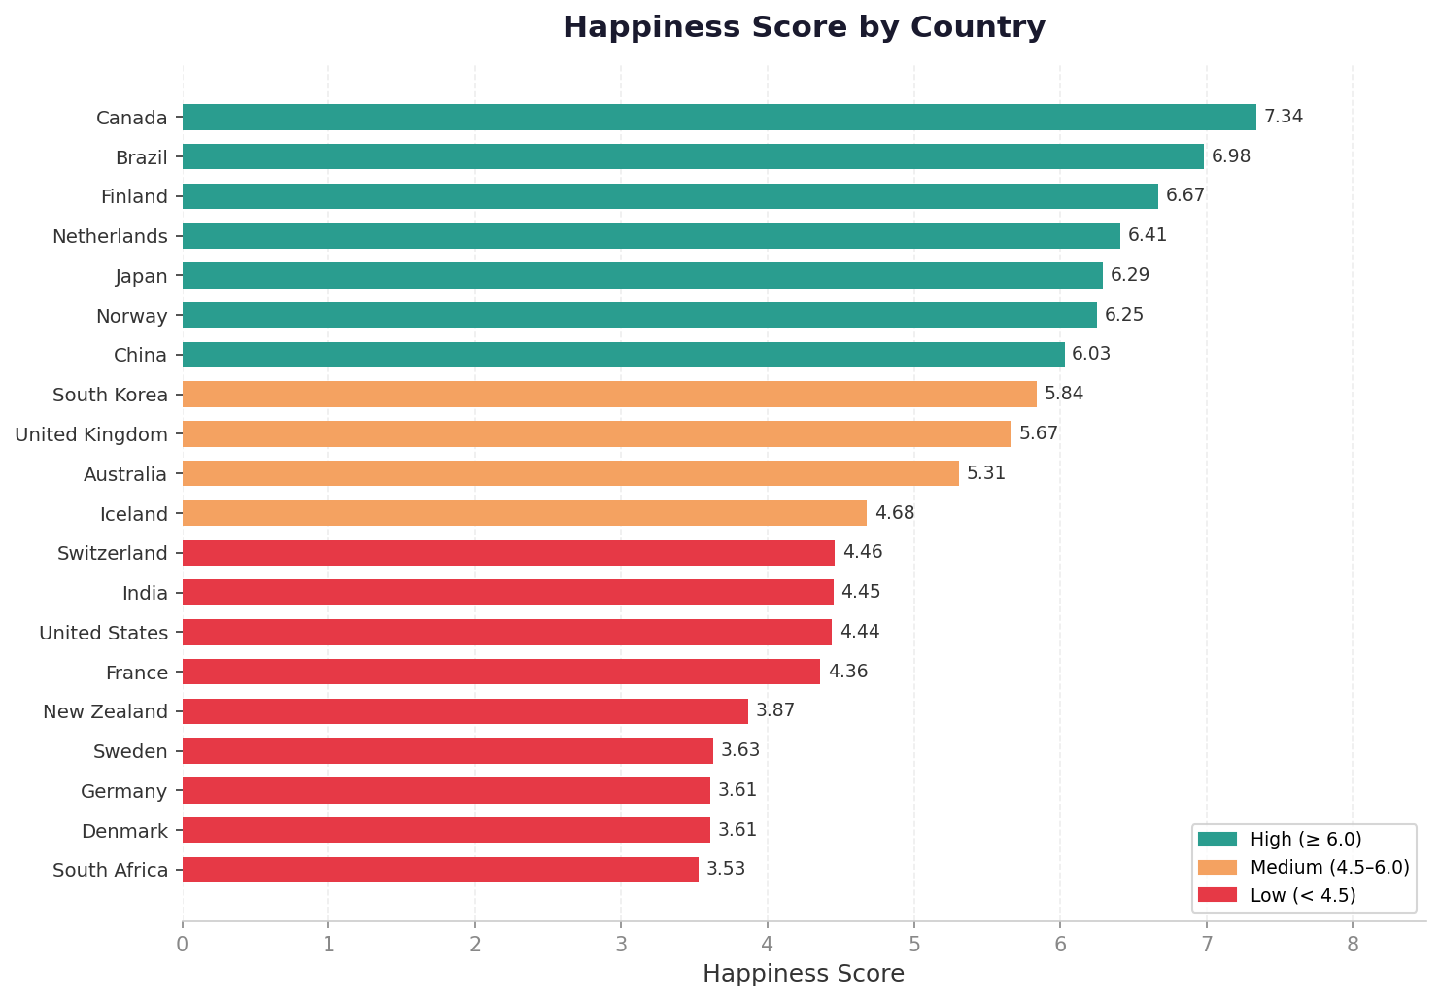
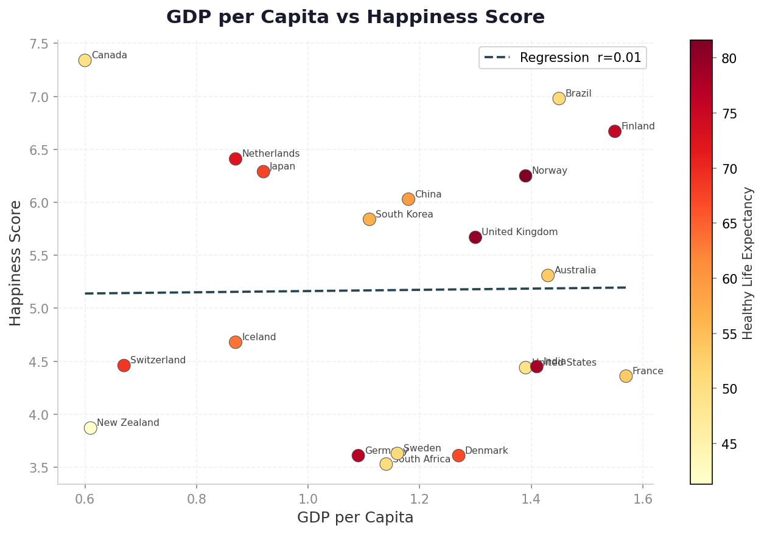
Happiness Rankings & Economic Comparison
Happiness Score by Country
GDP per Capita vs Happiness Score
Key Insight: Canada ranks highest (7.34); South Africa lowest (3.53). GDP has almost no linear relationship with happiness in this sample (r ≈ 0.01), suggesting economic output alone does not determine wellbeing.

Slide 4
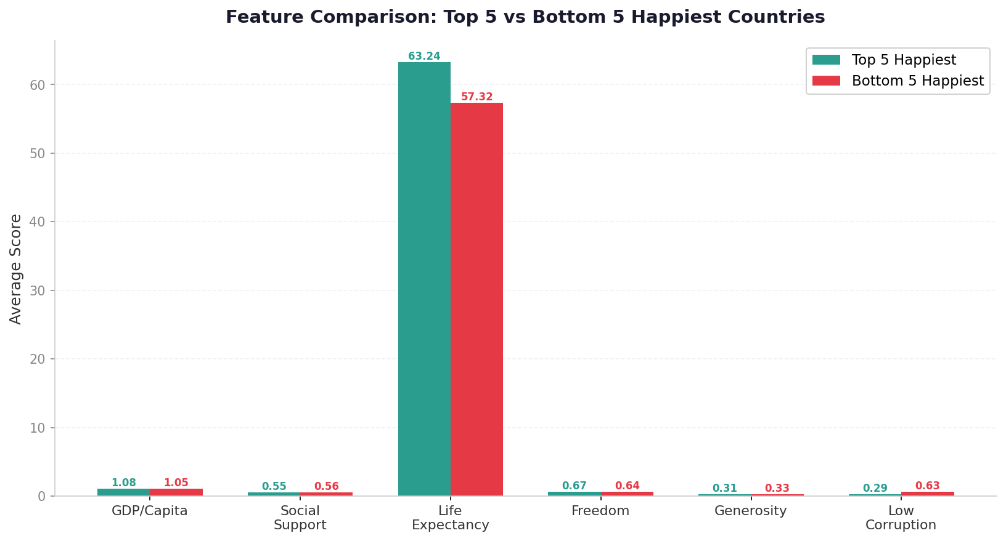
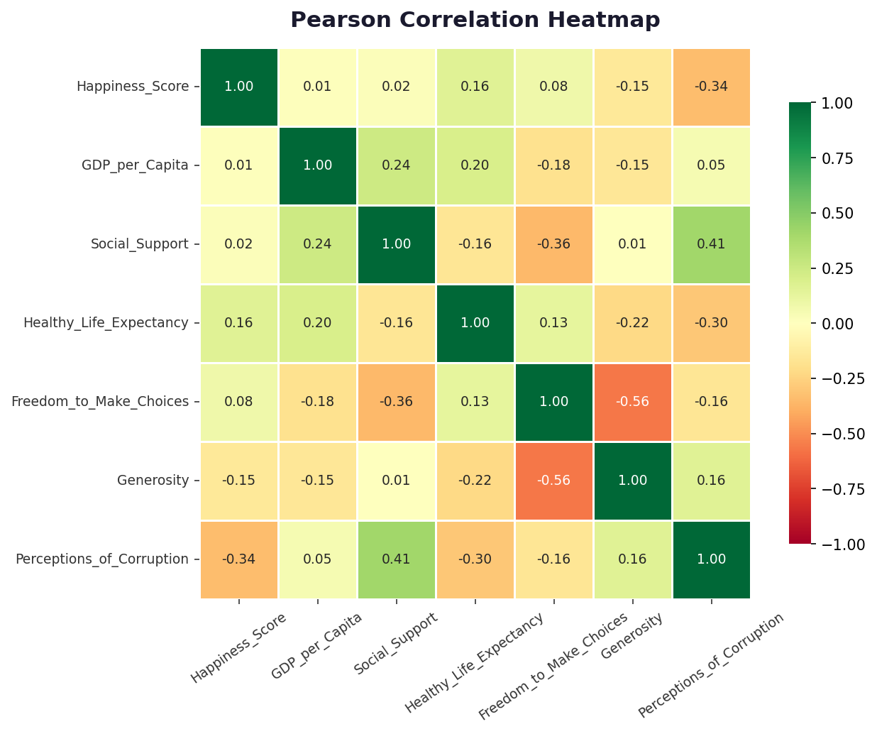
Feature Comparison & Correlation Analysis
Top 5 vs Bottom 5 Happiest Countries — Feature Averages
Pearson Correlation Heatmap (all features)
Key Insight: Top-5 countries score higher on Life Expectancy and Social Support. The heatmap confirms that higher Corruption Perceptions most strongly reduces happiness (r = −0.34), while Life Expectancy is the top positive predictor (r = +0.16).

Slide 5
Summary of Findings
01
Data Quality
02
Top Performer
03
GDP vs Happiness
No missing values and no outliers detected across all 20 countries and 7 numeric features.
Canada leads with a happiness score of 7.34, while South Africa scores lowest at 3.53.
GDP per capita shows almost no linear correlation with happiness (r = 0.01) in this dataset.
04
Corruption Impact
05
Life Expectancy
06
Top vs Bottom
Perceptions of Corruption has the strongest negative correlation with happiness (r = −0.34).
Healthy Life Expectancy is the strongest positive predictor of happiness (r = +0.16).
Happiest countries consistently score higher on Social Support and Life Expectancy than least happy ones.

Slide 6
Conclusion
The dataset is clean and complete, ensuring reliable and valid analysis results.
GDP per capita shows very weak correlation with happiness, indicating limited influence.
Social support and life expectancy are key positive factors contributing to higher happiness levels.
Perception of corruption has a negative impact on happiness across countries.
Overall, happiness is influenced by multiple factors, not only economic performance.
01
02
03
04
05

Slide 7
Thank you!

