Slide 1
Week 9 Activity 1
K-Means Clustering Analysis
Fitness App User Data
Data Cleaning, Clustering and Insights
Benjelyn Reves Patiag

Slide 2
Dataset Preparation
• Records analysed: 200
• Removed duplicate records
• Checked and handled missing values
• Converted incorrect data types where needed
• Selected numerical attributes for clustering
• Standardized features before K-Means

Slide 3
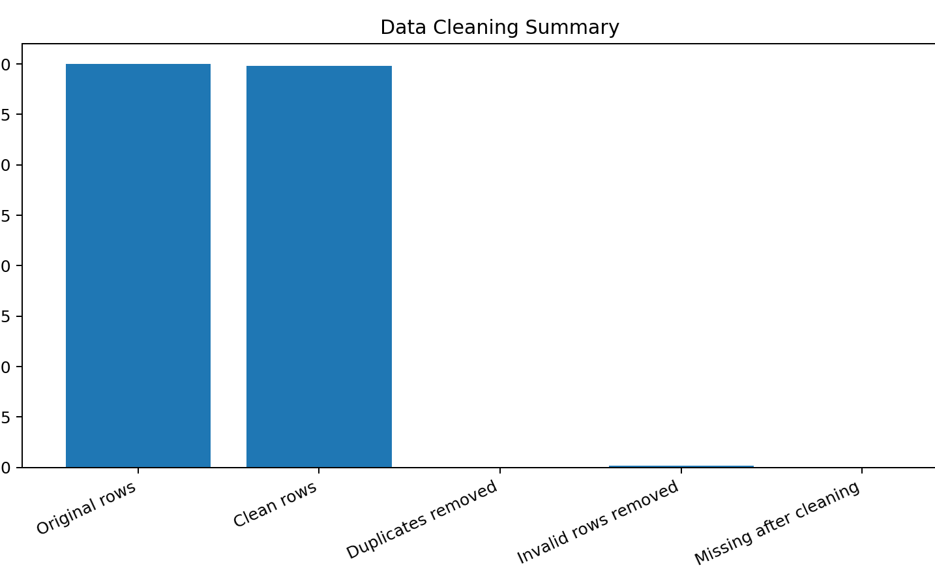
Fitness App User Clustering using K-Means
Data cleaning, K-Means clustering, and cluster insights
Goal
Evidence: data cleaning summary
Group similar fitness app users based on activity behaviour, then explain which group needs more engagement.
200
199
original rows
clean rows
K = 4
29%
selected clusters
highest churn cluster
Cleaning steps completed
No missing values found. No duplicate rows removed. One invalid row was removed because session duration was negative. Text categories were standardised and numeric columns were checked.
Dataset was already mostly clean, but one impossible value was still handled to protect the model.
Features selected: Age, Workouts per Week, Avg Session Duration, Steps per Day. User_ID and Churned were not used for training.

Slide 4
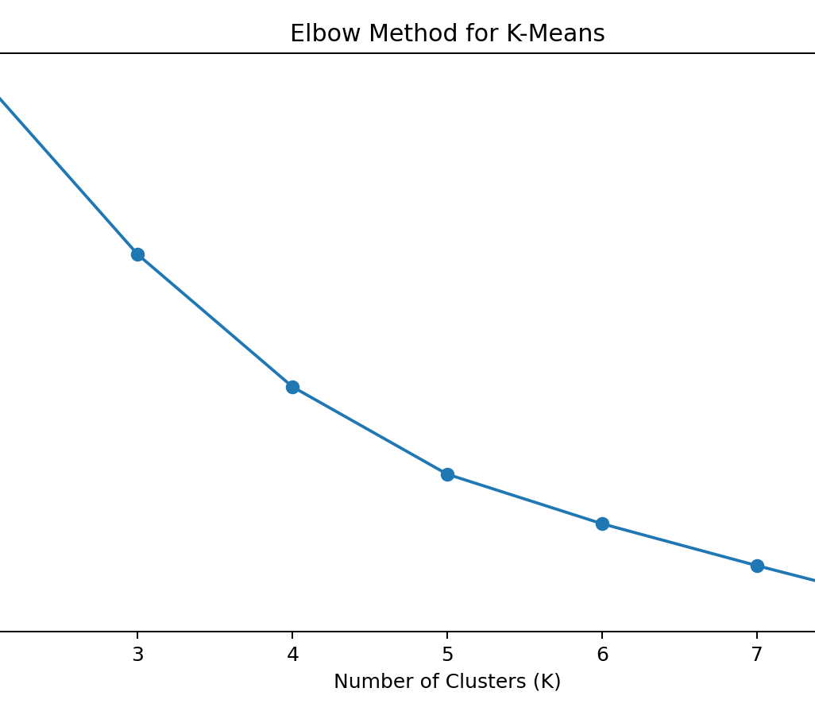
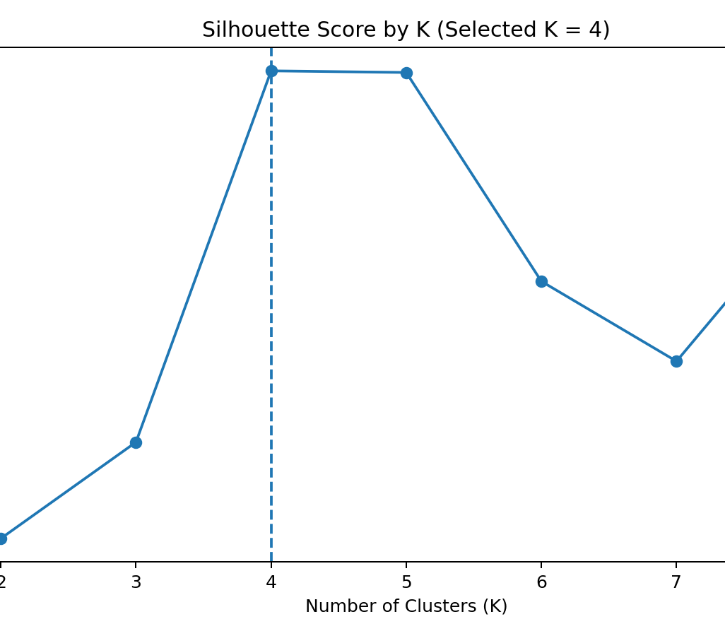
Clustering Methodology
K-Means was trained on scaled behaviour features; optimal K was selected using elbow and silhouette score.
Pipeline
1. Select features
2. StandardScaler
3. Test K = 2 to 8
4. Train K-Means
5. Interpret clusters
Why scaling is needed
K-Means is distance-based. Steps per day has large values, so StandardScaler prevents it from dominating Age and Workouts.
Chosen K
K = 4 has the highest silhouette score (0.2327). K = 5 is very close, but K = 4 is simpler and easier to explain.
K
Inertia
Silhouette
Best score is marked by K = 4. This gives clean enough groups for short activity presentation.
2
627.54
0.2051
3
514.41
0.2108
4
428.79
0.2327
5
372.23
0.2326
6
340.19
0.2203
7
313.12
0.2156
8
287.37
0.2251
Method follows scikit-learn KMeans workflow: fit model, assign labels, then interpret labels using original features.

Slide 5
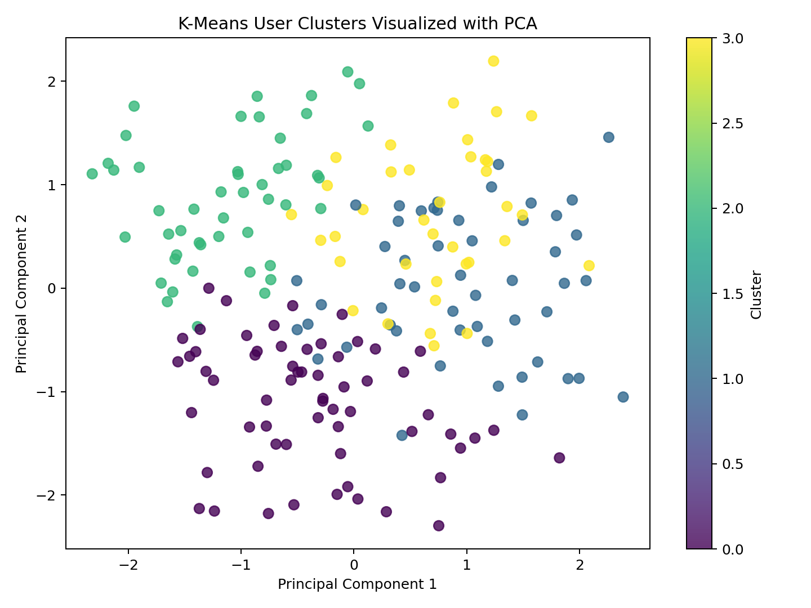
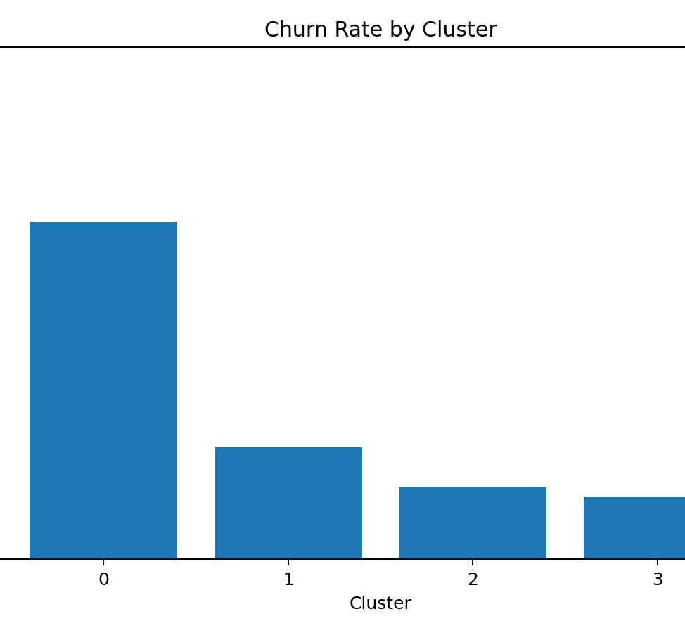
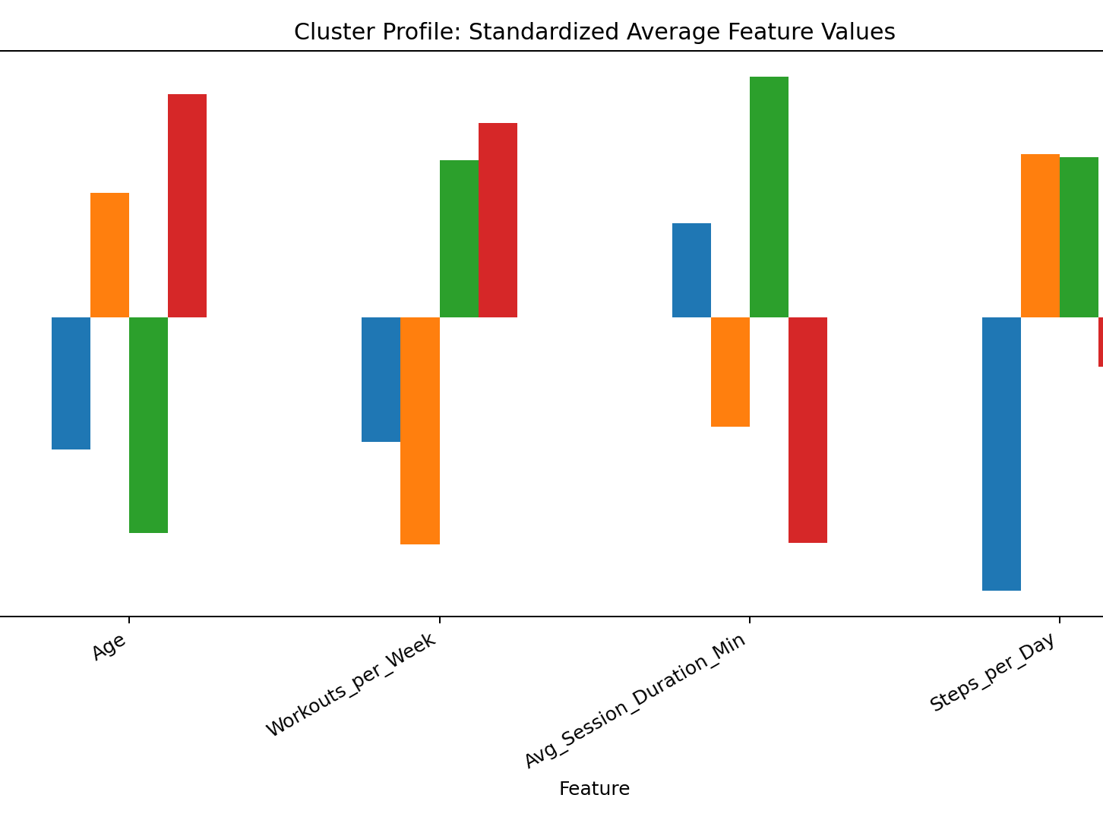
Key Findings and Insights
The model found four user groups with different activity levels and churn risk.
Cluster
Users
Activity profile
Churn
Action
Main takeaway
0
62
Low steps, low workouts
29%
Send reminders and challenges
Cluster 0 is the main attention group because it has the highest churn rate. Cluster 2 is the strongest group because users are highly active and less likely to churn.
1
52
High steps, low workouts
10%
Suggest guided workouts
2
48
Highly active users
6%
Premium rewards / loyalty
3
37
Older, consistent users
5%
Safe balanced workout plan
Churned was used only for interpretation after clustering, not as a training feature.

Slide 6
Conclusion
Data cleaning improved dataset quality by handling missing values, duplicates, and inconsistencies.
Feature scaling improved clustering accuracy by ensuring all variables contributed equally to the model.
K-Means identified meaningful user segments based on similar fitness and activity patterns.
The optimal number of clusters was selected using Silhouette Score analysis to improve clustering performance.
The clustering results provide actionable insights for personalization, marketing, user retention, and future analytics.

