Slide 1
פרק 10 - File-System Interface

Slide 2
File Concept
הגדרת הקובץ -
File = named collection of related information that is recorded on a secondary storage
למעשה הקובץ מייצג Contiguous logical address space
מה נשמור בקבצים?
Data
numeric
character
binary
Program

Slide 3
File Structure
None - sequence of words, bytes (free form)
Simple record structure
Lines
Fixed length
Variable length
Complex Structures
Formatted document
Relocatable load file
Can simulate last two with first method by inserting appropriate control characters

Slide 4
File Attributes
Name – only information kept in human-readable form (e.g., example.c)
Naming makes the file independent of the process, the user and even the system that created it (all future access is through the name)
Identifier – unique tag (number) identifies file within file system
Type – needed for systems that support different types
Location – pointer to device and location on device
Size – current file size
Protection – controls who can do reading, writing, executing
Time, date, and user identification – data for protection, security, and usage monitoring (e.g., when created? When modified? Who was the last to use?)
Information about files are kept in the directory structure, which is maintained on the disk
The size of the directory itself may be megabytes

Slide 5
File Operations (system calls)
Minimum set required:
Create
Find space
Create entry in directory
Write
Search directory to find file’s location
Maintain a write pointer to the location of the file where the next write is to take place
Read
Search directory to find file’s location
Maintain a read pointer to the location of the file where the next read is to take place
file seek – reposition within file:
Search directory to appropriate entry
Set file position to a certain value (doesn’t involve any actual I/O)

Slide 6
File Operations (system calls)
Delete
Search directory to find file
Release all file space
Erase directory entry
Truncate – same as delete however keep the file properties
Open(F_{i}) – search the directory structure on disk for entry F_{i}, and move the content of entry to memory
Saves future searches when calling the same file again
Close (F_{i}) – move the content of entry F_{i} in memory to directory structure on disk

Slide 7
Open Files
Several pieces of data are needed to manage open files:
File pointer: pointer to last read/write location, per process that has the file open
File-open count: counter of number of times a file is open – to allow removal of data from open-file table when last processes closes it
Disk location of the file: cache of data access information
Access rights: per-process access mode information

Slide 8
Open File Locking
Provided by some operating systems and file systems
Mediates access to a file (shared lock, exclusive lock) – some OS provide only exclusive lock for files
Mandatory or advisory:
Mandatory – access is denied depending on locks held and requested (windows)
Advisory – processes can find status of locks and decide what to do (Unix)

Slide 9
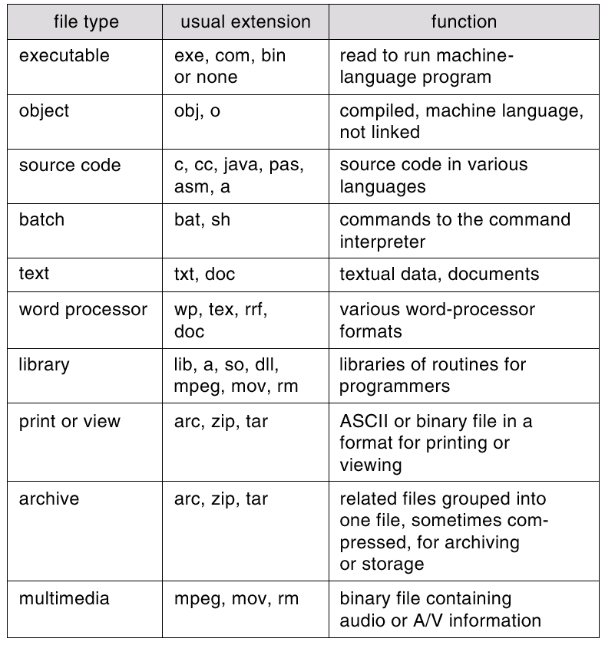
File Types – Name, Extension
Implementation – include the type as a part of the file name
Used for indicating the type of the file and the type of operations that can be done on that file
Can also be used to indicate the internal structure of a file

Slide 10
Access Methods
Accessing the information in the file:
Sequential Access (e.g., editor, compiler)
read next
write next (always at the end)
reset (to the beginning)
no read after last write
Direct Access – access directly a specific block of the file
read n
write n
position to n
read next
write next

Slide 11
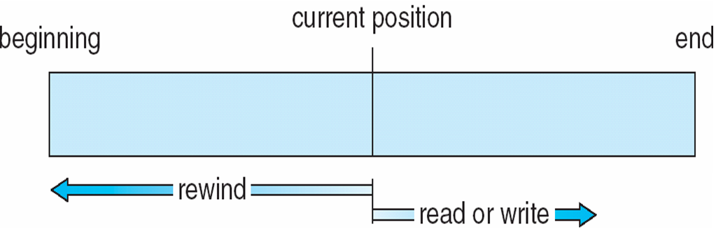
Sequential-access File

Slide 12
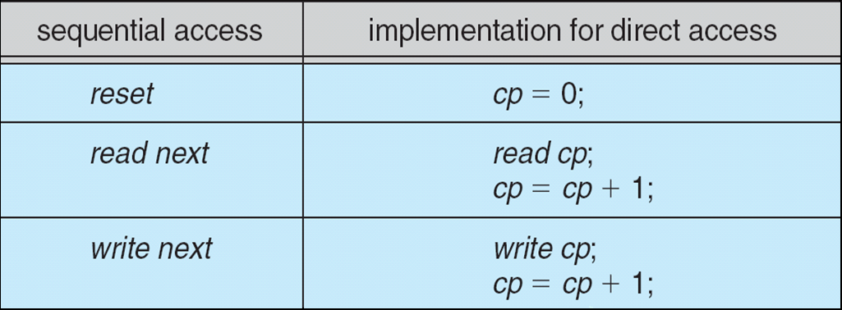
Simulation of Sequential Access on Direct-access File
Current position

Slide 13
Directory Structure
A collection of nodes containing information about all files
Directory
Files
F 1
F 2
F 3
F 4
F n
Both the directory structure and the files reside on disk
Backups of these two structures are kept on tapes

Slide 14
Operations Performed on Directory
Search for a file
Create a file
Delete a file
List a directory
Rename a file
Traverse the file system

Slide 15
Partitions
Low level structure in which files and directories reside
Part of a disk – separate area within a disk
Several disks (so disks can be grouped to one logical unit)
Partitions can be thought of as virtual disks
Each partition contains information about files in it (volume table of contents)

Slide 16
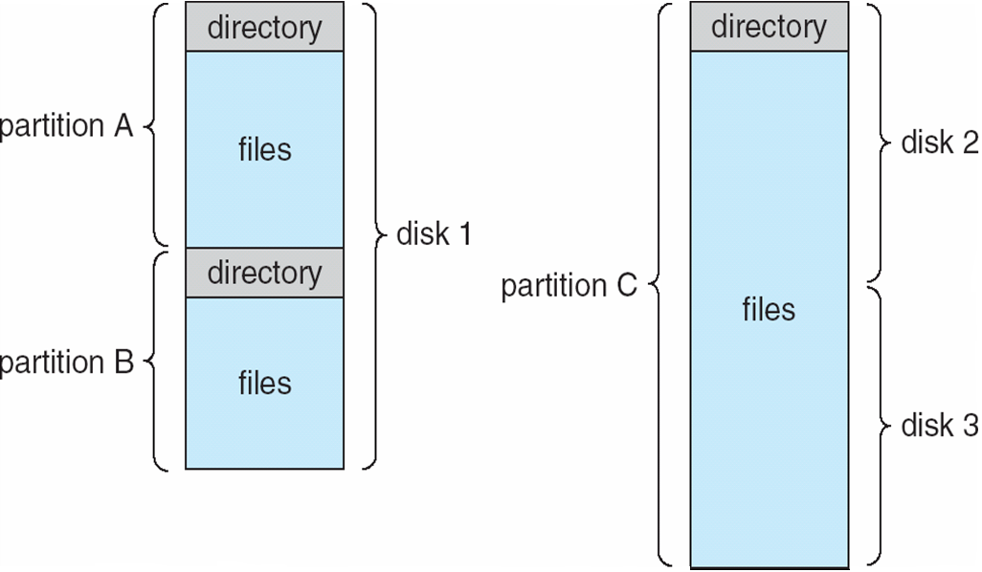
A Typical File-system Organization

Slide 17
Disk Structure
Disk can be subdivided into partitions
Disks or partitions can be RAID protected against failure
Disk or partition can be used raw – without a file system, or formatted with a file system
Partitions also known as minidisks, slices
As well as general-purpose file systems there are many special-purpose file systems, frequently all within the same operating system or computer

Slide 18
Organize the Directory (Logically) to Obtain
Efficiency – locating a file quickly
Naming – convenient to users
Two users can have same name for different files
The same file can have several different names
Grouping – logical grouping of files by properties, (e.g., all Java programs, all games, …)

Slide 19
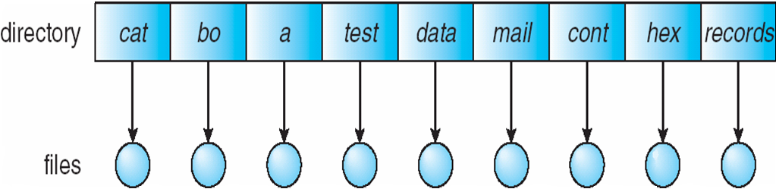
Single-Level Directory
A single directory for all users
Problems when having many files, or several users
Naming problem – all files must have unique names
Grouping problem

Slide 20
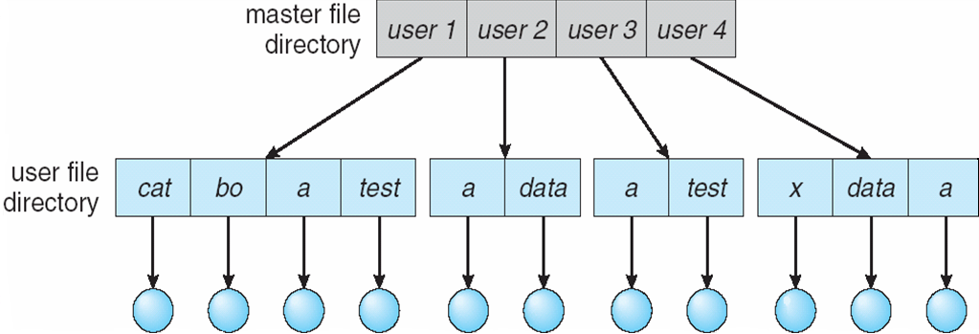
Two-Level Directory
Separate directory for each user
Can have the same file name for different user
Efficient searching
No grouping capability, no file sharing capability

Slide 21
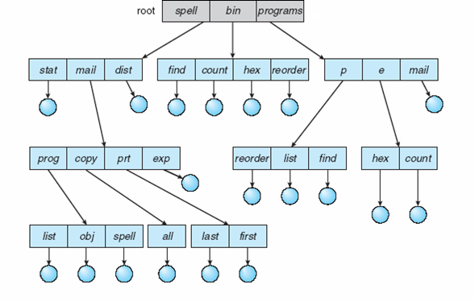
Tree-Structured Directories

Slide 22
Tree-Structured Directories (Cont)
Efficient searching
Grouping Capability
Current directory (working directory)
cd /spell/mail/prog

Slide 23
Tree-Structured Directories (Cont)
Absolute or relative path name
Creating a new file is done in current directory
Delete a file
rm <file-name>
Creating a new subdirectory is done in current directory
mkdir <dir-name>
Example: if in current directory /mail
mkdir count
mail
prog
copy
prt
exp
count
Deleting “mail” ⇒ deleting the entire subtree rooted by “mail”

Slide 24
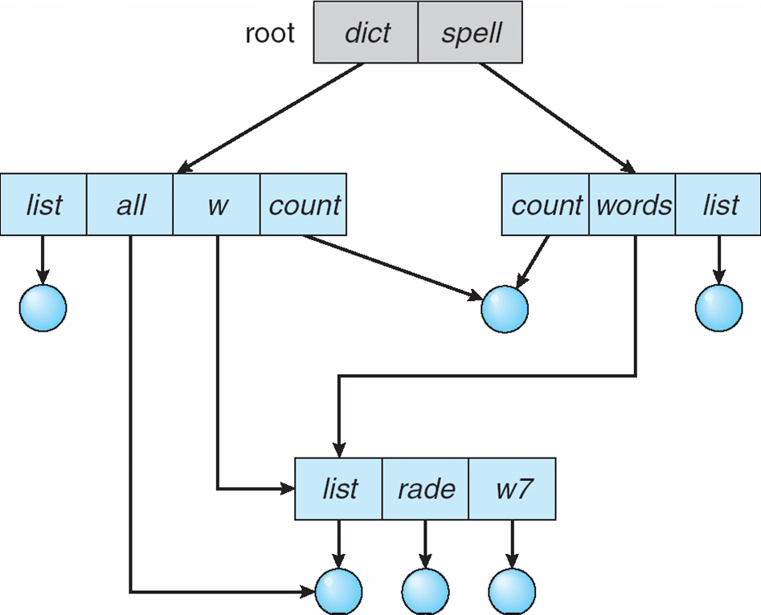
Acyclic-Graph Directories
Have shared subdirectories and files

Slide 25
Acyclic-Graph Directories (Cont.)
Problem:
If dict deletes list ⇒ dangling pointer
Solutions:
Backpointers, so we can delete all pointers
Backpointers using a daisy chain organization
Entry-hold-count solution – increment on new creation and decrement on deletion

Slide 26
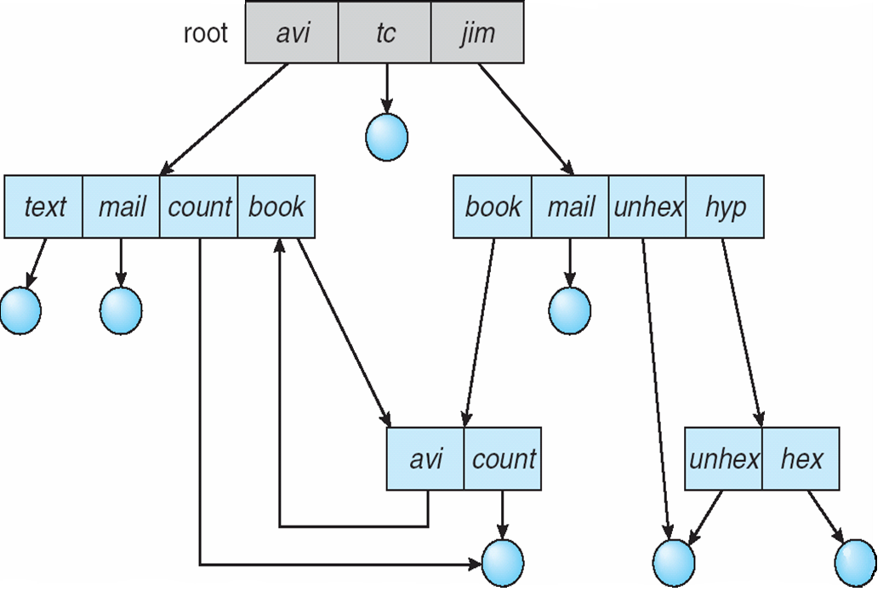
General Graph Directory

Slide 27
General Graph Directory (Cont.)
How do we guarantee no cycles?
Allow only links to file not subdirectories
Garbage collection
Every time a new link is added use a cycle detection algorithm to determine whether it is OK

Slide 28
File System Mounting
A file system must be mounted before it can be accessed
A unmounted file system is mounted at a mount point (the location within the file structure where the file system is to be attached)
Prior to mounting the OS verifies that the device contains a valid file system

Slide 29
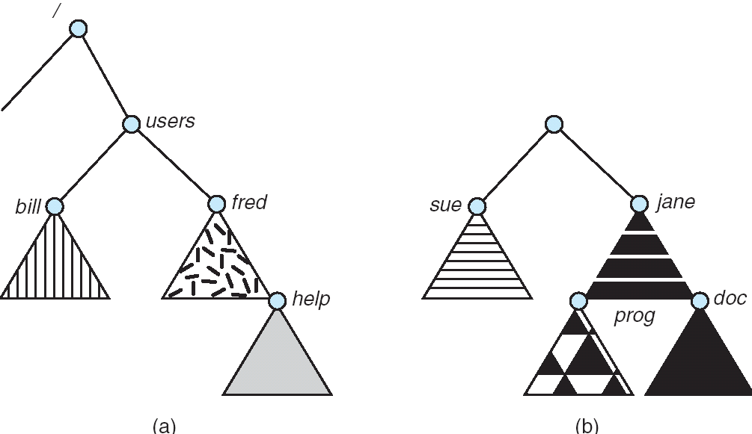
(a) Existing. (b) Unmounted Partition
Existing file system
Unmounted partition

Slide 30
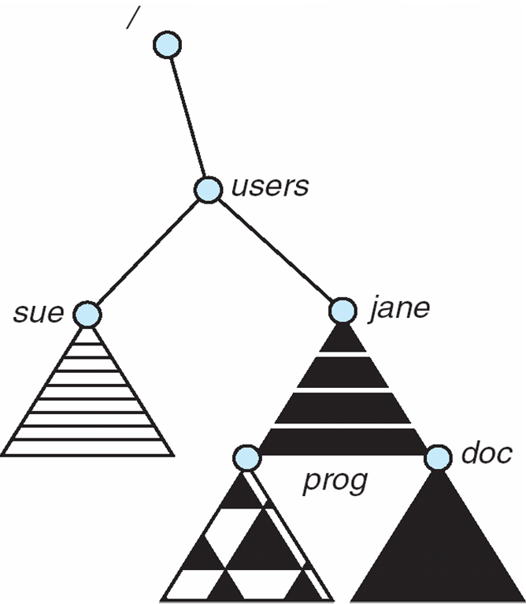
Mount Point

Slide 31
File Sharing
Sharing of files on multi-user systems is desirable
Sharing may be done through a protection scheme
On distributed systems, files may be shared across a network

Slide 32
File Sharing – Multiple Users
User IDs identify users, allowing permissions and protections to be per-user
Group IDs allow users to be in groups, permitting group access rights

Slide 33
Protection
File owner/creator should be able to control:
what can be done
by whom
Types of access
Read
Write
Execute – load the file into memory and execute it
Append – write new information at the end of the file
Delete
List – list the name and attributes of the file
Also – renaming, copying and editing

Slide 34
Access Lists and Groups
Mode of access: read, write, execute
Three classes of users
RWX
a) owner access 7 ⇒ 1 1 1 RWX
b) group access 6 ⇒ 1 1 0
RWX
c) public access 1 ⇒ 0 0 1
Ask manager to create a group (unique name), say G, and add some users to the group.
For a particular file (say game) or subdirectory, define an appropriate access.
owner
group
public
chmod
761
game
Attach a group to a file chgrp G game

Slide 35
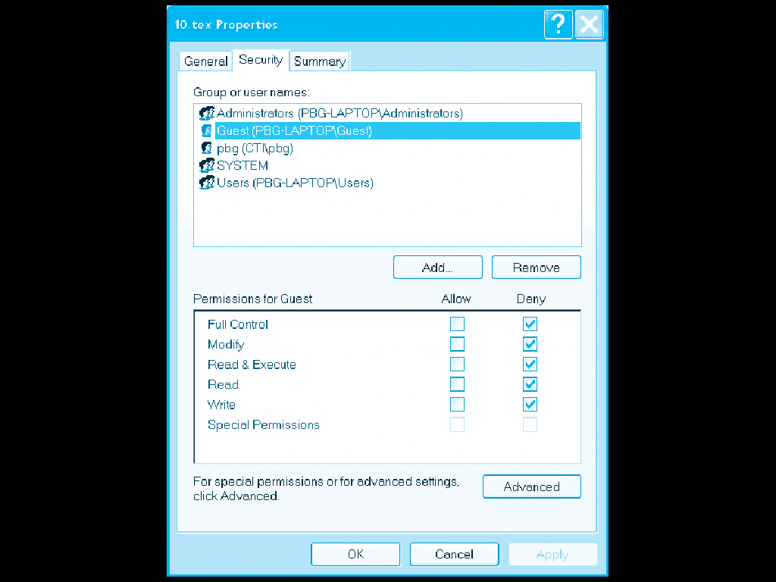
Windows XP Access-control List Management

Slide 36
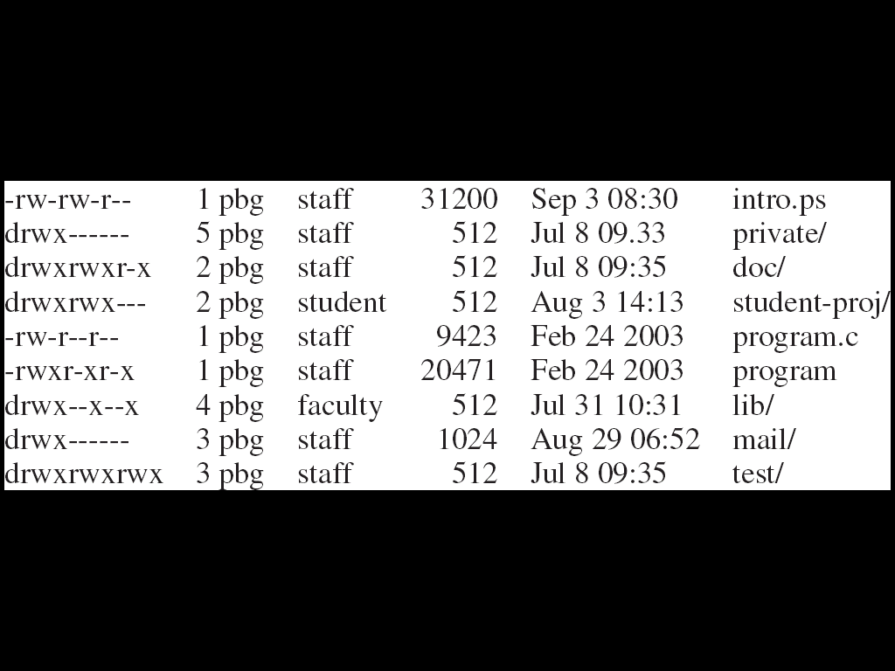
A Sample UNIX Directory Listing

Slide 37
סינכרוניזציה
מועדון "MyWine" הוא מועדון חברים סגור לייצור יין המונה 8 חברים ומחסן אספקה. כל חבר יכול להחליט על הכנת יין בכל נקודת זמן. על-מנת להכין יין, על החבר להשתמש ב- 2 קנקנים גדולים (carboys), מתסיס שמרים (yeast lock), מיץ פירות ממותק (juice) ושמרים (yeast). התהליך מתחיל בערבוב כל המרכיבים יחדיו בקנקן גדול באמצעות תחנת ערבוב (mixing station) . לאחר מכן מתרחש תהליך תסיסה בקנקן, באמצעות מתסיס השמרים, שנמשך 4 שבועות. הקנקן הגדול השני נדרש רק בסוף התהליך על-מנת להפריד את היין משאריות השמרים (תהליך הנקרא decanting). במועדון 2 תחנות ערבוב (mixing station), 6 קנקנים גדולים (carboys), 7 מתסיסי שמרים (yeast lock), 15 קנקני מיץ פירות ממותק (juice) (נדרשים 2 קנקני מיץ להכנת קנקן יין) ו- 20 חבילות של שמרים ליין (נדרשת חבילה אחת לכל קנקן יין). כאשר אחד החברים מסיים להכין יין, כל החברים טועמים מהיין לפני שאותו חבר מתחיל להכין יין חדש. מיץ פירות ושמרים מוזמנים באופן תדיר.
להלן תוכנית אשר כתב אחד החברים במועדון לסמלוץ פעולת מועדון היין, כאשר כל אחד מהחברים הוא process. לטענת החבר, התוכנית מונעת deadlocks ופותרת את בעיית ה- race condition.
האם צודק החבר? במידה וכן, הסבר איזה deadlock ואיזה race condition שהיו עלולים להתרחש נמנעו, וכיצד. במידה ולא, אלו deadlock ו- race conditions עלולים להיווצר ואלו שורות יש לשנות על-מנת למנעם (ניתן לסמן על התוכנית)?

Slide 39
תשובה:
Deadlock שעשוי היה להתרחש נוגע לקנקנים הגדולים. ההפרדה שנעשית בקוד בין משאב קנקן גדול לצורך התהליך ומשאב קנקן גדול לצורך ההפרדה מהשמרים פותרת את הבעיה. מצבי ה- race condition לשמרים ולמיץ אמורים להיפתר באמצעות ה- mutex, אם כי על-מנת להיות 100% מדויקים צריך היה לשים אותו לפני הבדיקה של הכמות על-מנת שלא יבדקו שני תהליכים ורק אז יבצעו את ההפחתה. כלומר, ייתכן שמישהו הגיע לשורה של המיץ והשמרים וקיבל ערך שלילי כי הבדיקה מתבצעת לפני הסמאפור, אבל זה יגרום לתוצאה לא ולידית ולא ל- race condition או לדדלוק. לבסוף, אם מישהו במצב שהוא מחכה לקנקן אז לא יוכל לטעום מהיין של האחרים (למרות שאפשר להניח שמדובר בתרד נפרד).

