Slide 1
Data Reference System Explanation &Implementation Manual
May, 2021

Slide 2


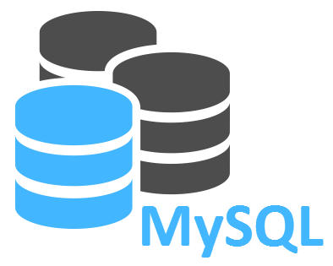

Whole System
Data Reference System
Front End Server
User Interface
Back End Server
Web Application
Database Serveｒ
Access
Client PC

Slide 3
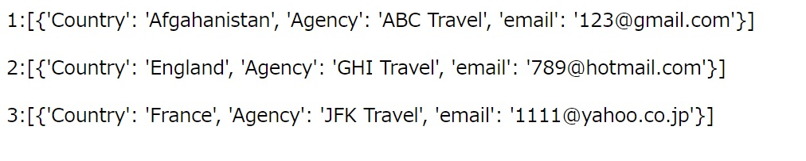


Typical Operation
Index.html
Index2.html
When countries are selected & “SEND” clicked, Related information is displayed.
Access using port TCP5000
Client PC

Slide 4
Methodology for System Implementation
simple and cost effective methodology
For PoC, Python Flask and Mysql DB on Linux VM instance.
Ubuntu 20.04 LTE
Python 3.8.3
Flask 1.1.2
Jinja2
Mysql 8.0.24
HTML 5
cloud oriented methodology
For PoC, AWS cloud accessed by Putty

Slide 5
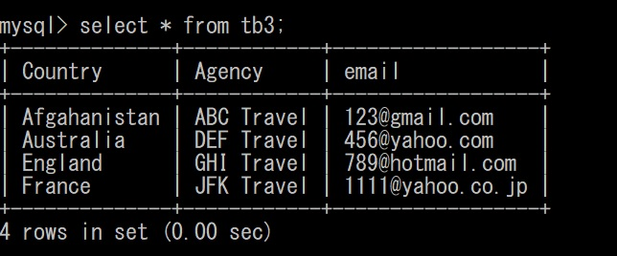
Sample Code /Data
Sample Data
<Code>
github0503.py → https://github.com/kazu0116/web_application/blob/main/Python_Flask_Jinja2/github0503.py
index.html → https://github.com/kazu0116/web_application/blob/main/Python_Flask_Jinja2/templates/index.html
index2.html→ https://github.com/kazu0116/web_application/blob/main/Python_Flask_Jinja2/templates/index2.html
<Data>
Sample data (Data Insert) → https://github.com/kazu0116/web_application/blob/main/mysql_sample_data/sample_data.txt

