Slide 1
Bird_Strikes_Ineuron_Project_1
File created on: 06-05-2023 09:51:10

Slide 2
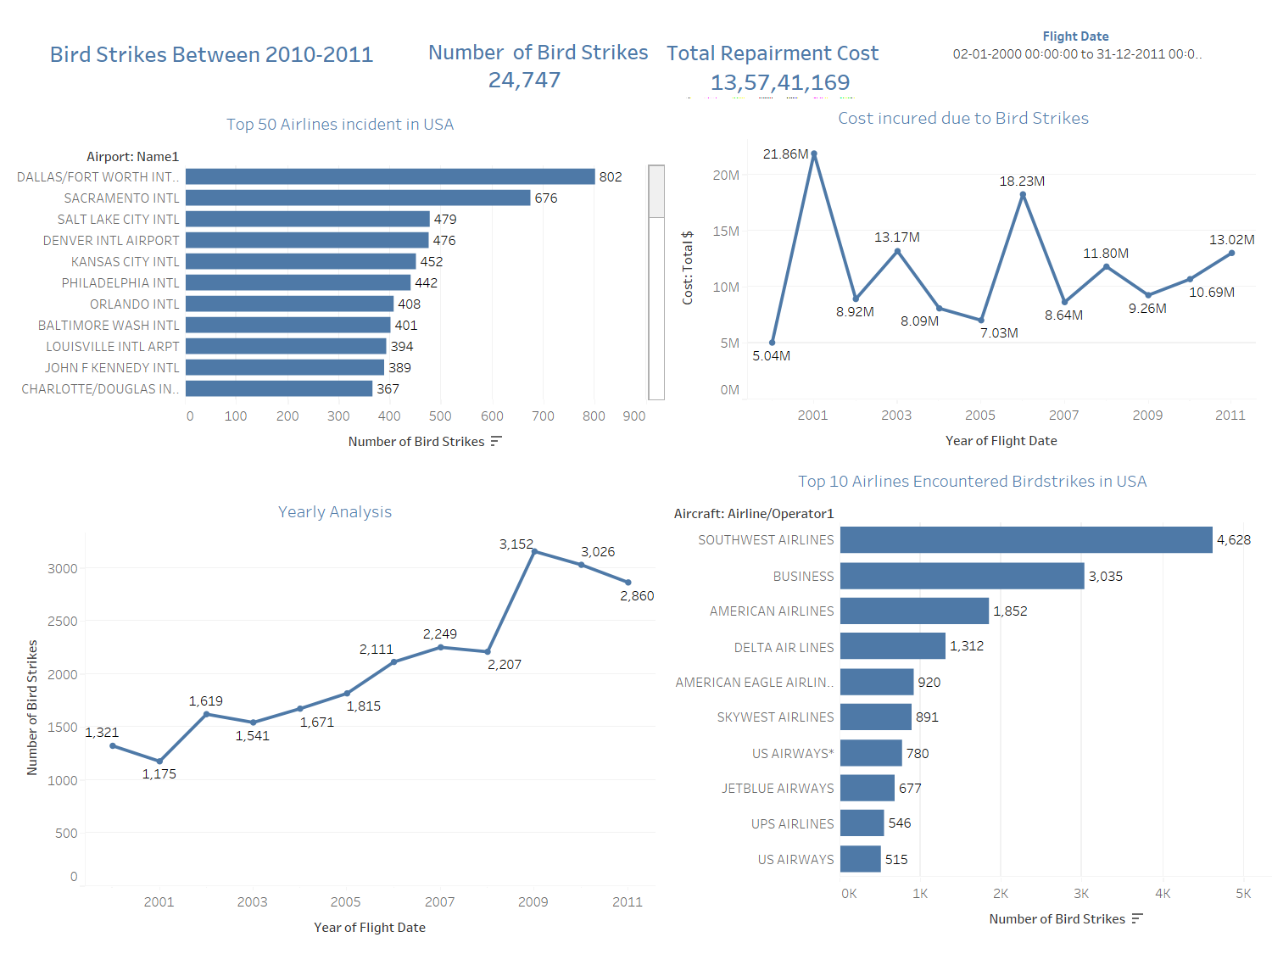

Slide 3
Insights
In a scenario,here,there are total number of birdstrikes and total repairment cost is 24.7K and $13.5M.
The highest number of bird airtstrike was occurred in Dallas worthand sacarmento international airport.
In terms companies airlines like southwest and business were encountered due to birdstrikes.
So,in a yearly basis,the total bird airstrikes were occurred on 2009 and the highest total cost were incurred was on 2001.

Slide 4
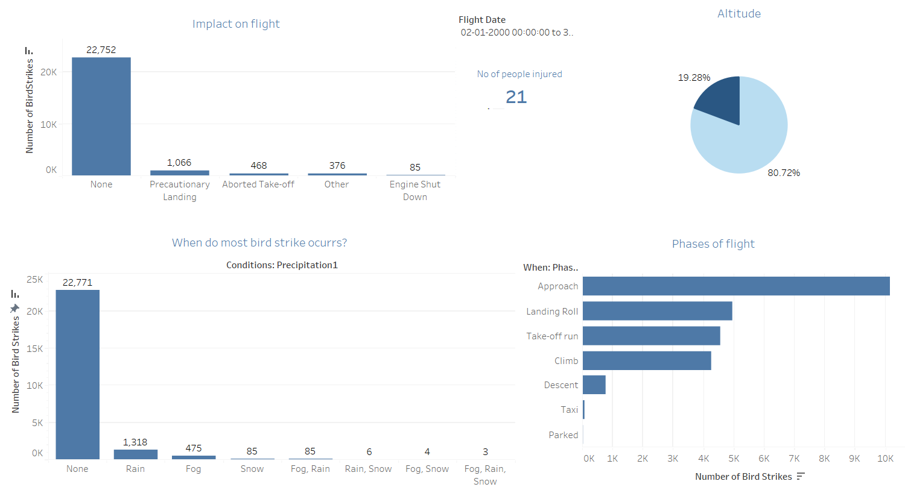

Slide 5
Insights
So,the total number of people were injured due to bird airstrike is 21
It was a none impact on flight and precipitation was happened.
During the phase of flight,the number of bird strikes were occurred in approach phase.

Slide 6
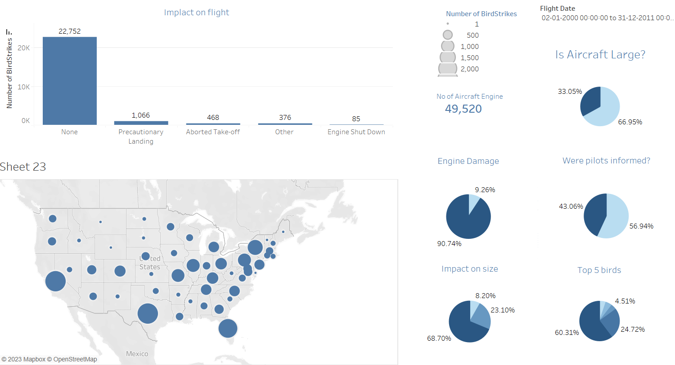

Slide 7
Insights
In a geographical usa map,states like florida,Texas and California had encountered with high number of bird strikes.
There were 49.5k engines out of that 90.74% caused no damaged while 9% people caused damage.
Out of only 43.06% pilots were informed while rest of the pilot were not informed.
60.31% unkown birds were trapped into airstrikes incident happened.

Slide 8
Conculsion
When birds collide with aircraft, they can damage the aircraft and put the lives of the passengers and crew at risk. Some bird species are more prone to cause bird strikes than others, depending on their characteristics and behavior.
Due to climate change,the risk of bird strikes may change with seasons,as bird changes their direction .So to reduce a bird strikes,to scare a birds or change a environment around airports
It’s crucial to look on a incidents and should take preventive measures. This will require working together with researchers, airport officials, and other stakeholders

