Slide 1
UNVEILING TELANGANA ECONOMIC DYNAMICS
BY-TANISH BALSARA
Stamp Registrations
Transportation
TS-iPASS

Slide 2
OBJECTIVE
The objective of this Telangana Growth Analysis presentation is to comprehensively analyze and present my key insights to the economic development and industrial progress of the state of Telangana. We aim to gain a deeper understanding of the district-wise economic landscape, the dynamics of vehicle sales, revenue generation from document registrations, and the impact of the TS-iPASS initiative on industrial growth. By doing so, we intend to provide stakeholders, policymakers, and investors with valuable information that can inform strategic decisions and promote sustainable economic development in Telangana.

Slide 3
OVERVIEW
Telangana, with its diverse districts and dynamic industries, presents a unique landscape for growth analysis.The analysis will then progress to examine revenue generation from document registrations and estamp challan payments, vehicle sales categorized by fuel types, vehicle class, and seating capacity, and finally, the impact of TS-iPASS on industrial investments and employment in various sectors

Slide 4
ABOUT DATA
I utilized this data from 2019 to 2023 to analyze economics trends and charts for primary and secondary research of Telangana.In this,it is related to districts, monthly dates, revenue from document registrations and e-stamp challan payments, vehicle sales categorized by fuel type, vehicle class, seating capacity, and other categories, and data on industrial projects and investments in the state of Telangana.

Slide 5
STAMP REGISTRATIONS

Slide 6
WHAT IS E-STAMP CHALLAN AND DOCUMENT REGISTERED?
E-stamp challan: An e-stamp challan is a digital document that is used to pay stamp duty on documents. E-stamp challans are generated and paid online, and they are more convenient and efficient than traditional paper stamp papers.
Document registered: A document registered is a document that has been officially recorded by the government. This process is necessary for certain types of documents, such as property deeds and sale agreements.

Slide 7
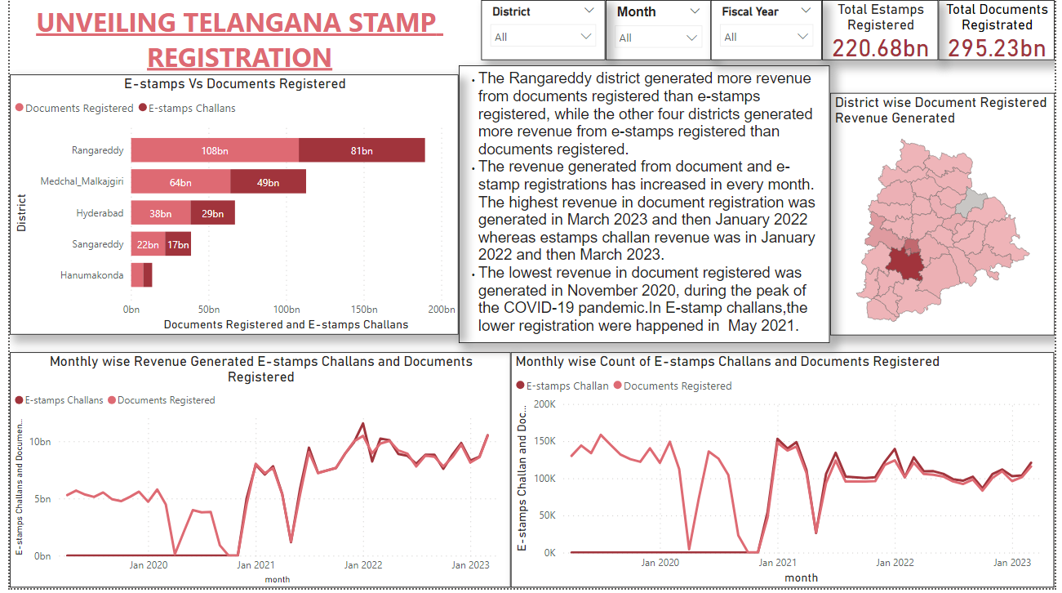

Slide 8
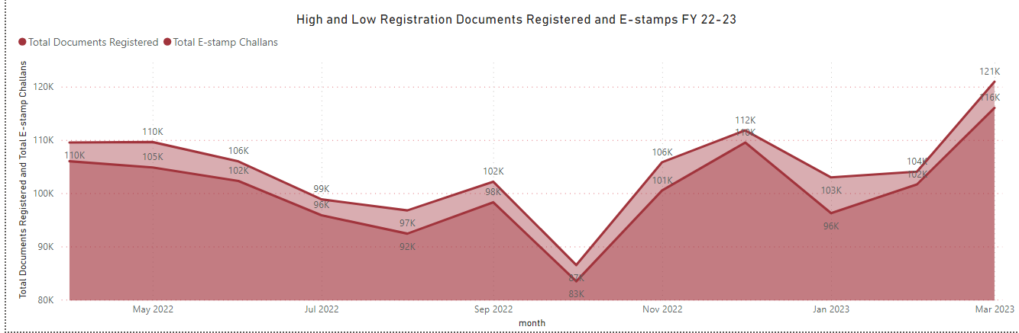
REVENUE GENERATED FY 22-23
As of March 2023, there have been 121,000 high regulation documents registered and 116k E-stamps registered. This represents an increase.
Meanwhile, there have been 87k low regulation documents registered and 83k in October 2022.

Slide 9
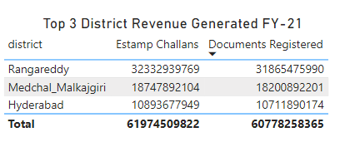

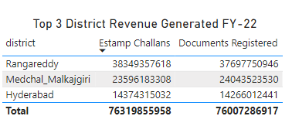

COMPARISON INDICATORS
The total revenue generated from Estamp Challans and Documents Registered has increased in all three districts from FY-21 to FY-22.The highest revenue generated was seen in Rangareddy
The revenue generated from Estamp Challans has increased at a faster pace than the revenue generated from Documents Registered in all three districts.

Slide 10
TRANSPORTATION

Slide 11
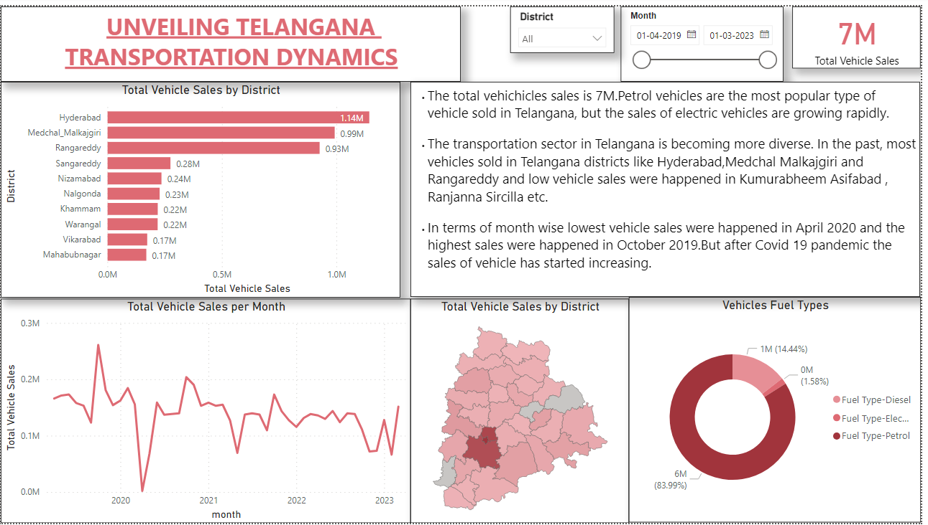

Slide 12
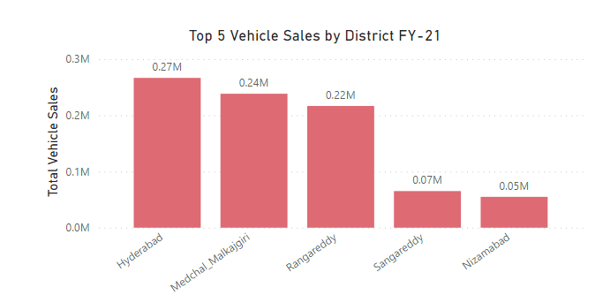
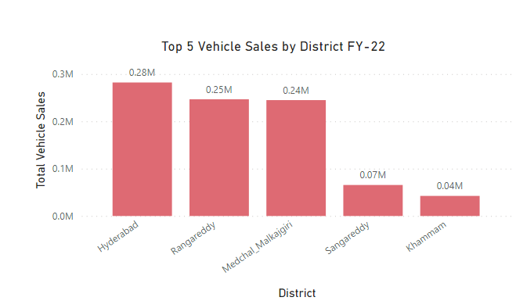
COMPARISON INDICATORS
The top 5 vehicle sales by district in FY-22 were all higher than the top 5 vehicle sales by district in FY-21.
The highest vehicles sales was happened in Hyderabad and followed by other districts.

Slide 13
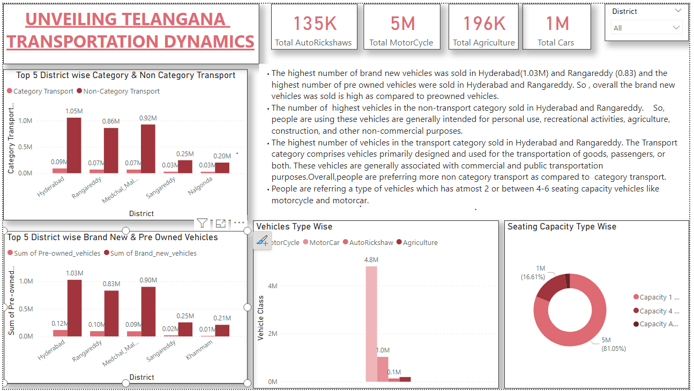

Slide 14
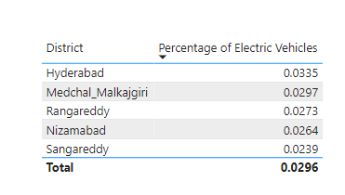
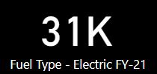
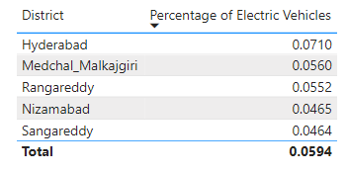

COMPARISON INDICATORS
In FY-21,the usage of electric vehicles is below 3.5% usage. In FY-22,in hyderabad the usage of electric vehicles is 7.1% and increase of using EVs has increased between 3.5%-8% .
The overall percentage of EVs in India is still very low.

Slide 15
TS-IPASS

Slide 16
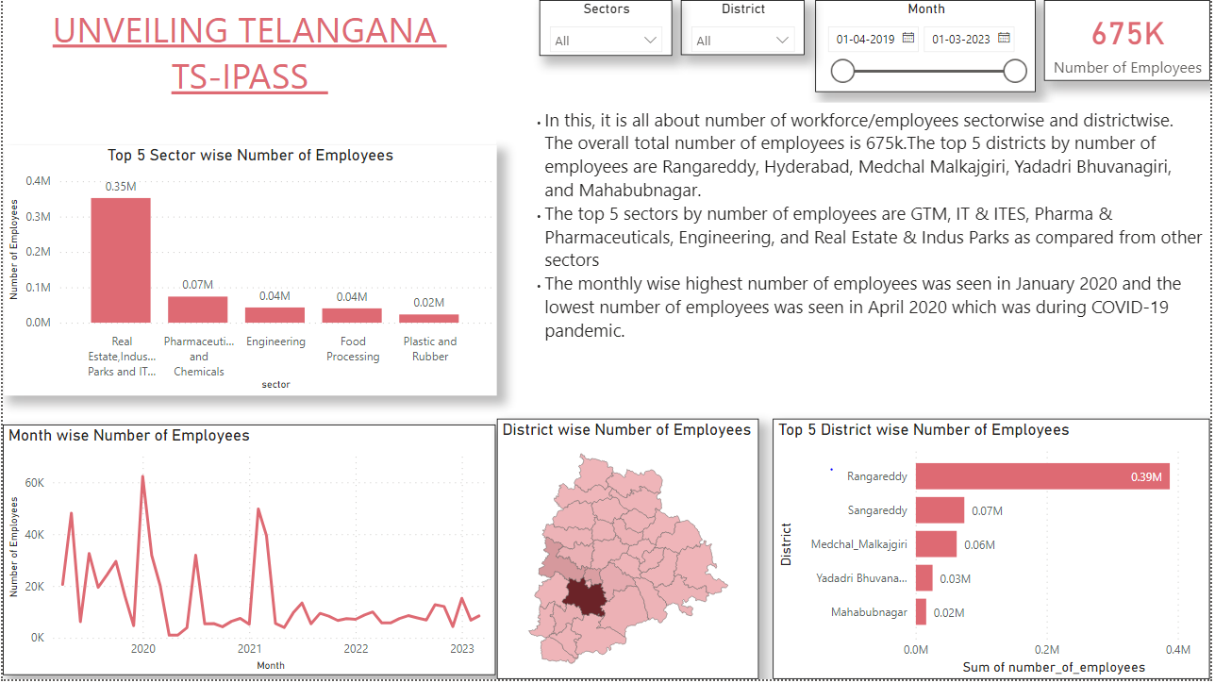

Slide 17
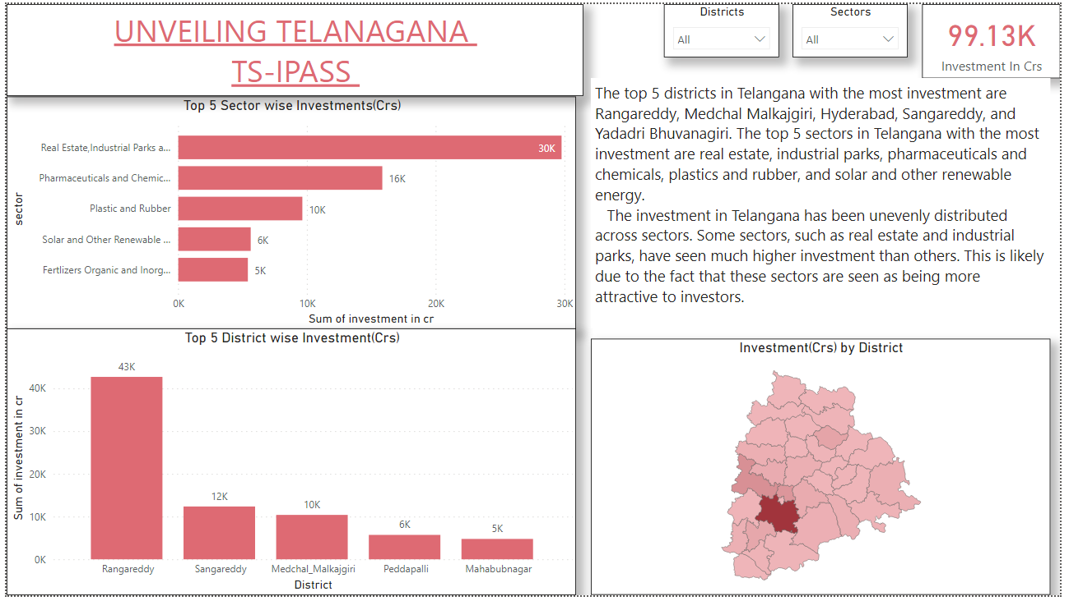

Slide 18
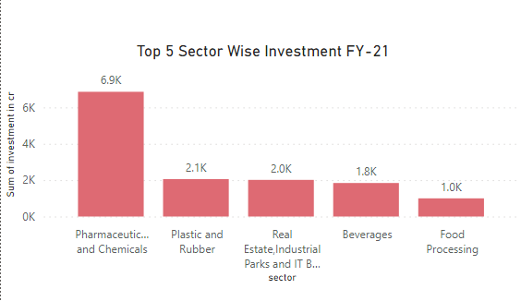
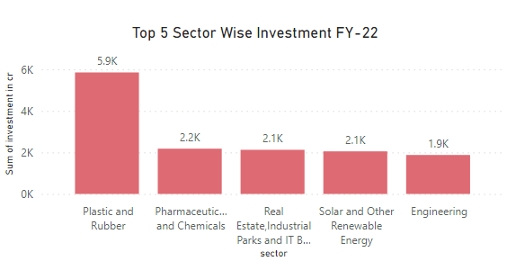
COMPARISON INDICATORS
The highest investment sector in FY-21 is pharmaceutical and chemical and FY-22 is Plastice & rubber.It might change every year due to demand and supply.
The investment in sectors such as pharmaceuticals and chemicals, real estate, and renewable energy is particularly encouraging and growing.

Slide 19
RECOMMENDATIONS
Enhance Charging Infrastructure: Invest in the expansion of charging stations across the state to alleviate concerns about limited driving range and to provide convenient and widespread charging options.
Registration Focus: Instead of offline documents registration,the government should focus on e-stamps registration and make it more asscessible to the people.Also,keep the e-stamp registration data needs to be updated.
Foster Continuous Improvement: Create a culture of ongoing enhancement by using data-driven insights to guide policy adjustments and iterative improvements.
Public Transportation Enhancement: Invest in the improvement and expansion of public transportation networks, including buses and trains, to provide viable alternatives to private car ownership and reduce congestion.
Incentives for Clean Energy: Offer incentives for the adoption of clean energy sources, such as solar panels and wind turbines, to power electric vehicles, reducing their carbon footprint.
Promote Sustainable Cities: Integrate eco-friendly infrastructure, energy-efficient buildings, waste reduction, and water conservation into urban development. Invest in sustainable planning with efficient public transportation, pedestrian-friendly infrastructure, and green spaces as urbanization and economic growth expand.

Slide 20
THANK YOU

