Slide 1
OneWord: A simple quiz application

Slide 2
A Brief Overview of the Project
Inspired by the “Speed Quiz” app.
Idea was to have a quiz where the answers are all one word (to avoid excessive typing for use on devices).
Should be easy to add new categories to the quiz by means of an import using openly available data from the internet.
Design should be flexible to adding new devices to play the quiz (mobile app, web browser, desktop application, etc).

Slide 3
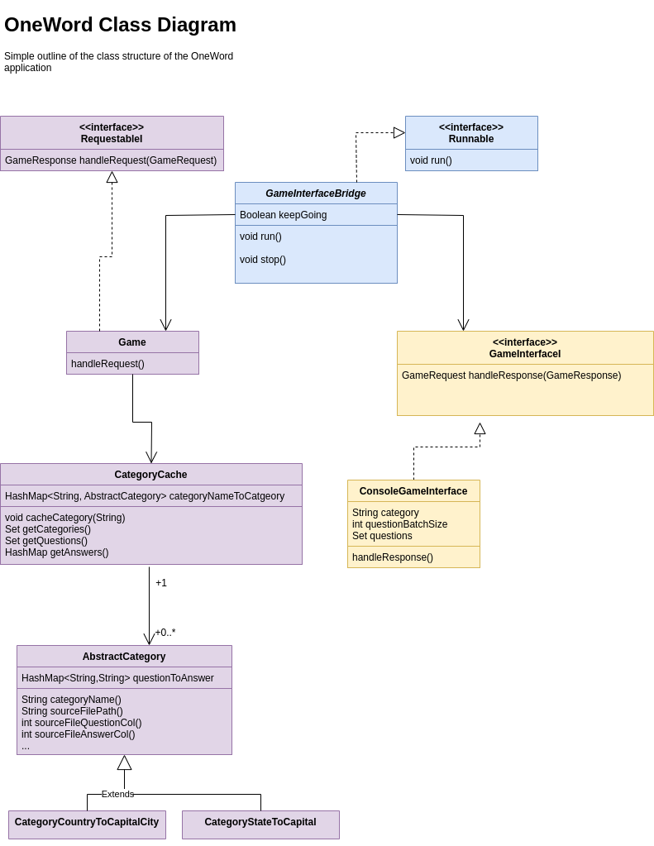
Design
Split into three distinct sections: Game, Bridge & (Game) Interface.
The Game and Interface communicate with each other using requests & responses that are passed via the Bridge. This design allows:
  Easy implementation of new GameInterfaces to play the game, e.g. a mobile phone app.
  A relatively simple redesign to allow the Game & its question cache to be hosted on one machine that all other clients connect to.
  Ability to flexibly add/remove categories. Requested by the Interface via the Bridge so no need to change the user facing part of the program.

Slide 4
Design
Limitations & Future Improvements
Technical problems
(In the context of splitting into app/server)
Problem: Could be many hits requesting categories/questions/answers etc.
Solution: Make GameInterfaceI’s also cache questions and answers (or just questions, if we don’t want people cheating!). Make the Game class multithreaded (and threadsafe) to be able to handle many requests.
User facing problems
Problem: Quizzes played from the command line aren’t particularly fun – need to make more accessible by turning into a mobile phone App.
Solution: Implement a new GameInterfaceI for a mobile phone application.
Problem: Game isn’t competitive – at the moment the user is just playing themselves
Solution: Give the Game class a way to track scores from different users.
Problem: Some of the questions are hard! (245 country & capital pairs in the file from the internet). Need to split up into categories.
Solution: Can’t be fixed with design. Would require a human to go through and subjectively decide on a case-by-case basis.

Slide 5
Design – Messages and Flows
Interface can request
Start – tell the Game it is starting to play.
Stop – tell the Game it is stopping play.
Categories – what categories can I play?
Questions – get questions for a given category.
Answers – get answers for a given category.
Remove questions – If I don’t want to be asked this question again.
→ Currently removes the question from the Game’s cache, but should be improved just to cache what questions a particular client has requested.
Game can respond
Start – Interface’s game is starting
Stop – Tells the Interface to stop playing.
Categories – return available categories.
Questions – return a requested number of questions for a requested category.
Answers – return answers (or maybe just booleans – future improvement?).
Remove questions – the requested questions have been removed.
Future improvement - General error responses.

Slide 6
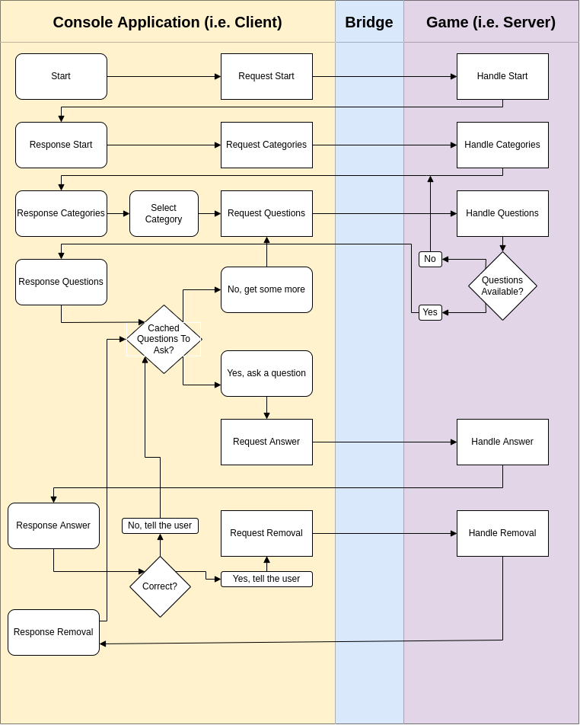
Message Flow - Diagram
Limitations
Currently no way to exit.
Solution: Implement the stop message.
No error handling between the GameInterfaceI and the Game.
Solution: Implement a general error message that the client can handle appropriately.
Dislikes
Logic on the Game when handling a request for questions – better to change to return a response of none found, and then let the client decide what to do.

Slide 7
Making the product competitive
Create a Mobile App that hooks into GameInterfaceI.
→Important to get the UI right (fast, pick up and play with little effort) otherwise people will lose interest.
Add more question categories.
→Requires more data processing, which can be laborious.
Diversify the types of questions that can be asked with a one word answer. E.g. First name of the author of book X.

Slide 8
Questions

