Slide 1

Pandas for Data Science
DAV Workshop
Dr. Gagan Raj Gupta
Associate Professor, IIT Bhilai
IIT Bhilai, Chhattisgarh, India

Slide 2





What is Pandas?
Python Library
Powerful tool for data manipulation & analysis.
Key Structures
Series (1D) for single columns, DataFrame (2D) for tables.
Core Uses
Essential for data cleaning, transformation, and visualization.
Open-Source
Widely adopted in data science & machine learning.

Slide 3
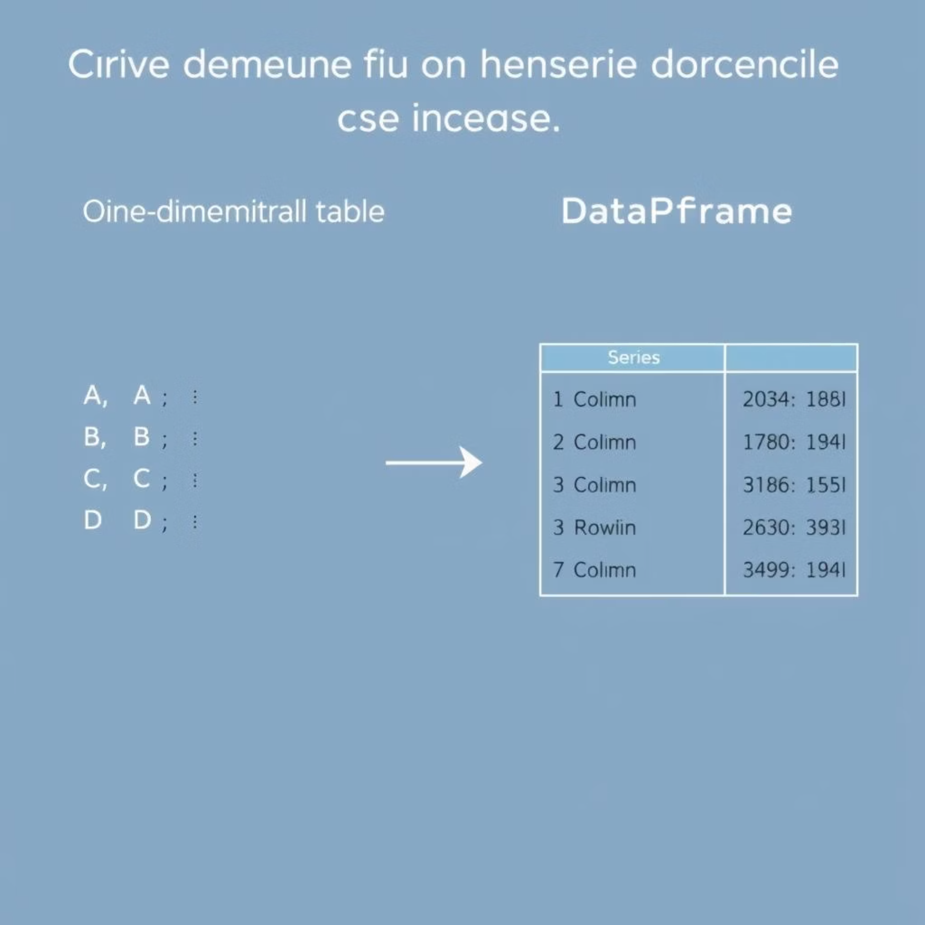
Series vs. DataFrame
Pandas' Core Structures
Code in Action
Series (1D Array)
import pandas as pdseries = pd.Series([5, 15, 25], index=['a', 'b', 'c'])df = pd.DataFrame({'Name': ['Alice', 'Bob'], 'Age': [25, 30]})print(series['b'])print(df['Age'].mean())
Single column of data
Indexed by labels
Example: `pd.Series([5, 15, 25])`
DataFrame (2D Table)
Rows & columns (like a spreadsheet)
Flexible data types per column
Example: `pd.DataFrame({'Name': ['Alice'], 'Age': [25]})`

Slide 4




Reading & Writing Data
Pandas offers robust I/O tools to interact with various data formats.
CSV
Excel
Comma-separated values:pd.read_csv('iris.csv')df.to_csv('output.csv')
Microsoft Excel files:pd.read_excel('data.xlsx')df.to_excel('output.xlsx')
JSON
SQL
JavaScript Object Notation:pd.read_json('data.json')df.to_json('output.json')
Database queries:pd.read_sql('SELECT * FROM iris', conn)
Example: CSV to Excel
import pandas as pddf = pd.read_csv('iris.csv')df.to_excel('output.xlsx', index=False) # index=False to avoid writing row indices

Slide 5
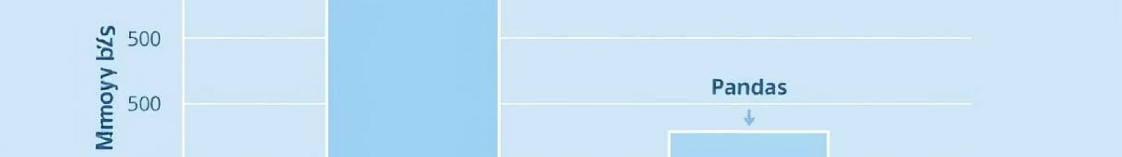
Optimising Pandas Performance
Efficiency matters, especially with large datasets. Optimize your Pandas workflows:
1
`dtype` Specification
Performance Impact
Explicitly define column data types (e.g., `float32`, `category`) to reduce memory footprint and speed up operations.
dtypes = {'sepal length (cm)': 'float32', 'species': 'category'}df = pd.read_csv('iris.csv', dtype=dtypes, usecols=['sepal length (cm)', 'species'])print(df.info(memory_usage='deep')) # See the memory savings!
2
`usecols` for Loading
Load only necessary columns using `usecols` when reading data to save memory and processing time.
3
`chunksize` for Large Files
Process very large files in manageable chunks, avoiding memory overload and enabling iterative processing.

Slide 6

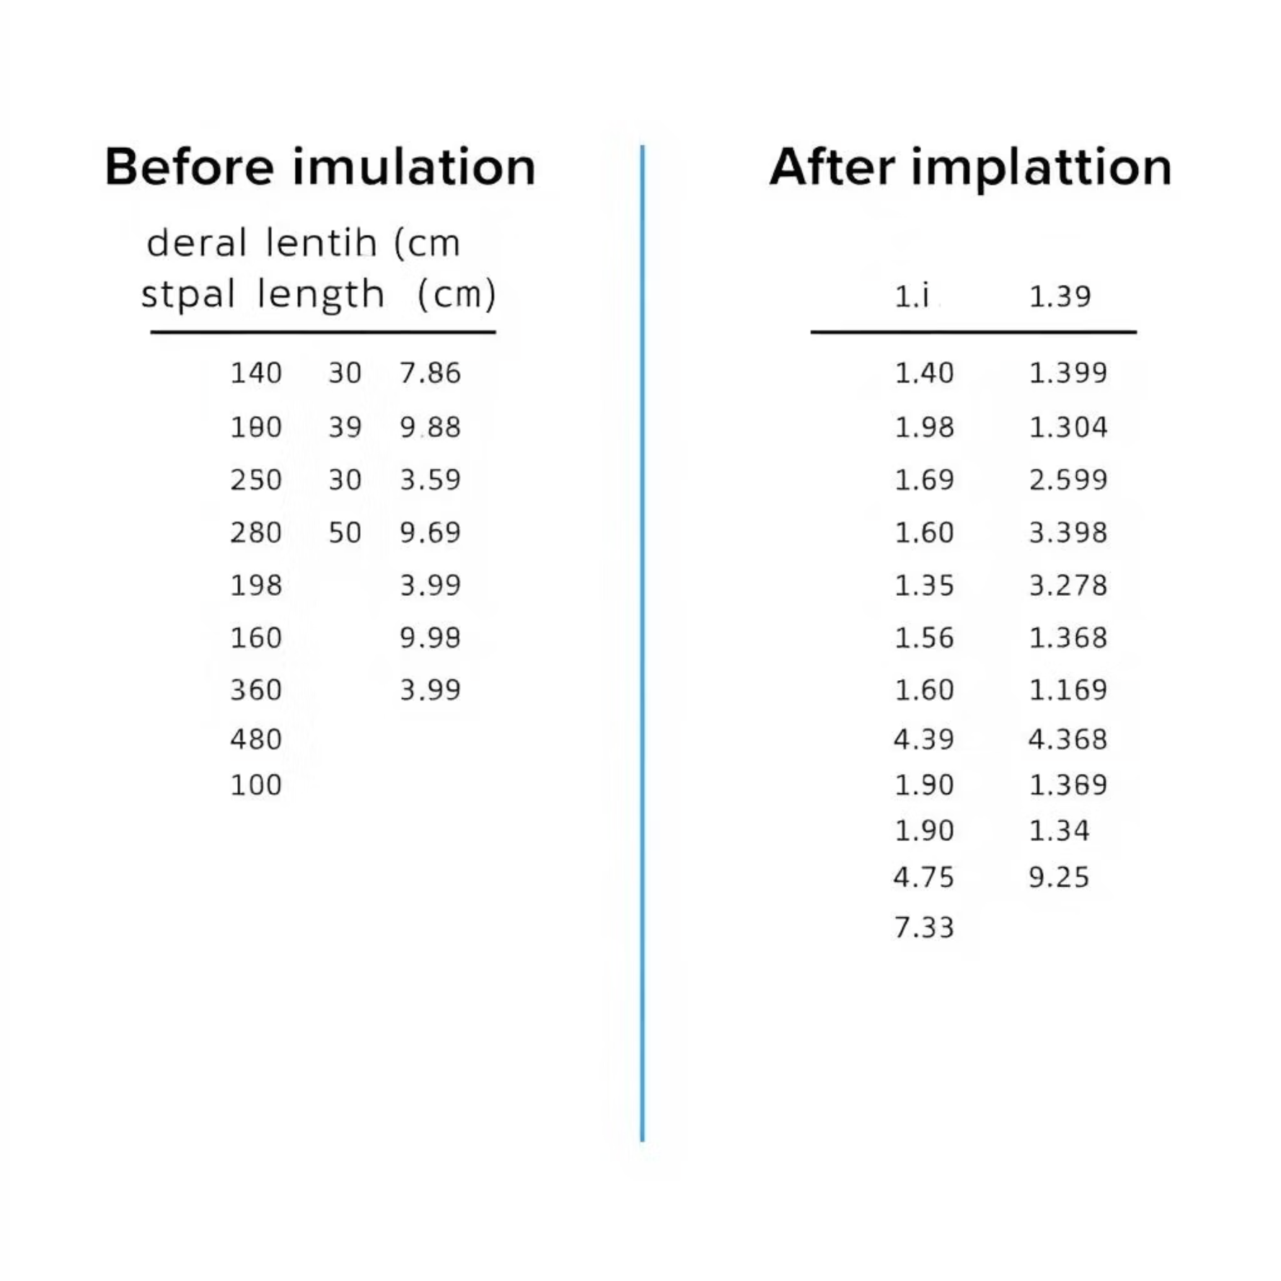

Handling Missing Data
Missing data can skew analyses. Pandas offers simple solutions:
Common Strategies
Example: Iris Dataset
Drop Rows/Columns
df.dropna(axis=0) removes rows with any missing values.df.dropna(axis=1) removes columns with any missing values.
Impute Values
Fill missing values with a statistical measure (mean, median, mode) or a constant.df['col'].fillna(df['col'].mean(), inplace=True)
df = pd.read_csv('iris_with_missing.csv') # Assume some NaNsprint("Shape after dropping NaNs:", df.dropna().shape)# Impute 'sepal length (cm)' with its meandf['sepal length (cm)'].fillna(df['sepal length (cm)'].mean(), inplace=True)print("Nulls after imputation:\n", df.isnull().sum())

Slide 7
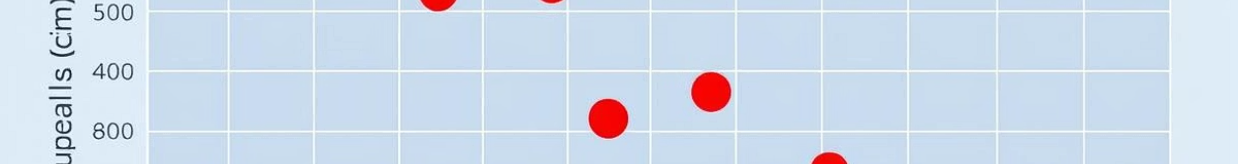
Detecting & Managing Outliers
Outliers can severely impact statistical analyses. Here's how to identify and handle them:
Methods for Detection
Handling Outliers
Interquartile Range (IQR)
df = pd.read_csv('iris.csv')Q1 = df['sepal width (cm)'].quantile(0.25)Q3 = df['sepal width (cm)'].quantile(0.75)IQR = Q3 - Q1# Identify outliersoutliers = df[(df['sepal width (cm)'] < (Q1 - 1.5 * IQR)) | (df['sepal width (cm)'] > (Q3 + 1.5 * IQR))]print("Detected outliers:\n", outliers)# Example: Cap outliers# df['sepal width (cm)'] = df['sepal width (cm)'].clip(lower=Q1 - 1.5*IQR, upper=Q3 + 1.5*IQR)
Values beyond `Q1 - 1.5*IQR` or `Q3 + 1.5*IQR` are considered outliers.
Z-score
Values typically more than 2.5-3 standard deviations from the mean.

Slide 8

Type Conversion & Dates
Ensuring correct data types is crucial for accurate analysis and calculations.
Essential Conversions
Code Example: Dates & Values
Numeric Conversion
Convert string or mixed types to numbers: pd.to_numeric()
Categorical Conversion
Optimise memory for repetitive string data: df['col'].astype('category')
Datetime Parsing
Transform strings to datetime objects: pd.to_datetime(). Allows extraction of year, month, day, etc.
df = pd.DataFrame({'date': ['2023-01-01', '2023-02-01'], 'value': ['100', '200']})# Convert 'date' column to datetime objectsdf['date'] = pd.to_datetime(df['date'])# Convert 'value' column to numericdf['value'] = pd.to_numeric(df['value'])# Extract yeardf['year'] = df['date'].dt.yearprint(df.info())print("\nDataFrame with new 'year' column:\n", df)

Slide 9
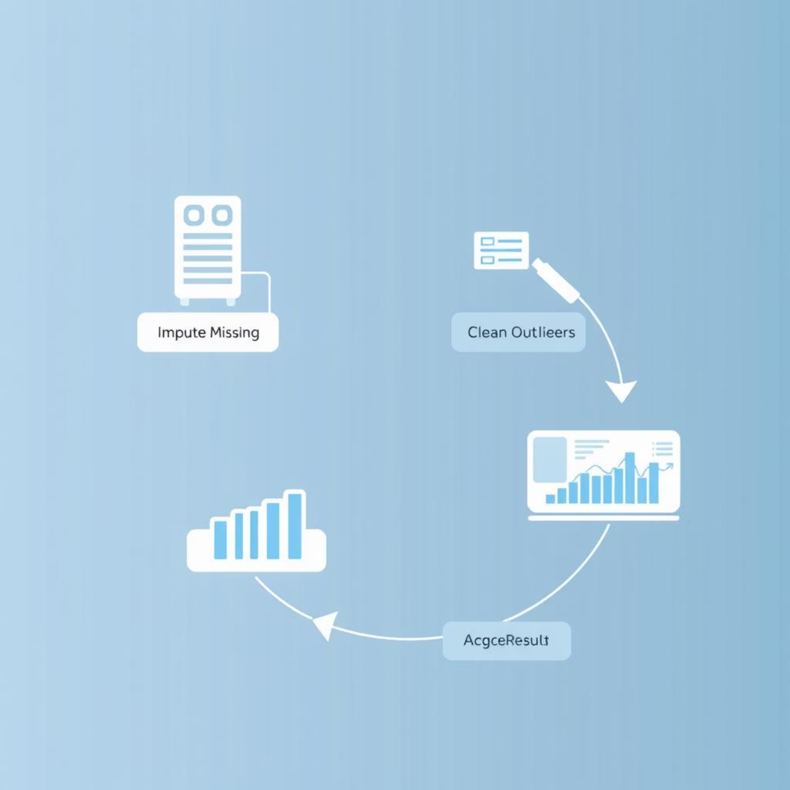
Building Data Pipelines with `.pipe()`
Streamline your data processing with method chaining and the powerful `.pipe()` method.
Why Pipelines?
Example: Imputation Pipeline
Method Chaining
Combine multiple Pandas operations in a readable, sequential manner (e.g., `.dropna().groupby().mean()`).
Custom Function Integration
Use `.pipe()` to seamlessly integrate custom Python functions into your Pandas method chains, making complex transformations concise and reusable.
Readability & Maintainability
Pipelines improve code clarity, making it easier to understand and debug complex data workflows.
def impute_missing(df, col, strategy='mean'): if strategy == 'mean': df[col].fillna(df[col].mean(), inplace=True) elif strategy == 'median': df[col].fillna(df[col].median(), inplace=True) return df# Build a pipeline to load, then imputedf_cleaned = pd.read_csv('iris_with_missing.csv').pipe(impute_missing, 'sepal length (cm)', strategy='median')print("Nulls in 'sepal length (cm)' after pipeline:", df_cleaned['sepal length (cm)'].isnull().sum())

Slide 10

Hands-On Exercises
Now, it's your turn to apply what you've learned.
Series & Filtering: Create a Pandas Series and filter values greater than 20.
1
Data Cleaning: Load `iris.csv`, introduce and impute missing values, then detect outliers.
2
Pipeline Challenge: Build a data pipeline to clean the 'Age' column in the Titanic dataset (replace missing values, handle outliers).
3
Discussion Point: When is it better to drop missing data versus impute it? Consider scenarios and impacts.
4

Slide 11

Resources & Next Steps
Further Learning
Connect with Us
Workshop Notebook
github.com/IITBhilai-DS/PandasWorkshop
Pandas Documentation
pandas.pydata.org/docs/
Advanced Topics
Merging, reshaping, time series analysis, categorical data.
Dr. Gagan Raj GuptaAssociate Professor, IIT Bhilai✉️ gagan.gupta@iitbhilai.ac.in
Thank you for your active participation!

