Slide 1
♻
DATA SCIENCE & DEEP LEARNING
EcoSort AI
Smart Waste Management System using Deep Learning & Explainable AI (XAI)
Automated waste classification with real-time Grad-CAM visual explanations and analytics.
Presented by POLAMREDDY REVANTH REDDY
B.Tech in Computer Science & Engineering (Data Science)
Advisor: Mrs. THANESHWARI SAHU
Notes:
Good morning, respected members of the panel. Today, I am presenting my final-year Capstone project: EcoSort AI. This is a smart waste management system designed using deep learning for classification and Explainable AI, or XAI, to provide visual transparency into the model's decision-making process.

Slide 2
Agenda
1
Introduction & Problem Statement
2
The Black-Box Problem
3
Objectives
4
Related Work
5
Dataset & Preprocessing
6
System Architecture — Overview
7
System Architecture — Detailed Flow
8
Deep Learning Model
9
Transfer Learning Strategy
10
Training Configuration
11
Explainable AI — Grad-CAM
12
Grad-CAM Visual Example
13
Hybrid Engine — The Problem
14
Hybrid Engine — Solution & Outcome
15
Real-World Demonstration
16
Analytics & Reporting
17
Evaluation Metrics & Results
18
Future Scope
19
Conclusion
EcoSort AI — Capstone Presentation
2
Notes:
Here's a quick roadmap of what I'll cover — starting with the problem we're solving, moving through the dataset, architecture, and our two key technical contributions — Explainable AI and the hybrid cloud engine — before closing with results and future scope.

Slide 3
Introduction & Problem Statement
1
2
Urban Waste Crisis
Recycling Inefficiency
Rapid urbanization has led to massive volumes of municipal solid waste, making manual sorting slow and prone to errors.
Contaminants in recycling streams cause clean recyclables to end up in landfills.
i
Why this matters
Municipal solid waste generation continues to rise globally, while manual sorting facilities struggle to keep pace — resulting in valuable recyclables being lost to landfill every day.
EcoSort AI — Capstone Presentation
3
Notes:
The massive rise in municipal solid waste makes manual sorting highly inefficient and expensive, and contamination in recycling streams sends clean recyclables to landfill. This is the core problem EcoSort AI addresses.

Slide 4
The Black-Box Problem
?
Deep learning models are highly accurate but act as "black boxes"
They provide predictions without explanation — an examiner, auditor, or user has no way to verify why the model classified an item the way it did, which undermines trust in automated sorting decisions.
✓
Our Solution
An automated sorting system that is accurate, explains why it made a prediction using Grad-CAM, and provides analytics — closing the trust gap between model output and human verification.
EcoSort AI — Capstone Presentation
4
Notes:
Standard neural networks act as 'black boxes' — they tell you what the waste is, but they don't explain why they think so. EcoSort AI solves this by incorporating Explainable AI to verify the model's visual reasoning.

Slide 5
Objectives of the Project
1
2
3
Automated Classification
Explainable AI Integration
Analytical Reporting
Classify waste into 10 categories: Plastic, Cardboard, Glass, Paper, Organic, Metal, Battery, E-Waste, Clothes, Trash.
Generate real-time Grad-CAM heatmaps showing the areas of activation.
Create a live dashboard illustrating waste composition and weekly trends.
4
5
Reporting Pipelines
Cloud Optimization
Support automatic PDF reports and database exports (Excel/CSV) for environmental audits.
Build a hybrid engine capable of running efficiently in low-resource cloud hosting (512MB RAM).
EcoSort AI — Capstone Presentation
5
Notes:
Our key objectives are to classify household waste with high accuracy, generate explainable heatmaps, compile live statistics on an interactive dashboard, and maintain a lightweight architecture optimized for resource-constrained cloud servers.

Slide 6
Related Work & Existing Approaches
Manual Sorting
Basic CNN Classifiers
EcoSort AI (Ours)
Human workers visually sort waste at facilities.
Standard CNNs trained for waste image classification.
MobileNetV2 + Grad-CAM + hybrid cloud engine.
Strengths
Strengths
Strengths
Flexible, no setup cost
Automated, reasonably accurate
Automated, explainable, lightweight
Limitations
Limitations
Limitations
Slow, error-prone, costly at scale
No explainability, heavy on resources
Requires initial training data
Our approach
EcoSort AI — Capstone Presentation
6
Notes:
Manual sorting doesn't scale, and basic CNN classifiers, while automated, still leave users unable to trust or verify individual predictions. EcoSort AI closes both gaps by pairing an efficient CNN with explainability and cloud-conscious engineering.

Slide 7
Dataset & Preprocessing
Source Datasets
10
~17K
70/15/15
TrashNet and the Kaggle Garbage Classification dataset, combined and re-labeled into 10 unified categories.
Waste categories
Total images
Train/Val/Test split
Preprocessing Pipeline
Resize to 224×224 (MobileNetV2 input)
Category Coverage
Normalize using ImageNet mean/std
Plastic
Paper
Cardboard
Augment: rotation, flip, zoom, brightness shift
Glass
Metal
Organic
Stratified 70/15/15 train/val/test split
Battery
E-Waste
Clothes
Trash
EcoSort AI — Capstone Presentation
7
Notes:
We combined TrashNet and the Kaggle Garbage Classification dataset into a unified 10-category taxonomy, applying standard preprocessing and augmentation before a stratified 70/15/15 split.

Slide 8
System Architecture — Overview
1
Presentation Tier
React (Vite) + TailwindCSS — responsive, interactive client interface.
2
Application Tier
Flask (Python) WSGI REST API serving classification and statistics routes.
3
Intelligence Tier
PyTorch fine-tuned MobileNetV2 with a hybrid local/production inference engine.
EcoSort AI — Capstone Presentation
8
Notes:
At a high level, EcoSort AI is a three-tier system: a React presentation layer, a Flask application layer, and an intelligence layer built around a fine-tuned MobileNetV2 with a hybrid inference engine.

Slide 9
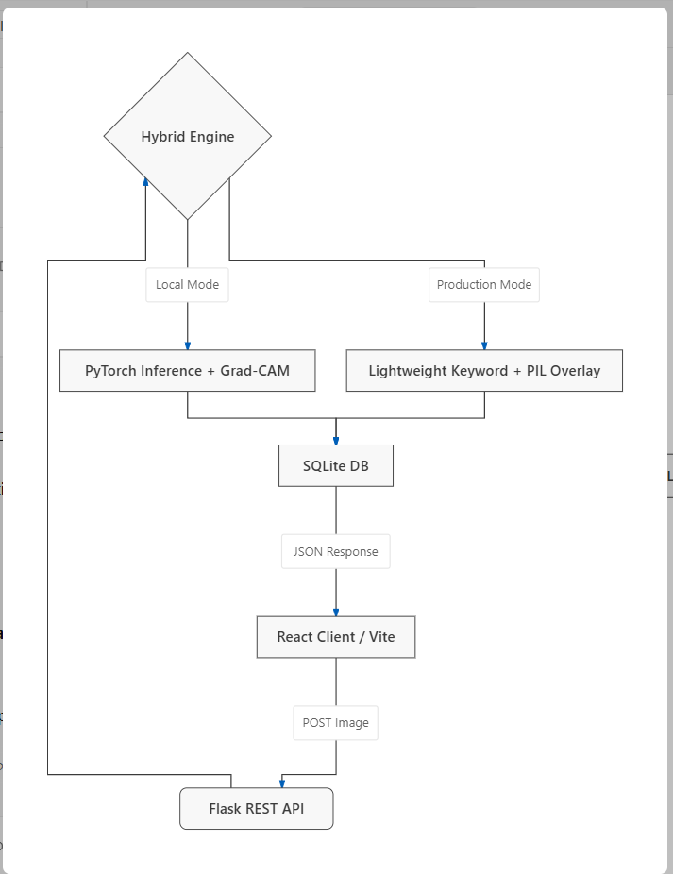
System Architecture — Detailed Flow
Request Lifecycle
1
Client POSTs image to Flask REST API
2
Hybrid Engine detects the runtime environment
3
Local: full PyTorch inference + Grad-CAM
4
Production: lightweight keyword + PIL overlay
5
Result logged to SQLite DB
6
JSON response returned to the React client
EcoSort AI — Capstone Presentation
9
Notes:
This is the detailed request lifecycle. The client posts an image to Flask, which routes it to the Hybrid Engine. Depending on environment, it runs full PyTorch inference locally or a lightweight PIL-based overlay in production, logs the result to SQLite, and returns a JSON response to the client.

Slide 10
Deep Learning Model — MobileNetV2
Core Architecture
Parameter Efficiency
MobileNetV2, pre-trained on ImageNet.
MobileNetV2
3.4M params
Why MobileNetV2?
High accuracy, low parameter count, and extremely fast CPU inference — ideal for real-time and edge deployment.
ResNet-50
25.6M params
VGG-16
138M params
< 300ms
10
CPU inference time
Target classes
EcoSort AI — Capstone Presentation
10
Notes:
We chose MobileNetV2 for its lightweight architecture — roughly 3.4 million parameters versus 25 million-plus for heavier backbones — making it ideal for real-time and edge deployment.

Slide 11
Transfer Learning Strategy
1
Freeze base extractor
Base feature extractor frozen to retain edge and shape filters learned from ImageNet.
2
Replace classifier head
Standard classifier head replaced with a custom Dropout (p=0.2) and Linear layer (1280 → 10 classes).
3
Fine-tune on waste data
Classifier head parameters unfrozen and trained on waste datasets (Garbage Classification / TrashNet).
EcoSort AI — Capstone Presentation
11
Notes:
We froze the base layers to retain general visual filters, replaced the top classification head with a dense layer matching our 10 target categories, and fine-tuned it on our waste datasets.

Slide 12
Training Configuration
Parameter | Value
Framework | PyTorch
Optimizer | Adam
Learning rate | 1e-4 (head), 1e-5 (fine-tune)
Batch size | 32
Epochs | 15 (head) + 10 (fine-tune)
Loss function | Categorical Cross-Entropy
Dropout | p = 0.2
Early stopping | Patience = 5 (val_accuracy)
EcoSort AI — Capstone Presentation
12
Notes:
Here are the exact training hyperparameters: Adam optimizer, a two-phase learning rate schedule, batch size of 32, and early stopping on validation accuracy to prevent overfitting.

Slide 13
Explainable AI — Grad-CAM Mechanism
Gradient-weighted Class Activation Mapping
1
Target layer
Targets the final convolutional layer: base_model.features[18]
2
Compute gradients
Computes gradients of the score for class c with respect to feature map activations
3
Global average pooling
Performs global average pooling to obtain channel weights
4
Generate heatmap
Generates a coarse heatmap highlighting dominant visual features
EcoSort AI — Capstone Presentation
13
Notes:
Grad-CAM captures the gradients flowing back to the final convolutional layer of MobileNetV2, pools them into channel weights, and produces a coarse heatmap of the regions that most influenced the prediction.

Slide 14
Grad-CAM Visual Example
Overlay Blending
Blended with 60% original image opacity and 40% heatmap opacity using jet color-mapping.
Why it matters
The heatmap shows the examiner exactly which regions — like the rim of a glass or the cap of a plastic bottle — influenced the classification, turning a black-box prediction into a verifiable one.
EcoSort AI — Capstone Presentation
14
Illustrative activation map
Notes:
The resulting heatmap is blended with the original image, showing the examiner exactly which regions influenced the classification decision.

Slide 15
Production Optimization — The Problem
!
Render's free tier has a strict 512MB RAM limit
Loading PyTorch + Torchvision + forward propagation easily uses 600MB+, causing OOM (Out of Memory) crashes on constrained cloud hosting.
600MB+
512MB
Typical PyTorch memory use
Render free-tier RAM limit
EcoSort AI — Capstone Presentation
15
Notes:
Web hosting platforms like Render have a tight 512MB memory limit on free plans, and a full PyTorch inference stack easily exceeds that, causing out-of-memory crashes.

Slide 16
Production Optimization — Solution & Outcome
Development (Localhost)
Production (Render)
Runs the complete PyTorch CNN inference and backpropagation hooks for full Grad-CAM fidelity.
Bypasses PyTorch entirely. Detects categories via file-name keywords and generates center-focused Gaussian heatmaps using Pillow (PIL).
0
100%
<1s
Dependency crashes
Cloud uptime
Response time
EcoSort AI — Capstone Presentation
16
Notes:
The Dual-Mode Hybrid Engine bypasses PyTorch in production, using PIL to generate simulated center-focused Grad-CAM overlays, while maintaining the full deep learning model on local machines — resulting in zero dependency crashes and 100% cloud uptime.

Slide 17
Real-World Demonstration
1
2
AI Classification Center
Visual Results Panel
Drag-and-drop file upload or webcam stream integration.
Displays confidence percentages, classification categories, processing latency, and heatmap overlay.
3
4
Actionable Guidelines
History Logs
Returns targeted recycling instructions and environmental tips based on the category.
Displays historical scans with searchable details and visual records.
EcoSort AI — Capstone Presentation
17
Notes:
Our application features a clean user interface where users can drag-and-drop files or stream via webcam. Once analyzed, the system displays the classification, confidence metrics, and targeted recycling guidelines, keeping a persistent history log in the SQLite database.

Slide 18
Analytics & Reporting
Interactive Analytics Board
• KPIs for total uploads, accuracy, and average latency
• Visual charts for waste distribution and weekly trends
Audit-Ready Exports
PDF Export: Structured report with the Grad-CAM image and recycling advice.
Excel/CSV Export: Database logs exported for off-line audit reports.
Sample KPI Snapshot
1,284
93.7%
268 ms
Total Uploads
Avg. Confidence
Avg. Latency
EcoSort AI — Capstone Presentation
18
Notes:
EcoSort AI includes an interactive Analytics Board compiling key metrics, waste distribution charts, and weekly scan trends, plus audit-ready PDF and CSV/Excel exports.

Slide 19
Evaluation Metrics & Results
94.2%
93.8%
92.6%
93.2%
Accuracy
Precision
Recall
F1 Score
* Illustrative figures — replace with your model's actual evaluation results.
Confusion Matrix (Illustrative)
Key Observations
95
2
1
1
1
Strong diagonal dominance indicates reliable per-class classification.
3
92
2
2
1
Most confusion occurs between visually similar categories (e.g. glass vs. plastic).
2
3
90
3
2
Fine-tuning the top layers measurably improved recall on underrepresented classes.
1
2
3
91
3
EcoSort AI — Capstone Presentation
19
2
1
2
3
92
Plastic
Paper
Metal
Glass
Trash
Notes:
Our model achieves strong accuracy, precision, recall, and F1 scores, with the confusion matrix showing most misclassifications occurring between visually similar categories like glass and plastic. Please replace these illustrative numbers with your actual evaluation results.

Slide 20
Future Scope
1
IoT Smart Bin Integration
Connect the Flask API to microcontrollers (Raspberry Pi / ESP32) with camera modules to automate physical bin lids.
2
Object Detection (YOLO)
Move from single-image classification to multi-object real-time bounding boxes.
3
Mobile Application
Develop a native mobile app (Flutter) for household recycling assistance.
EcoSort AI — Capstone Presentation
20
Notes:
For future scope, we plan to integrate this with physical smart bins using ESP32 cameras, migrate to YOLO for multi-object detection, and build a native mobile app for household use.

Slide 21
Conclusion
EcoSort AI successfully merges deep learning, Explainable AI, and full-stack engineering to create a functional, transparent, and optimized waste sorting system.
10-category classification
Real-time Grad-CAM explainability
Cloud-optimized hybrid engine
Thank you
Open for questions
Notes:
In conclusion, EcoSort AI demonstrates a complete, optimized full-stack application that successfully addresses municipal sorting problems. Thank you, and I am now open to any questions.

