Slide 1
INTERNSHIP STUDIO
INTERNSHIP FOR ETHICAL HACKING
TASK-2

Slide 2
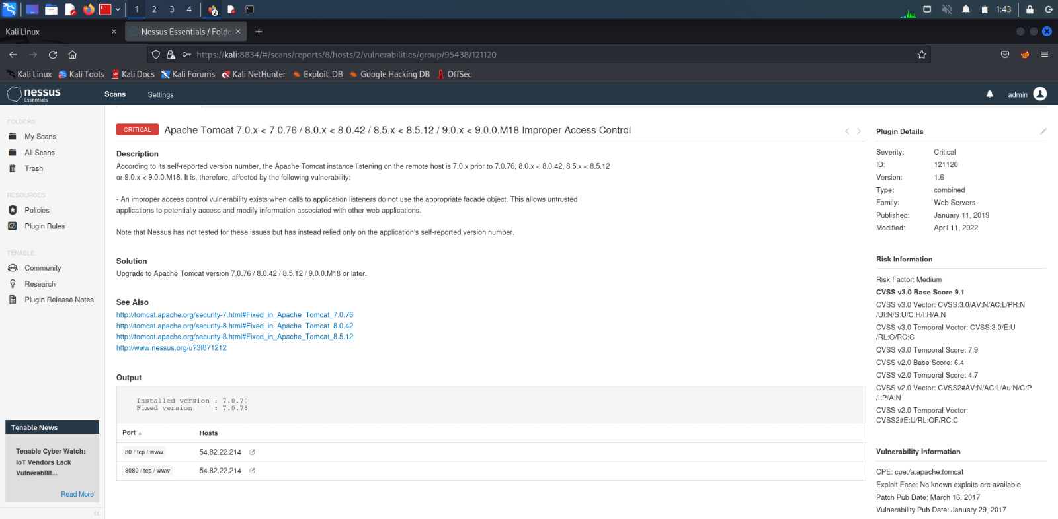
SCREENSHOT

Slide 3
Report for Improper Access Control Vulnerability
Vulnerability:
1.It is detected that there is improper access control.
2.Improper access control occurs when the web server does not properly enforce authentication and authorization mechanisms.
3.This vulnerability allows the attacker to access the sensitive information like sensitive files , directories and other resources.
4.This can be achieved by manipulating the URL parameters or manipulating the requests to the web server.

Slide 4
Impact: 1.The impact of this vulnerability can be severe, as it allows unauthorized users to perform actions that can harm the affected system. 2.This can include accessing sensitive information, deploying malicious code, and potentially compromising the entire server.

Slide 5
Recommendations: To migitate the risk of exploitation, the users can take the following steps: 1.Upgrade the latest version of Tomcat, as the vulnerability has been addressed in newer releases. 2.Monitor the logs and network traffic for any suspicious activity. 3.Regularly update the software and operating system to ensure that all known vulnerabilities are addressed.

Slide 6
Where was the threat found: URL:http://zero.webappsecurity.com/ Target action://http:zero.webappsecurity.com/
How it was detected:
It was detected by well known automatic vulnerability application known as NESSUS.

Slide 7
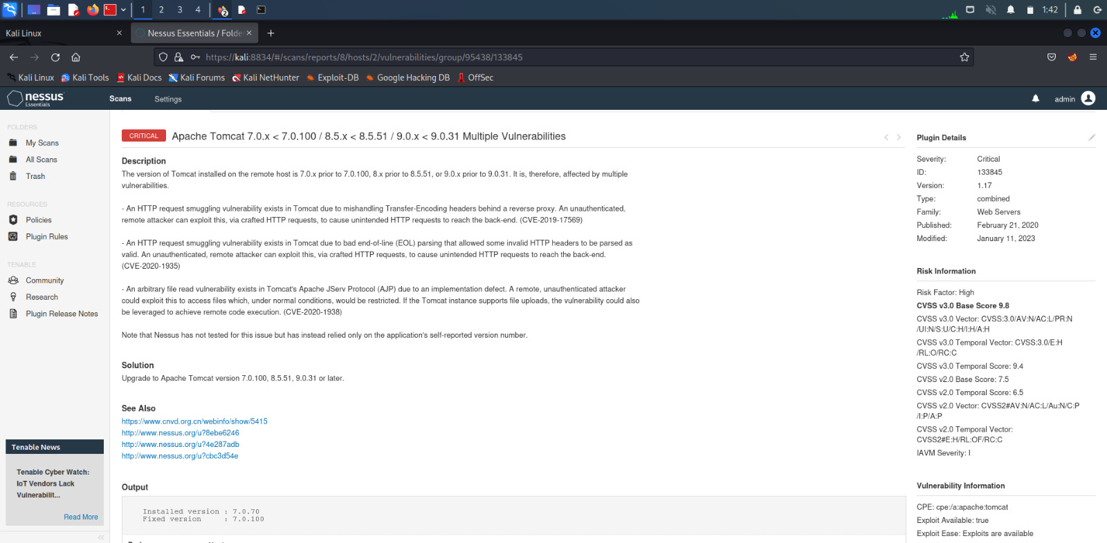
Other Critical Vulnerabilities found are:

Slide 8
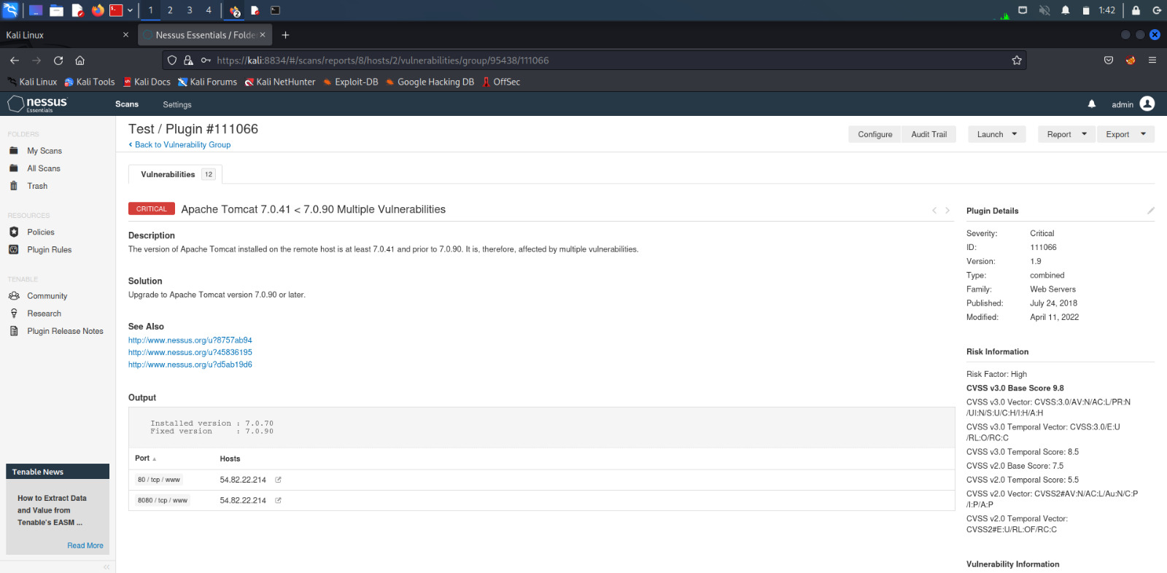

Slide 9
