Slide 1
INTERNSHIP STUDIO
INTERNSHIP FOR ETHICAL HACKING
TASK-3

Slide 2
Cross Site Scripting on vulnweb.com
Domain:vulnweb.com
Sub-domain:testasp.vulnweb.com

Slide 3
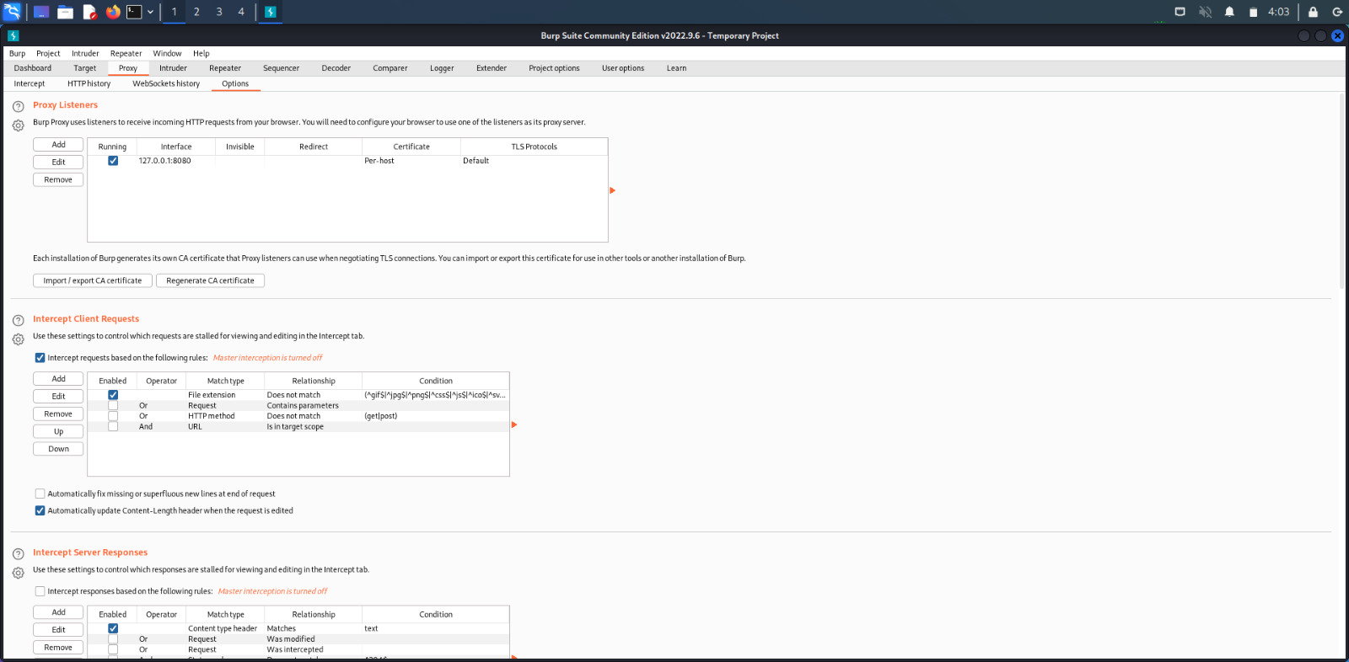
Steps to produce:
Step-1:
We can use Burpsuite for Cross Site Scripting.

Slide 4
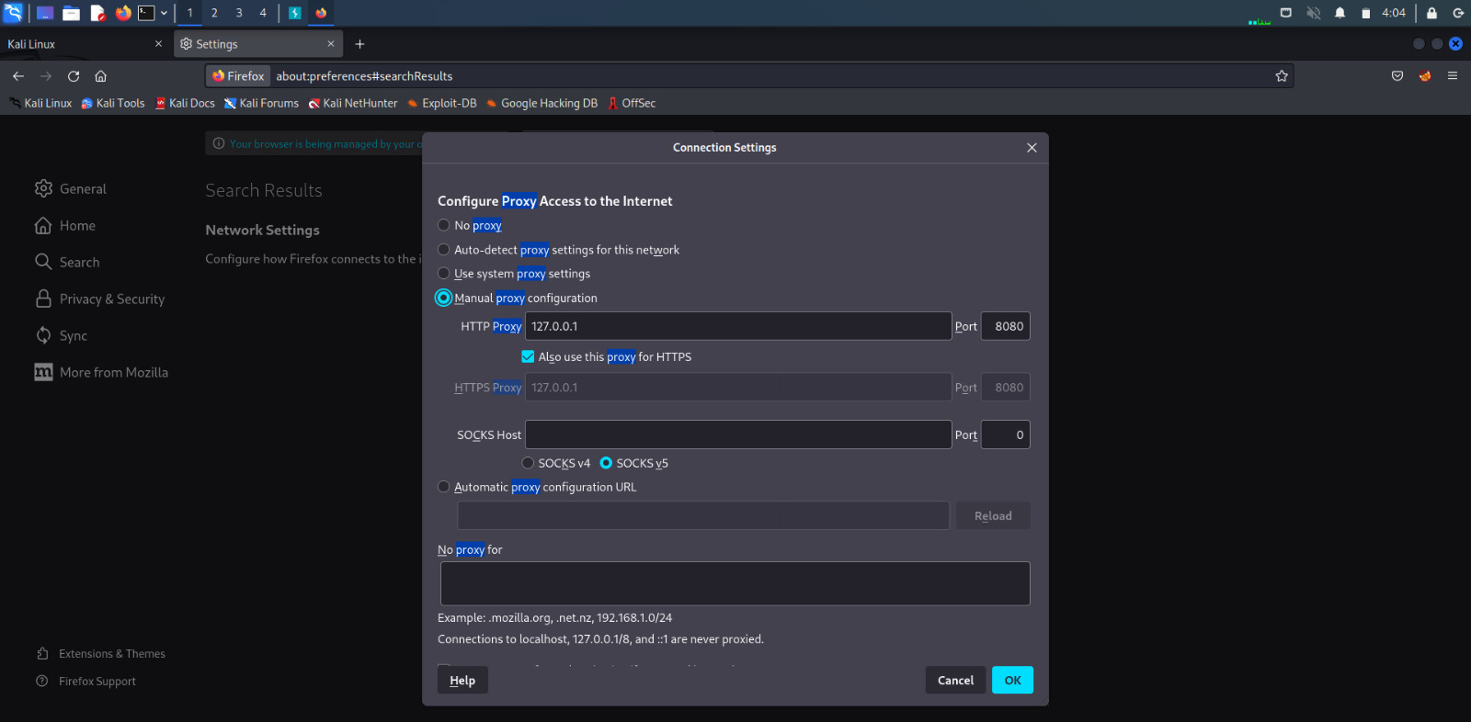
Step-2:Firstly, we have to set the proxy settings in firefox as burpsuite settings.

Slide 5
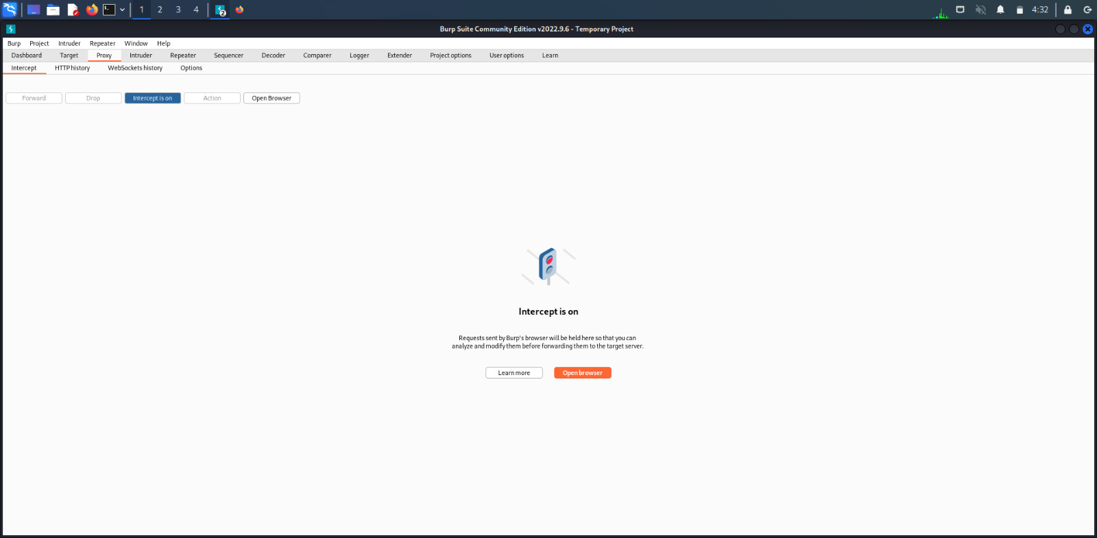
Step-3:Now,turn on the intercept in burpsuite.

Slide 6
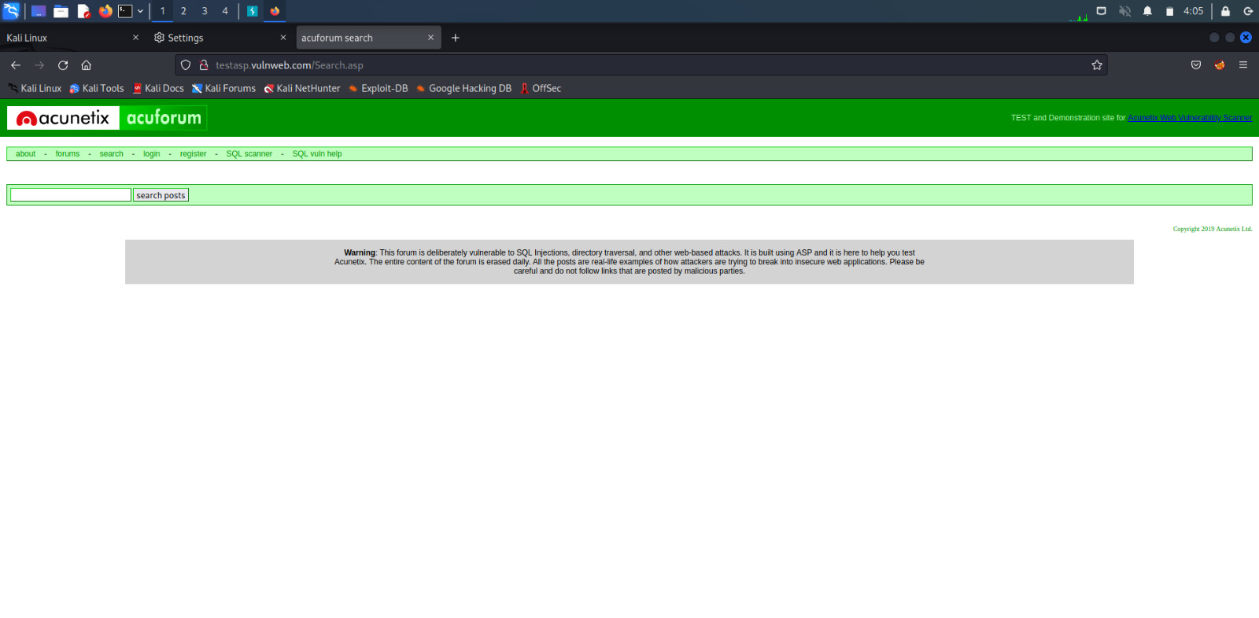
Step-4:Visit http://testasp.vulnweb.com

Slide 7
Step-5:Forward in the intercept in burpsuite. Step-6:On the top menu, you will find a search option.

Slide 8
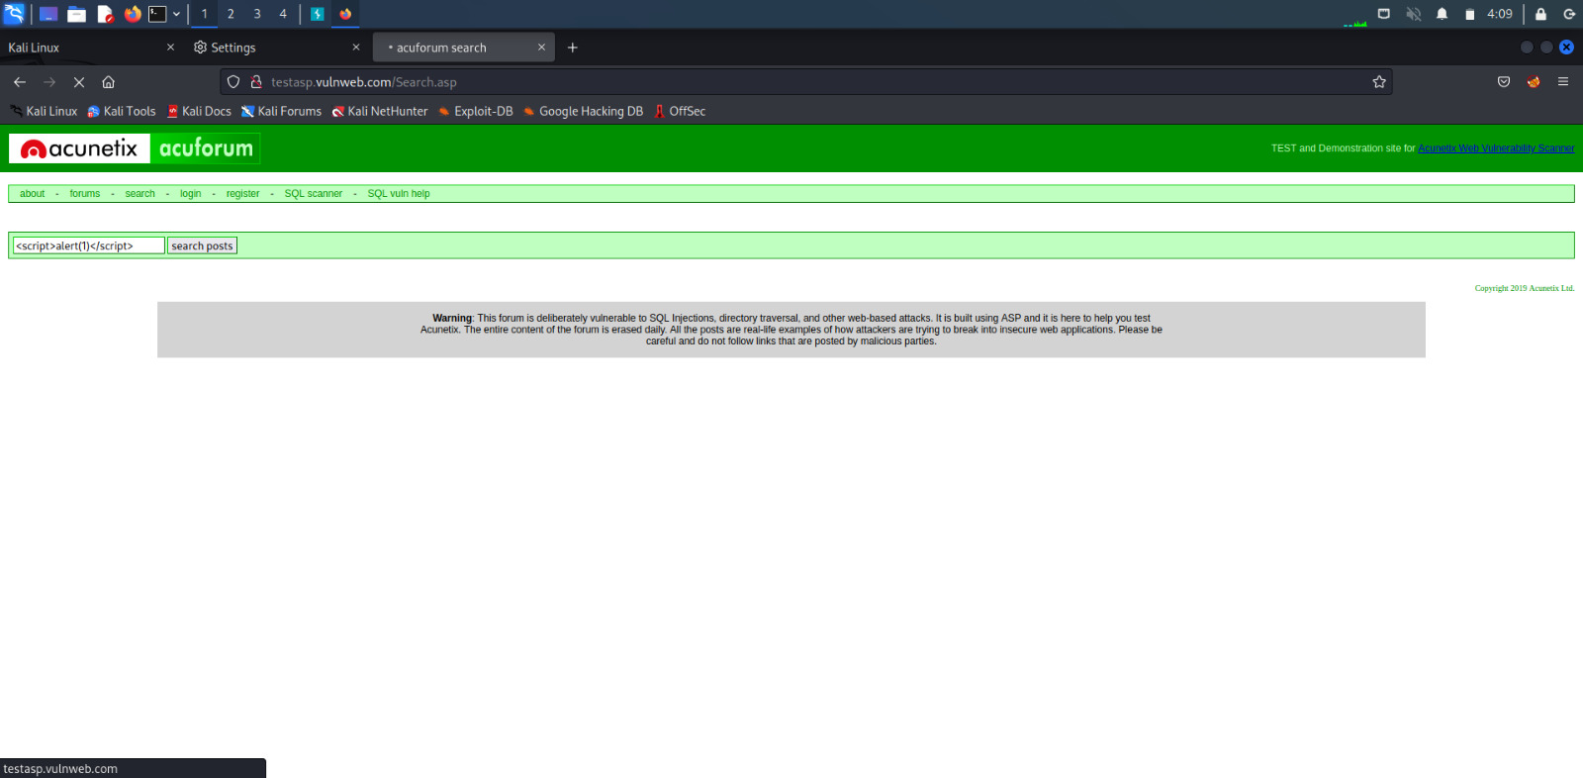
Step-7:Now, try the payload as <script>alert(1)</script> in search box.

Slide 9
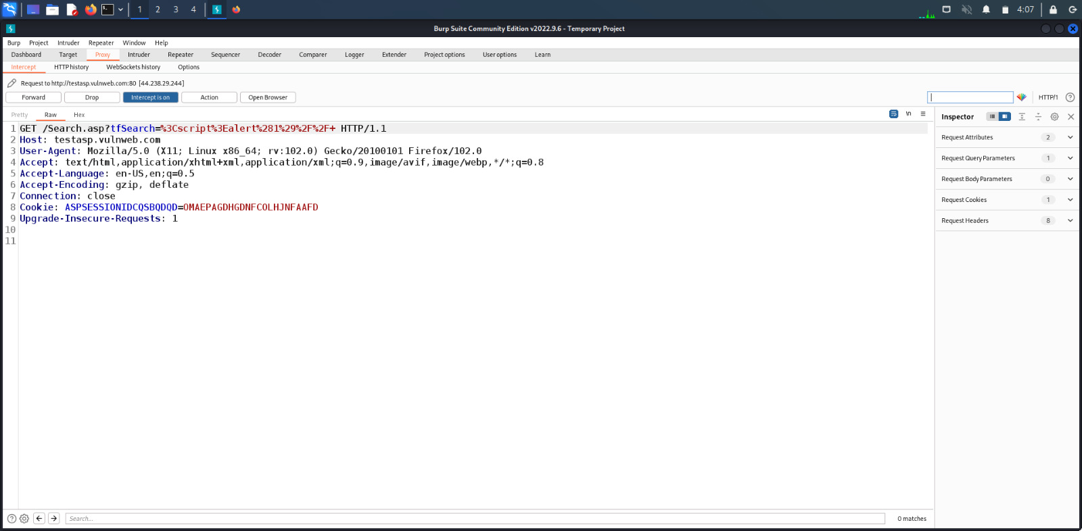
Step-8:You can intercept the request in burpsuite.

Slide 10
Step-9:You can find different payloads for Cross Site Scrpiting. Step-10:Send the request to Intruder and paste all payloads.

Slide 11
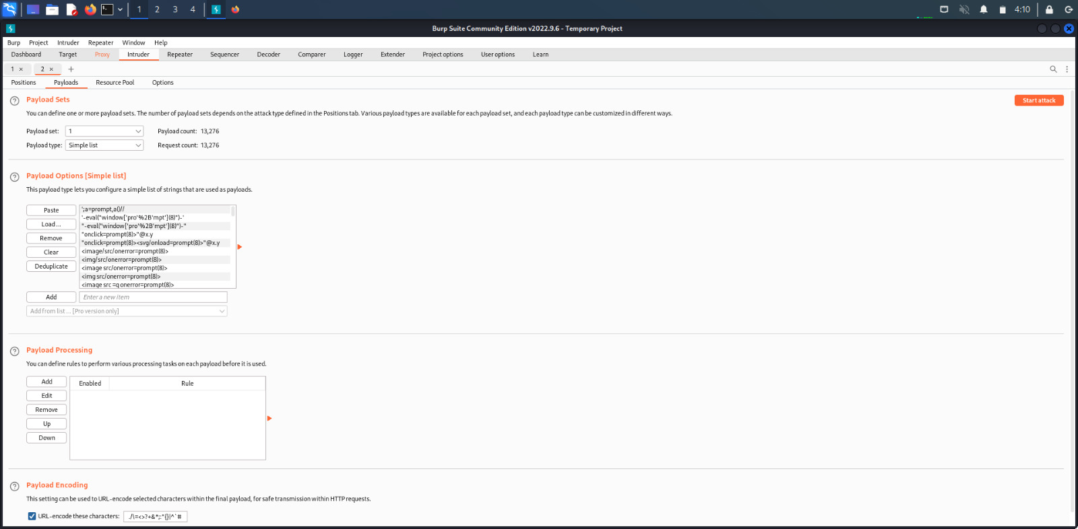
Step-11:After pasting all payloads, start the attack.

Slide 12
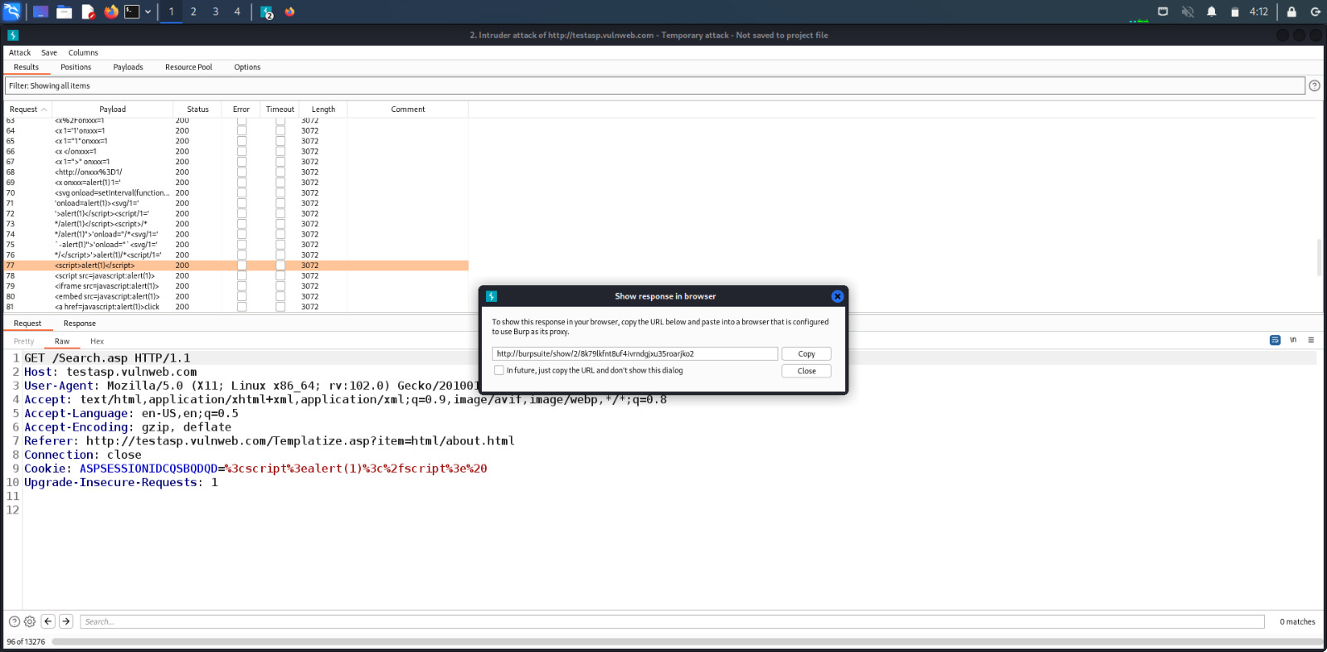
Step-12:Check the XSS script that intruded copy the response of it and paste it in Firefox Browser to see how it works.

Slide 13
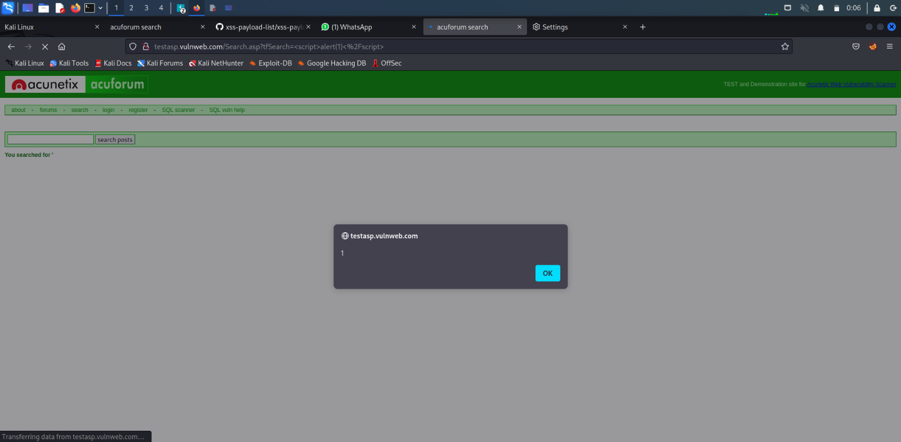
Step-13:Now the XSS payload <script>alert(1)</script> works and you will get an alert message as 1.

Slide 14
Impact: Cross Site Scripting can lead to stealing of user’s data and it can be harmful for your website. It can lead to stealing the sensitive information such as login credentials , personal data , perform actions on behalf of user. So , this payload has serious consequences for security and privacy of user visiting the website.

Slide 15
Mitigation: We can mitigate the risk posed by the payload by input validation, encoding and regular software updates. By taking these steps, you can help protect against the risk posed by the payloads. We can also mitigate by enabling no script on browser.
The screenshots and screen recording is included in the report.

