Slide 1
The Story of Wages: A Data-Driven Journey
Analyzing 4,165 workers to understand what really drives pay

Slide 2
Introduction: Who Are We Studying?
Analysis of 4,165 workers from the US labor market.
Diverse demographics: experience, education, weeks worked, and wages.
Key variables include gender, union status, residency, and occupation type.
Goal: Use data science to uncover the primary drivers of wage variation.

Slide 3
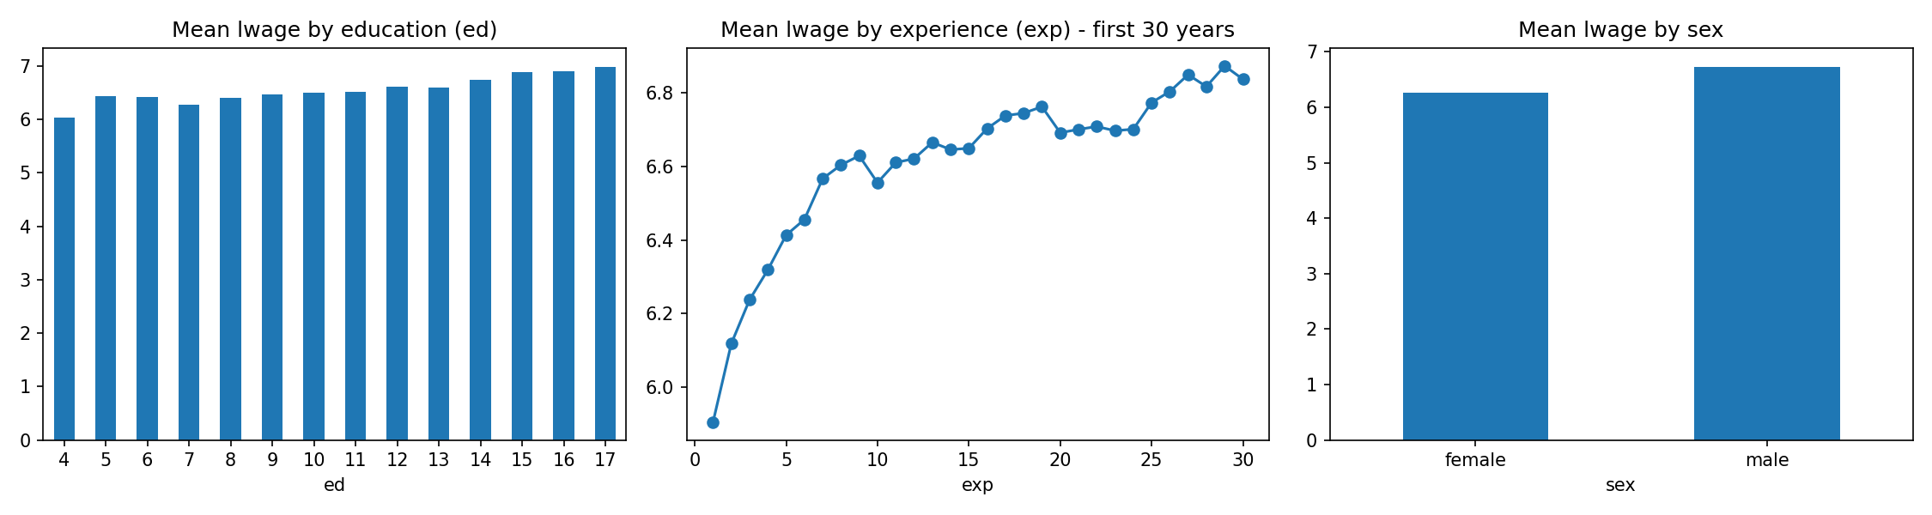
Key Revelations: Education, Experience, and Gender
Education Effect: Solid correlation (0.394). Every extra year of schooling adds ~7.3% to wages.
Experience Dynamics: Wages rise with experience but tend to plateau around 25 years.
Gender Disparity: Men earn significantly more on average (6.73 vs 6.26 log wage).
Mean wages categorized by Education, Experience, and Sex.

Slide 4
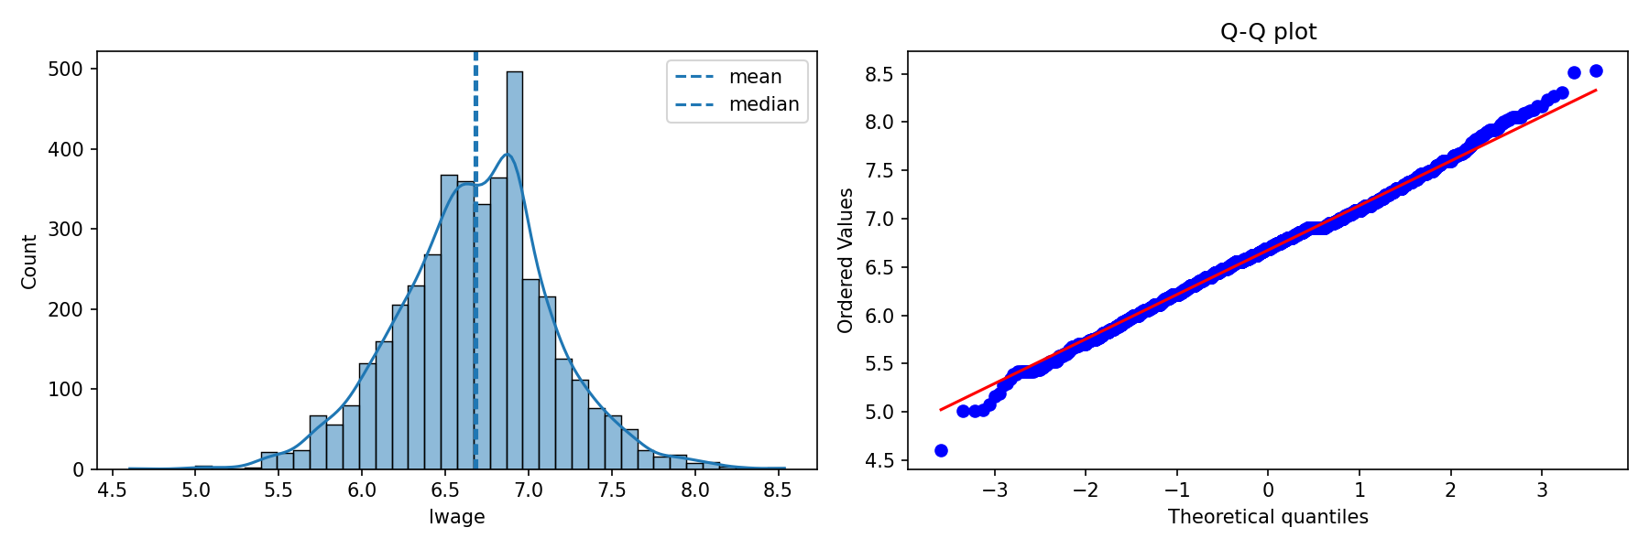
What Does a Typical Worker's Wage Look Like?
Distribution: Displays a near-symmetric bell curve.
Symmetry: Mean and Median are almost identical, suggesting balanced data.
Statistical Normality: Shapiro-Wilk p-value of 0.0028 rejects perfect normality, typical for real-world datasets.
Histogram and Q-Q plot of log wages (lwage).

Slide 5
Cleaning Up the Messy Parts: Handling Outliers
Methodology: Used Interquartile Range (IQR) to identify statistical anomalies.
Detection: Found 95 workers (2.3% of data) as outliers.
Thresholds: Wages identified below 5.56 or above 7.79 in log terms.
Decision: Retained outliers for modeling to ensure a comprehensive market view.

Slide 6
Putting a Hypothesis to the Test: Union Impact
Question: Does joining a union actually pay off in higher wages?
Comparison: Union Mean (6.6817) vs. Non-union Mean (6.6733).
Significance: P-value of 0.527 indicates no statistically significant difference.
Conclusion: Union benefits likely manifest in job security and conditions rather than raw wage premiums in this dataset.

Slide 7
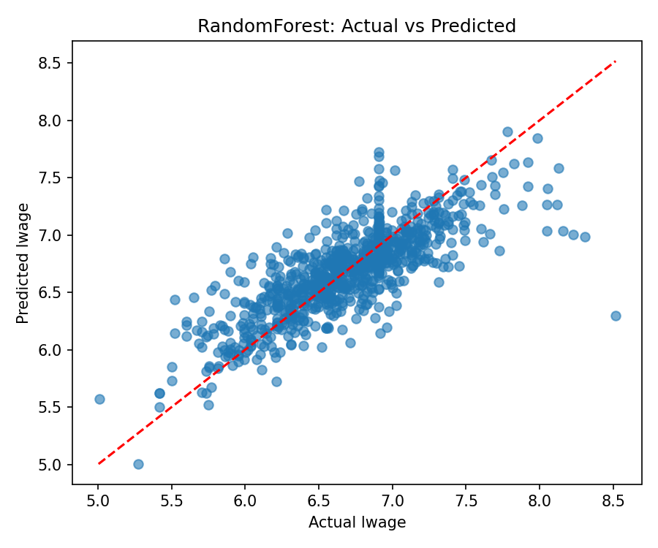
Building a Model to Predict Wages
Linear Regression: Explained 41% of wage variation (R² = 0.41).
Random Forest: Superior performance with R² of 0.62 and RMSE of 0.2955.
Top Predictors: 1. Education, 2. Experience, 3. Occupation Type, 4. Gender.
Critical Finding: Systemic disparities remain even when controlling for education and experience.
Random Forest: Actual vs Predicted Log Wages.

Slide 8
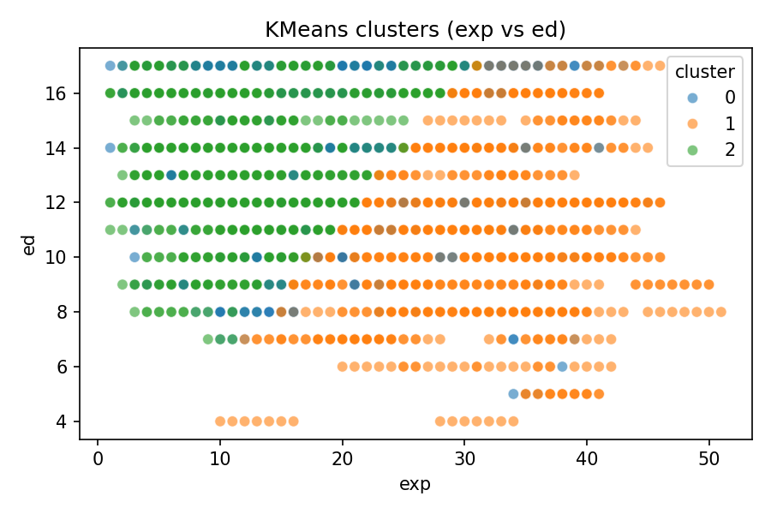
Finding Natural Groups: Worker Segmentation
Cluster 0 (Part-Timers): Educated professionals working ~35 weeks per year.
Cluster 1 (Seasoned Veterans): High experience (31 years avg), year-round activity.
Cluster 2 (High-Intensity Professionals): Large, high-education core working 48.7 weeks/year.
Insight: Multiple distinct paths exist to achieving competitive wages.
K-Means Clustering based on Experience, Education, and Weeks Worked.

Slide 9
Sampling Strategy: Accuracy and Efficiency
Required Sample: 352 respondents for 95% confidence and 5% margin of error.
Method: Proportional Stratified Sampling is recommended.
Implementation: Survey 313 men and 40 women to maintain demographic integrity.
Benefit: Ensures the sample is a perfect representation of the 4,165-worker population.

Slide 10
Why Do We Sample Instead of Studying Everyone?
Advantages: Lower costs, faster turnaround, and higher focus on data quality.
Limitations: Risk of sampling error and potential design bias.
Practicality: Sampling makes wide-scale labor market research feasible.

Slide 11
What Makes or Breaks a Good Sample?
Sample Size: Balance between reliability and resource expenditure.
Methodology: Stratified sampling protects representation for minorities.
Frame & Variability: Success depends on a high-quality list and understanding data spread.
Non-Response: Managing participation rates to avoid self-selection bias.

Slide 12
Closing Thoughts
Wages follow a complex story of schooling, experience, and systemic factors.
Data science allows us to read these stories and identify areas for improvement.
Next steps: Use these insights to build fairer workplaces and more effective career paths.

