Slide 1
Web software
Modeling

Slide 2
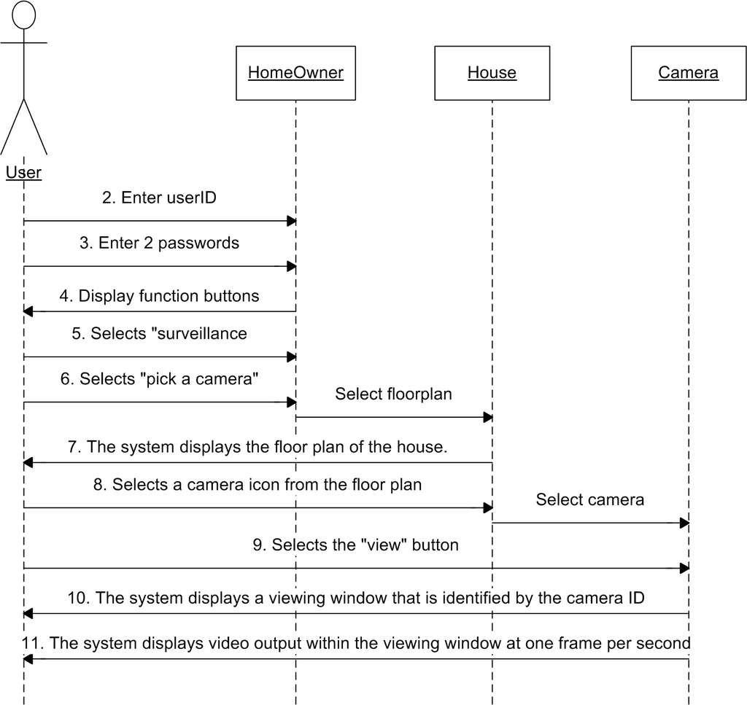
Sequence Diagram
an "interaction diagram" that models a single scenario executing in the system

Slide 3
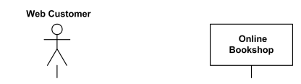
Question 1.a
Draw a sequence diagram for online customer can search book catalog, view description of a selected book, add book to shopping cart, do checkout.

Slide 4
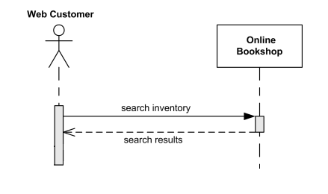
Question 1.a cont.

Slide 5
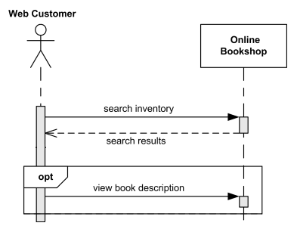
Question 1.a cont.

Slide 6
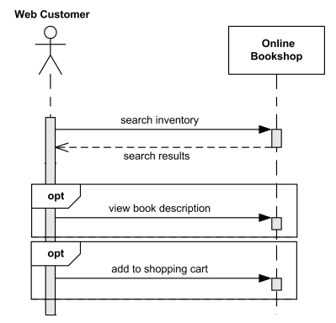
Question 1.a cont.

Slide 7
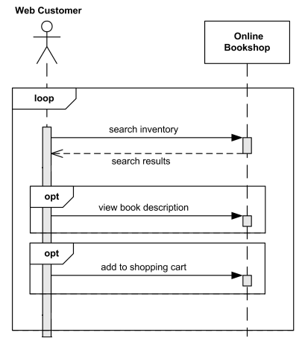
Question 1.a cont.

Slide 8
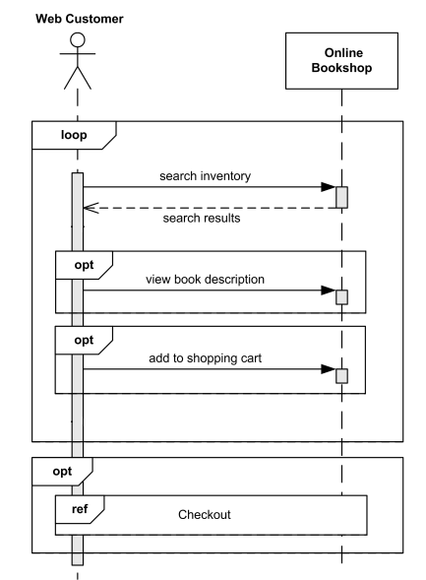
Question 1.a cont.

Slide 9

Question 1.b
Draw a sequence diagram for An emotion based music player.

Slide 10
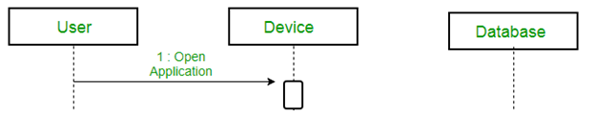
Question 1.b cont.

Slide 11
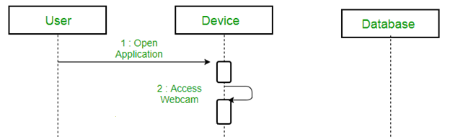
Question 1.b cont.

Slide 12
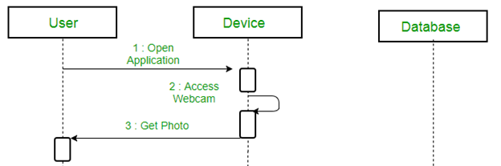
Question 1.b cont.

Slide 13
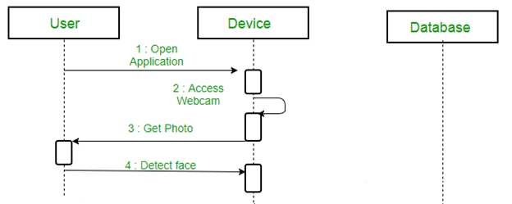
Question 1.b cont.

Slide 14
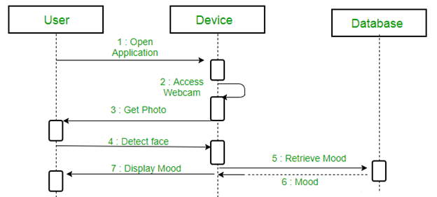
Question 1.b cont.

Slide 15
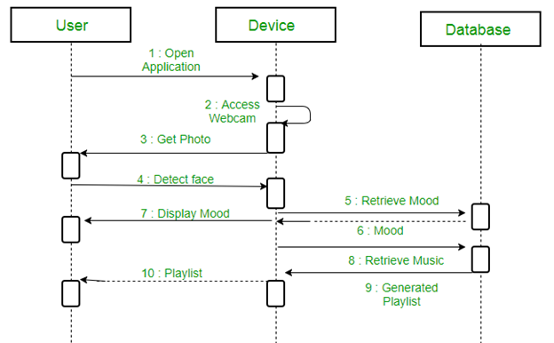
Question 1.b cont.

Slide 16
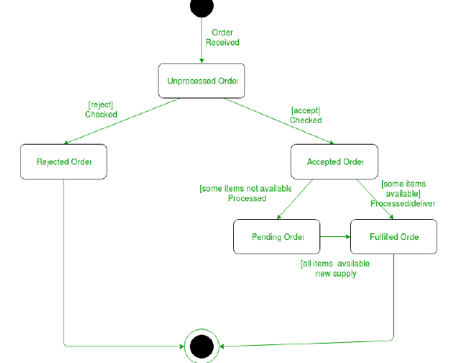
State Diagram
A state diagram is used to represent the condition of the system or part of the system at finite instances of time.

Slide 17


Question 2.a
Draw a state diagram to describe one’s marital status

Slide 18
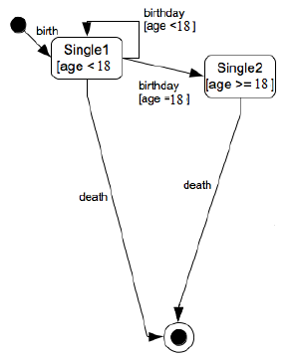
Question 2.a cont.

Slide 19
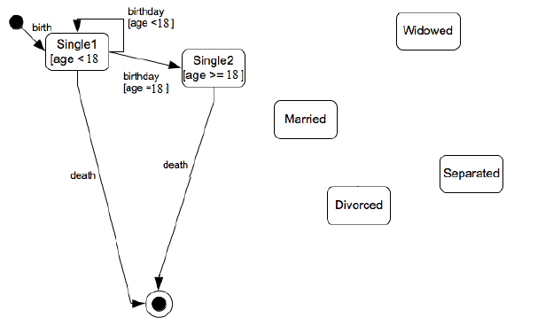
Question 2.a cont.

Slide 20
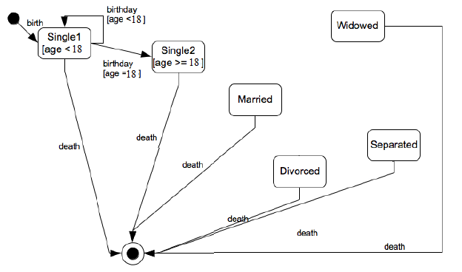
Question 2.a cont.

Slide 21
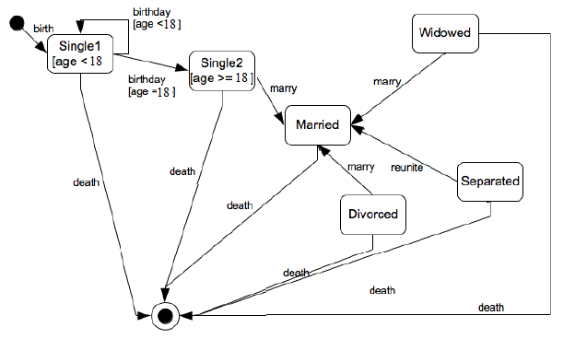
Question 2.a cont.

Slide 22
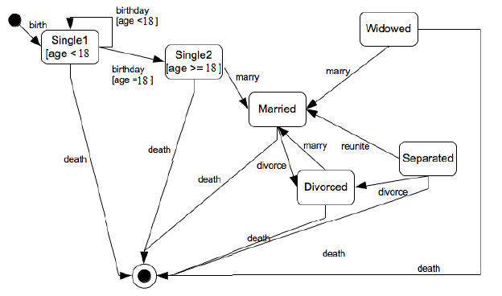
Question 2.a cont.

Slide 23
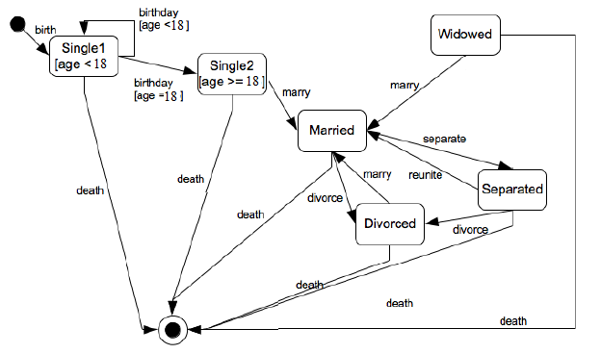
Question 2.a cont.

Slide 24
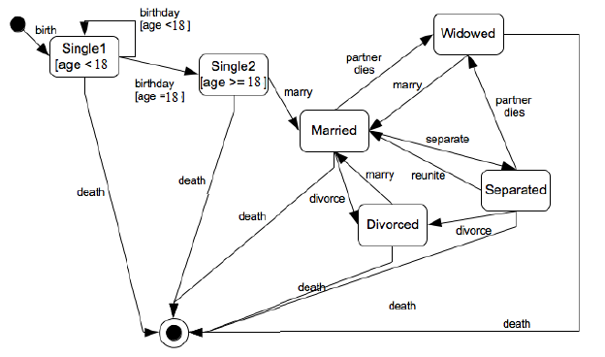
Question 2.a cont.

Slide 25

Question 2.b
Draw a state diagram to describe the process of booking a set for some special event.

Slide 26
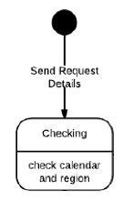
Question 2.b cont.

Slide 27
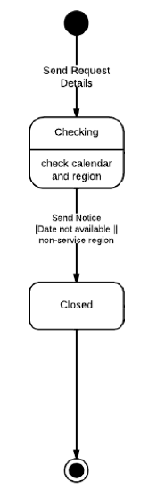
Question 2.b cont.

Slide 28
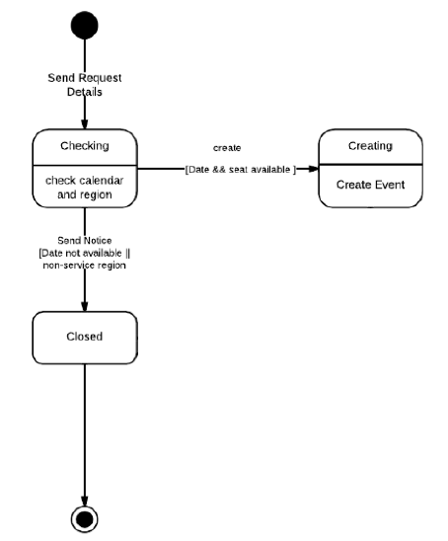
Question 2.b cont.

Slide 29
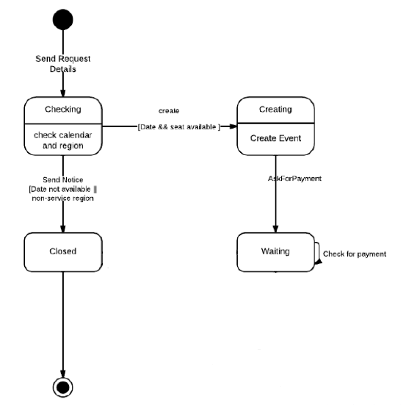
Question 2.b cont.

Slide 30
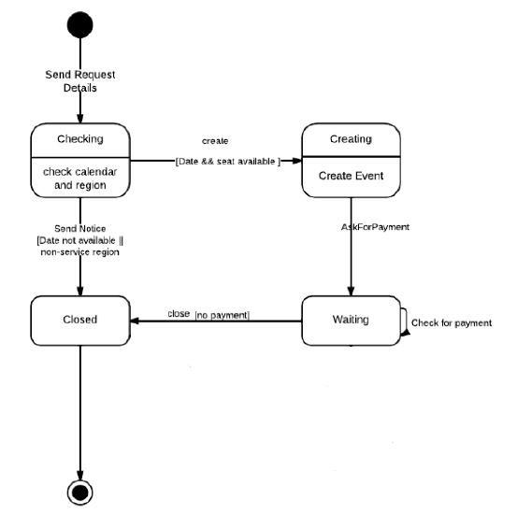
Question 2.b cont.

Slide 31
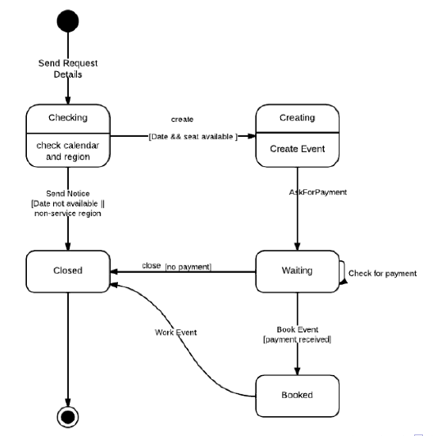
Question 2.b cont.

Slide 32
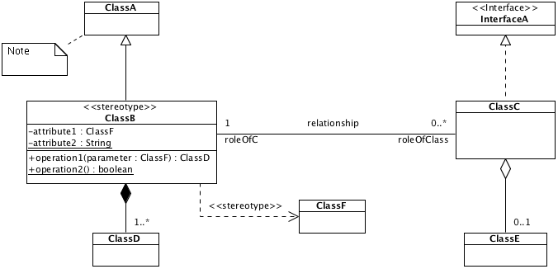
Class Diagram
Describe the structure of the system in terms of classes and objects

Slide 33
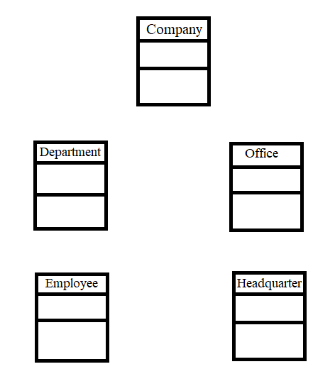
Question 3.a
Draw a class diagram for a company consists of departments. Departments are located in one or more offices. One office acts as headquarter. Each department has a manager who is recruited from the set of employees.

Slide 34
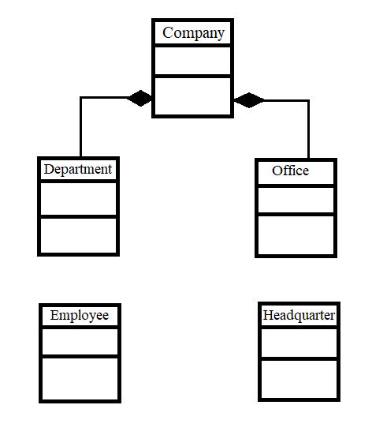
Question 3.a cont.
*
*

Slide 35
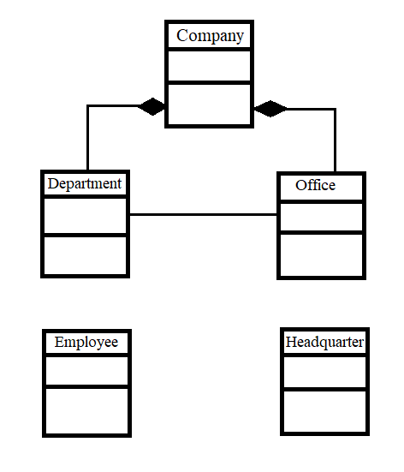
Question 3.a cont.
*
*
*
*

Slide 36
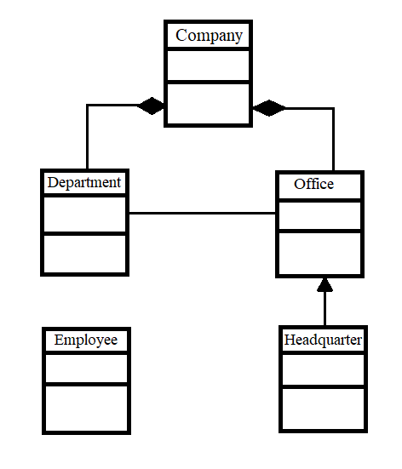
Question 3.a cont.
*
*
*
*

Slide 37
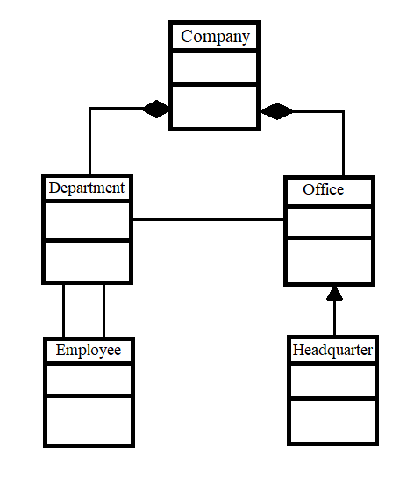
Question 3.a cont.
*
*
*
*
Managed by
1
1 .. *

Slide 38
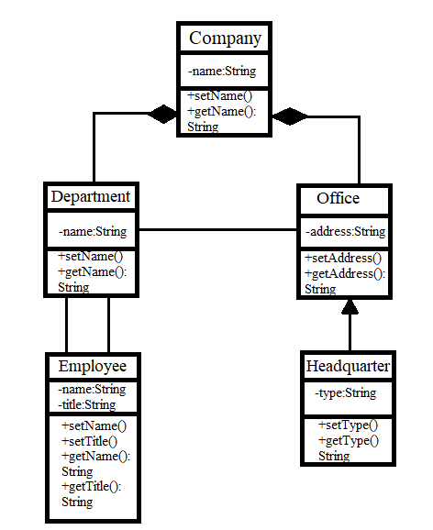
Question 3.a cont.
*
*
*
*
Managed by
1
1 .. *

Slide 39
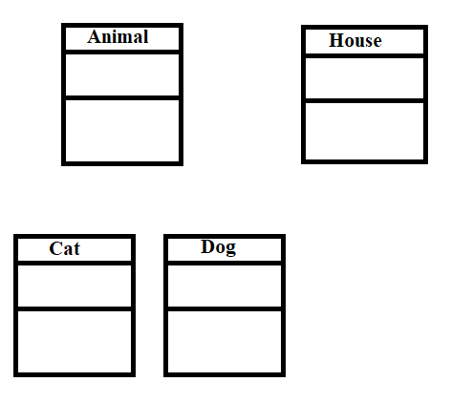
Question 3.b
Draw a class diagram for a house may have any number of pets living in it. The two possible types of pets that can live in a house are dogs and cats. Each dog or cat has a name. An animal’s house is its one and only home. You can tell an animal to make noise and it will do its thing.

Slide 40
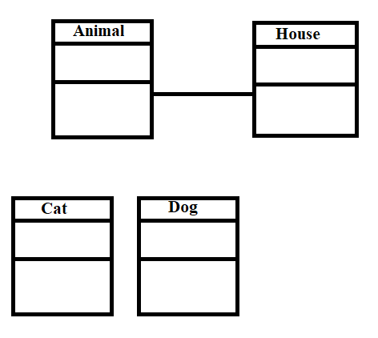
Question 3.b cont.
* 1

Slide 41
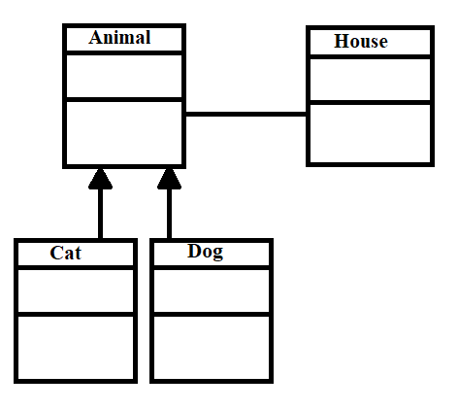
Question 3.b cont.
* 1

Slide 42
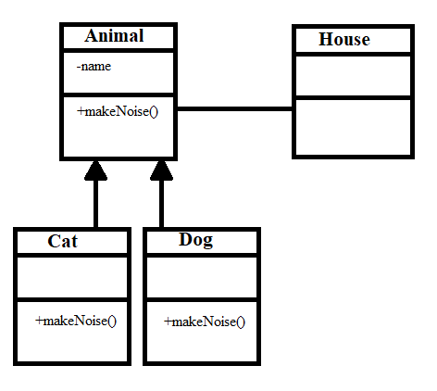
Question 3.b cont.
* 1

Slide 43
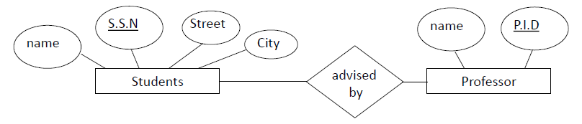
Entity-Relationship Diagram
The overall logical structure of a database graphically is expressed with an E-R diagram
Its components are:
•rectangles representing entity sets.
•ellipses representing attributes.
•diamonds representing relationship sets.
•lines linking attributes to entity sets and entity sets to relationship sets.

Slide 44
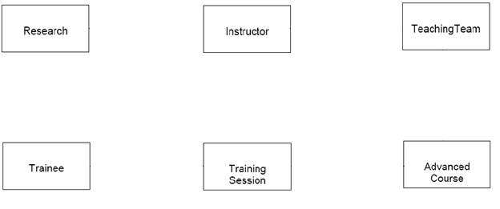
Question 4.a
A company specializes in IT training. The Company has 30 instructors and can handle up to 100 trainees per training session. The Company offers five advanced technology courses, each of which is taught by a teaching team of two or more instructors. Each instructor is assigned to a maximum of two teaching teams or may be assigned to do research. Each trainee undertakes one advanced technology course per training session.

Slide 45
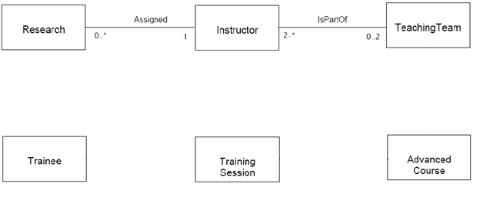
Question 4.a cont.

Slide 46
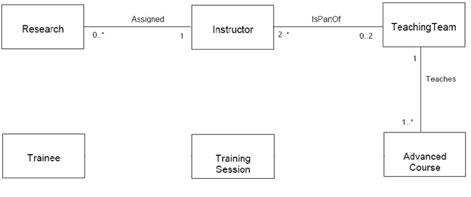
Question 4.a cont.

Slide 47
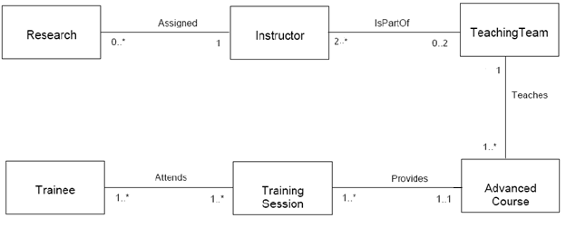
Question 4.a cont.

Slide 48
Question 4.b
The video rental company has several branches throughout the USA. The data held on each branch is the branch address and the telephone number. Each branch is given a branch number, which is unique throughout the company. Each branch is allocated staff which includes a Manager. The data held on a member of staff is his or her name, position, and salary. Each member of staff is given a staff number, which is unique throughout the company. Each branch has a stock of videos. The data held on a video is the catalog number, title, status and cost. The catalog number uniquely identifies each video. Before hiring a video from the company, a customer must first register as a member of a local branch. The data held on a member is the first name, last name, and address. Each member is given a member number, which is unique throughout all branches of the company. Once registered, a member is free to rent videos.

Slide 49
Question 4.b cont.
The video rental company has several branches throughout the USA. The data held on each branch is the branch address and the telephone number. Each branch is given a branch number, which is unique throughout the company. Each branch is allocated staff which includes a Manager. The data held on a member of staff is his or her name, position, and salary. Each member of staff is given a staff number, which is unique throughout the company. Each branch has a stock of videos. The data held on a video is the catalog number, title, status and cost. The catalog number uniquely identifies each video. Before hiring a video from the company, a customer must first register as a member of a local branch. The data held on a member is the first name, last name, and address. Each member is given a member number, which is unique throughout all branches of the company. Once registered, a member is free to rent videos.

Slide 50
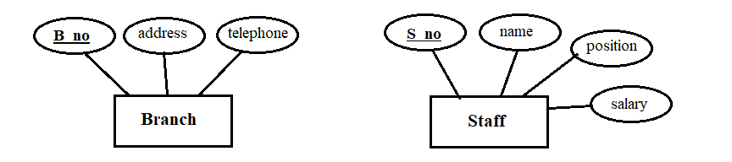
Question 4.b cont.

Slide 51
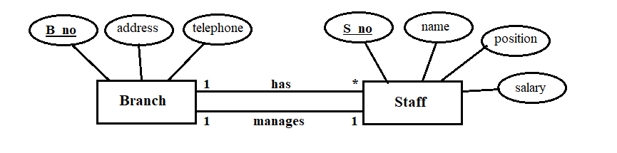
Question 4.b cont.

Slide 52
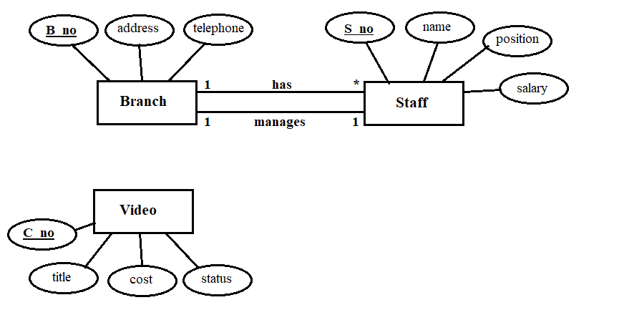
Question 4.b cont.

Slide 53
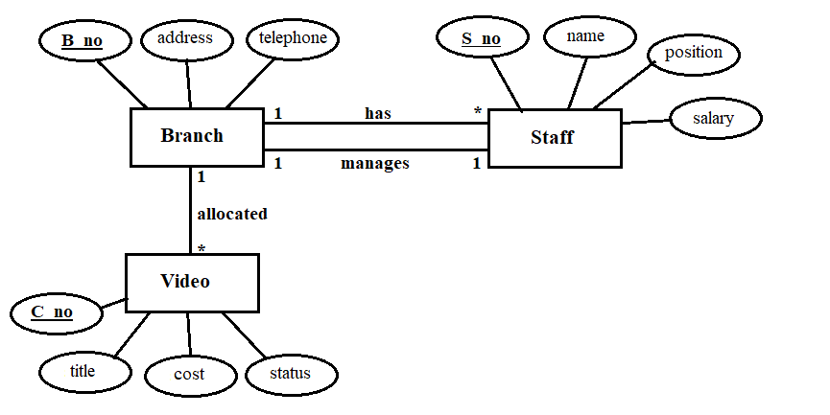
Question 4.b cont.

Slide 54
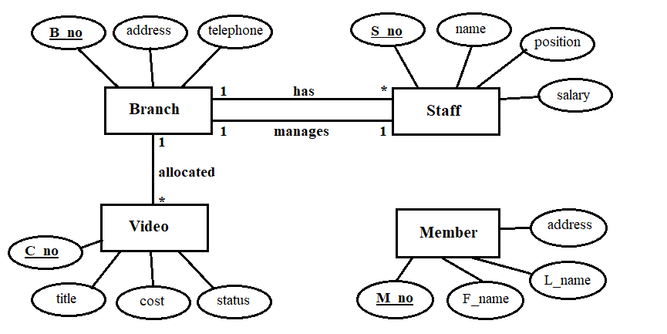
Question 4.b cont.

Slide 55
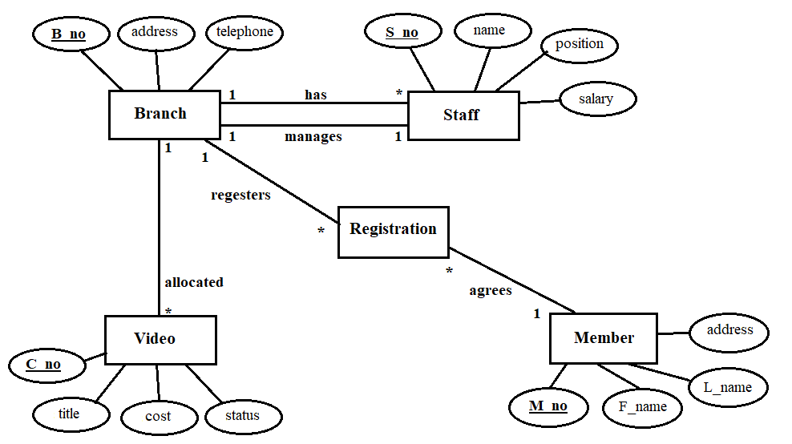
Question 4.b cont.

Slide 56
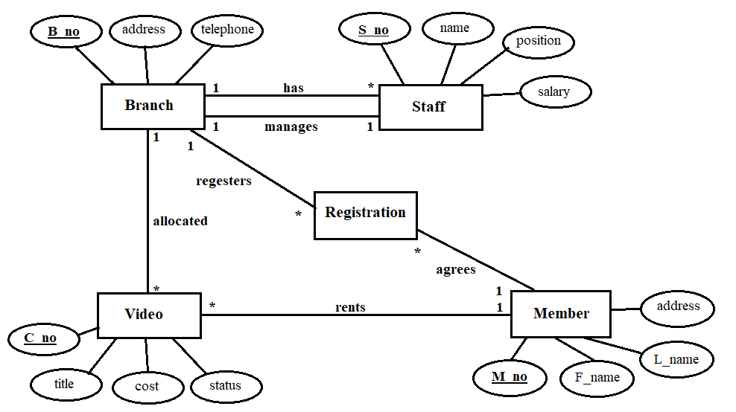
Question 4.b cont.

