Slide 1
Revision
Case study

Slide 2
Online order system
Goals
Sequence diagram
State diagram
Class diagram
ERD

Slide 3
Goals

Slide 4
Goals
Informational goals
Information for end user
Applicative goals
Ability to perform some task within the webapp

Slide 5
Informational goals
Allow the users to learn about the company
Allow the users to learn about the products
Allow the users to know new offers
Allow the users to know the details of his previous requests

Slide 6
Applicative goals
Allow users to sign up for monitoring services
Allow users to order his request
Allow users to pay by the different possible methods
Allow users to evaluate the service

Slide 7
Sequence diagram

Slide 8
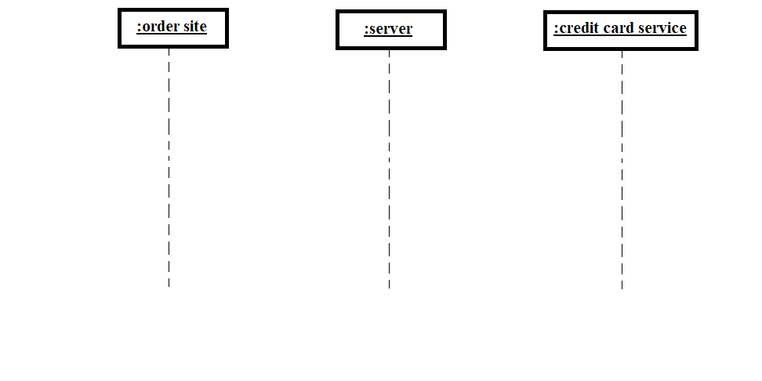

Slide 9
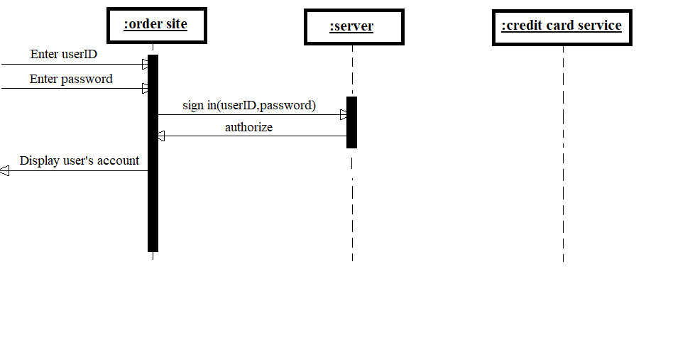

Slide 10
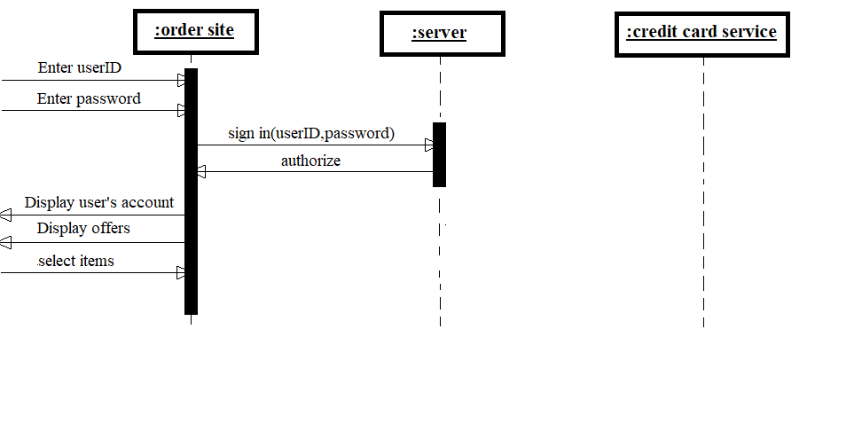

Slide 11
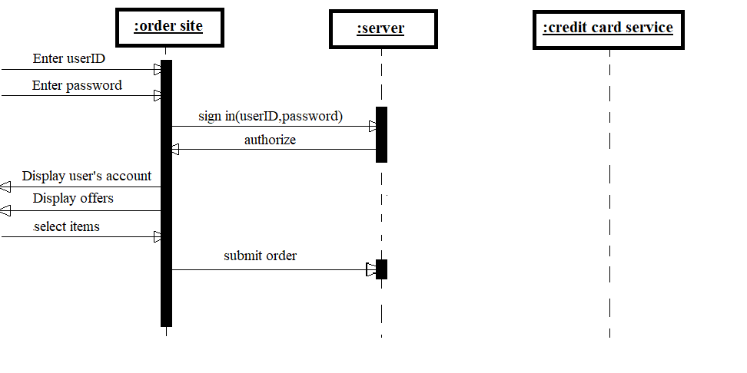

Slide 12
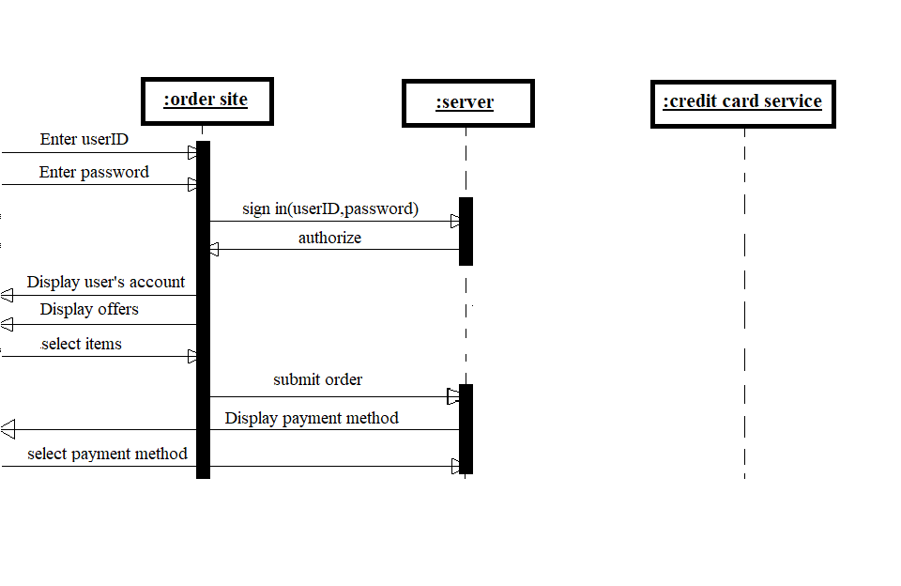

Slide 13
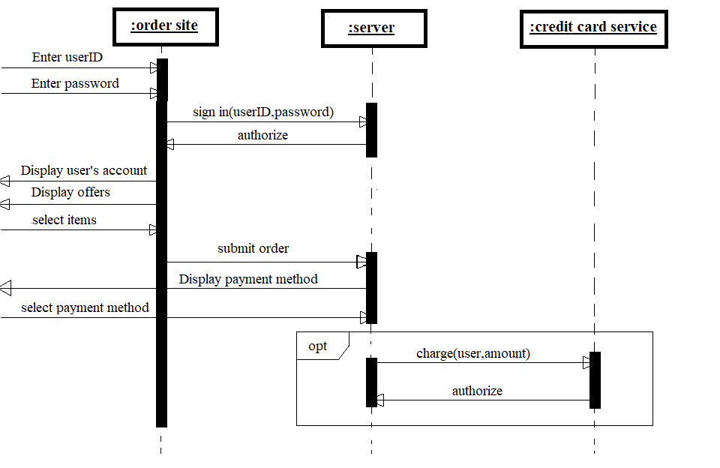

Slide 14
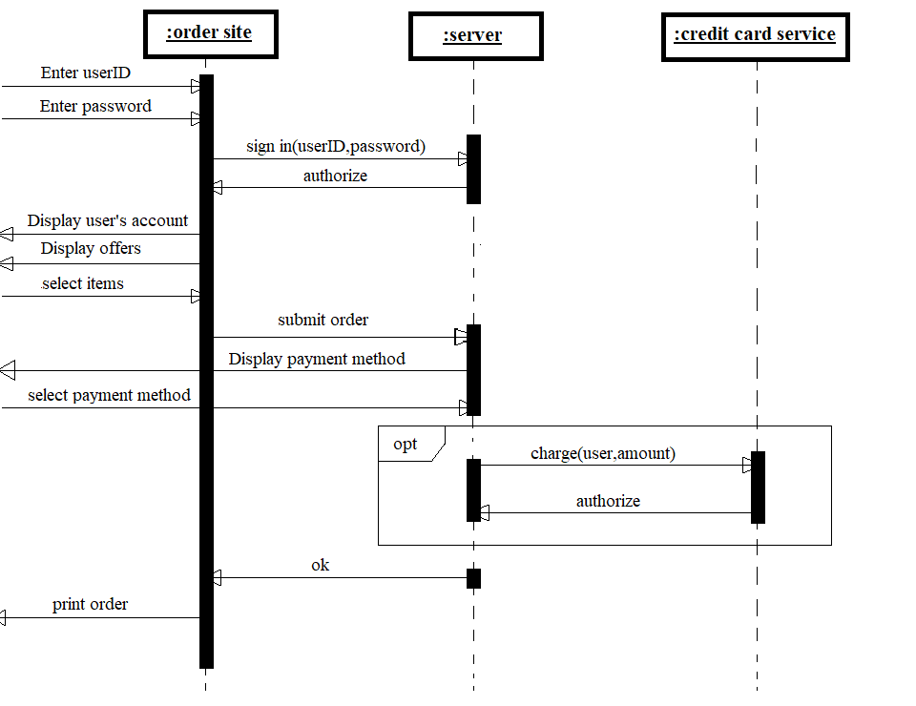

Slide 15
State diagram

Slide 16
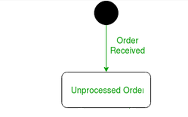

Slide 18
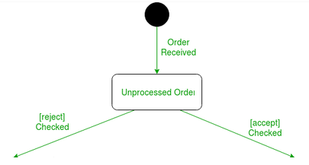

Slide 19
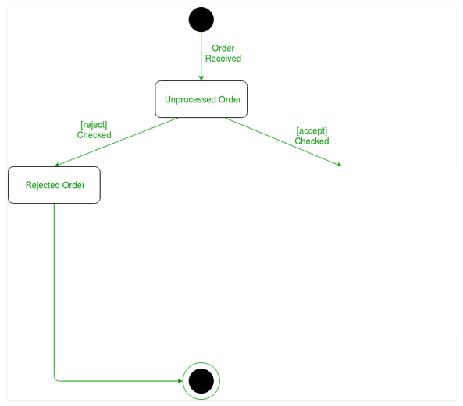

Slide 20
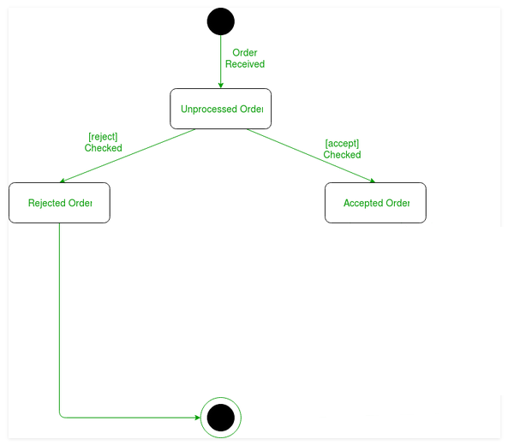

Slide 21
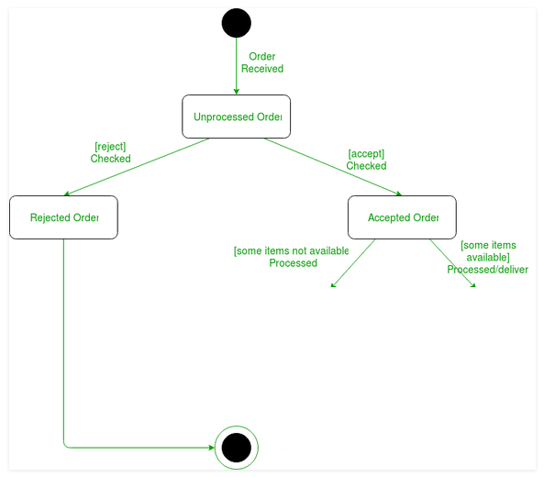

Slide 22
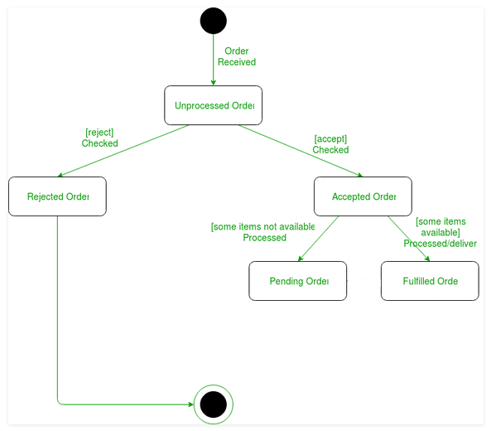

Slide 23
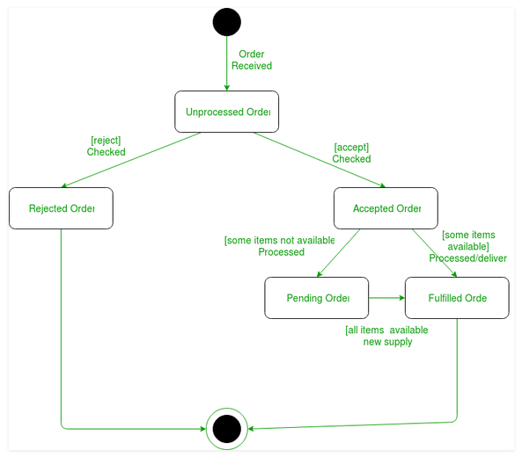

Slide 24
Class diagram

Slide 25
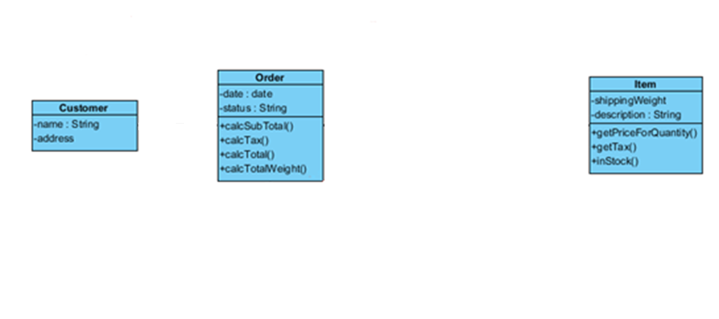

Slide 26
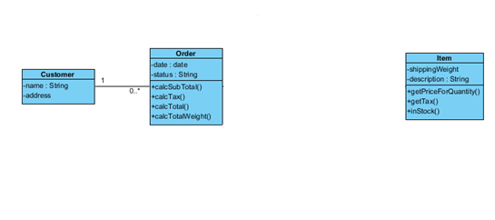

Slide 27
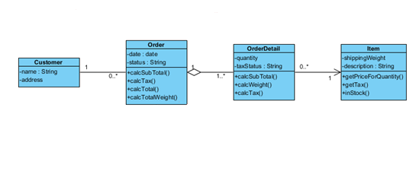

Slide 28
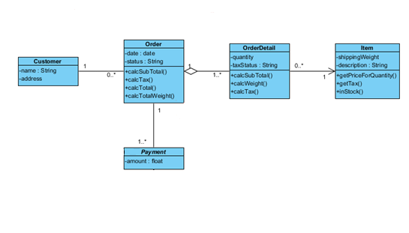

Slide 29
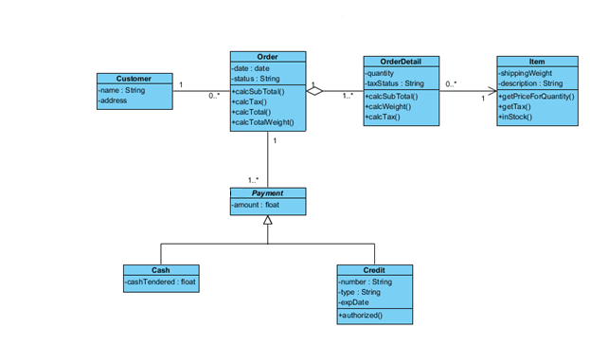

Slide 30
ERD

Slide 31
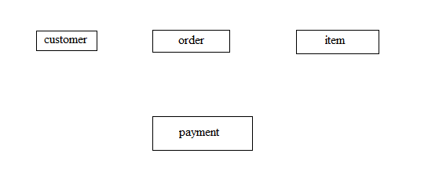

Slide 32
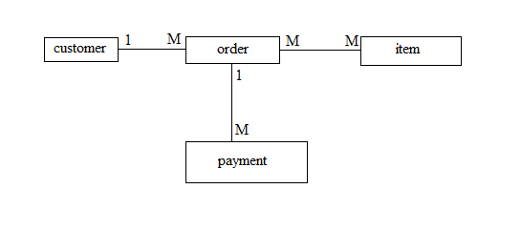

Slide 33
