Slide 1
Software engineering
UMLs

Slide 2
State diagram
1.The watch displays the current time and it has a single mode button and a single advance button. Pressing the mode button once allows setting the hours. Each press of the advance button increment the hour by one. Pressing the mode button the second time allows setting the minutes. Each press of the advance button increments the minute by one. Pressing the mode button a third time displays the current time. Pressing the mode button allows the user to set the hour again.
◻ Draw a state machine diagram.

Slide 3
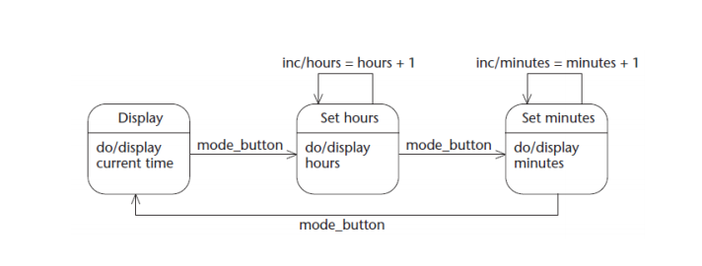

Slide 4
2.To take IS340, a student must go through the following process. When the instructor posts assignment 1, each student must form a team, do the assignment and hand it in. When assignment 2 is posted, each student works on it with her team; in parallel, when the midterm is made available, each student writes it. After both assignment 2 and the midterm are done with, each student waits for assignment 3, and when it is available, does it with her team.
◻ Draw a state diagram that models this process . Make sure to model activities (e.g., doing an assignment, writing a test) as states, not transitions

Slide 5
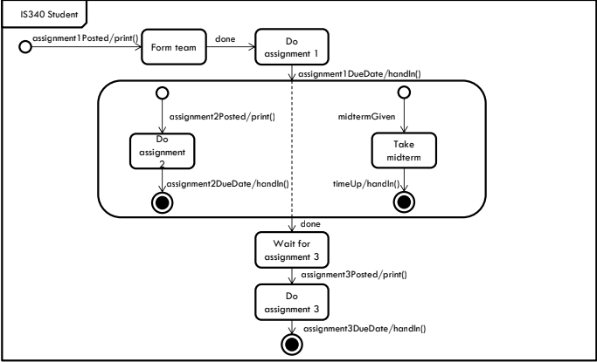

Slide 6
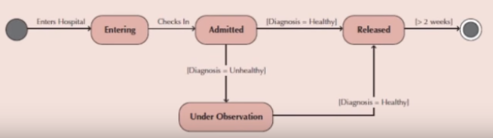
Draw a state diagram for the following:
a. .Draw a state chart to a patient entering a hospital

Slide 7
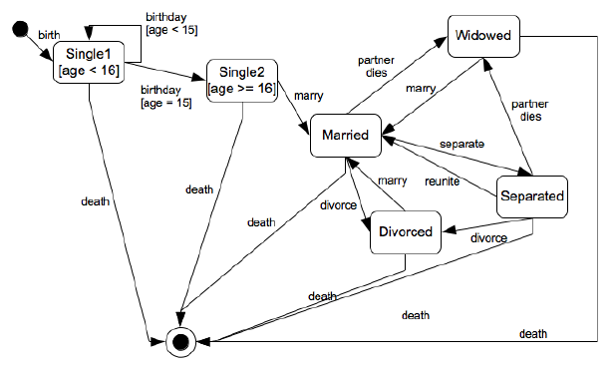
b.Draw a state chart to describe one’s marital status.

Slide 8
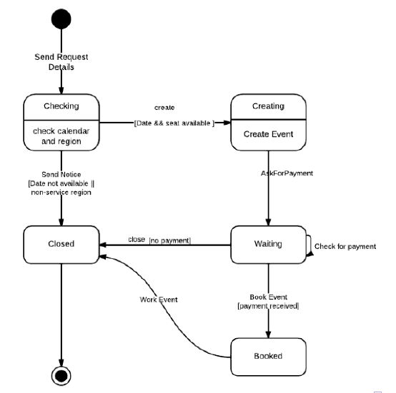
c.Draw a state chart to describe the process of booking a set for some special event.

Slide 9
class diagram
.Draw a class diagram that fulfills the following statements1
◻ An insurance company has insurance contracts (zero or more), which refer to one or more customers.
◻ A customer has insurance contracts (zero or more), which refer to one insurance company.
◻ An insurance contract is between an insurance company and one or more customers. The insurance contract refers to both a customer (or customers) and an insurance company.
◻ The insurance contract is expressed in an (zero or one) insurance policy (a written contract of insurance.
◻ The insurance policy expresses an insurance contract.

Slide 10
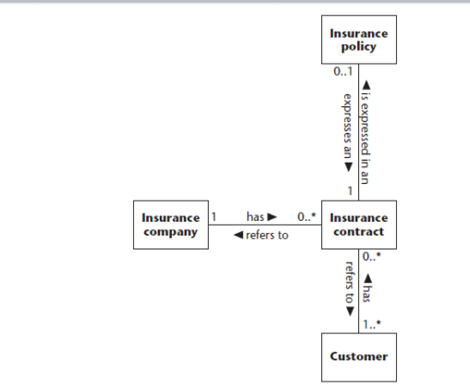

Slide 11
2. In a university there are different classrooms, office and departments. A department has a name and it contains many offices. A person working at the university has a unique ID and can be a professor or an employee.
A professor can be a full, associate or assistant professor and he/she is enrolled in one department.
Offices and classrooms have a number ID, and a classroom has a number of seats.
Every employee works in an office.

Slide 12
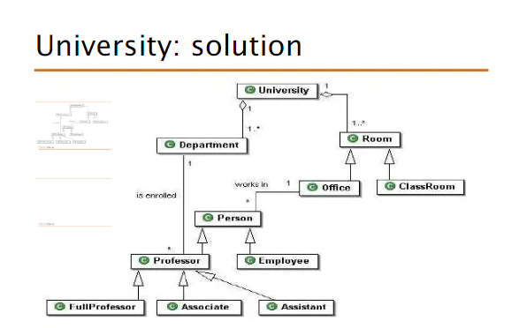

Slide 13
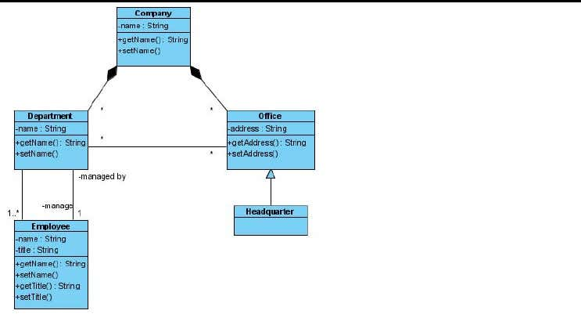
3. A company consists of departments. Departments are located in one or more offices. One office acts as headquarter. Each department has a manager who is recruited from the set of employees.

Slide 14
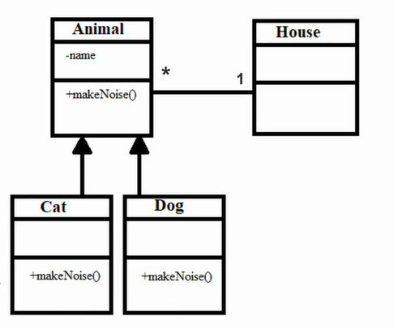
4. A house may have any number of pets living in it •The two possible types of pets that can live in a house are dogs and cats •Each dog or cat has a name •An animal’s house is its one and only home •You can ell an animal to make noise and it will do its thing

Slide 15
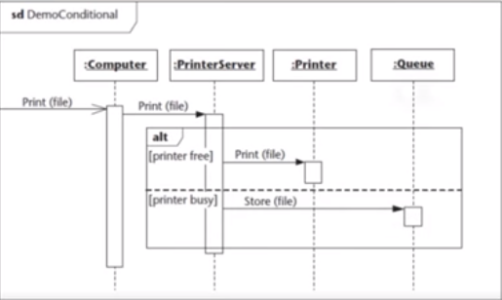
Sequence diagram

Slide 16
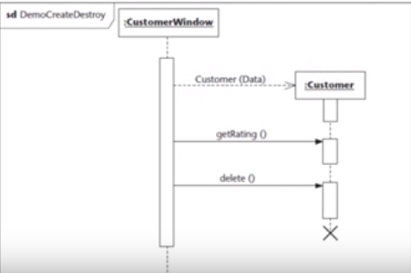
Create & destroy object

Slide 17
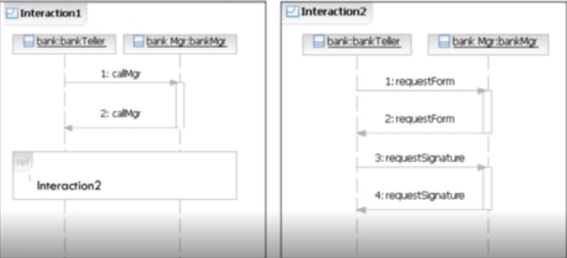
reference

Slide 18
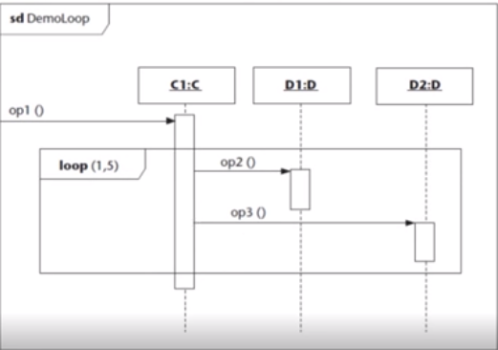
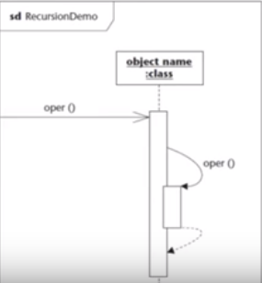
Loop and recursion

Slide 19
Draw a sequence diagram for the following:
a. Online customer can search book catalog, view description of a selected book, add book to shopping cart, do checkout.

Slide 20
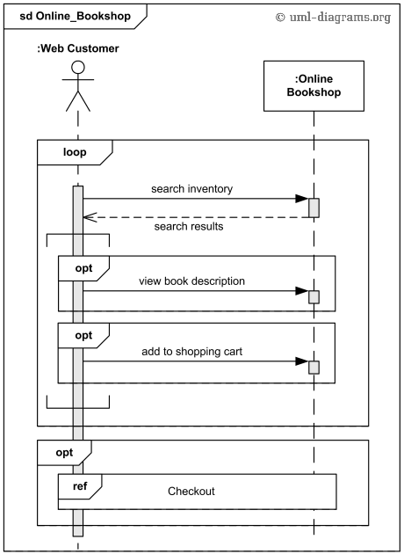

Slide 21
2.An emotion based music player:
Firstly the application is opened by the user.
The device then gets access to the web cam.
The webcam captures the image of the user.
The device uses algorithms to detect the face and predict the mood.
It then requests database for dictionary of possible moods.
The mood is retrieved from the database.
The mood is displayed to the user.
The music is requested from the database.
The playlist is generated and finally shown to the user.

Slide 22
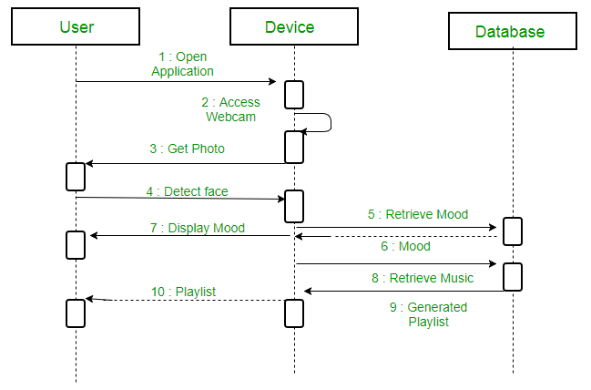

Slide 23
3. Show the interactions between a user and a ticket booking system in booking a seat. It consists of mainly four parts: The actor, which is the user, the boundary object ‘interface', the controller object ‘main Controller' and two entity objects routes and route.

Slide 24
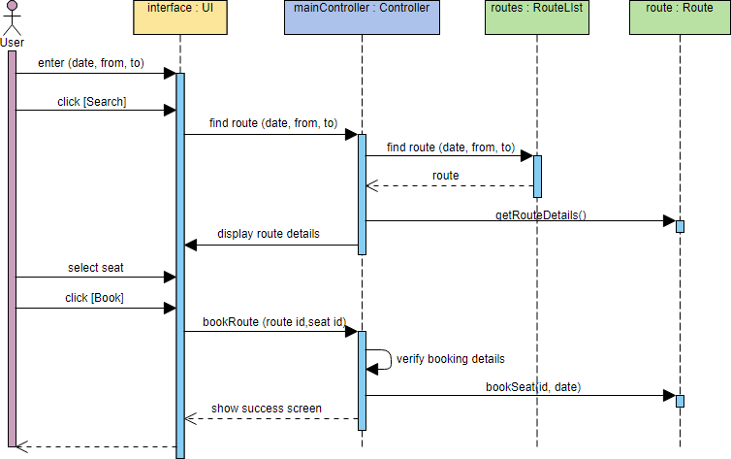

Slide 25
2..Creating sequence diagram for Borrow Books use case
Scenario: Students who have a valid ID and do not have any overdue books or any fines. ♦ 1. Set context: Borrow Book use case - Students who have a valid ID and do not have any overdue books or any fines.
♦ 2. Identify the actors and objects involved in the scenario: students, librarians, and the registrar’s database as actors and borrowers, the book collection, and books as the objects. Place the actors and objects across the top of the diagram based on the ordering of their appearance in the normal flow of events.
♦3. Set lifeline: Drawing the lifelines beneath the actors and objects in the scenario.
♦ 4. Add messages: Add the actual messages to the diagram. Librarian executes the CheckOutBooks() procedure (the Student sends the message CheckOutBooks() to ask the Librarian to execute the CheckOutBooks() procedure) when the student hands the librarian the books to check out. The Librarian in return asks the Student for the ID card. When the student hands the ID Card to the Librarian, the Librarian asks the Registrar’s Database to execute the ValidID() procedure. This continues until the ID Card and Books are returned to the student. Once we have decided from whom the messages are to be sent and to whom they are sent, we can place the messages on the diagram.
♦5. Place execution occurrence: Add the execution occurrence to the diagrams to show when each actor or object is in the process of executing one of its operations.
♦ 6. Validate the diagram.
Normal folw of events:
The borrower brings books to the librarian at the checkout desk
The borrower provides librarian their ID card
The librarian checks the validity of the ID card
If the borrower is a student borrower, validate ID card against registrar's database
If the borrower is a faculty/staff borrower, validate ID card against personnel database
If the borrower is a guest borrower, validate ID card against library's guest database
The librarian checks whether the borrower has any overdue books and/or fines
The borrower checks out the books

Slide 26
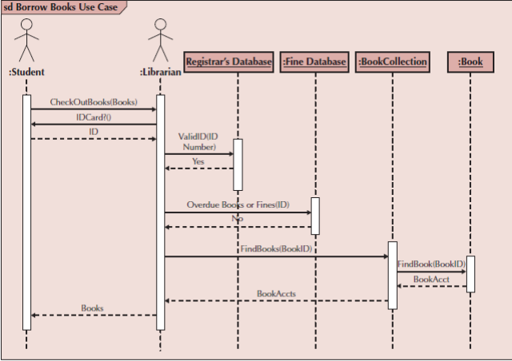

Slide 27
ERD
1. You are required to create a conceptual data model of the data requirements for a company that specializes in it training . the company has 30 instructors and can handle up to 100 trainees per training session. The company offers five advanced technology courses, each of which is taught by a teaching team of two or more instructors. Each instructor is assigned to a maximum of two teaching teams or may be assigned to do research each trainee undertakes one advanced technology course per training session
Draw a single ER diagram to represent the data requirements for the company

Slide 28
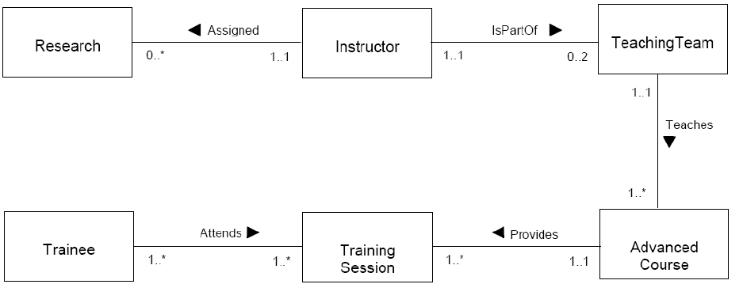

Slide 29
2. we need to create a database scheme based on the following requirements of the company database:
 The company is organized into departments each department has a unique name, unique number and an employee who manages the department. We keep track of the start date of the department manager. A department may have several locations.
 Each department controls a number of projects each project has a unique name, unique number and is located at a single location.
 We store each employee social security number, address, salary, sex and birthdate
Each employee works for one department but may work on several projects.
We keep track of the number of hours per week that an employee currently works on each project
We keep track of the direct supervisor of each employee.
 Each employee may have a number of dependents
For each dependent, we keep track of their name, sex , birthdate, and relationship to the employee.

Slide 30
3. Read the following case study, which describes the data requirements for a video rental company. The video rental company has several branches throughout the USA. The data held on each branch is the branch address made up of street, city, state, and zip code, and the telephone number. Each branch is given a branch number, which is unique throughout the company. Each branch is allocated sta;, which ncludes a Manager. The Manager is responsible for the day-today running of a given branch. The data held on a member of sta; is his or her name, posion, and salary. Each member of sta; is given a sta; number, which is unique throughout the company. Each branch has a stock of videos. The data held on a video is the catalog number, video number, tle, category, daily rental, cost, status, and the names of the main actors, and the director. The catalog number uniquely iden<es each video. However, in most cases, there are several copies of each video at a branch, and the individual copies are iden<ed using the video number. A video is given a category such as Acon, Adult, Children, Drama, Horror, or Sci-Fi. The status indicates whether a speci<c copy of a video is available for rent. Before hiring a video from the company, a customer must <rst register as a member of a local branch. The data held on a member is the <rst and last name, address, and the date that the member registered at a branch. Each member is given a member number, which is unique throughout all branches of the company. Once registered, a member is free to rent videos, up to maximum of ten at any one me. The data held on each video rented is the rental number, the full name and number of the member, the video number, tle, and daily rental, and the date the video is rented out and date returned. The rental number is unique throughout the company.
a) Idenfy the main enty types of the video rental company.
b) Idenfy the main relaonship types between the enty types described in (a) and represent
each relaonship as an ER diagram.
c) Determine the mulplicity constraints for each relaonship described in (b). Represent the
mulplicity for each relaonship in the ER diagrams created in (b).
d) Idenfy a1ributes and associate them with enty or relaonship types. Represent each a1ribute
in the ER diagrams created in (c).
e) Determine candidate and primary key a1ributes for each (strong) enty type.
f) Using your answers (a) to (e) a1empt to represent the data requirements of the video rental
company as a single ER diagram. State any assumpons necessary to support your design.

Slide 31
